Slide 1
Core FB MC
Core Parallel Run KPI report
October 2021

Slide 2
Parallel Run KPI report
Introduction
Context
According to Article 28(4) of the Core FB DA CCM, Core TSOs
shall continuously monitor the effects and the performance of the application of this methodology during the parallel run
shall develop, in coordination with the Core regulatory authorities, the Agency and stakeholders, the monitoring and performance criteria and report on the outcome of this monitoring on quarterly basis in a report
Core TSOs & NEMOs have aligned on the
Specific KPIs with NRAs and this alignment resulted in the format of this KPI report
Frequency of provision of the report, which was increased to monthly, going beyond formal requirements
Agreement to have the increased frequency reflected in the Core CCM amendment (November 2020)
In the next slide the overview of the KPIs covered in this monthly KPI report is provided:
KPIs related to Capacity Calculation in blue
KPIs related to Market Coupling simulations in green

Slide 3
Parallel Run KPI report
Overview of Core FB MC Parallel Run KPIs
Adjustment for minimum RAM and LTA Inclusion | Slide 7 - 35
1. Average maximum AMR per CNE per BD
2. Average maximum AMR per TSO per BD
3. Average maximum AMR+LTAmargin per CNE per BD
4. Average maximum AMR+LTAmargin per TSO per BD
TSOs’ adjustment after validation | Slide 36 - 60
5. Share of MTUs with intervention per TSO
6. Total IVA applied per BD for each CNE affected by TSO intervention
Power System Impact Analysis | Slide 61 - 86
13. Min & max Net Position per BZ hub
14. Virtual margins at MCP per TSO, per BD
15. Flow deviation on non-Core borders
Non-costly Remedial Action Optimization Analysis | Slide 87 - 94
16. Relative Time Share of Applied RAs, by TSO, Type and Mode
17. Most limiting CNEC per TSO (NRAO)
18. Average variation of relative RAM before and after NRAO
Market Impact Assessment (FB Plain) | Slide 95 - 231
7. Most often presolved CNEs (top 20)
8a. Most limiting CNEs (top 20)
8b. Allocation Constraints
9. Clearing prices, price spread and price convergence
10. CNECs with highest non-zero shadow price in each hour per day
11. Core Social Welfare
12. Paradoxically Rejected Block orders (PRB)

Slide 4
Parallel Run KPI report
Reporting period (Business days covered)
Context
The progressive transition towards ext//run started on the 16th of November 2020 and since 14th of April 2021 TSOs publish 7 out of 7 Business Days.
A Reading Guide with a description of the KPIs is available on JAO.
The KPI report contains the following 30 Business Days (highlighted in green, Business Days with Default Flow-based Parameters are highlighted in blue):
October ‘21
M | T | W | T | F | S | S
 |  |  |  | 1 | 2 | 3
4 | 5 | 6 | 7 | 8 | 9 | 10
11 | 12 | 13 | 14 | 15 | 16 | 17
18 | 19 | 20 | 21 | 22 | 23 | 24
25 | 26 | 27 | 28 | 29 | 30 | 31

Slide 5
Parallel Run KPI report
Overview limitations & assumptions
Core project parties maintain an overview on the JAO website with the assumptions and limitations for specific Business days during the parallel run – see JAO website (LINK).
Note:Unknown issues can be present and can be discovered in the future as analysis continues. This might lead to the ex-post conclusion that results for certain BDs are invalid. German TSO names uses abbreviations: D2: Tennet GmbH, D4: TransnetBW, D7: Amprion, D8: 50Hertz
Description of issue / limitation | FROM BD | TO BD
An issue occurred that prevented Elia applying minRAM reduction on (some of) its CNECs in relation to excessive loopflows. Impacted BDs: Oct 18, Oct 22, Oct 31 | 01/01/2021 | TBD
Following issues with the individual validation, fallback has been activated to reduce capacities as explained in the assumptions list. Until August, Elia experienced inconsistencies in the application of fallback capacities, leading to sometimes smaller values that were applied compared to the assumptions list. Impacted BDs (TSOs): Oct 10 (DAVinCy TSOs), Oct 11 (DAVinCy TSOs), Oct 12 (DAVinCy TSOs), Oct 14 (ELES), Oct 20 (DAVinCy TSOs), Oct 24 (Elia), Oct 27 (DAVinCy TSOs) | 16/11/2020 | TBD
Due to changes in node naming in the Italian IGM, in particular with regards to the nodes of the Monita cable and Padricano PST, both the Monita cable and the Padricano PST with its associated target flow (see Article 24 and Annex 3 here) are not included in the calculation for the business days since this change was first applied by TERNA (starting from June 2021). Since the Monita cable and the Padricano PST are not considered during these business days, a measurable impact on the results - in particular on the reference flows - for the most affected Core bidding zones (mainly HR, SI, AT, HU, RO) is expected. | 10/06/2021 | TBD
An issue occurred resulting in overestimated capacities, as both individual validation and the fallback for individual validation was not applied. Impacted BDs (TSOs): Oct 2 (Elia), Oct 18 (RTE), Oct 22 (ELES, HOPS, PSE, TEL), Oct 31 (Elia | 01/09/2021 | TBD
There is a modelling issue for the power exchange between DE and DK2 via the Combined Grid Solution (HVDC). This issue inhibits all shifts of this net position for loop-flow and Fuaf calculation. | 15/04/2021 | TBD

Slide 6
Parallel Run KPI report
Overview limitations & assumptions (part II)
Core project parties maintain an overview on the JAO website with the assumptions and limitations for specific Business days during the parallel run – see JAO website (LINK).
For the reporting period TSOs apply the following Ramr values:
TSOs | Ramr values |  | Comments
 | BDs | Value
APG | 01/10 – 31/10 | 18.4% | In line with linear trajectory in accordance with Action Plan.
CEPS | 01/10 – 31/10 | 70% | Static value
Eles | 01/10 – 31/10 | 70% | Static value
Elia | 01/10 – 31/10 | 70% minus excessive LF | In line with its derogation on loopflows, Elia defines the Ramr per CNEC per MTU taking 70% as a starting point and reducing in case of excessive loopflows
German TSOs | 01/10 – 31/10 | 21.3% | According to the German action plan: -Until BD 09/12: 11,5% (rounding required in CWE, therefore 12%) -From BD 10/12/2020 21,3%
HOPS | 01/10 – 31/10 | 70% | For majority of CNECs in the beginning, while for specific CNECs identified based on internal analysis (per ACER recommendation) will be defined differently (20% - 70%)
MAVIR | 01/10 – 31/10 | 30% - 70% | In a range of 30%-70%. 70% for the majority of the CNECs while 30%, 50% as well as 60% for a certain set of CNECs based on analysis. In parallel, a set of CNECs being close to high concentration of generation nodes has been set to MNECs as well
PSE | 01/10 – 31/10 | 5% - 40% | Calculated according ACER methodology for all CNECs
RTE | 01/10 – 31/10 | 70% | Static value
SEPS | 01/10 – 31/10 | 30% | Some CNECs can have higher Ramr value than 30%. Further updates towards the higher Ramr values are expected based on the derogation process.
TenneT NL | 01/10 – 31/10 | 20% - 70% | In line with action plan which defines Ramr per CNE in range 20-70%. In addition Ramr values per CNEC per MTU are updated to consider derogation on loopflows.
Transelectrica | 01/10 – 31/10 | 33% | Static value

Slide 7
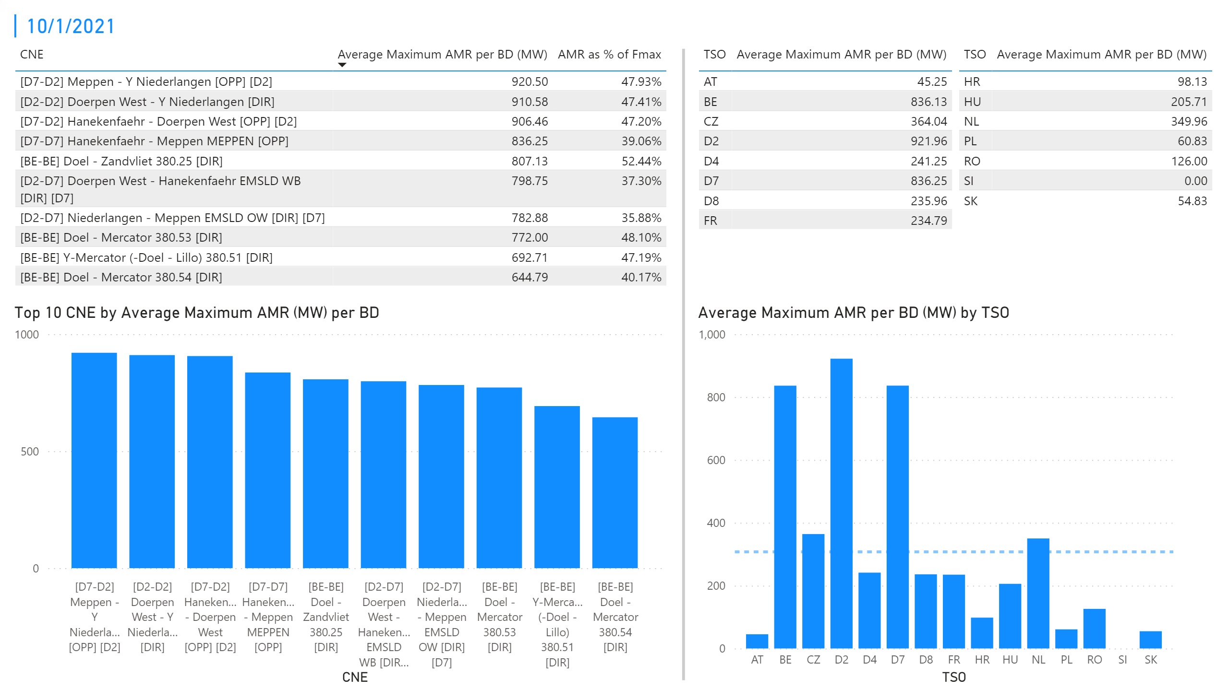
KPI 1 +2_1
KPI 1: Average maximum AMR per CNE per BD
KPI 2: Average maximum AMR per CNE per TSO
Notes:
tableEx
No alt text provided.
Top 10 CNE by Average Maximum AMR (MW) per BD
No alt text provided.
multiRowCard
No alt text provided.
tableEx
No alt text provided.
Average Maximum AMR per BD (MW) by TSO
No alt text provided.
tableEx
No alt text provided.
basicShape
No alt text provided.

Slide 8
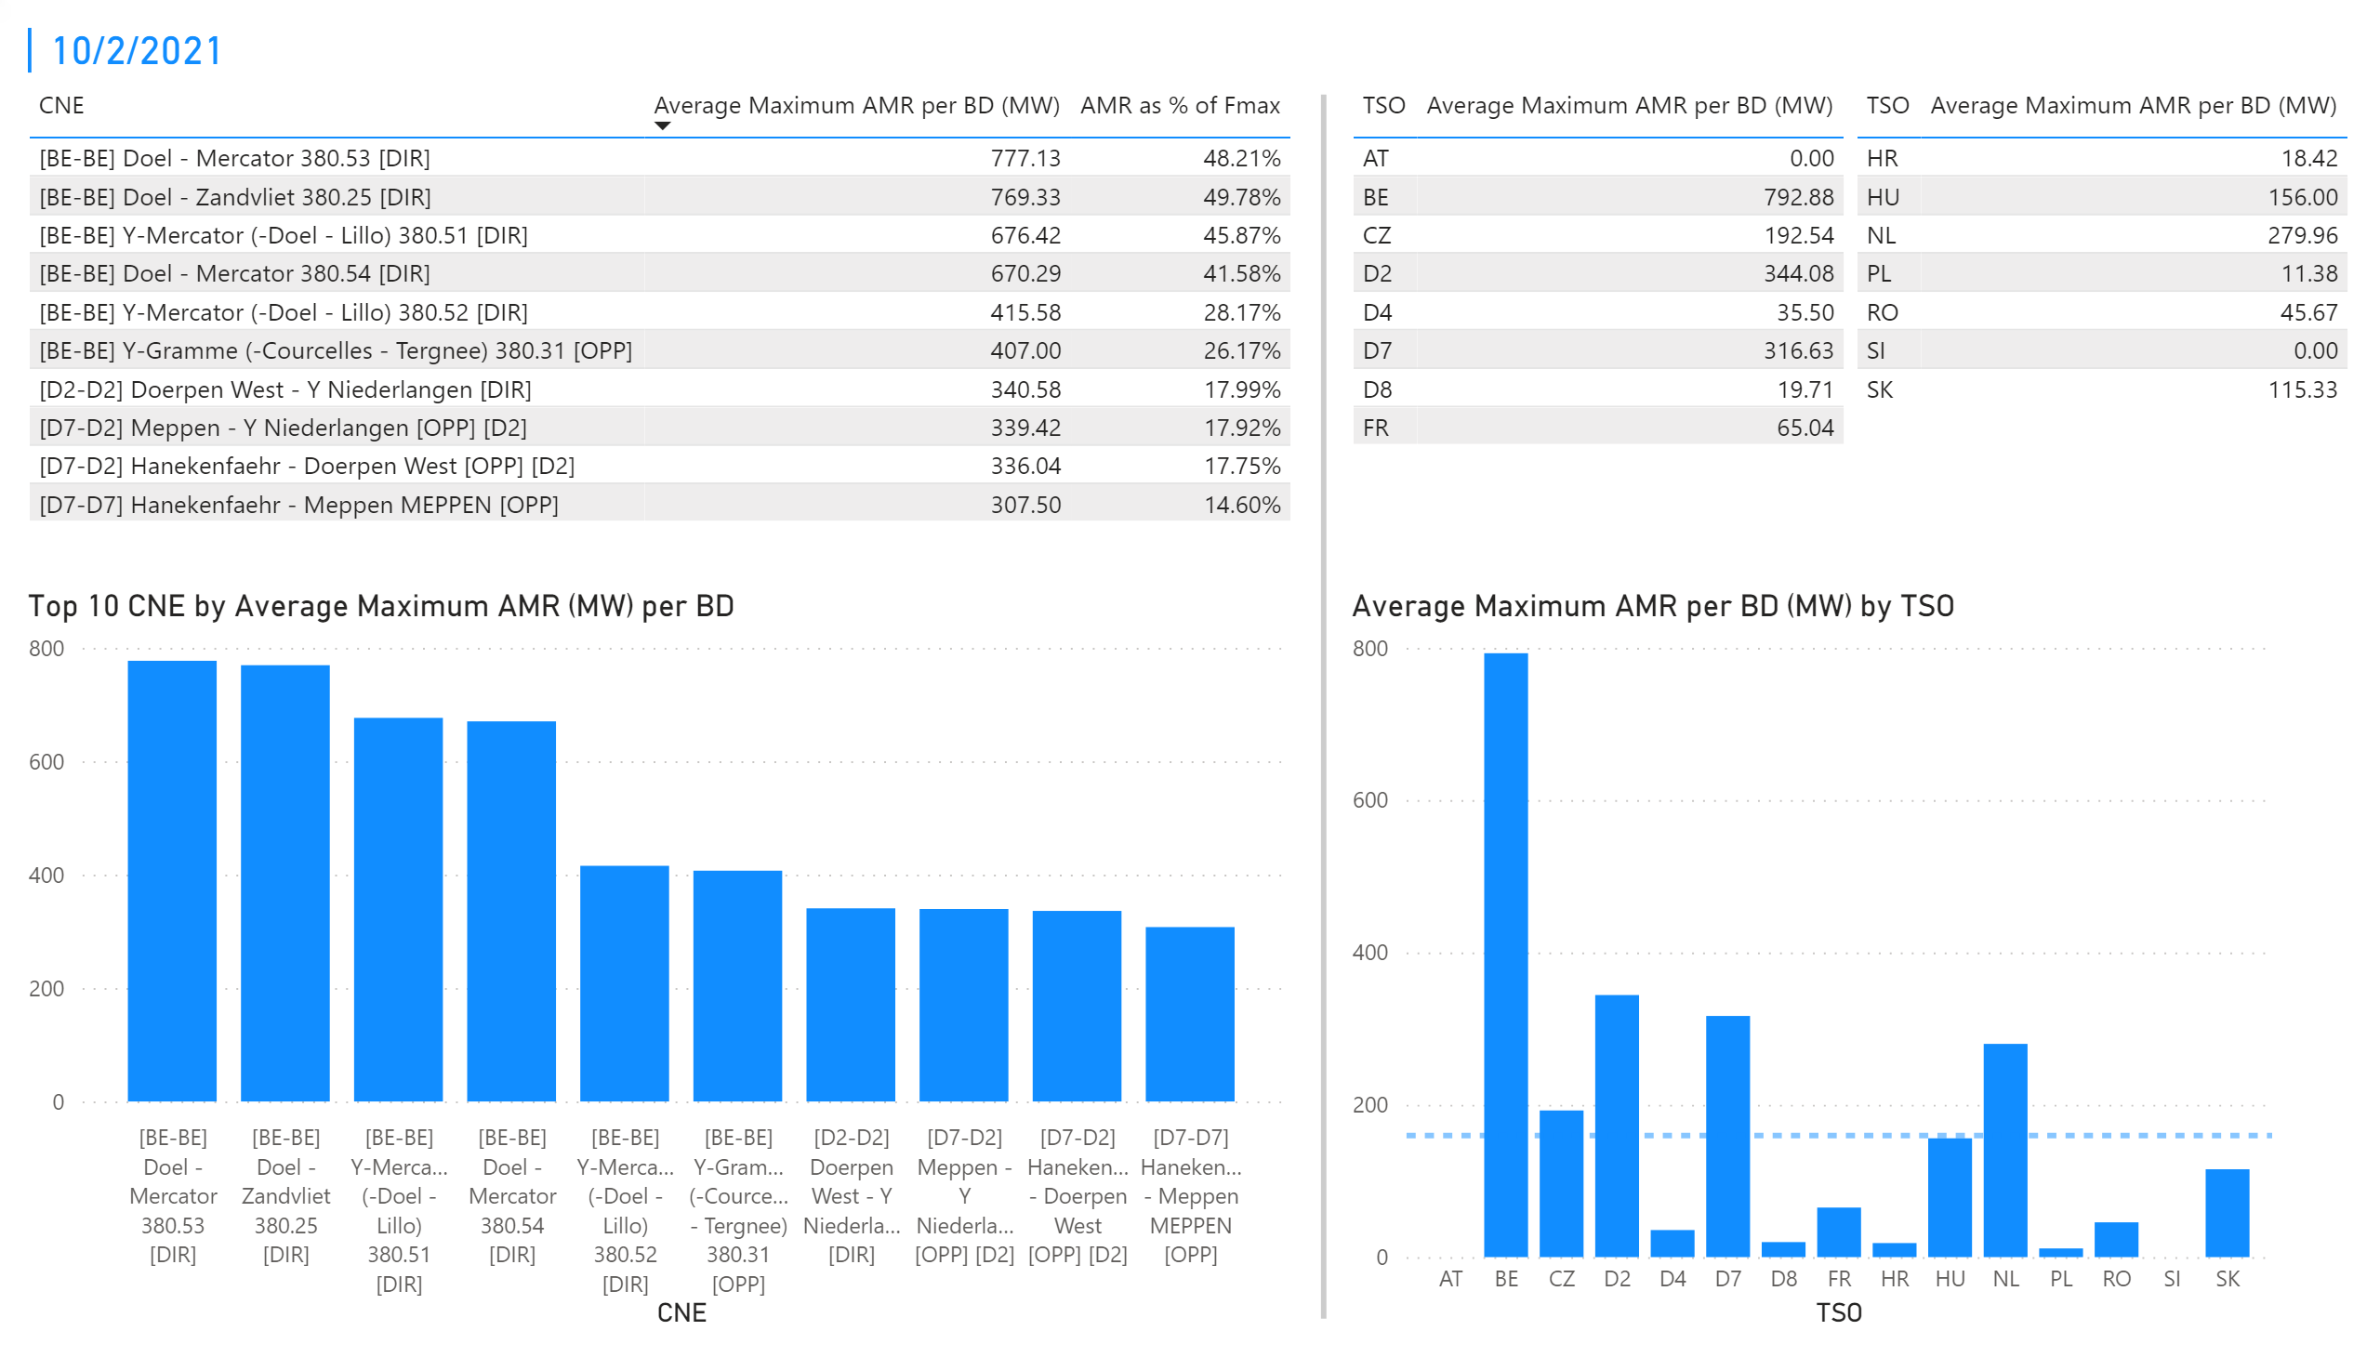
KPI 1 +2_2
KPI 1: Average maximum AMR per CNE per BD
KPI 2: Average maximum AMR per CNE per TSO
Notes:
tableEx
No alt text provided.
Top 10 CNE by Average Maximum AMR (MW) per BD
No alt text provided.
multiRowCard
No alt text provided.
tableEx
No alt text provided.
Average Maximum AMR per BD (MW) by TSO
No alt text provided.
tableEx
No alt text provided.
basicShape
No alt text provided.

Slide 9
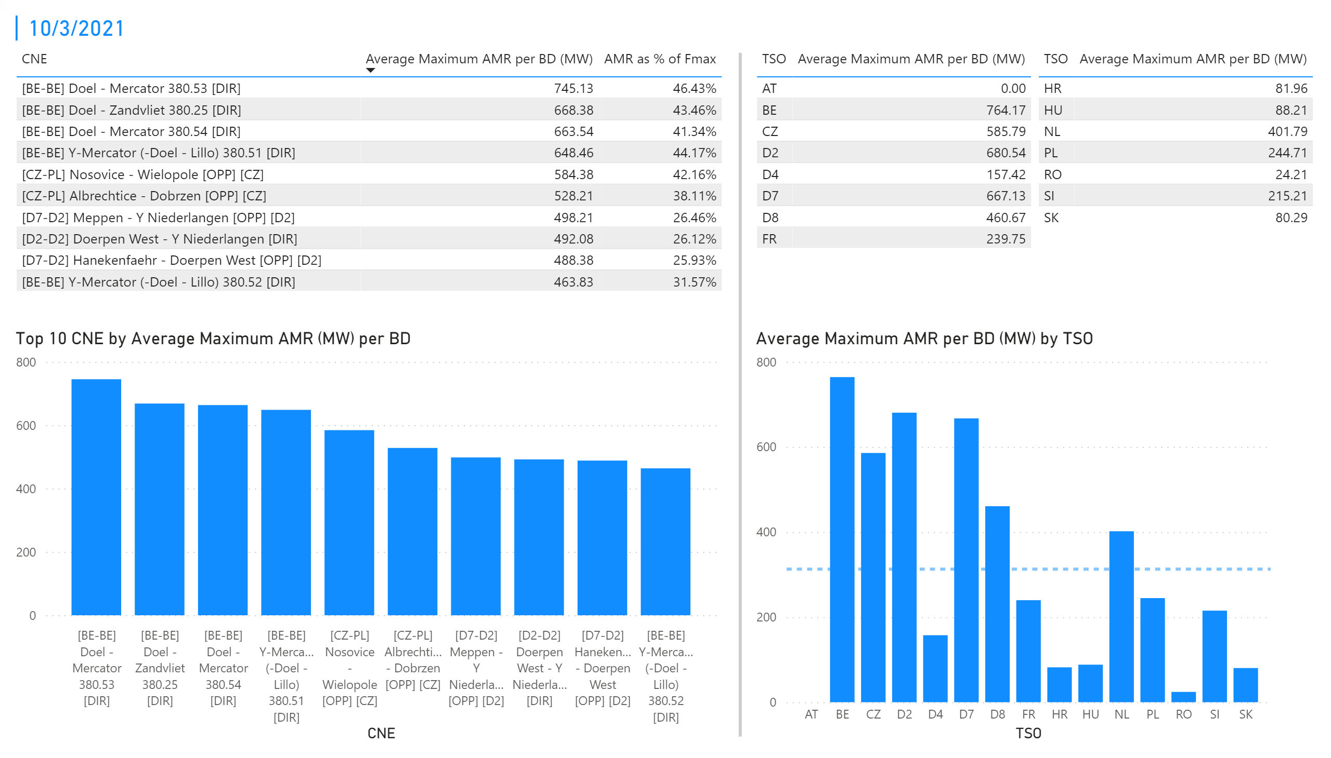
KPI 1 +2_3
KPI 1: Average maximum AMR per CNE per BD
KPI 2: Average maximum AMR per CNE per TSO
Notes:
tableEx
No alt text provided.
Top 10 CNE by Average Maximum AMR (MW) per BD
No alt text provided.
multiRowCard
No alt text provided.
tableEx
No alt text provided.
Average Maximum AMR per BD (MW) by TSO
No alt text provided.
tableEx
No alt text provided.
basicShape
No alt text provided.

Slide 10
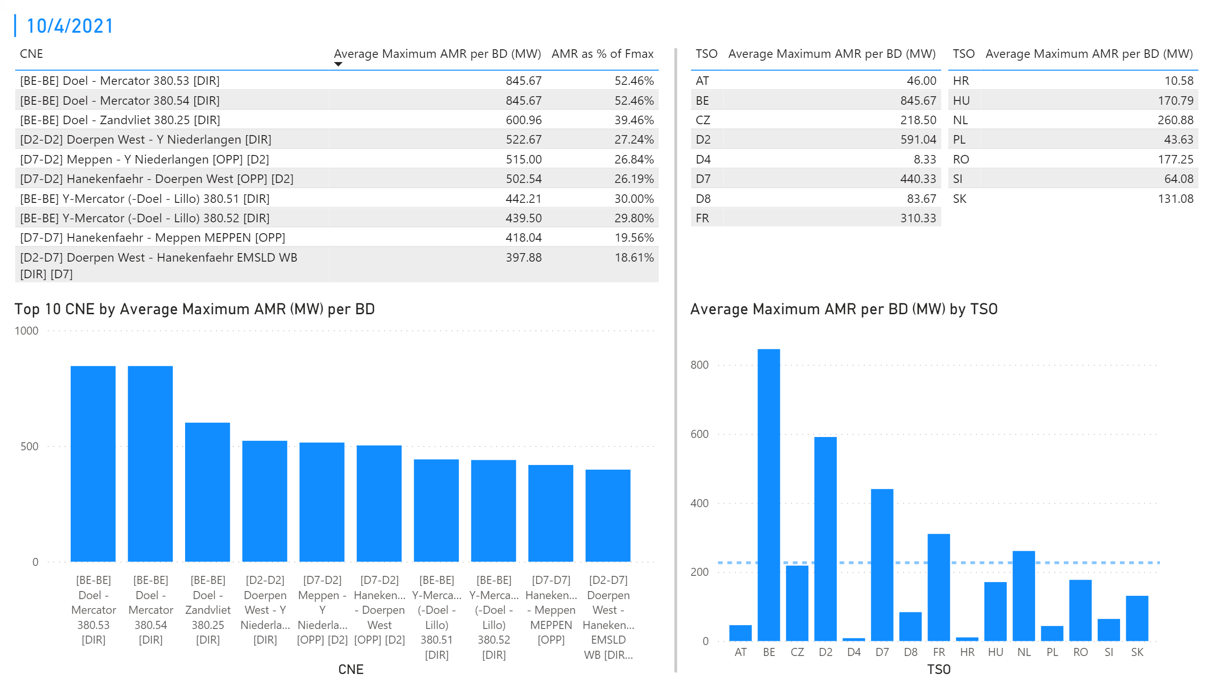
KPI 1 +2_4
KPI 1: Average maximum AMR per CNE per BD
KPI 2: Average maximum AMR per CNE per TSO
Notes:
tableEx
No alt text provided.
Top 10 CNE by Average Maximum AMR (MW) per BD
No alt text provided.
multiRowCard
No alt text provided.
tableEx
No alt text provided.
Average Maximum AMR per BD (MW) by TSO
No alt text provided.
tableEx
No alt text provided.
basicShape
No alt text provided.

Slide 11
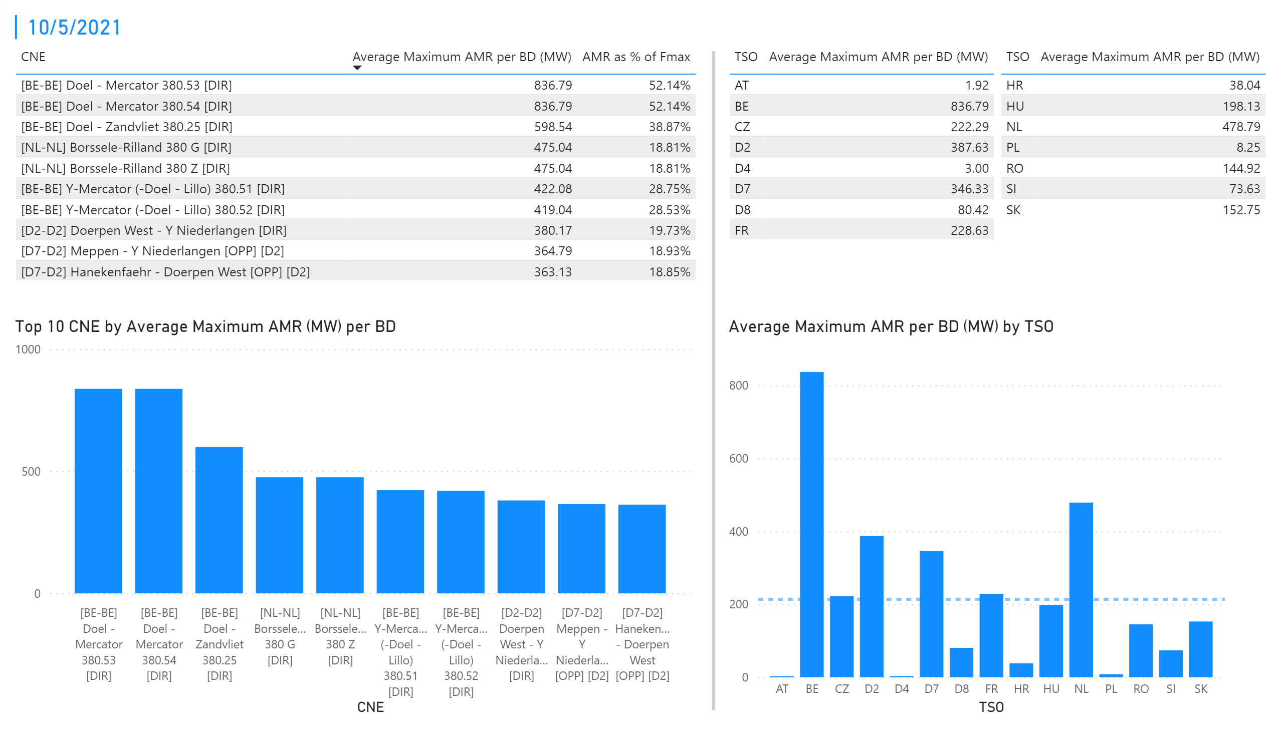
KPI 1 +2_5
KPI 1: Average maximum AMR per CNE per BD
KPI 2: Average maximum AMR per CNE per TSO
Notes:
tableEx
No alt text provided.
Top 10 CNE by Average Maximum AMR (MW) per BD
No alt text provided.
multiRowCard
No alt text provided.
tableEx
No alt text provided.
Average Maximum AMR per BD (MW) by TSO
No alt text provided.
tableEx
No alt text provided.
basicShape
No alt text provided.

Slide 12
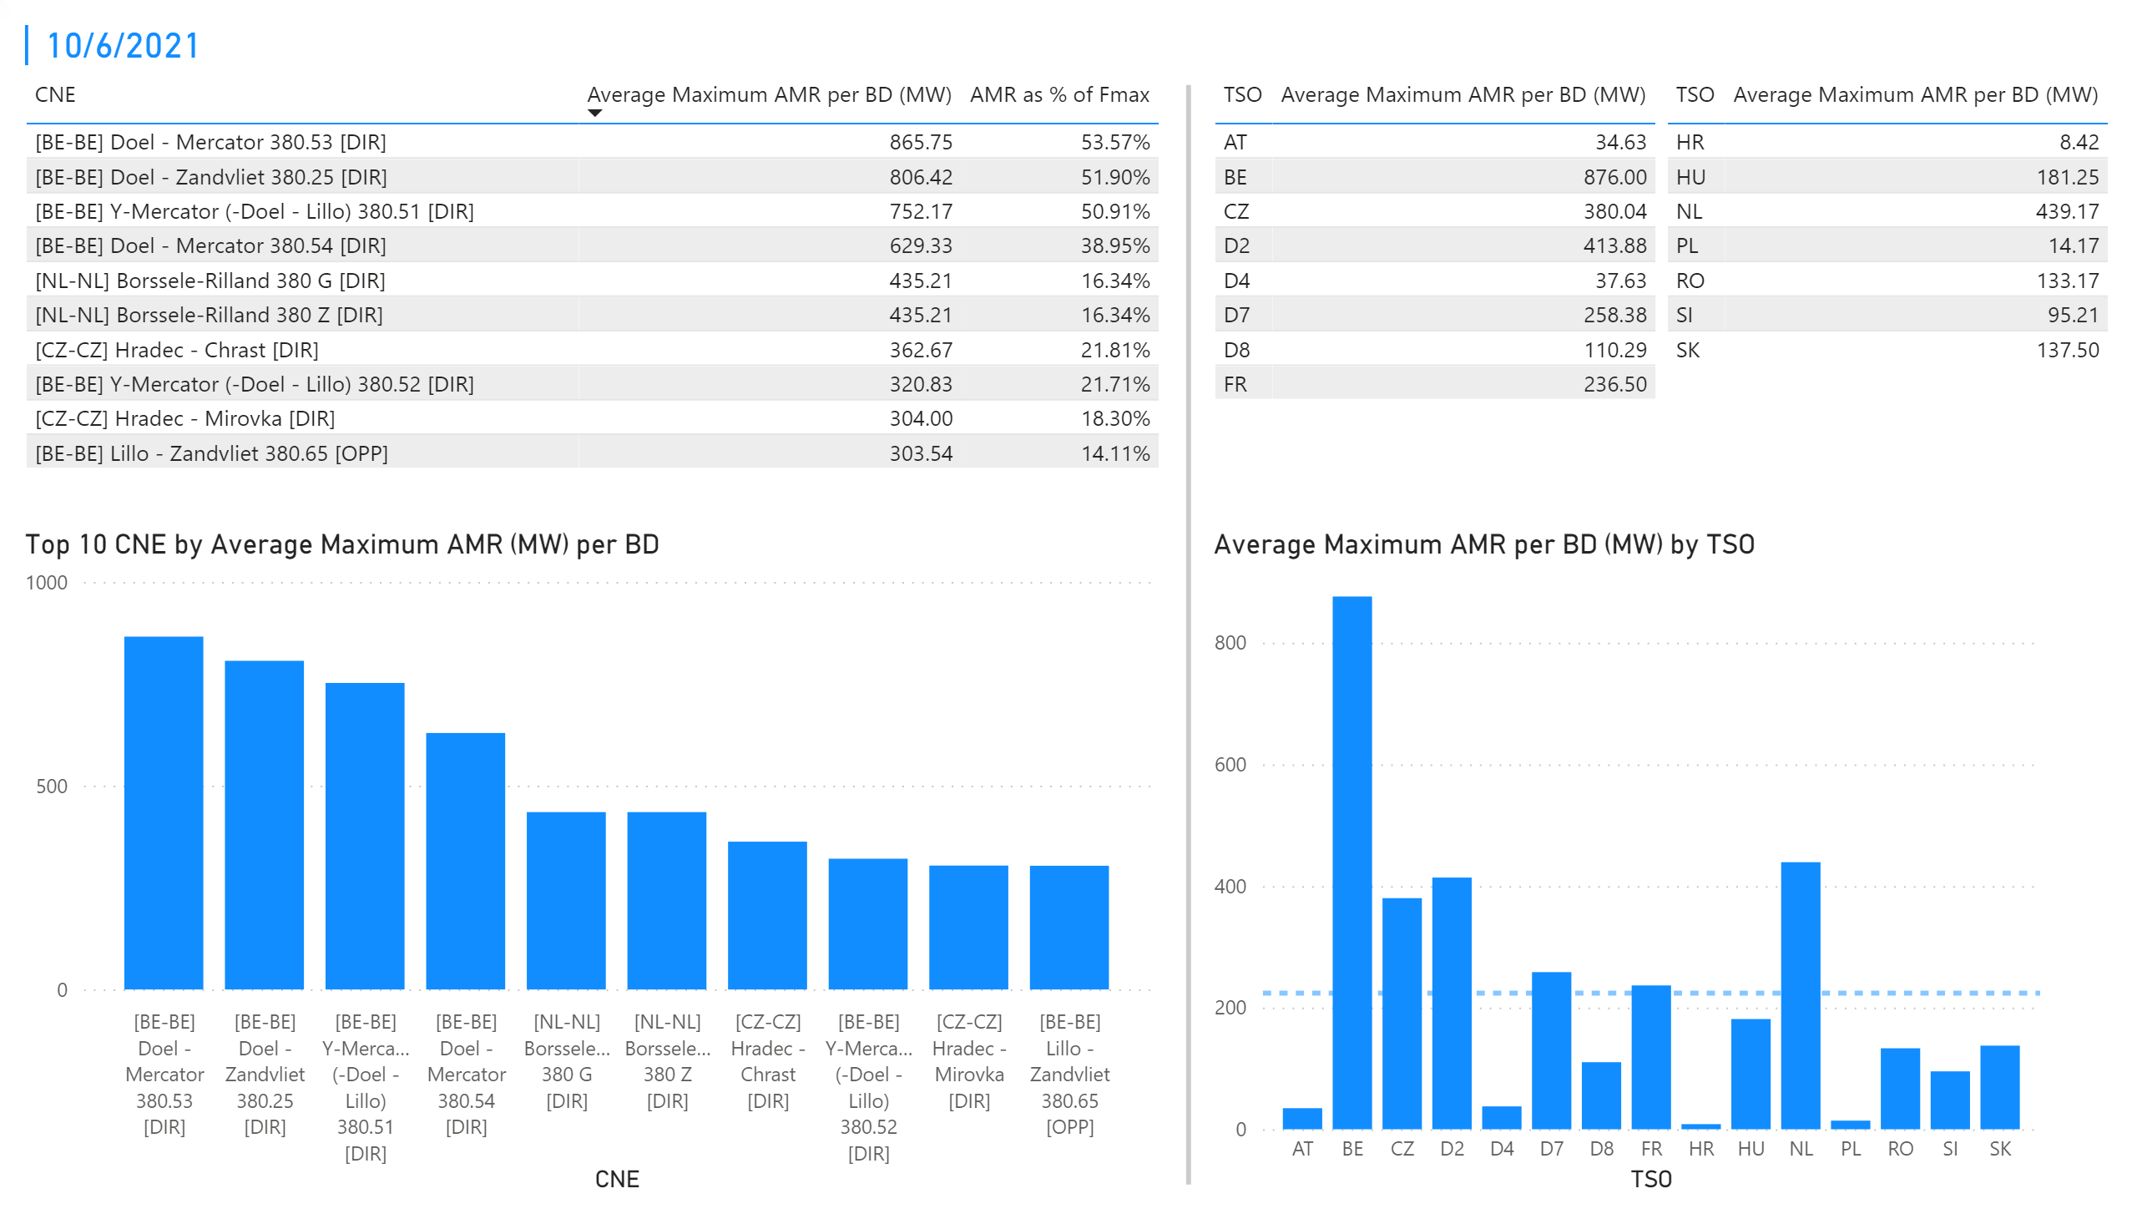
KPI 1 +2_6
KPI 1: Average maximum AMR per CNE per BD
KPI 2: Average maximum AMR per CNE per TSO
Notes:
tableEx
No alt text provided.
Top 10 CNE by Average Maximum AMR (MW) per BD
No alt text provided.
multiRowCard
No alt text provided.
tableEx
No alt text provided.
Average Maximum AMR per BD (MW) by TSO
No alt text provided.
tableEx
No alt text provided.
basicShape
No alt text provided.

Slide 13
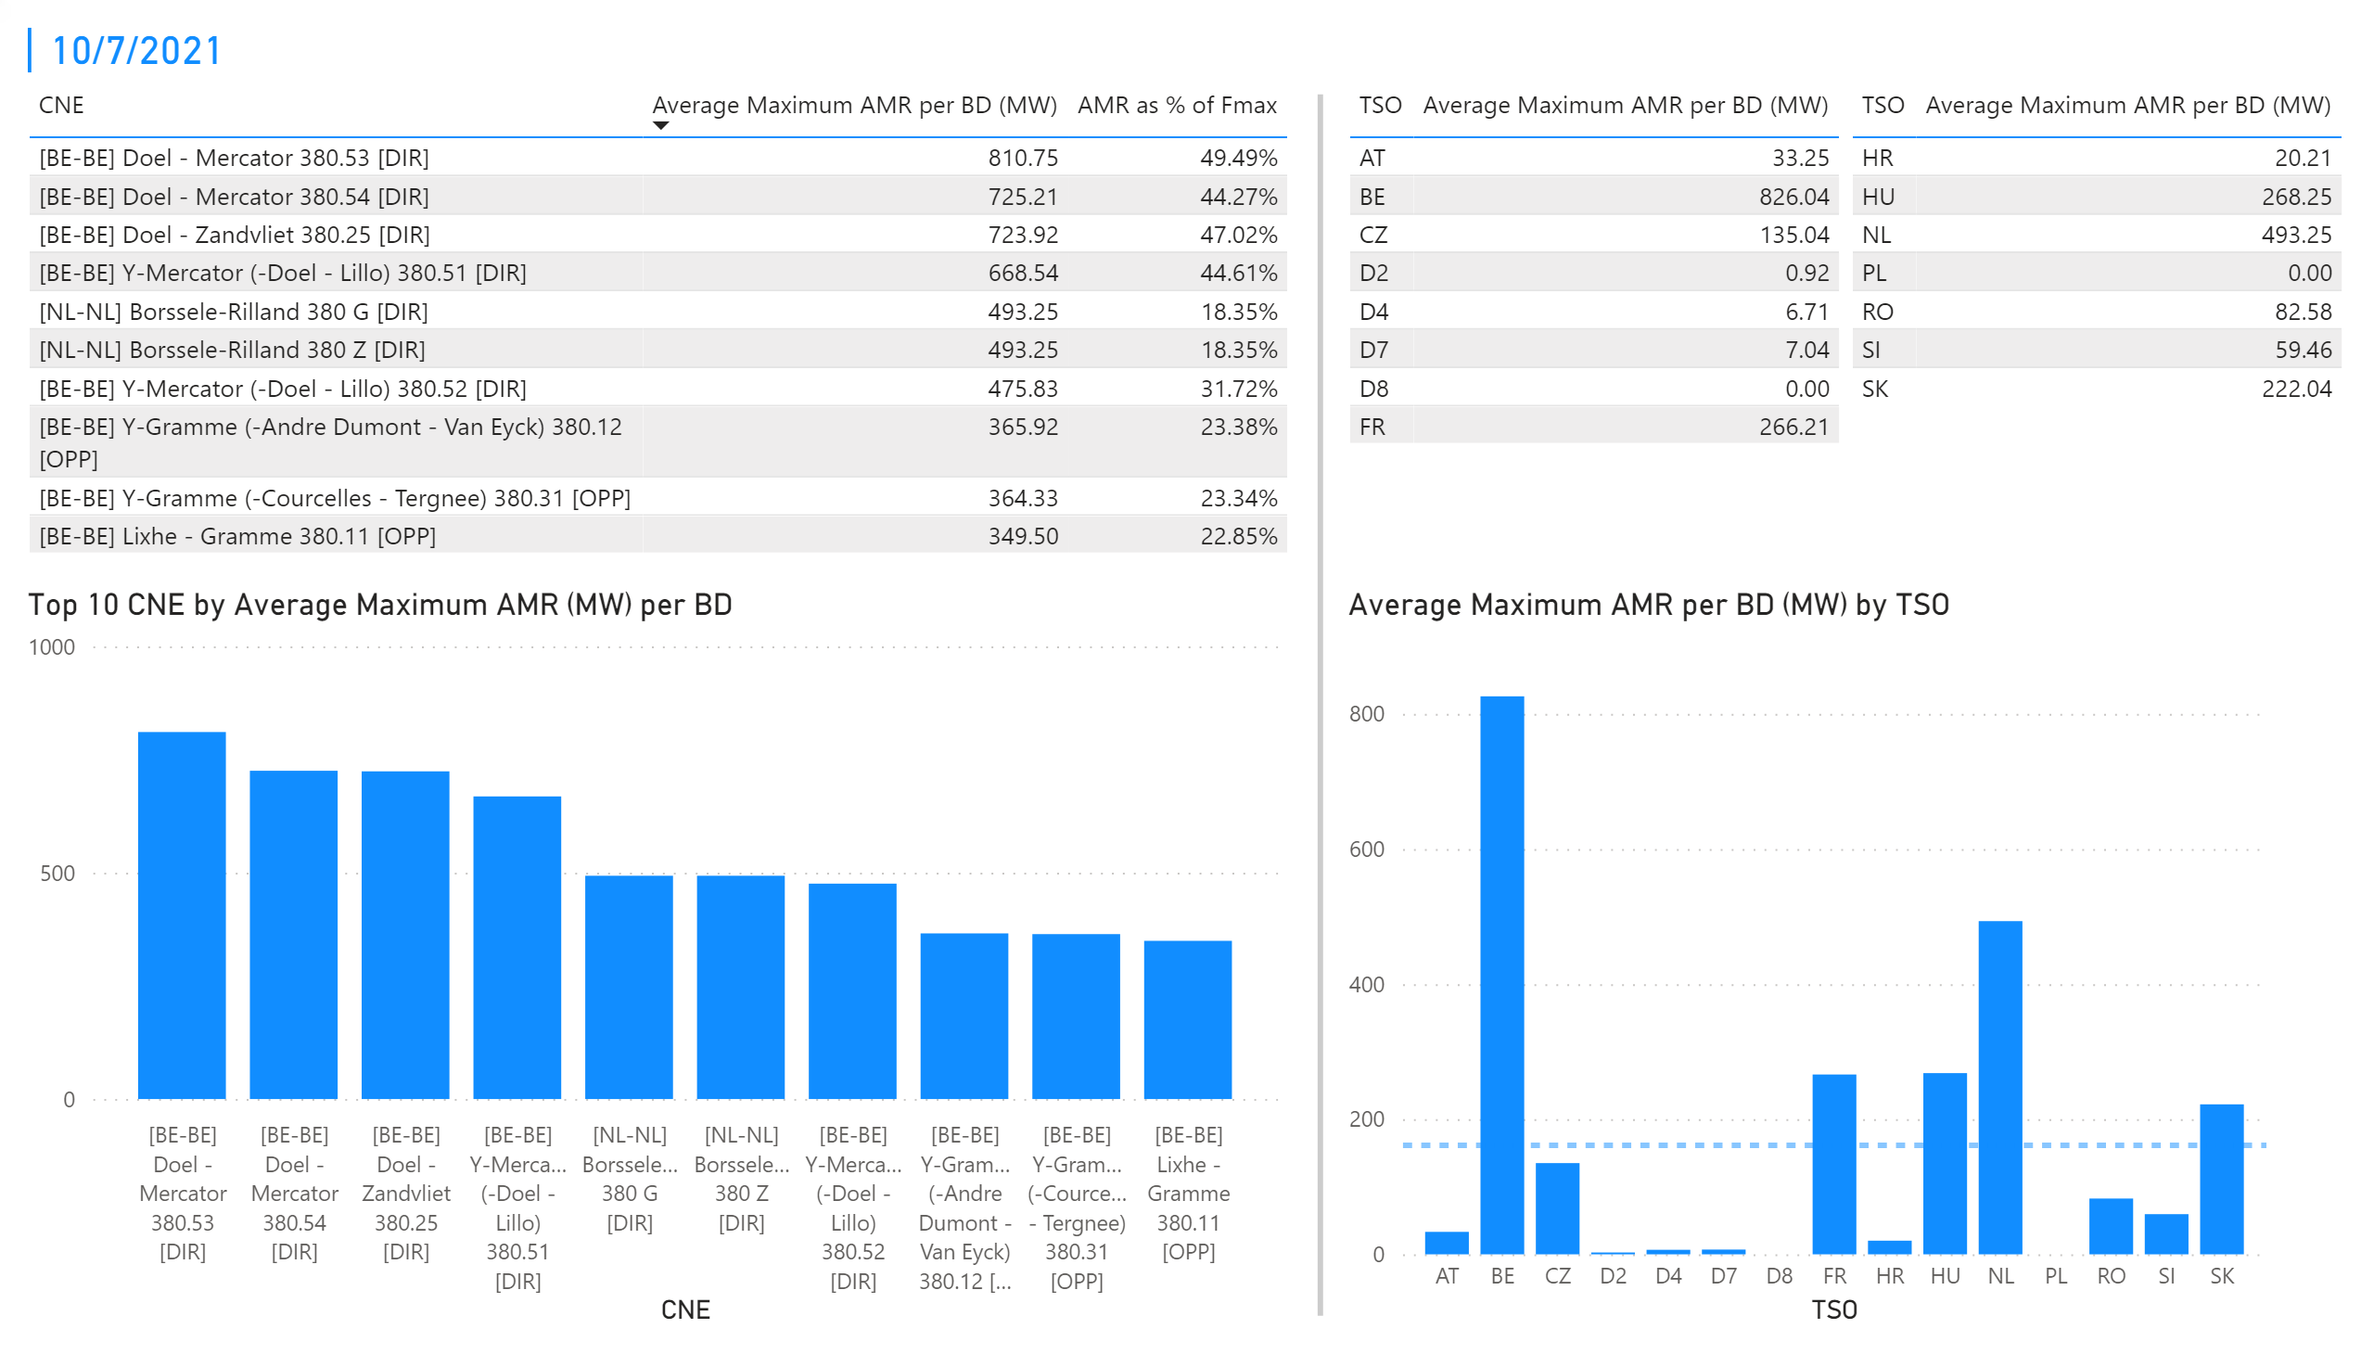
KPI 1 +2_7
KPI 1: Average maximum AMR per CNE per BD
KPI 2: Average maximum AMR per CNE per TSO
Notes:
tableEx
No alt text provided.
Top 10 CNE by Average Maximum AMR (MW) per BD
No alt text provided.
multiRowCard
No alt text provided.
tableEx
No alt text provided.
Average Maximum AMR per BD (MW) by TSO
No alt text provided.
tableEx
No alt text provided.
basicShape
No alt text provided.

Slide 14
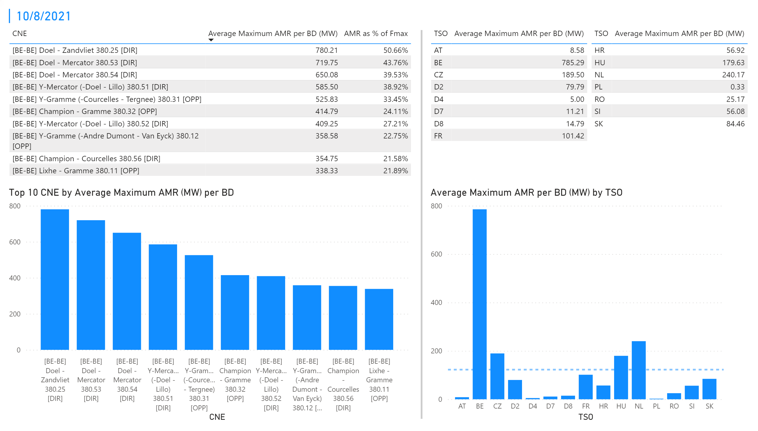
KPI 1 +2_8
KPI 1: Average maximum AMR per CNE per BD
KPI 2: Average maximum AMR per CNE per TSO
Notes:
tableEx
No alt text provided.
Top 10 CNE by Average Maximum AMR (MW) per BD
No alt text provided.
multiRowCard
No alt text provided.
tableEx
No alt text provided.
Average Maximum AMR per BD (MW) by TSO
No alt text provided.
tableEx
No alt text provided.
basicShape
No alt text provided.

Slide 15
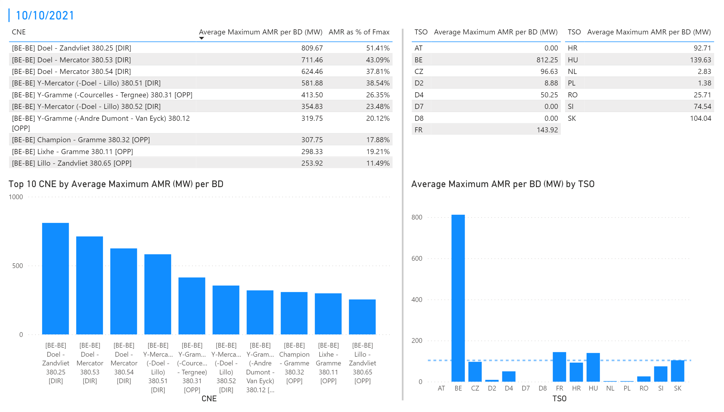
KPI 1 +2_10
KPI 1: Average maximum AMR per CNE per BD
KPI 2: Average maximum AMR per CNE per TSO
Notes:
tableEx
No alt text provided.
Top 10 CNE by Average Maximum AMR (MW) per BD
No alt text provided.
multiRowCard
No alt text provided.
tableEx
No alt text provided.
Average Maximum AMR per BD (MW) by TSO
No alt text provided.
tableEx
No alt text provided.
basicShape
No alt text provided.

Slide 16
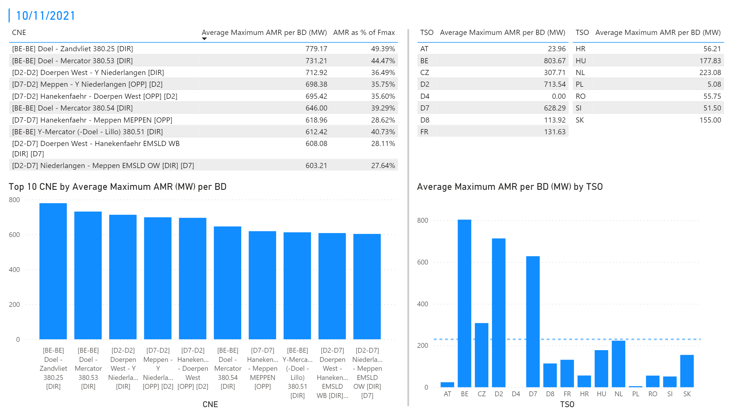
KPI 1 +2_11
KPI 1: Average maximum AMR per CNE per BD
KPI 2: Average maximum AMR per CNE per TSO
Notes:
tableEx
No alt text provided.
Top 10 CNE by Average Maximum AMR (MW) per BD
No alt text provided.
multiRowCard
No alt text provided.
tableEx
No alt text provided.
Average Maximum AMR per BD (MW) by TSO
No alt text provided.
tableEx
No alt text provided.
basicShape
No alt text provided.

Slide 17
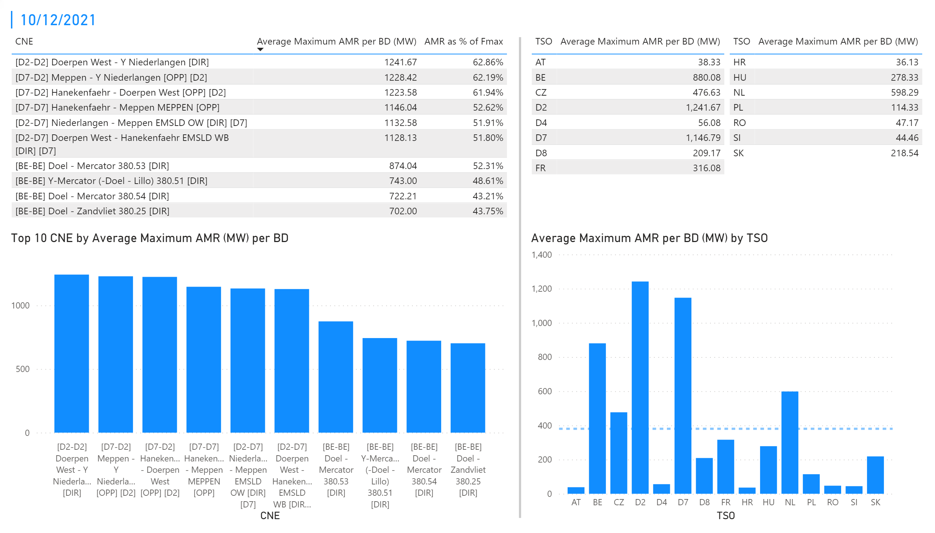
KPI 1 +2_12
KPI 1: Average maximum AMR per CNE per BD
KPI 2: Average maximum AMR per CNE per TSO
Notes:
tableEx
No alt text provided.
Top 10 CNE by Average Maximum AMR (MW) per BD
No alt text provided.
multiRowCard
No alt text provided.
tableEx
No alt text provided.
Average Maximum AMR per BD (MW) by TSO
No alt text provided.
tableEx
No alt text provided.
basicShape
No alt text provided.

Slide 18
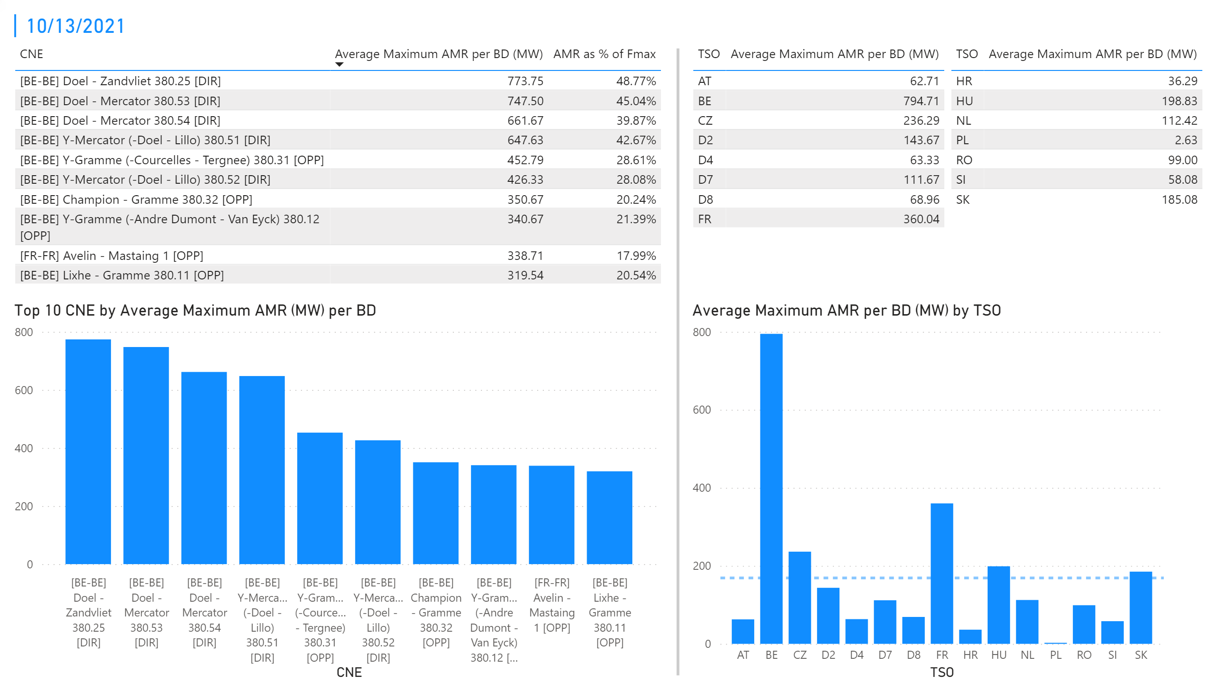
KPI 1 +2_13
KPI 1: Average maximum AMR per CNE per BD
KPI 2: Average maximum AMR per CNE per TSO
Notes:
tableEx
No alt text provided.
Top 10 CNE by Average Maximum AMR (MW) per BD
No alt text provided.
multiRowCard
No alt text provided.
tableEx
No alt text provided.
Average Maximum AMR per BD (MW) by TSO
No alt text provided.
tableEx
No alt text provided.
basicShape
No alt text provided.

Slide 19
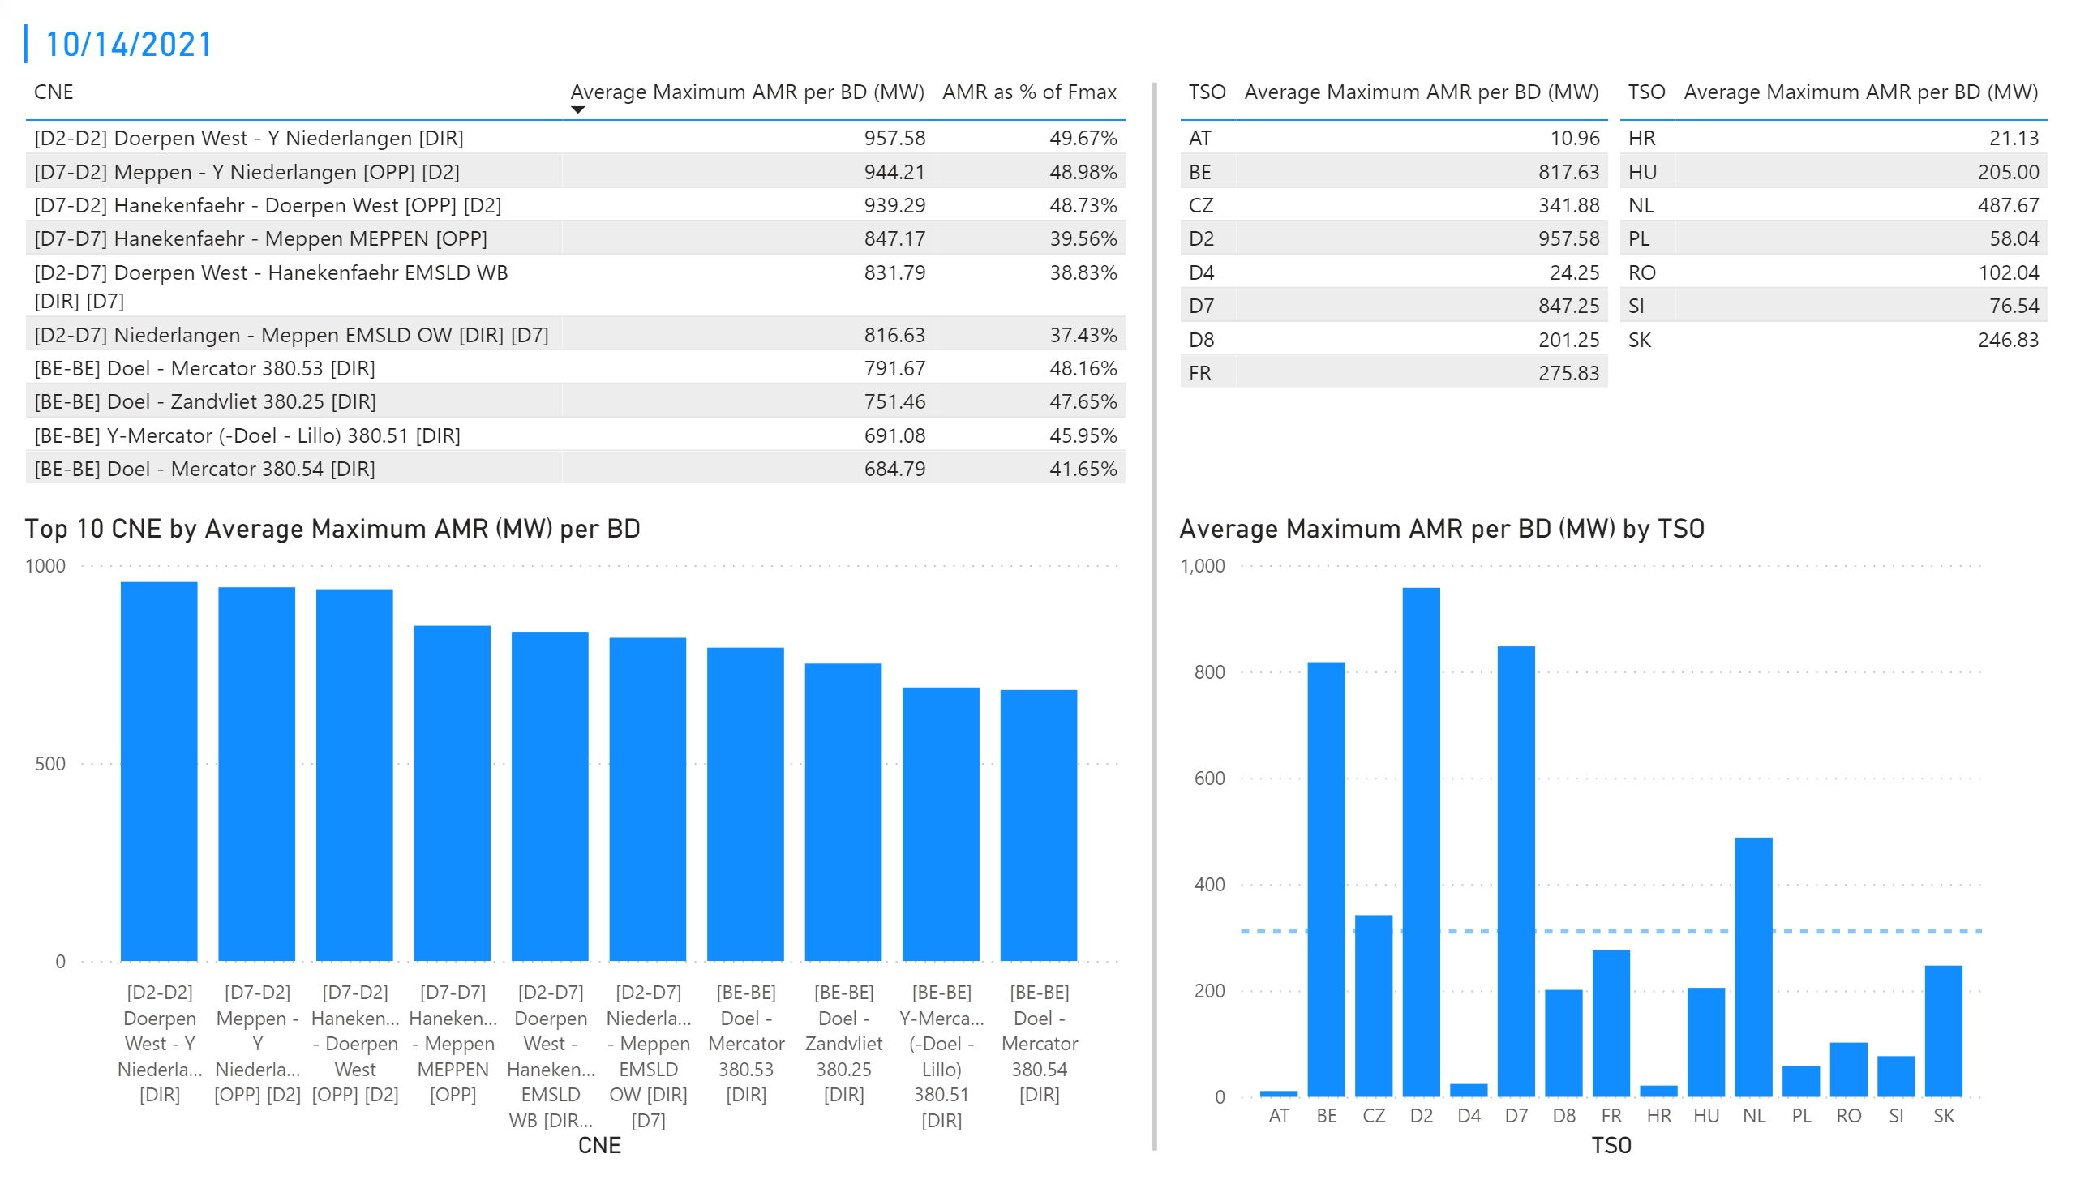
KPI 1 +2_14
KPI 1: Average maximum AMR per CNE per BD
KPI 2: Average maximum AMR per CNE per TSO
Notes:
tableEx
No alt text provided.
Top 10 CNE by Average Maximum AMR (MW) per BD
No alt text provided.
multiRowCard
No alt text provided.
tableEx
No alt text provided.
Average Maximum AMR per BD (MW) by TSO
No alt text provided.
tableEx
No alt text provided.
basicShape
No alt text provided.

Slide 20
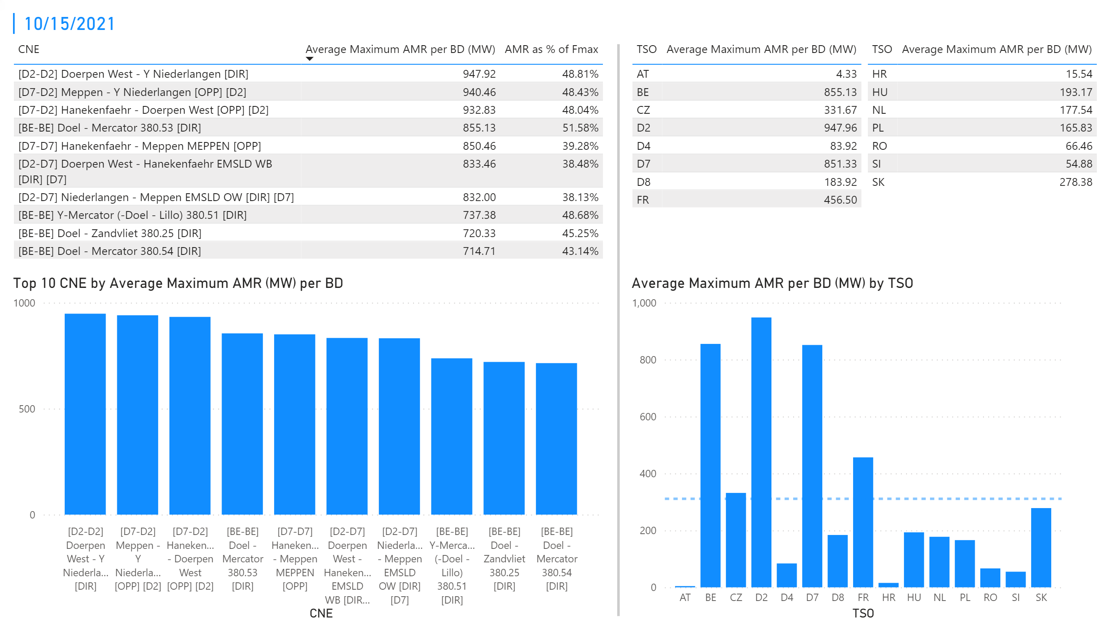
KPI 1 +2_15
KPI 1: Average maximum AMR per CNE per BD
KPI 2: Average maximum AMR per CNE per TSO
Notes:
tableEx
No alt text provided.
Top 10 CNE by Average Maximum AMR (MW) per BD
No alt text provided.
multiRowCard
No alt text provided.
tableEx
No alt text provided.
Average Maximum AMR per BD (MW) by TSO
No alt text provided.
tableEx
No alt text provided.
basicShape
No alt text provided.

Slide 21
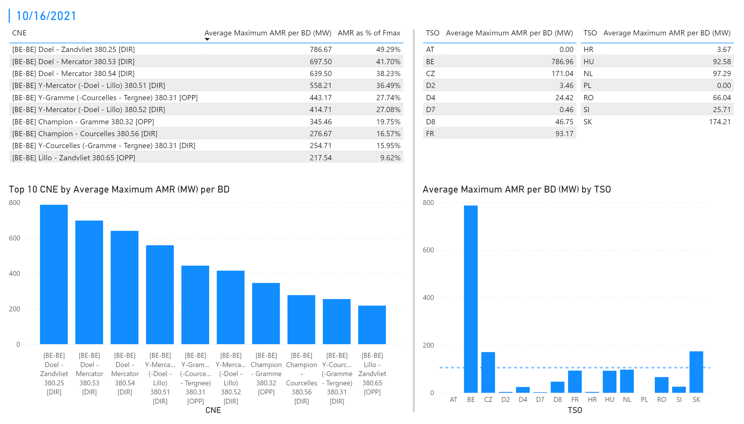
KPI 1 +2_16
KPI 1: Average maximum AMR per CNE per BD
KPI 2: Average maximum AMR per CNE per TSO
Notes:
tableEx
No alt text provided.
Top 10 CNE by Average Maximum AMR (MW) per BD
No alt text provided.
multiRowCard
No alt text provided.
tableEx
No alt text provided.
Average Maximum AMR per BD (MW) by TSO
No alt text provided.
tableEx
No alt text provided.
basicShape
No alt text provided.

Slide 22
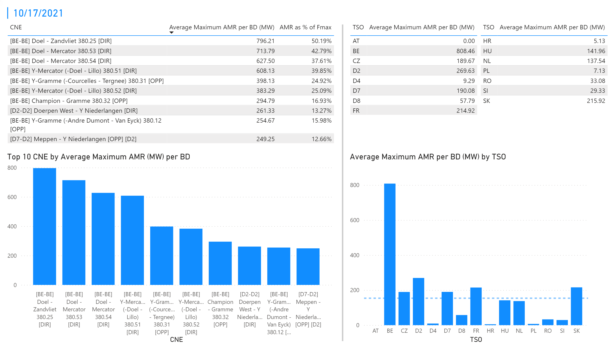
KPI 1 +2_17
KPI 1: Average maximum AMR per CNE per BD
KPI 2: Average maximum AMR per CNE per TSO
Notes:
tableEx
No alt text provided.
Top 10 CNE by Average Maximum AMR (MW) per BD
No alt text provided.
multiRowCard
No alt text provided.
tableEx
No alt text provided.
Average Maximum AMR per BD (MW) by TSO
No alt text provided.
tableEx
No alt text provided.
basicShape
No alt text provided.

Slide 23
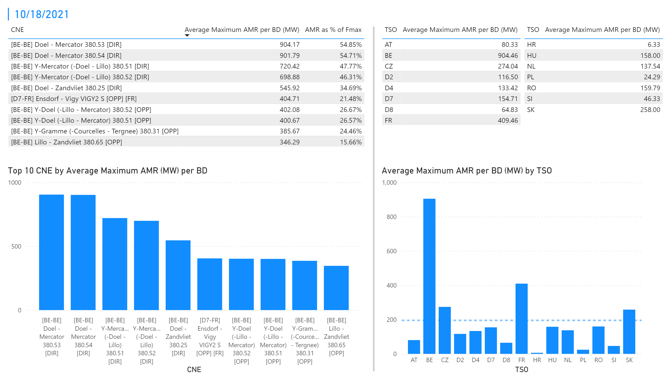
KPI 1 +2_18
KPI 1: Average maximum AMR per CNE per BD
KPI 2: Average maximum AMR per CNE per TSO
Notes:
tableEx
No alt text provided.
Top 10 CNE by Average Maximum AMR (MW) per BD
No alt text provided.
multiRowCard
No alt text provided.
tableEx
No alt text provided.
Average Maximum AMR per BD (MW) by TSO
No alt text provided.
tableEx
No alt text provided.
basicShape
No alt text provided.

Slide 24
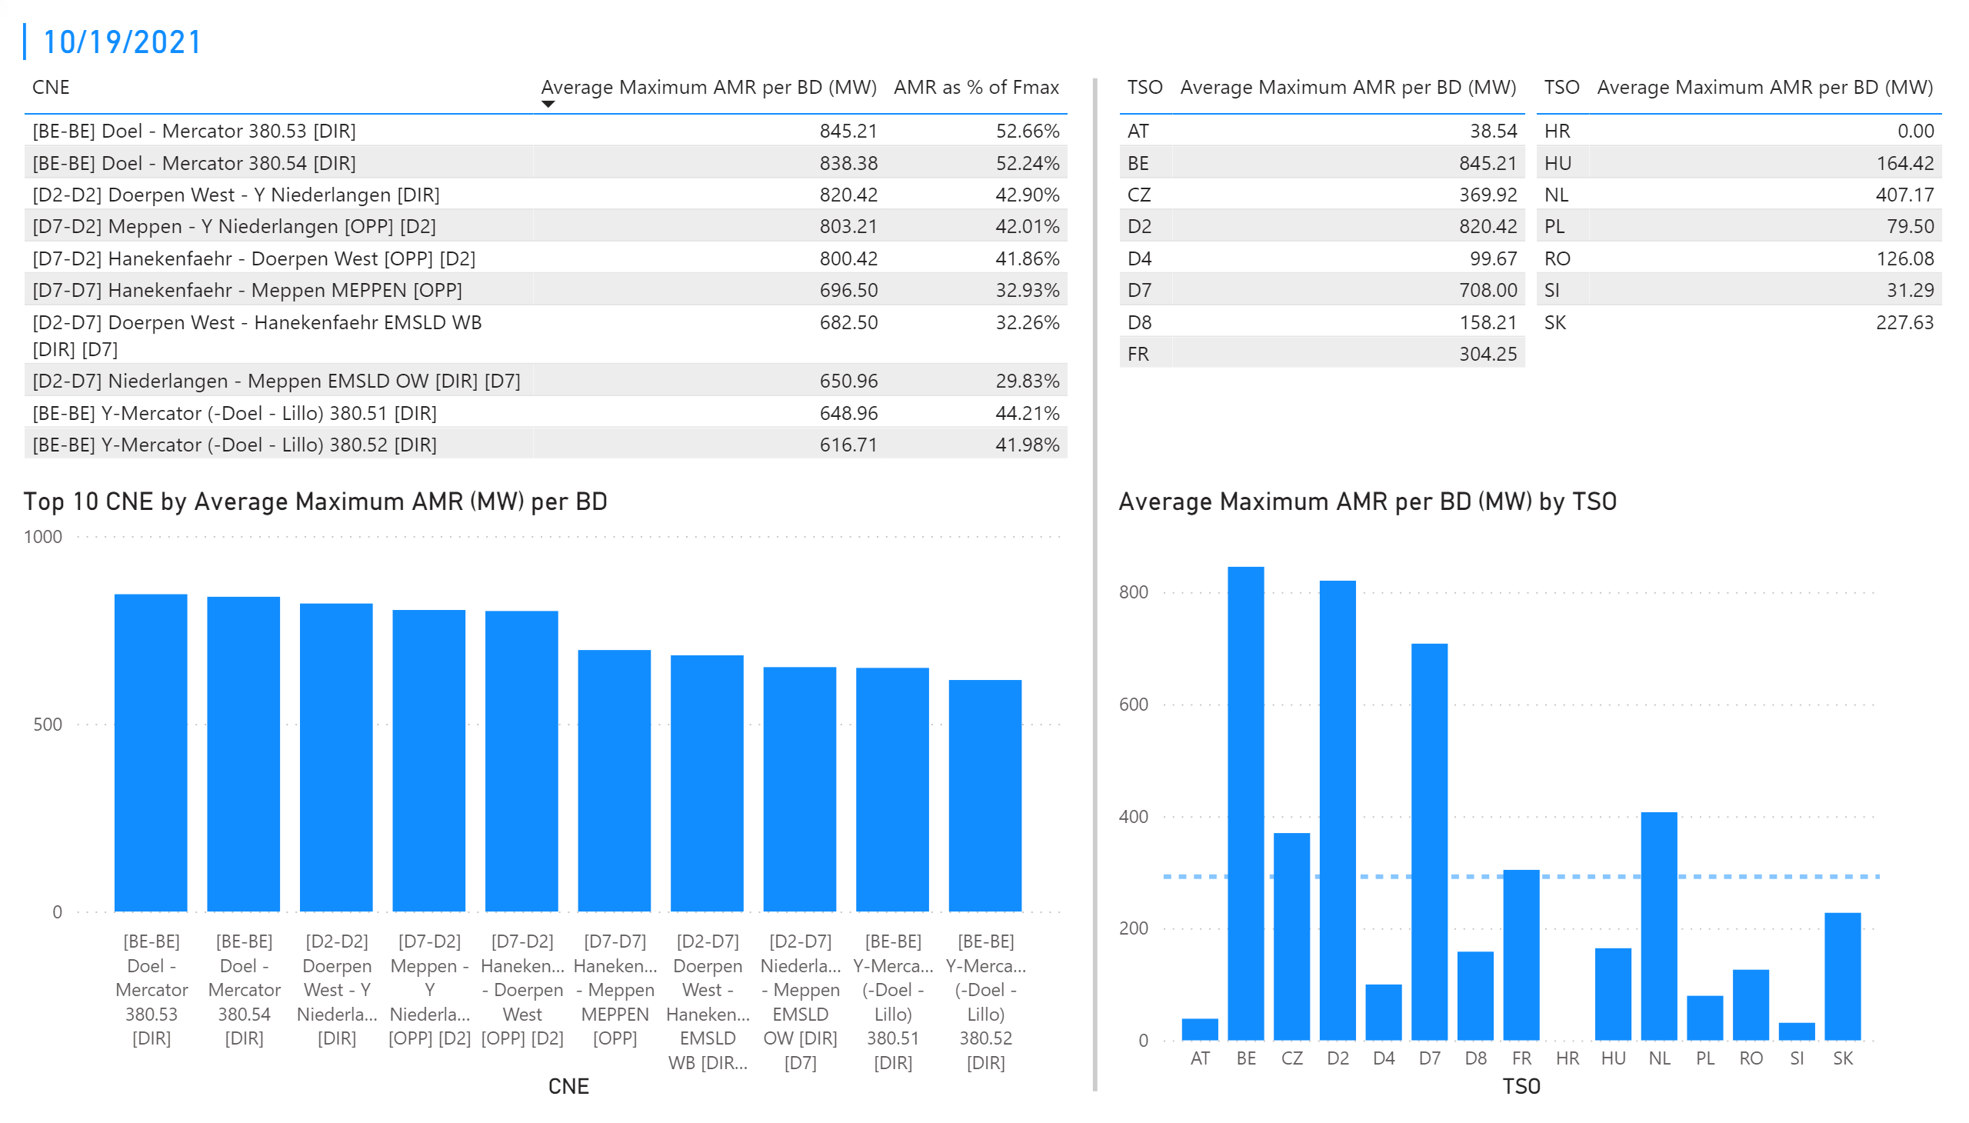
KPI 1 +2_19
KPI 1: Average maximum AMR per CNE per BD
KPI 2: Average maximum AMR per CNE per TSO
Notes:
tableEx
No alt text provided.
Top 10 CNE by Average Maximum AMR (MW) per BD
No alt text provided.
multiRowCard
No alt text provided.
tableEx
No alt text provided.
Average Maximum AMR per BD (MW) by TSO
No alt text provided.
tableEx
No alt text provided.
basicShape
No alt text provided.

Slide 25
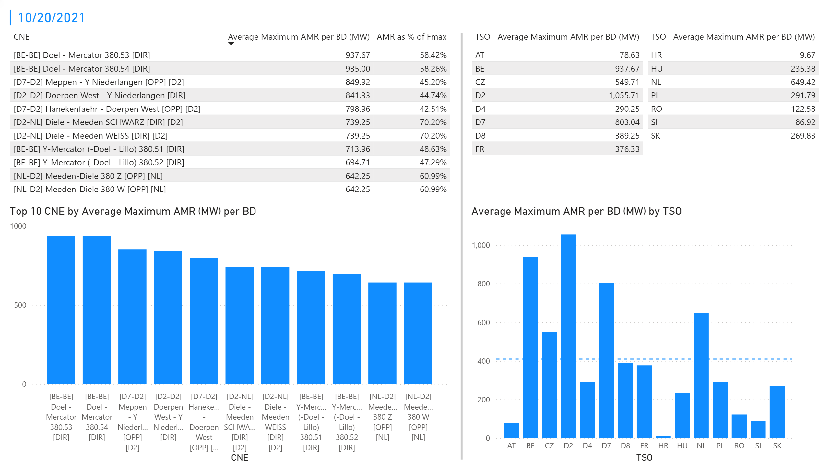
KPI 1 +2_20
KPI 1: Average maximum AMR per CNE per BD
KPI 2: Average maximum AMR per CNE per TSO
Notes:
tableEx
No alt text provided.
Top 10 CNE by Average Maximum AMR (MW) per BD
No alt text provided.
multiRowCard
No alt text provided.
tableEx
No alt text provided.
Average Maximum AMR per BD (MW) by TSO
No alt text provided.
tableEx
No alt text provided.
basicShape
No alt text provided.

Slide 26
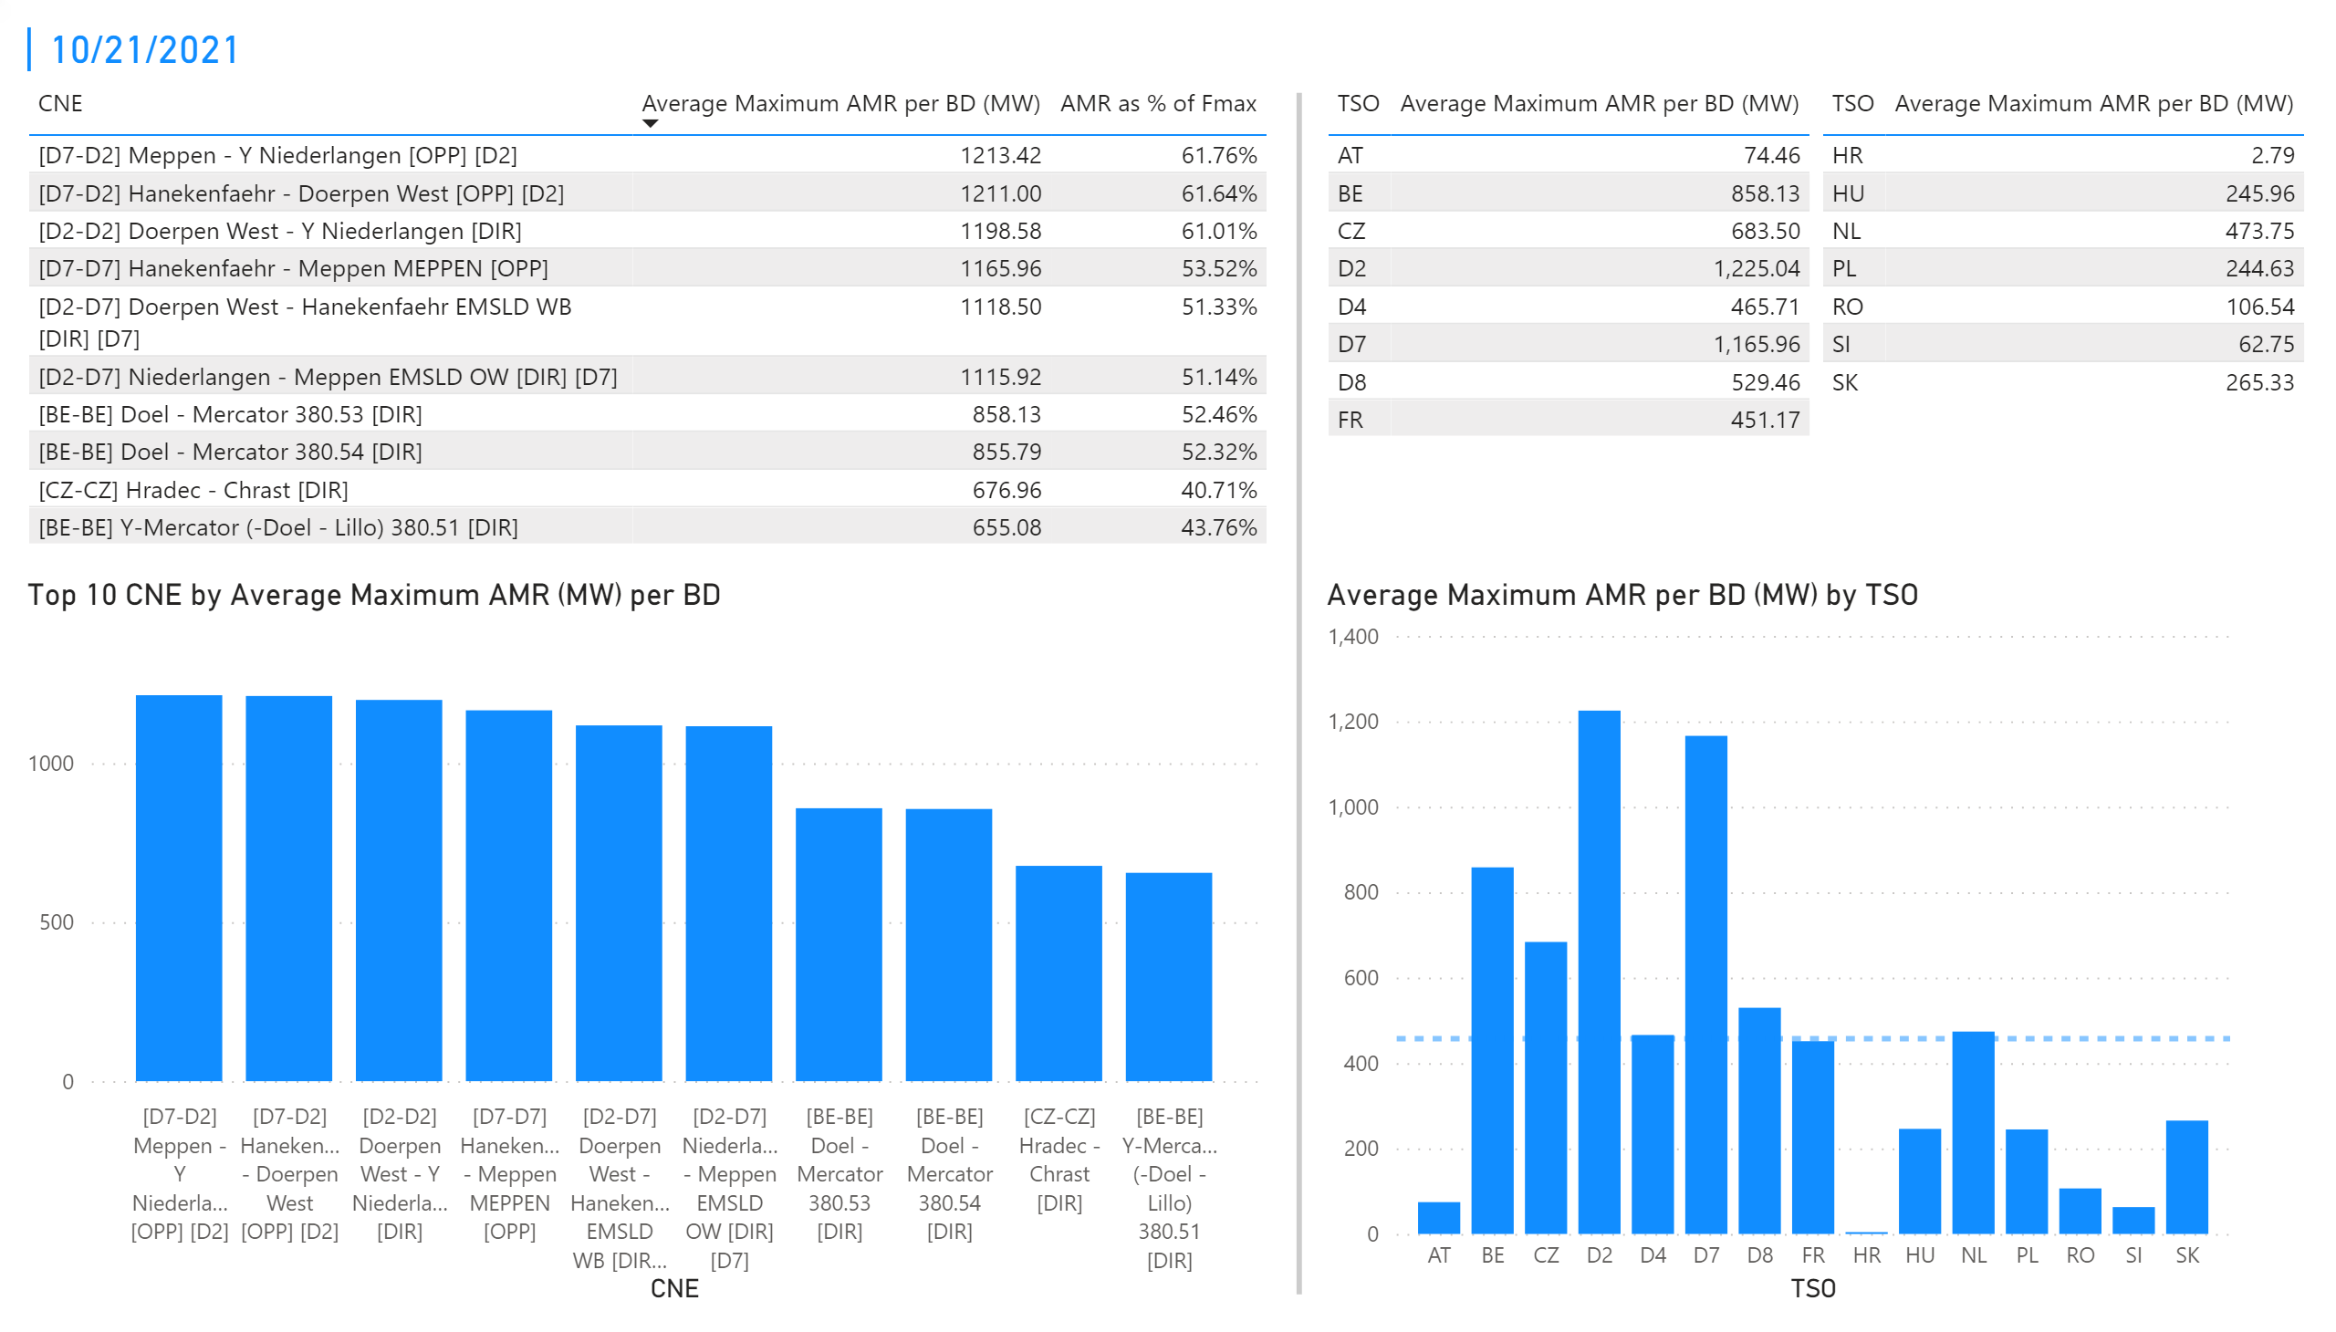
KPI 1 +2_21
KPI 1: Average maximum AMR per CNE per BD
KPI 2: Average maximum AMR per CNE per TSO
Notes:
tableEx
No alt text provided.
Top 10 CNE by Average Maximum AMR (MW) per BD
No alt text provided.
multiRowCard
No alt text provided.
tableEx
No alt text provided.
Average Maximum AMR per BD (MW) by TSO
No alt text provided.
tableEx
No alt text provided.
basicShape
No alt text provided.

Slide 27
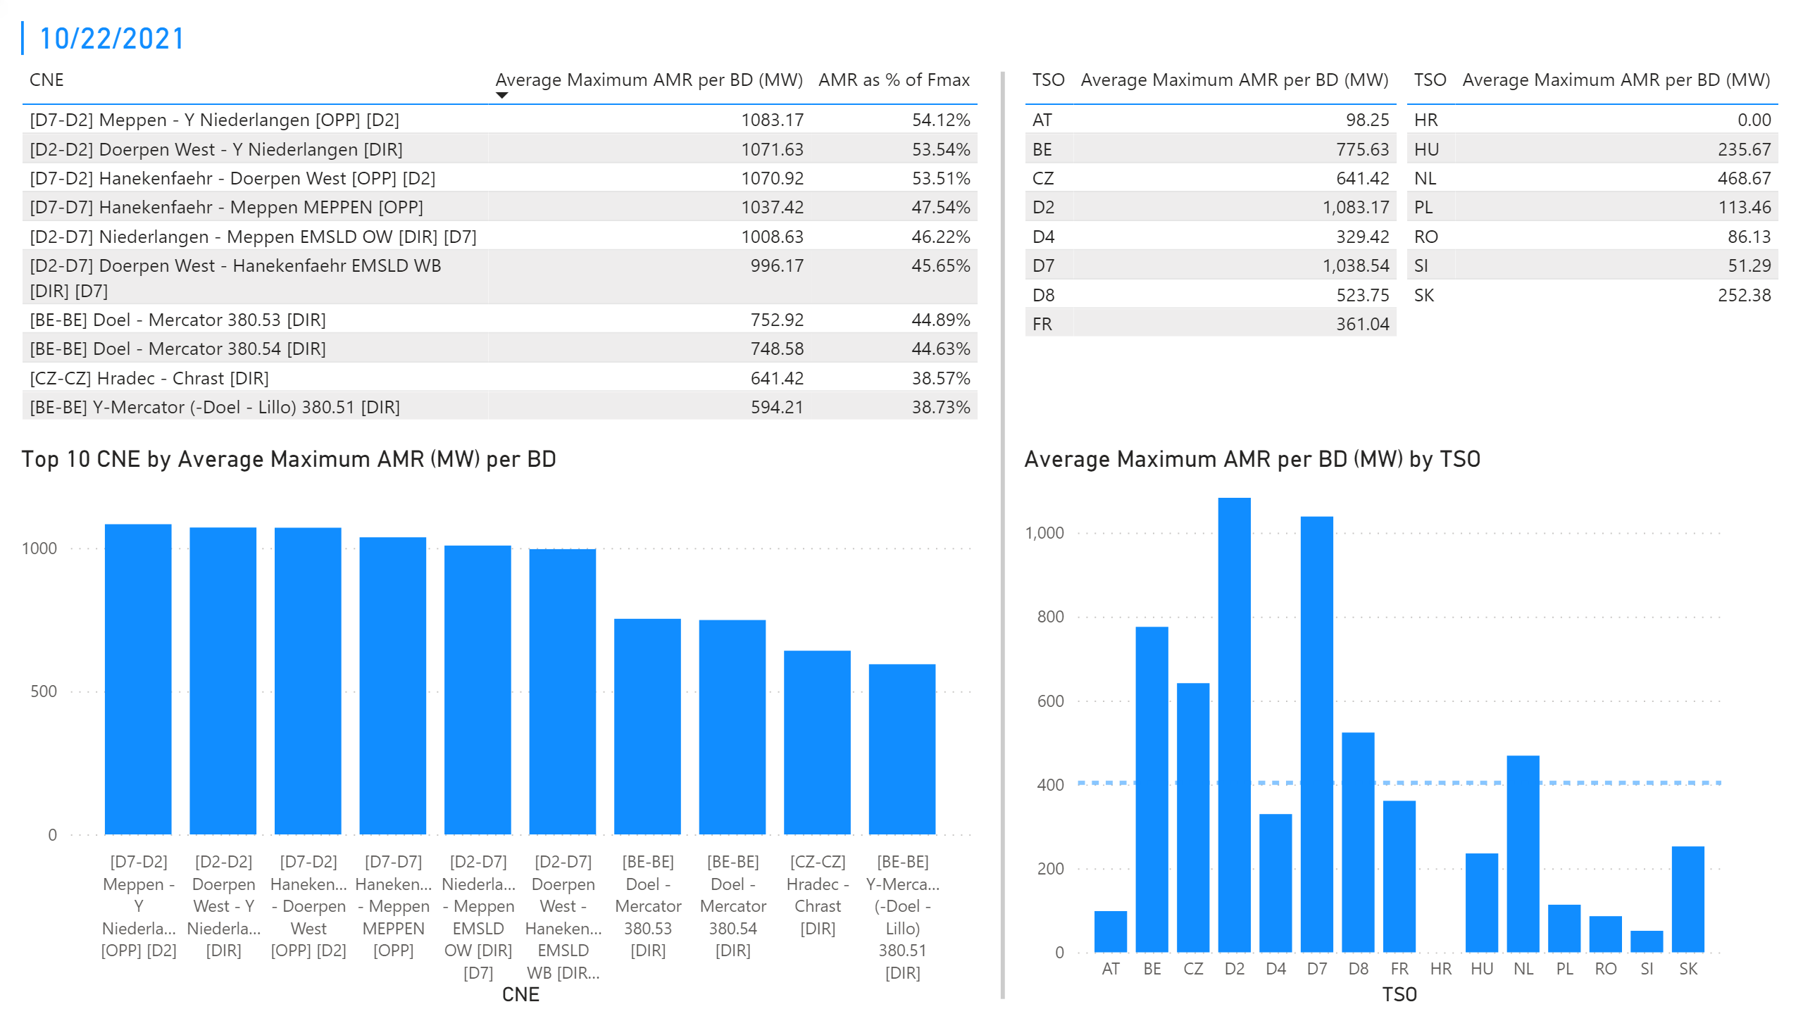
KPI 1 +2_22
KPI 1: Average maximum AMR per CNE per BD
KPI 2: Average maximum AMR per CNE per TSO
Notes:
tableEx
No alt text provided.
Top 10 CNE by Average Maximum AMR (MW) per BD
No alt text provided.
multiRowCard
No alt text provided.
tableEx
No alt text provided.
Average Maximum AMR per BD (MW) by TSO
No alt text provided.
tableEx
No alt text provided.
basicShape
No alt text provided.

Slide 28
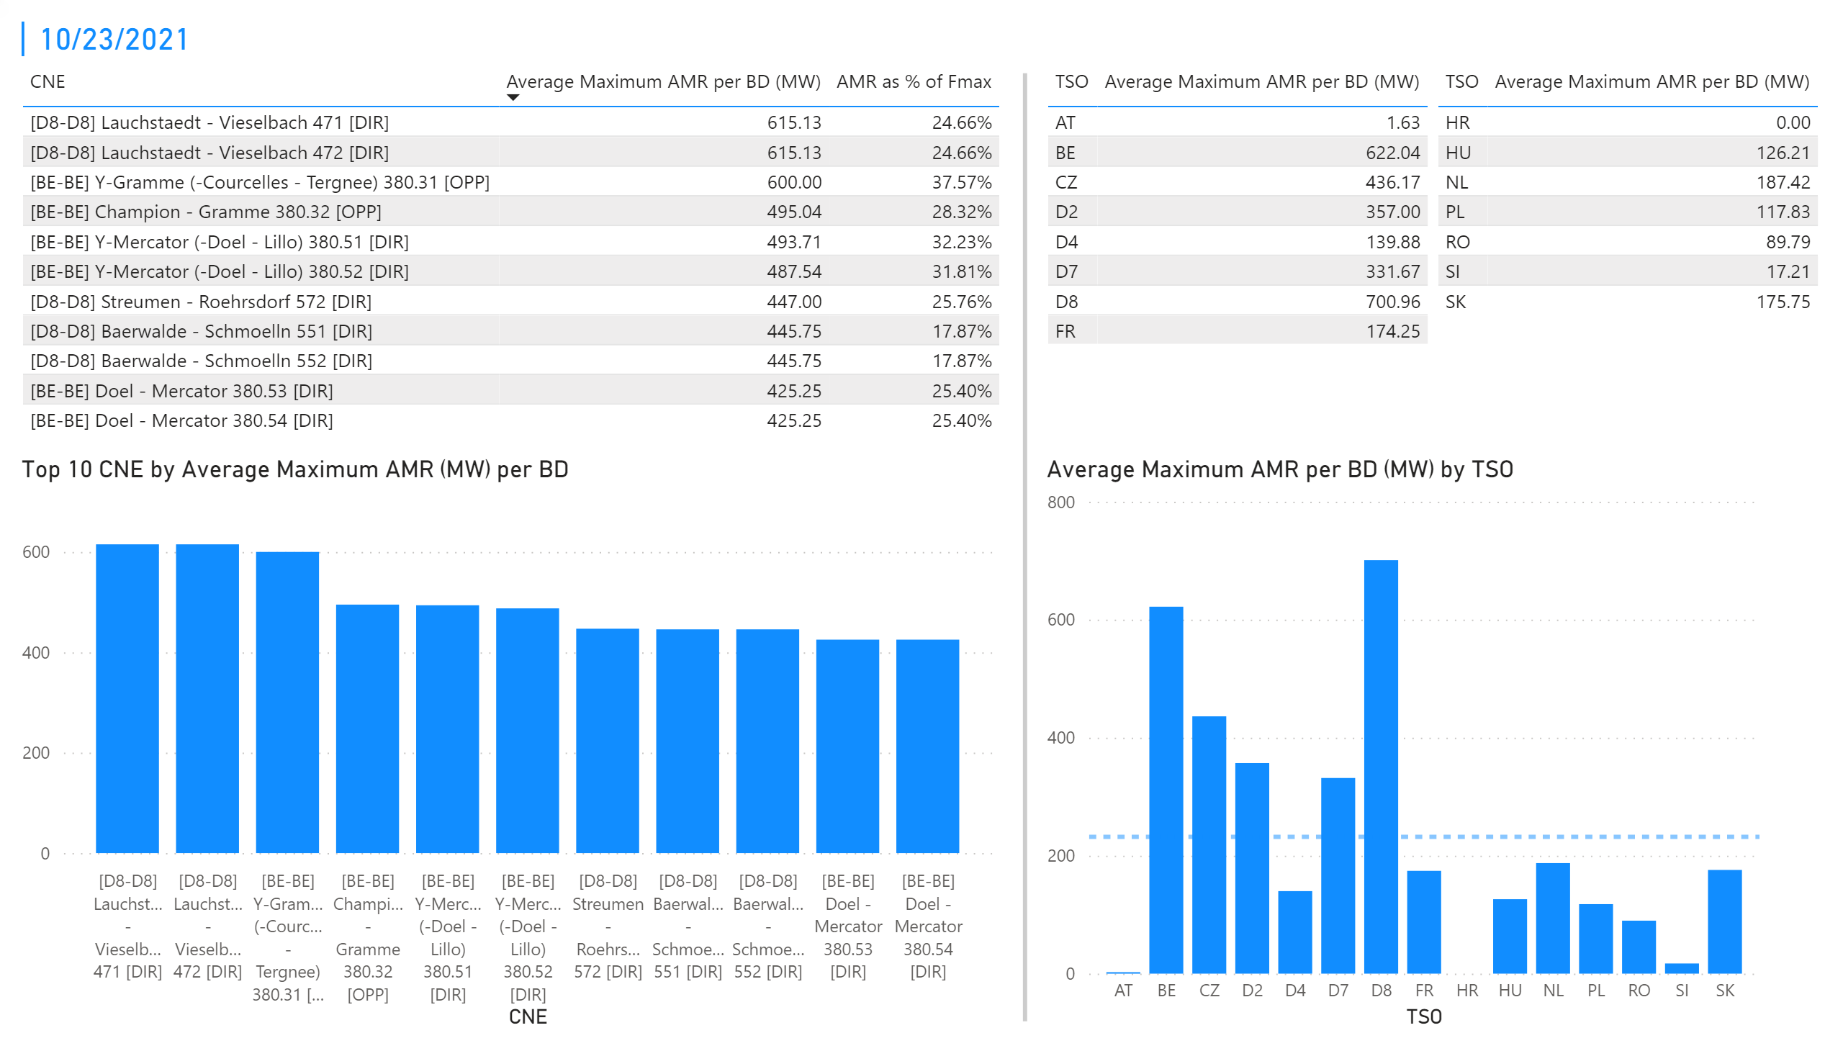
KPI 1 +2_23
KPI 1: Average maximum AMR per CNE per BD
KPI 2: Average maximum AMR per CNE per TSO
Notes:
tableEx
No alt text provided.
Top 10 CNE by Average Maximum AMR (MW) per BD
No alt text provided.
multiRowCard
No alt text provided.
tableEx
No alt text provided.
Average Maximum AMR per BD (MW) by TSO
No alt text provided.
tableEx
No alt text provided.
basicShape
No alt text provided.

Slide 29
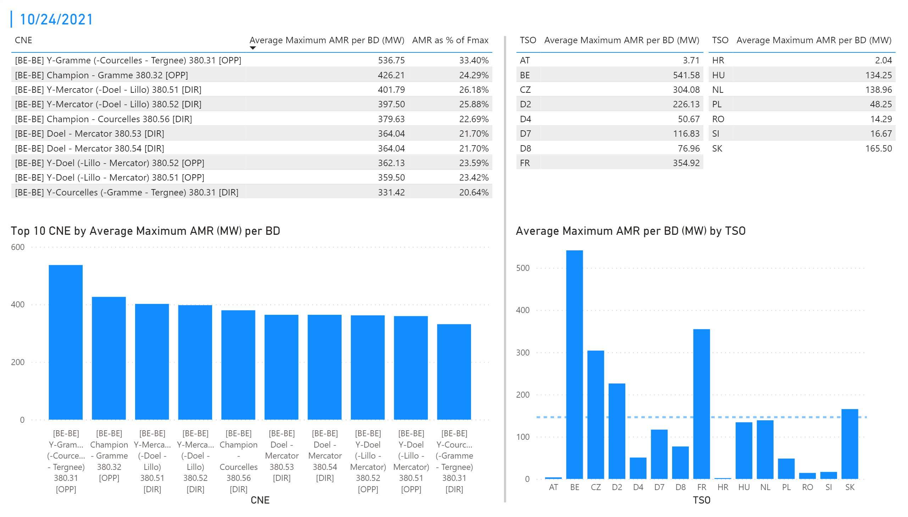
KPI 1 +2_24
KPI 1: Average maximum AMR per CNE per BD
KPI 2: Average maximum AMR per CNE per TSO
Notes:
tableEx
No alt text provided.
Top 10 CNE by Average Maximum AMR (MW) per BD
No alt text provided.
multiRowCard
No alt text provided.
tableEx
No alt text provided.
Average Maximum AMR per BD (MW) by TSO
No alt text provided.
tableEx
No alt text provided.
basicShape
No alt text provided.

Slide 30
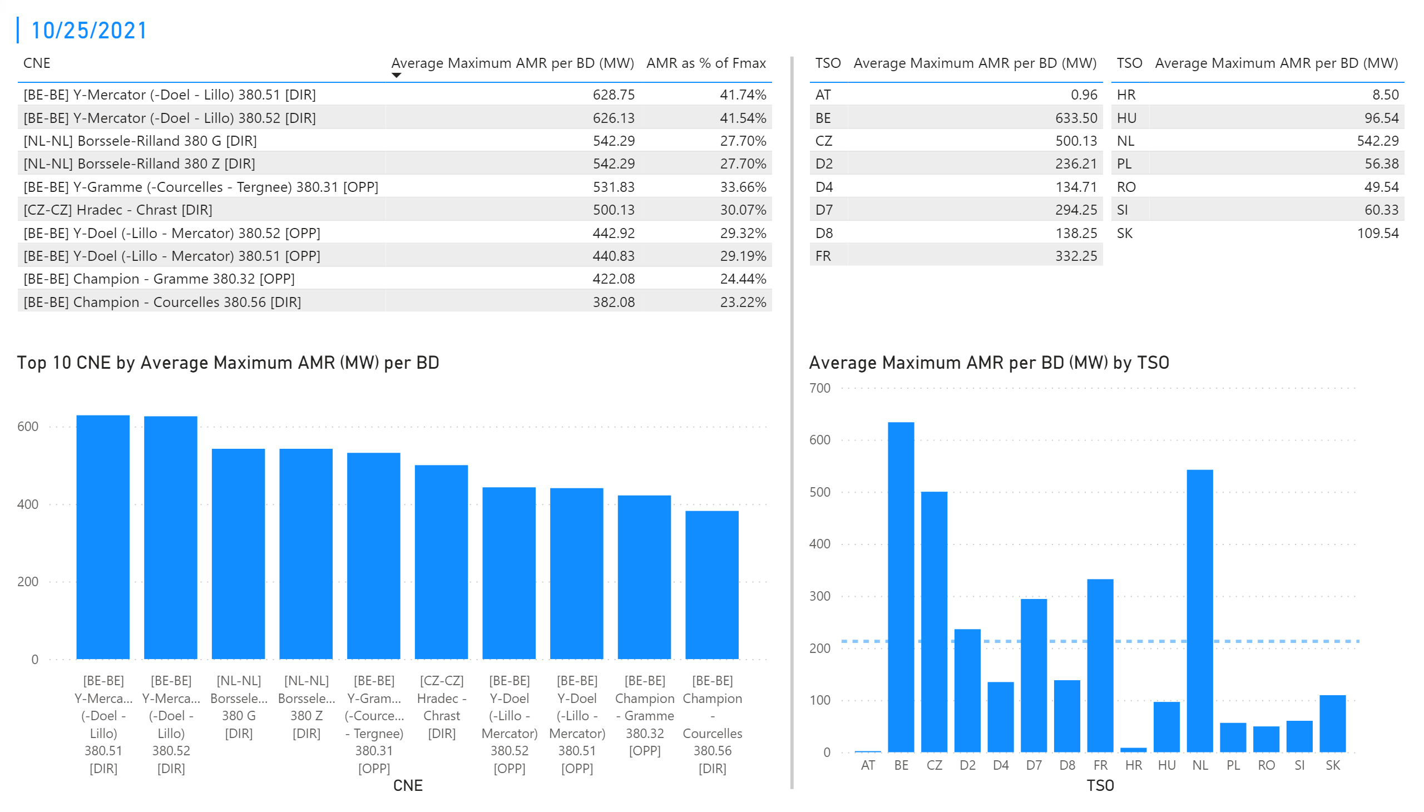
KPI 1 +2_25
KPI 1: Average maximum AMR per CNE per BD
KPI 2: Average maximum AMR per CNE per TSO
Notes:
tableEx
No alt text provided.
Top 10 CNE by Average Maximum AMR (MW) per BD
No alt text provided.
multiRowCard
No alt text provided.
tableEx
No alt text provided.
Average Maximum AMR per BD (MW) by TSO
No alt text provided.
tableEx
No alt text provided.
basicShape
No alt text provided.

Slide 31
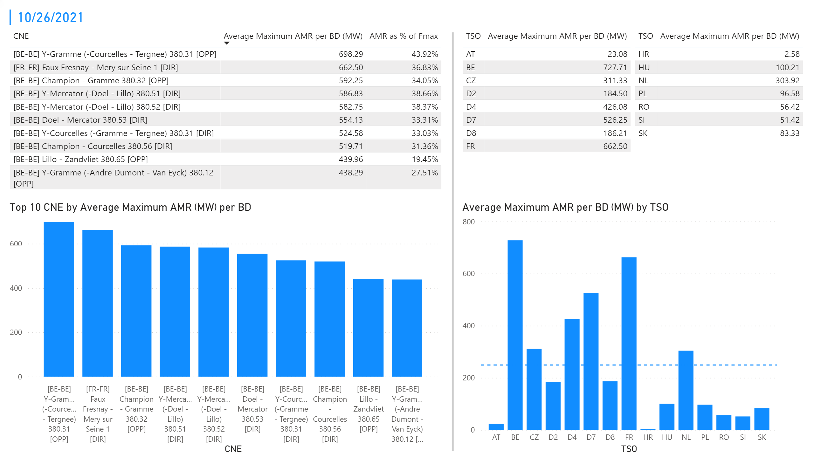
KPI 1 +2_26
KPI 1: Average maximum AMR per CNE per BD
KPI 2: Average maximum AMR per CNE per TSO
Notes:
tableEx
No alt text provided.
Top 10 CNE by Average Maximum AMR (MW) per BD
No alt text provided.
multiRowCard
No alt text provided.
tableEx
No alt text provided.
Average Maximum AMR per BD (MW) by TSO
No alt text provided.
tableEx
No alt text provided.
basicShape
No alt text provided.

Slide 32
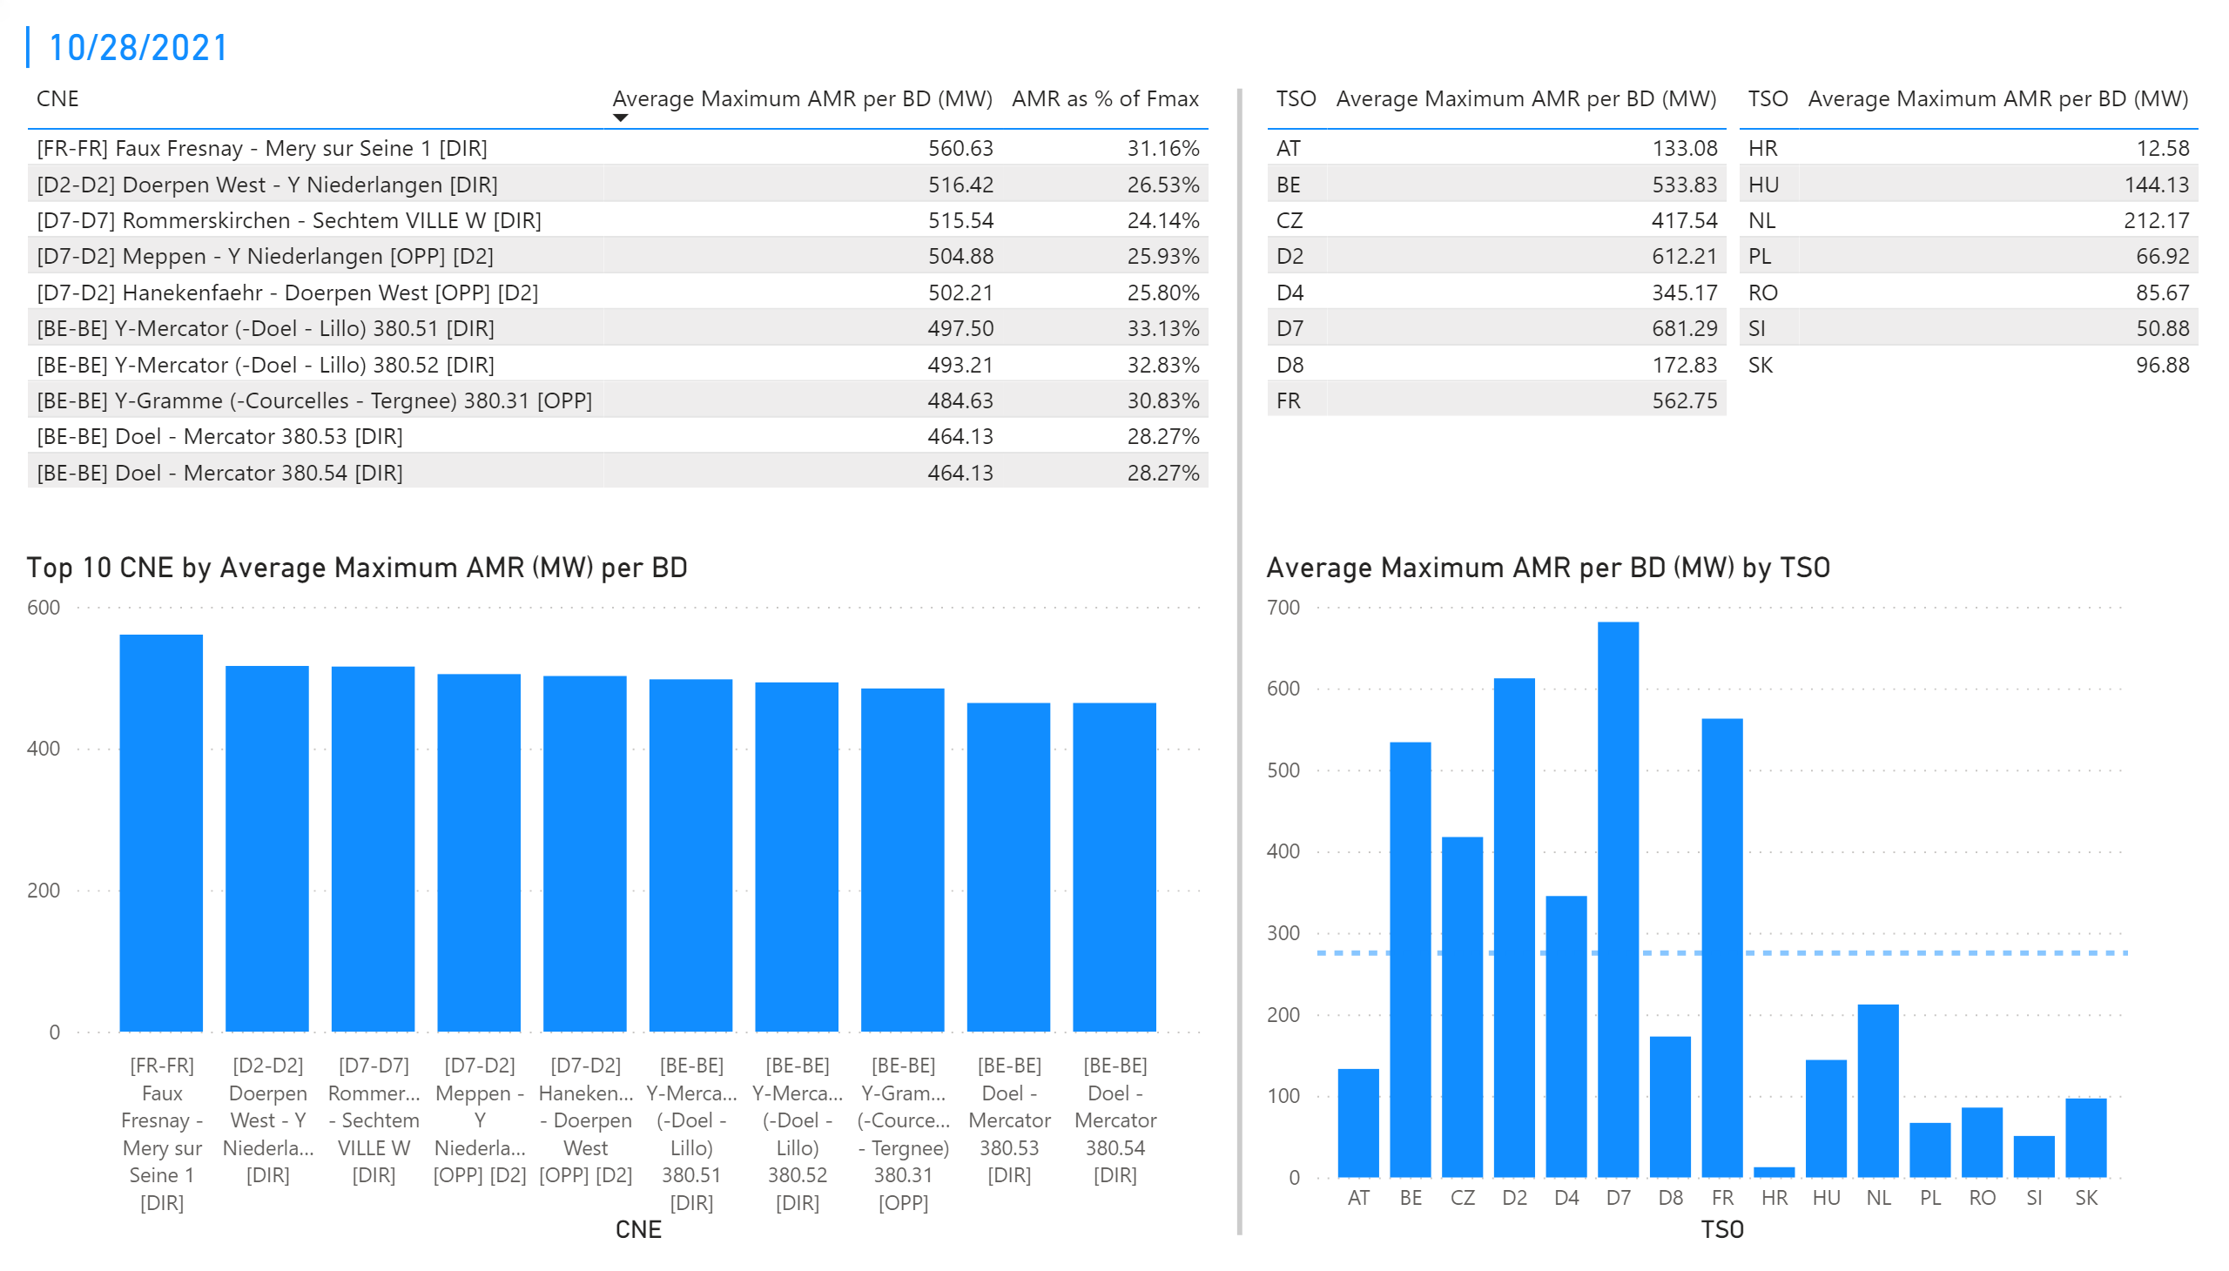
KPI 1 +2_28
KPI 1: Average maximum AMR per CNE per BD
KPI 2: Average maximum AMR per CNE per TSO
Notes:
tableEx
No alt text provided.
Top 10 CNE by Average Maximum AMR (MW) per BD
No alt text provided.
multiRowCard
No alt text provided.
tableEx
No alt text provided.
Average Maximum AMR per BD (MW) by TSO
No alt text provided.
tableEx
No alt text provided.
basicShape
No alt text provided.

Slide 33
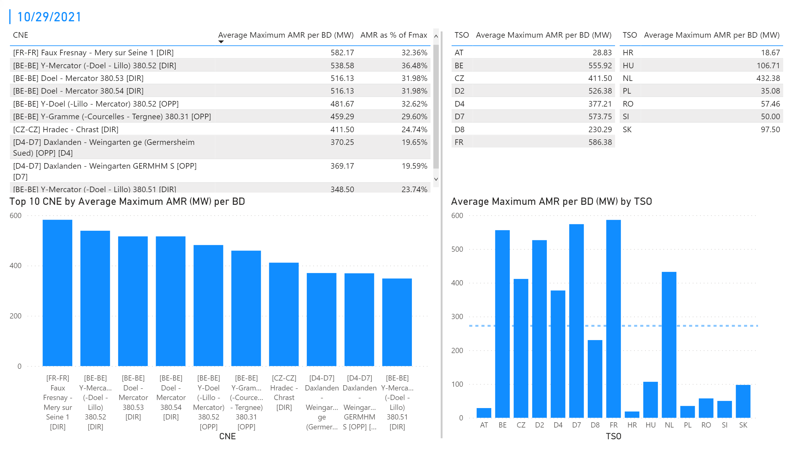
KPI 1 +2_29
KPI 1: Average maximum AMR per CNE per BD
KPI 2: Average maximum AMR per CNE per TSO
Notes:
tableEx
No alt text provided.
Top 10 CNE by Average Maximum AMR (MW) per BD
No alt text provided.
multiRowCard
No alt text provided.
tableEx
No alt text provided.
Average Maximum AMR per BD (MW) by TSO
No alt text provided.
tableEx
No alt text provided.
basicShape
No alt text provided.

Slide 34
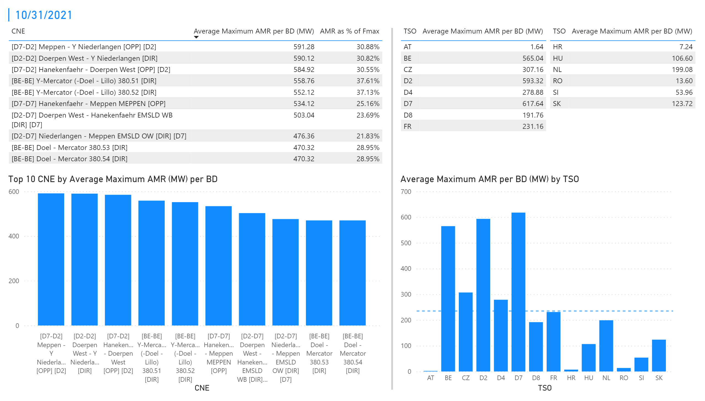
KPI 1 +2_31
KPI 1: Average maximum AMR per CNE per BD
KPI 2: Average maximum AMR per CNE per TSO
Notes:
tableEx
No alt text provided.
Top 10 CNE by Average Maximum AMR (MW) per BD
No alt text provided.
multiRowCard
No alt text provided.
tableEx
No alt text provided.
Average Maximum AMR per BD (MW) by TSO
No alt text provided.
tableEx
No alt text provided.
basicShape
No alt text provided.

Slide 35
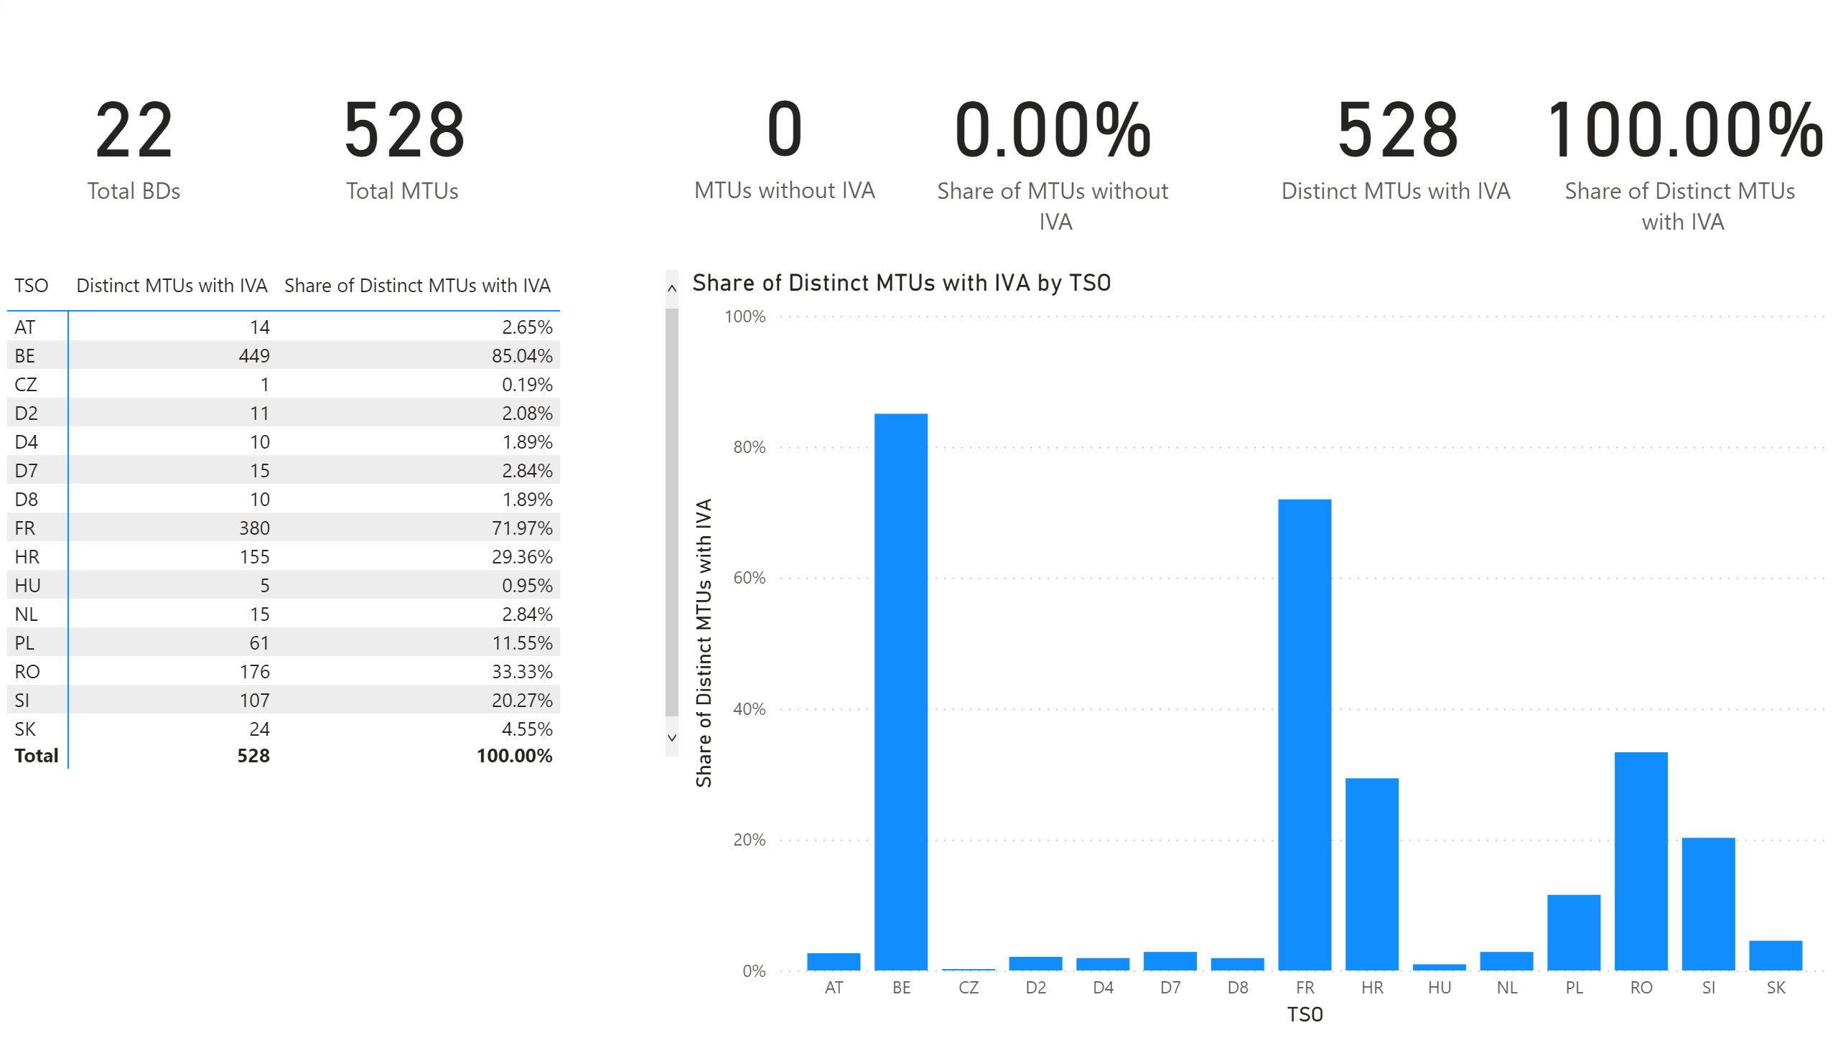
KPI 5
KPI 5: Share of MTUs with intervention per TSO
Notes:
pivotTable
No alt text provided.
clusteredColumnChart
No alt text provided.
card
No alt text provided.
card
No alt text provided.
card
No alt text provided.
card
No alt text provided.
card
No alt text provided.
card
No alt text provided.

Slide 36
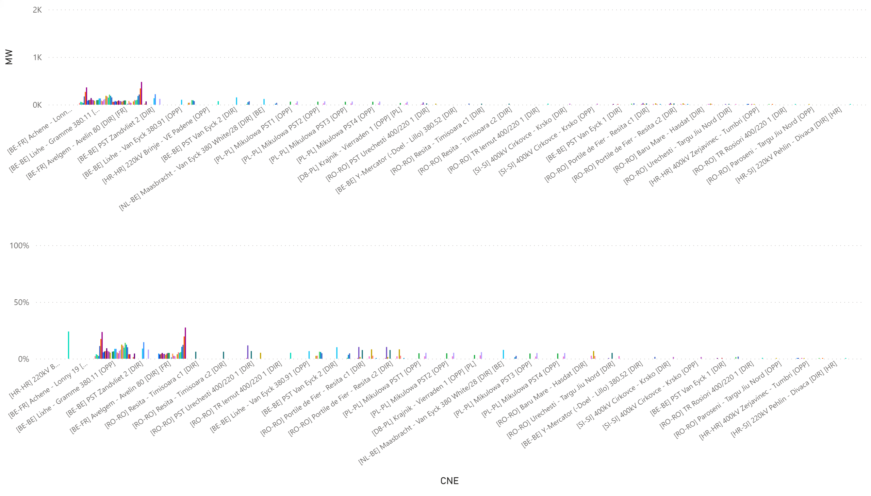
KPI6_1001
KPI 6: Total IVA applied per MTU for each CNE affected by TSO intervention
BD: 20211001 (top: in MW, bottom: in % of Fmax)
Notes:
clusteredColumnChart
No alt text provided.
clusteredColumnChart
No alt text provided.

Slide 37
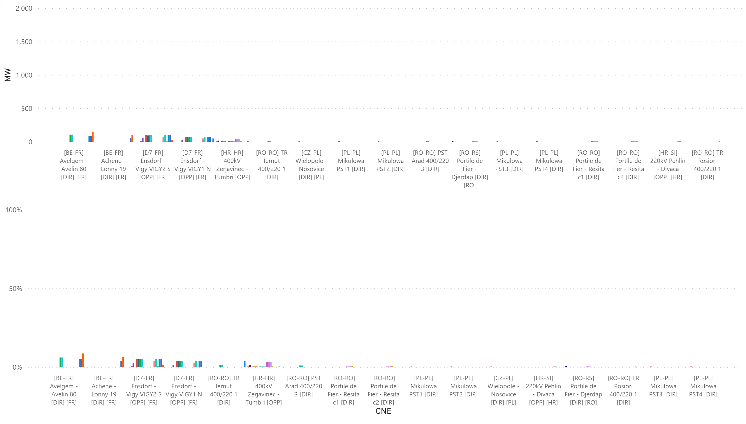
KPI6_1002
KPI 6: Total IVA applied per MTU for each CNE affected by TSO intervention
BD: 20211002 (top: in MW, bottom: in % of Fmax)
Notes:
clusteredColumnChart
No alt text provided.
clusteredColumnChart
No alt text provided.

Slide 38
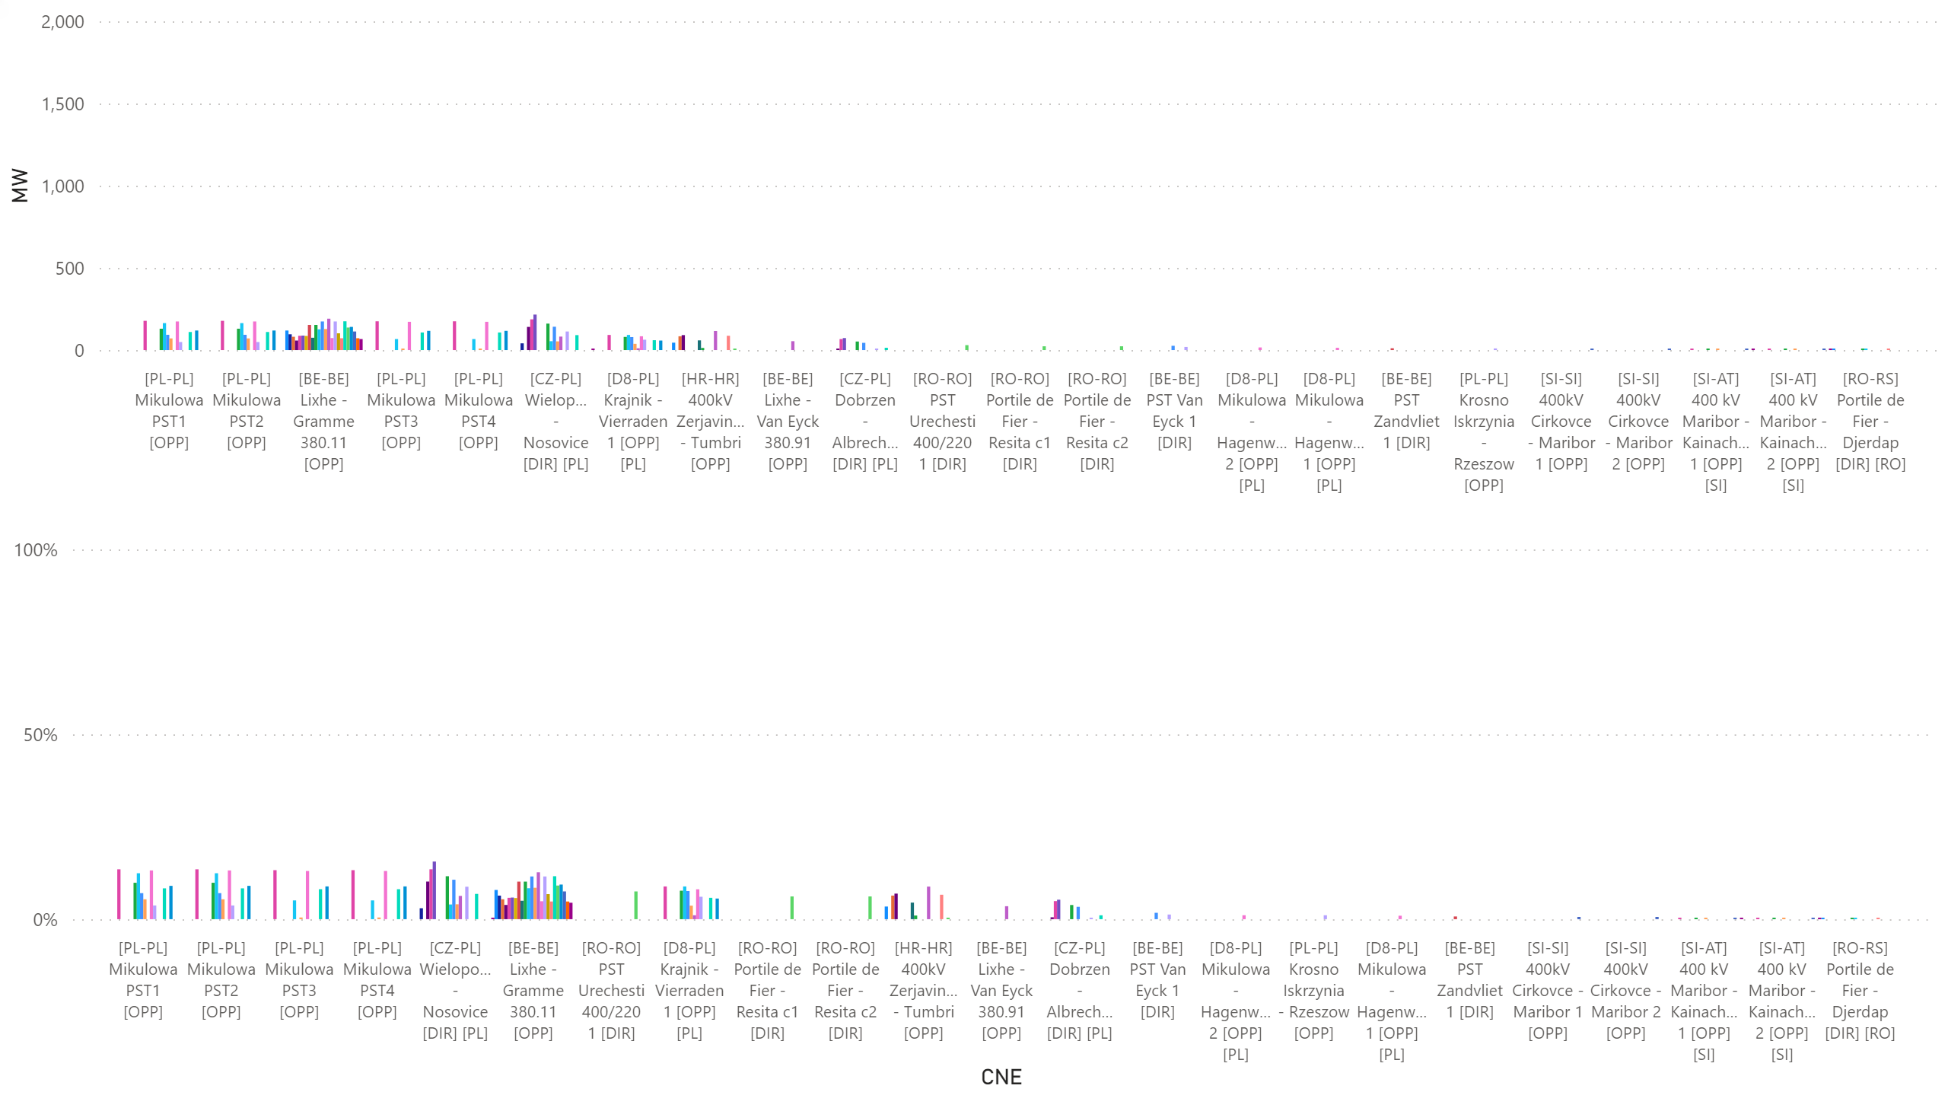
KPI6_1003
KPI 6: Total IVA applied per MTU for each CNE affected by TSO intervention
BD: 20211003 (top: in MW, bottom: in % of Fmax)
Notes:
clusteredColumnChart
No alt text provided.
clusteredColumnChart
No alt text provided.

Slide 39
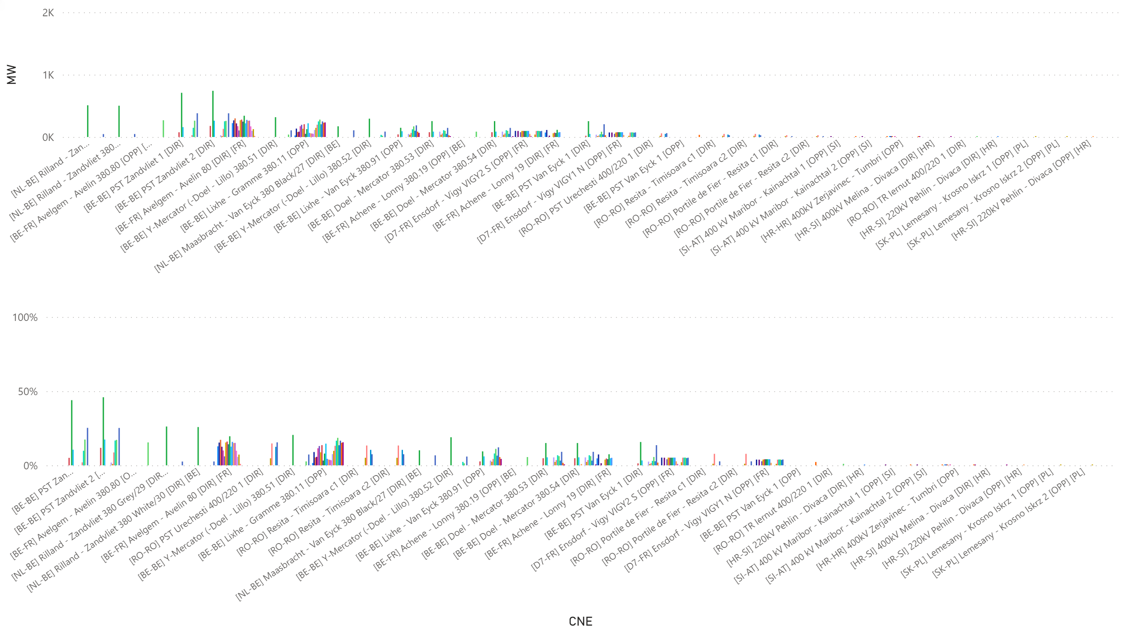
KPI6_1004
KPI 6: Total IVA applied per MTU for each CNE affected by TSO intervention
BD: 20211004 (top: in MW, bottom: in % of Fmax)
Notes:
clusteredColumnChart
No alt text provided.
clusteredColumnChart
No alt text provided.

Slide 40
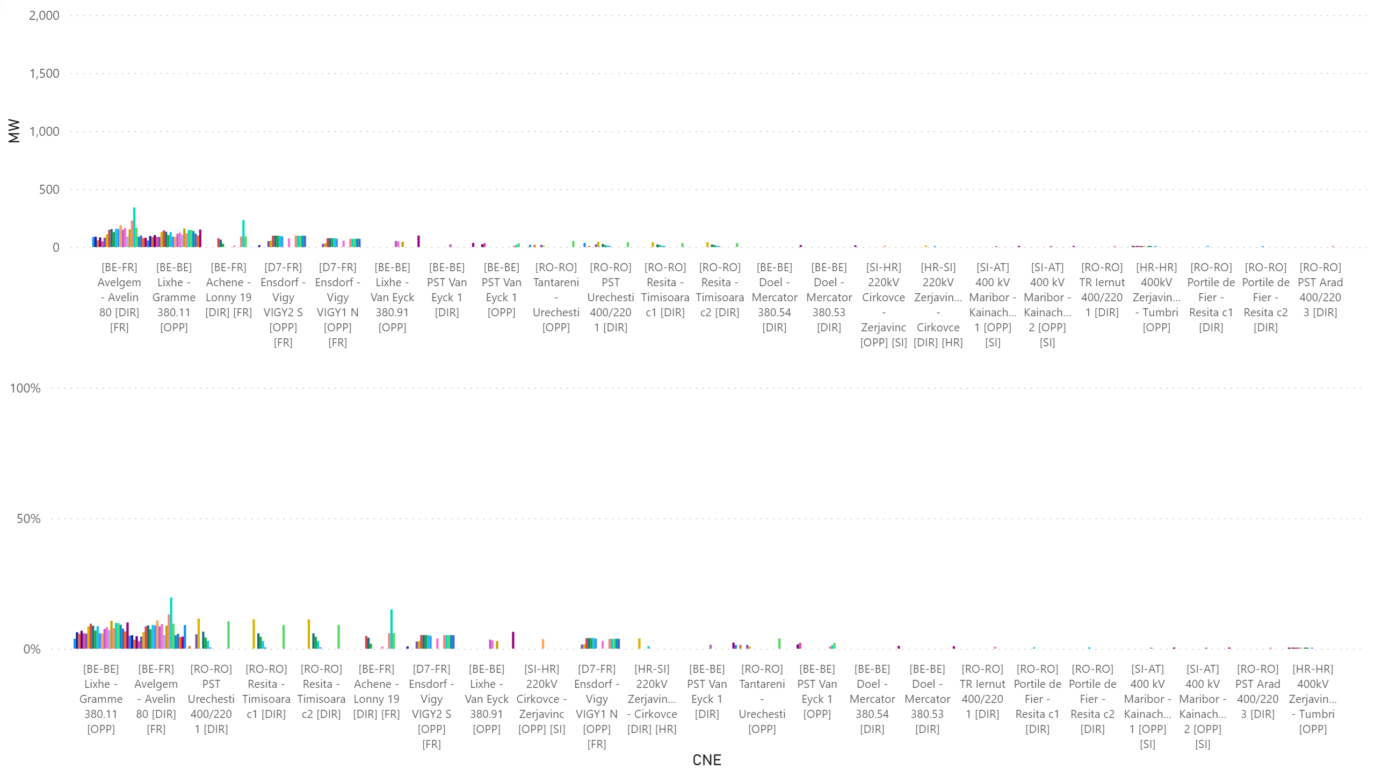
KPI6_1005
KPI 6: Total IVA applied per MTU for each CNE affected by TSO intervention
BD: 20211005 (top: in MW, bottom: in % of Fmax)
Notes:
clusteredColumnChart
No alt text provided.
clusteredColumnChart
No alt text provided.

Slide 41
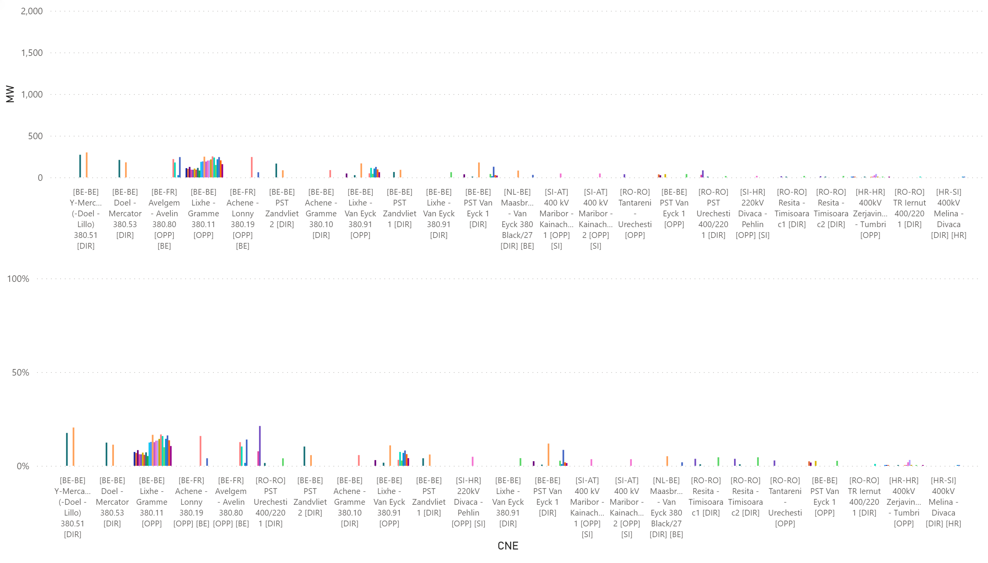
KPI6_1006
KPI 6: Total IVA applied per MTU for each CNE affected by TSO intervention
BD: 20211006 (top: in MW, bottom: in % of Fmax)
Notes:
clusteredColumnChart
No alt text provided.
clusteredColumnChart
No alt text provided.

Slide 42
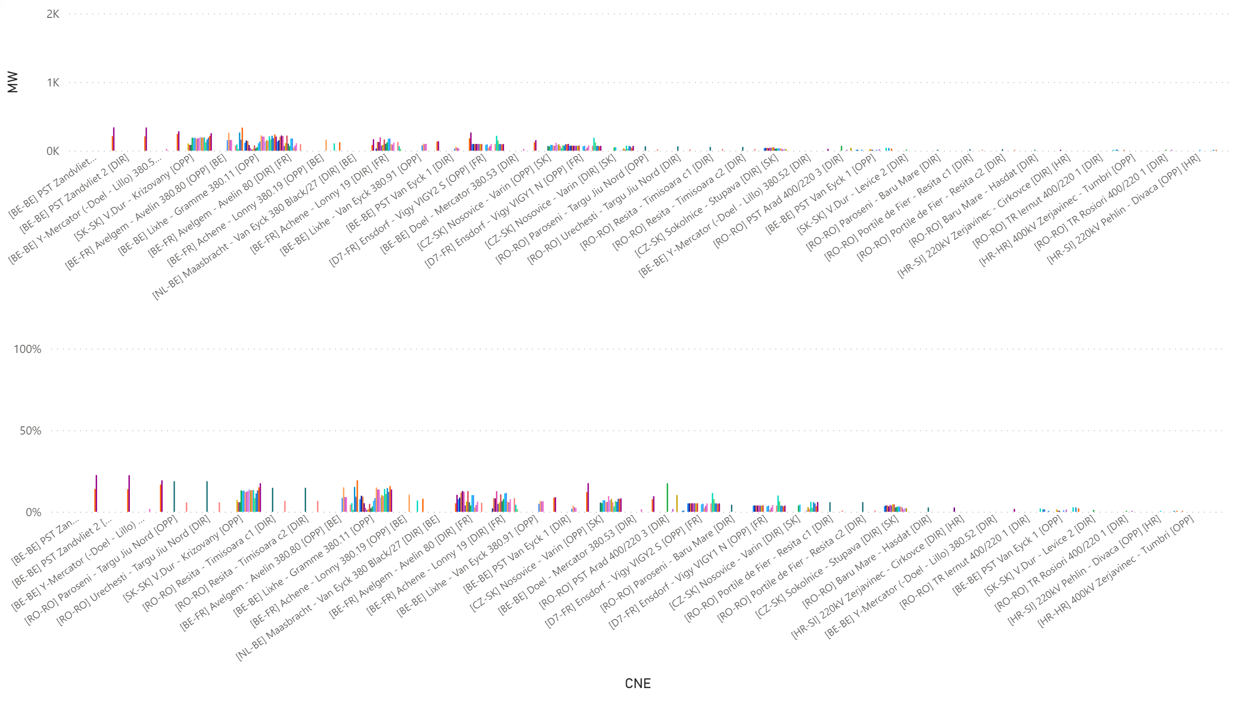
KPI6_1007
KPI 6: Total IVA applied per MTU for each CNE affected by TSO intervention
BD: 20211007 (top: in MW, bottom: in % of Fmax)
Notes:
clusteredColumnChart
No alt text provided.
clusteredColumnChart
No alt text provided.

Slide 43
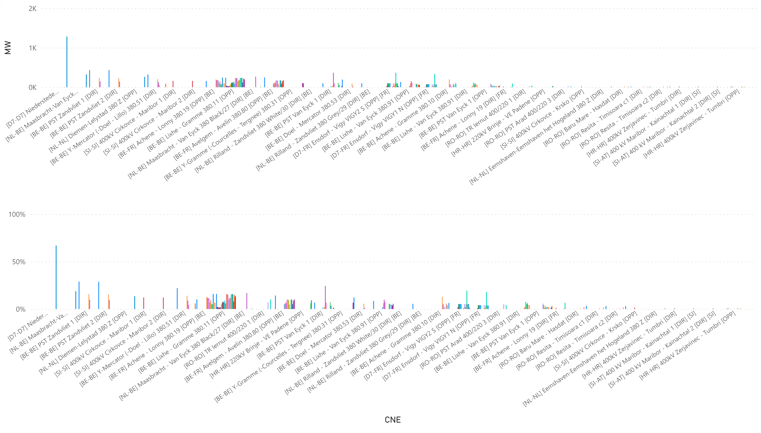
KPI6_1008
KPI 6: Total IVA applied per MTU for each CNE affected by TSO intervention
BD: 20211008 (top: in MW, bottom: in % of Fmax)
Notes:
clusteredColumnChart
No alt text provided.
clusteredColumnChart
No alt text provided.

Slide 44
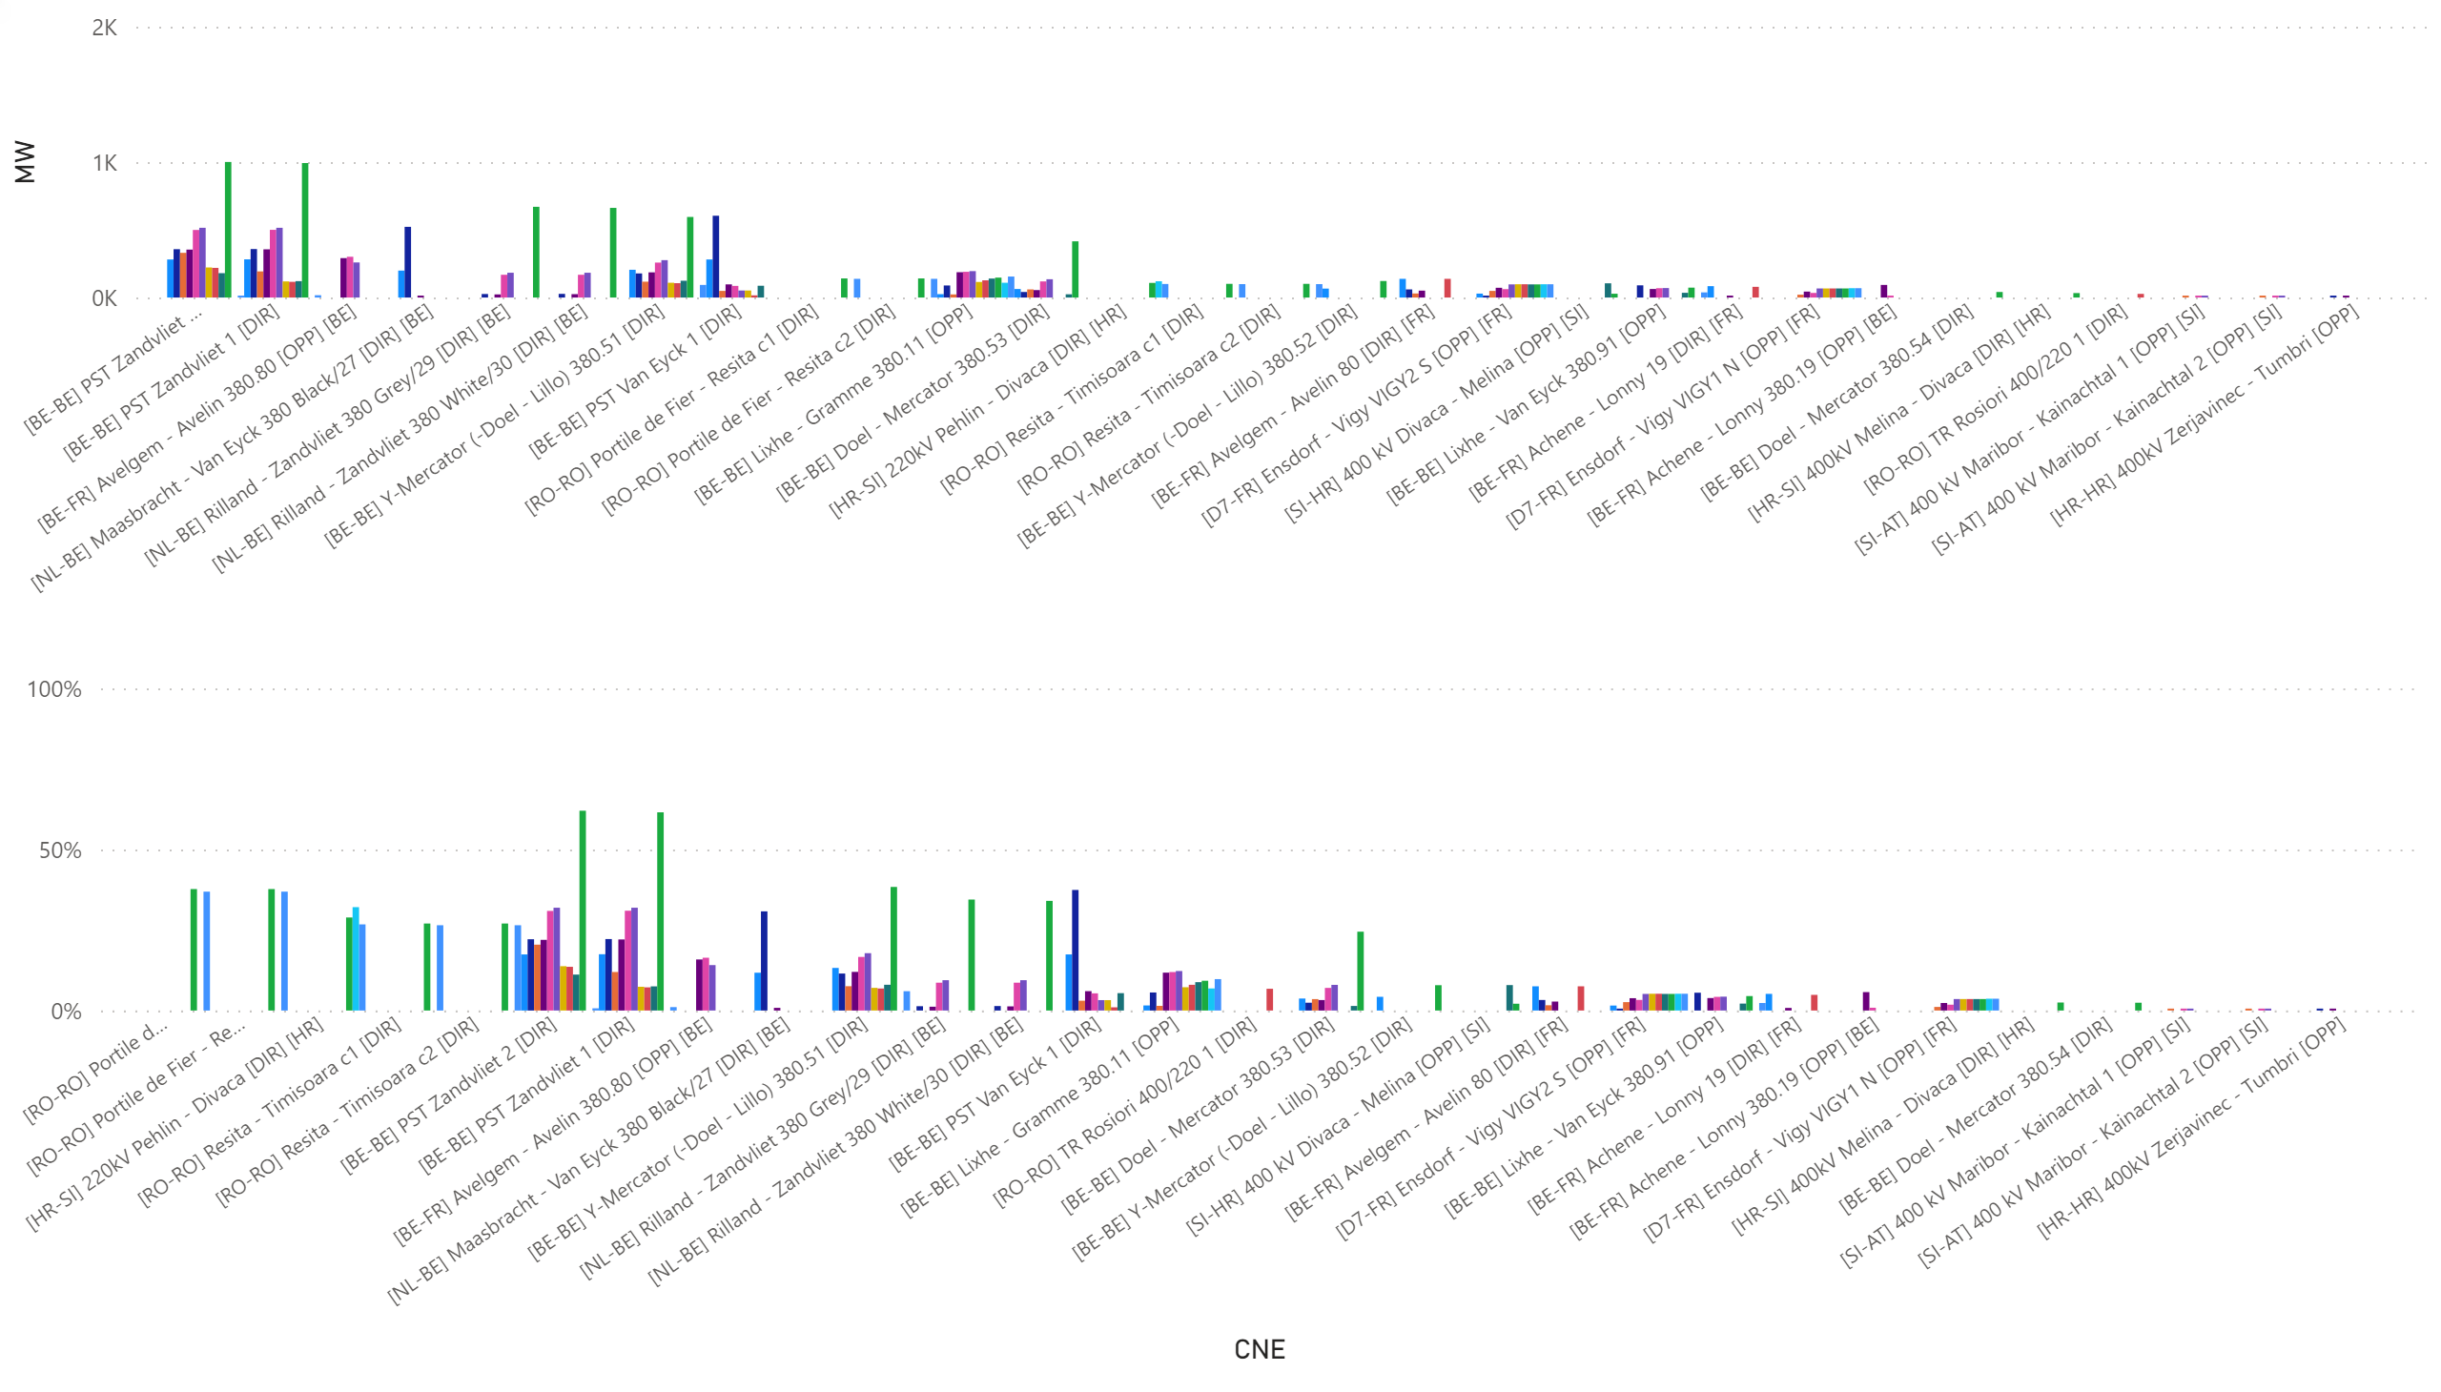
KPI6_1013_0-11
KPI 6: Total IVA applied per MTU for each CNE affected by TSO intervention
BD: 20211013_0-11 (top: in MW, bottom: in % of Fmax)
Notes:
clusteredColumnChart
No alt text provided.
clusteredColumnChart
No alt text provided.

Slide 45
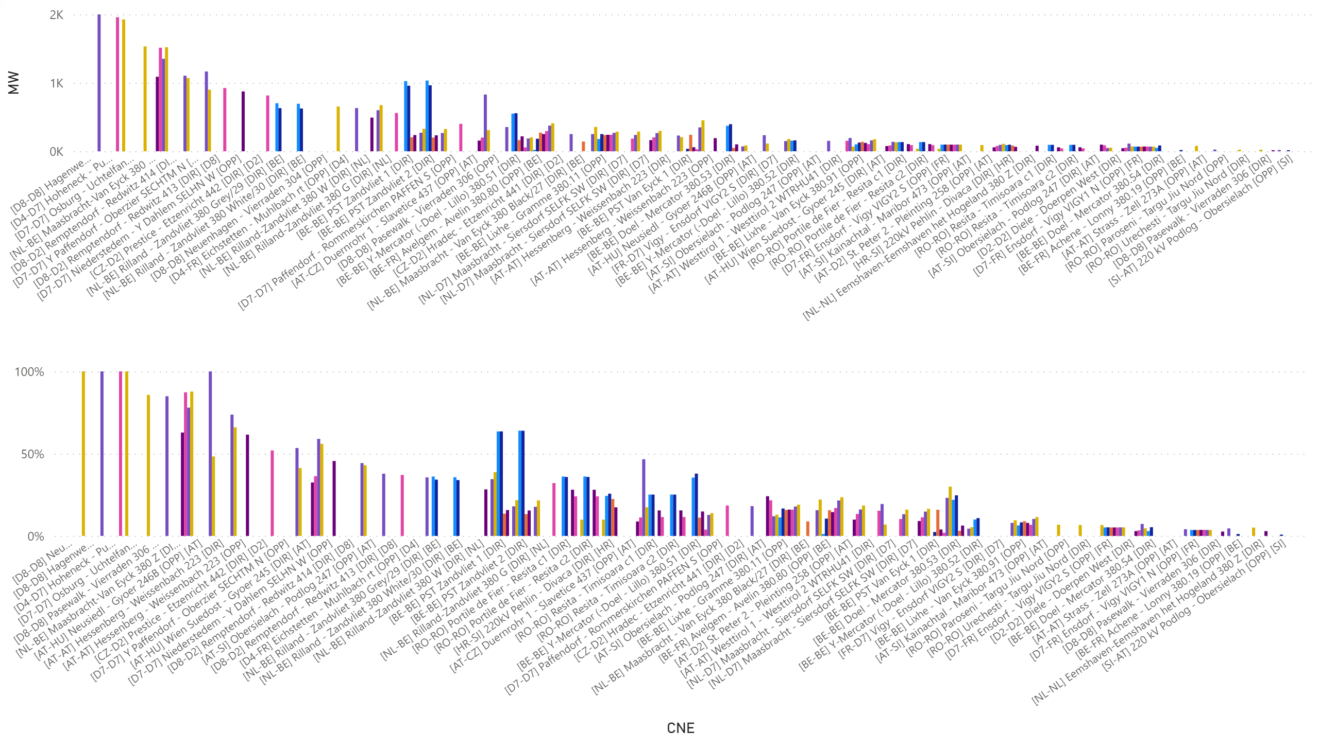
KPI6_1013_12-18
KPI 6: Total IVA applied per MTU for each CNE affected by TSO intervention
BD: 20211013_12-18 (top: in MW, bottom: in % of Fmax)
Notes:
clusteredColumnChart
No alt text provided.
clusteredColumnChart
No alt text provided.

Slide 46
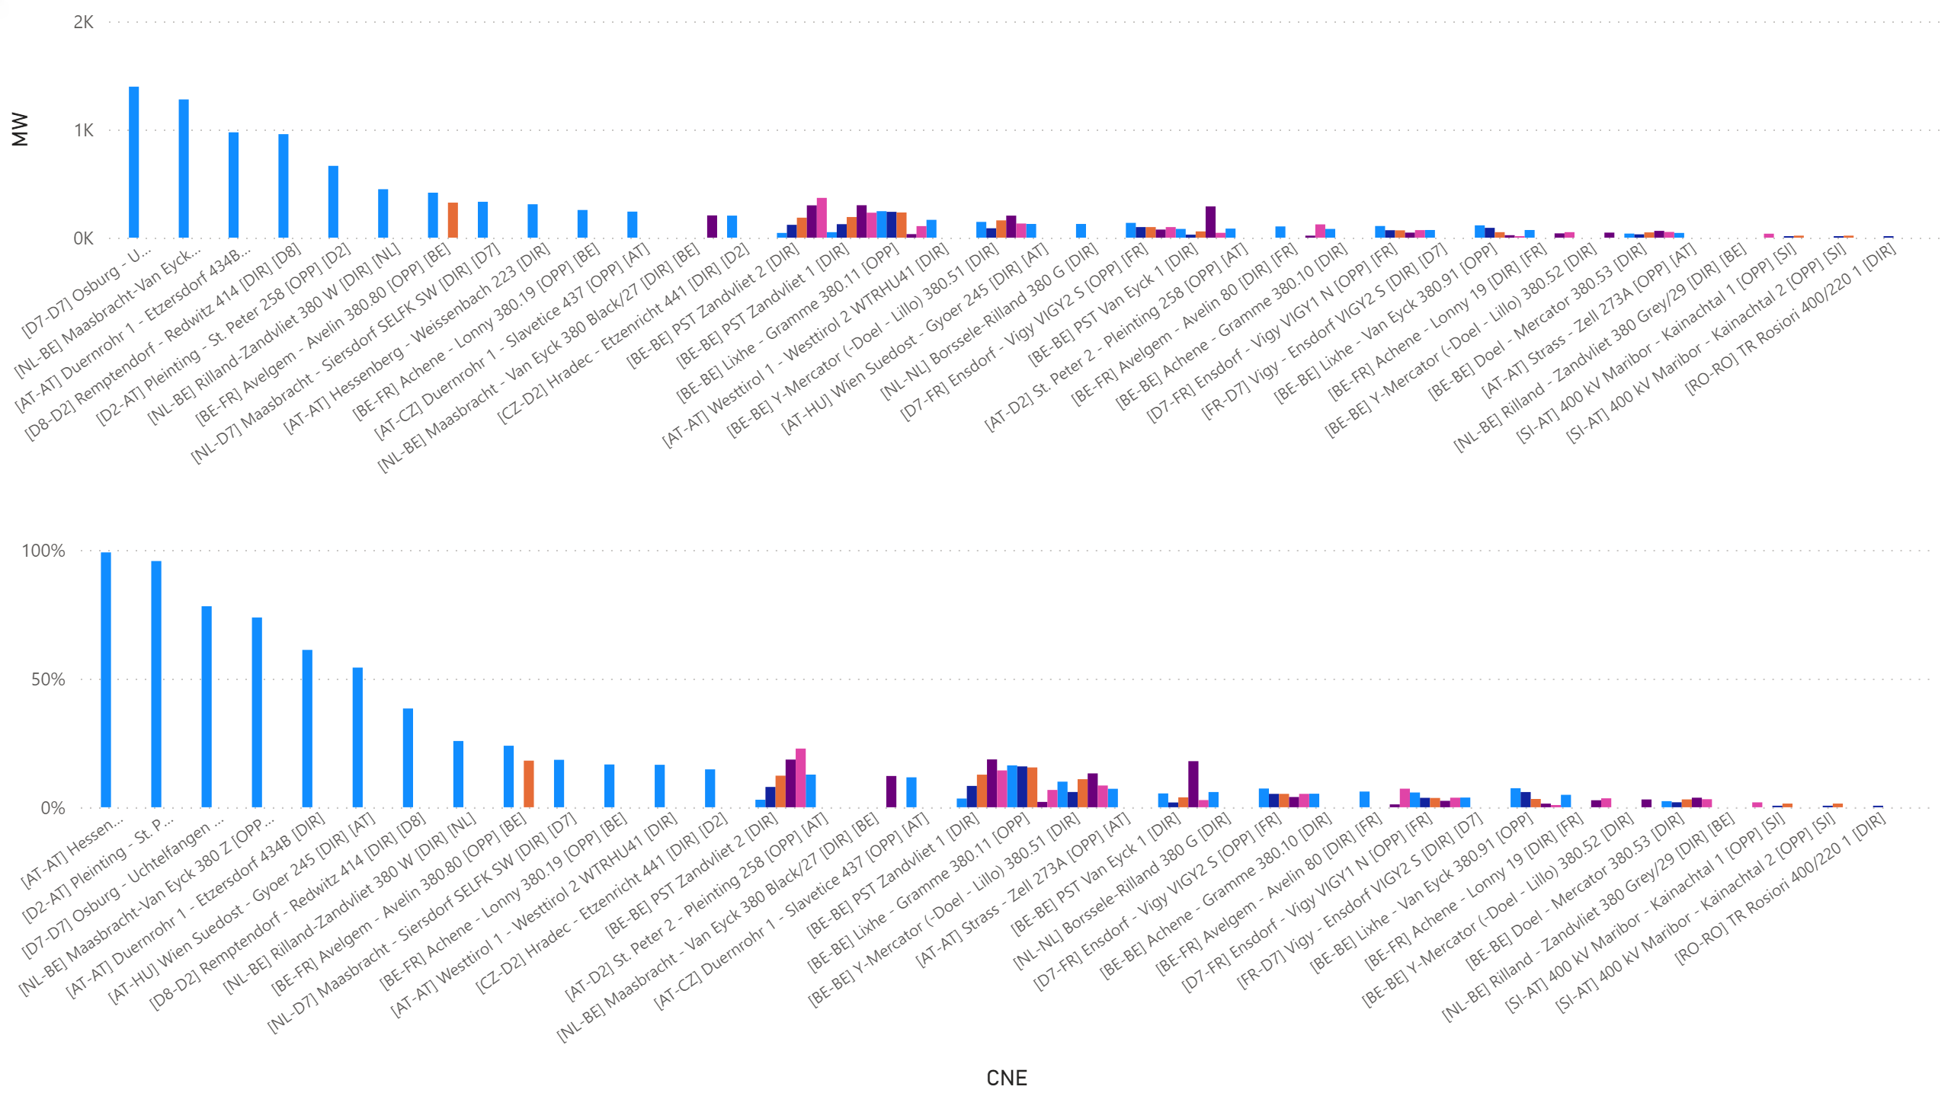
KPI6_1013_19-23
KPI 6: Total IVA applied per MTU for each CNE affected by TSO intervention
BD: 20211013_19-23 (top: in MW, bottom: in % of Fmax)
Notes:
clusteredColumnChart
No alt text provided.
clusteredColumnChart
No alt text provided.

Slide 47
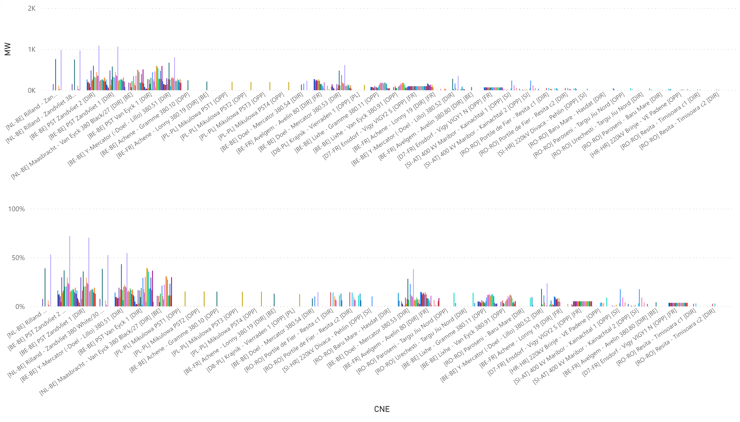
KPI6_1015
KPI 6: Total IVA applied per MTU for each CNE affected by TSO intervention
BD: 20211015 (top: in MW, bottom: in % of Fmax)
Notes:
clusteredColumnChart
No alt text provided.
clusteredColumnChart
No alt text provided.

Slide 48
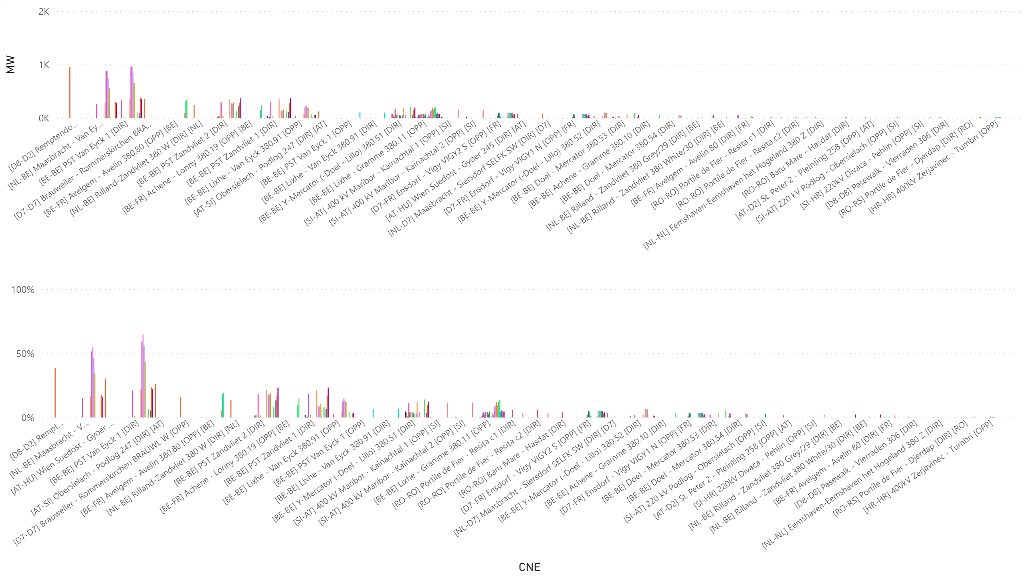
KPI6_1016
KPI 6: Total IVA applied per MTU for each CNE affected by TSO intervention
BD: 20211016 (top: in MW, bottom: in % of Fmax)
Notes:
clusteredColumnChart
No alt text provided.
clusteredColumnChart
No alt text provided.

Slide 49
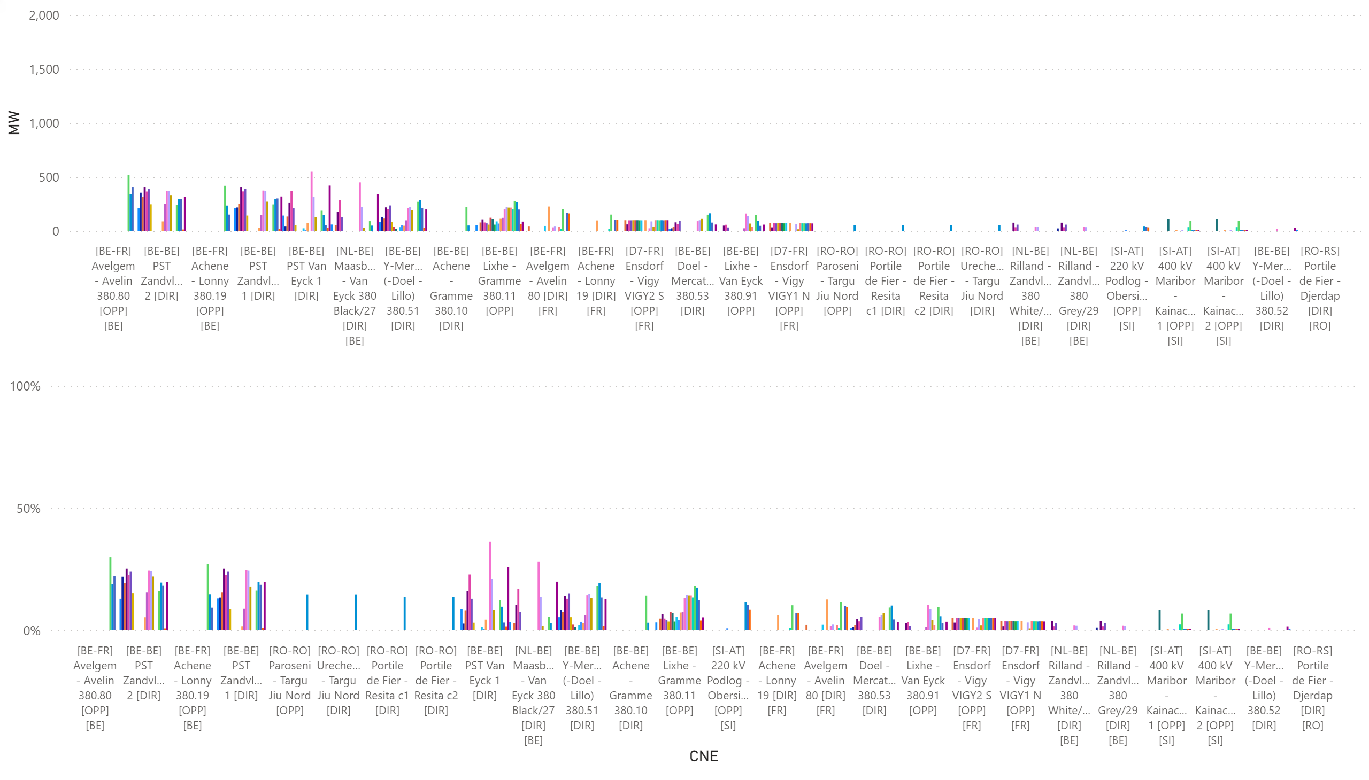
KPI6_1017
KPI 6: Total IVA applied per MTU for each CNE affected by TSO intervention
BD: 20211017 (top: in MW, bottom: in % of Fmax)
Notes:
clusteredColumnChart
No alt text provided.
clusteredColumnChart
No alt text provided.

Slide 50
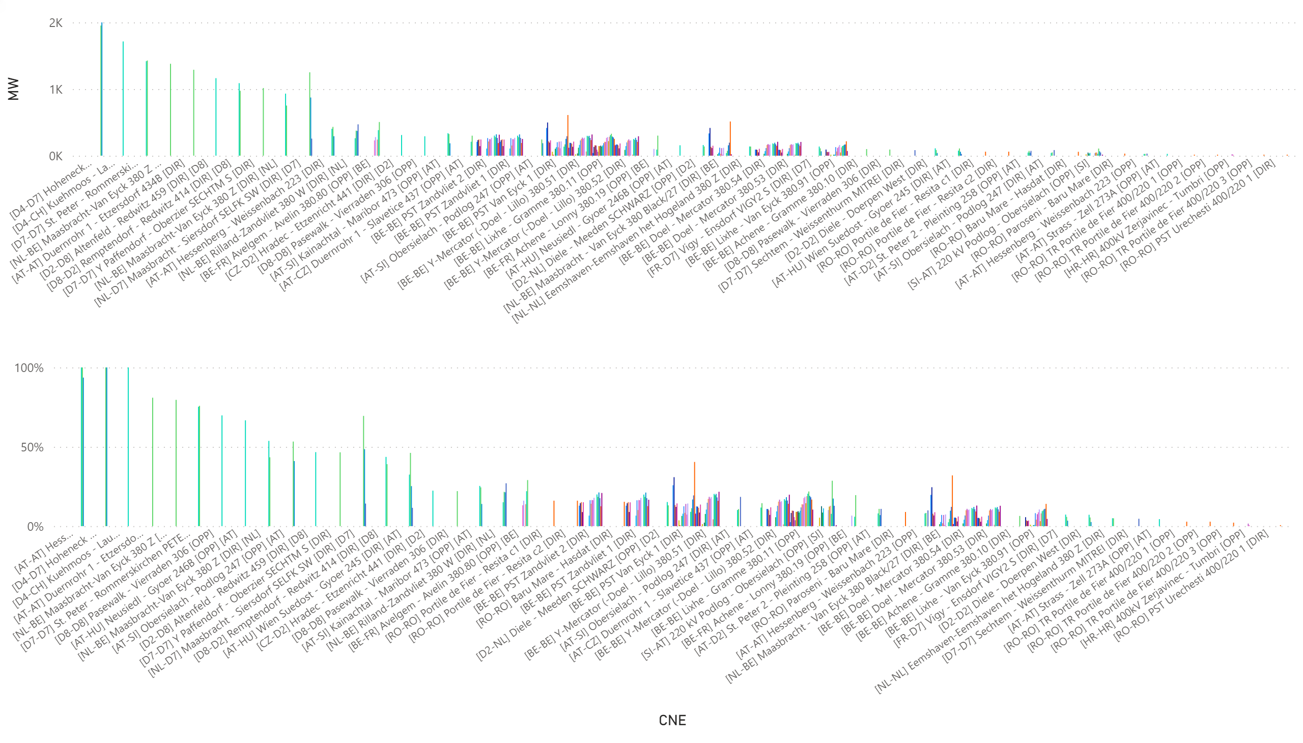
KPI6_1018
KPI 6: Total IVA applied per MTU for each CNE affected by TSO intervention
BD: 20211018 (top: in MW, bottom: in % of Fmax)
Notes:
clusteredColumnChart
No alt text provided.
clusteredColumnChart
No alt text provided.

Slide 51
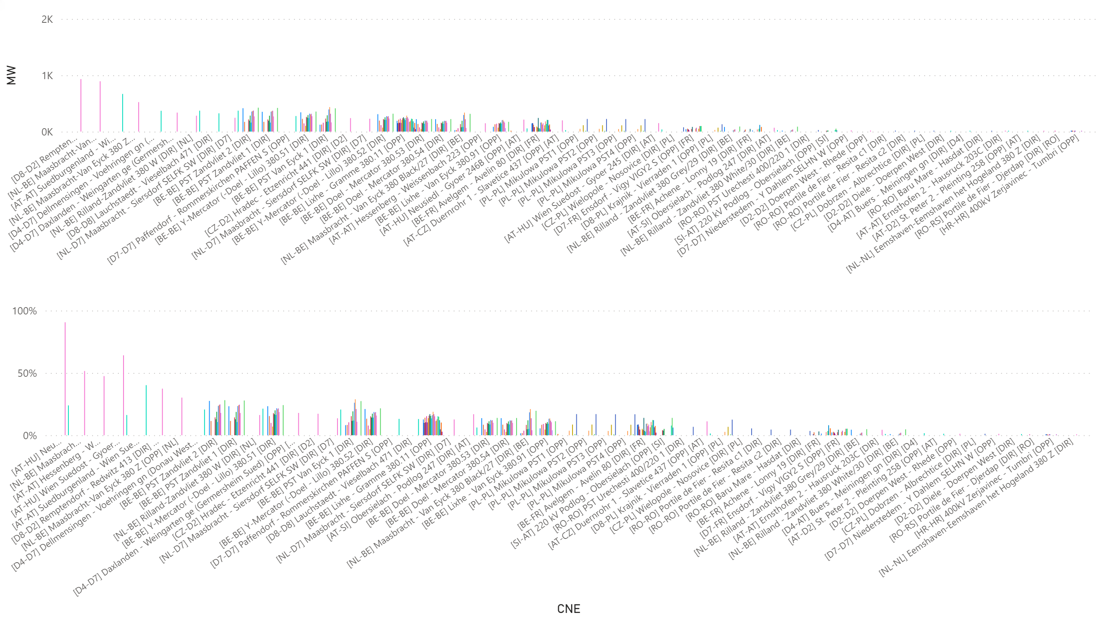
KPI6_1019
KPI 6: Total IVA applied per MTU for each CNE affected by TSO intervention
BD: 20211019 (top: in MW, bottom: in % of Fmax)
Notes:
clusteredColumnChart
No alt text provided.
clusteredColumnChart
No alt text provided.

Slide 52
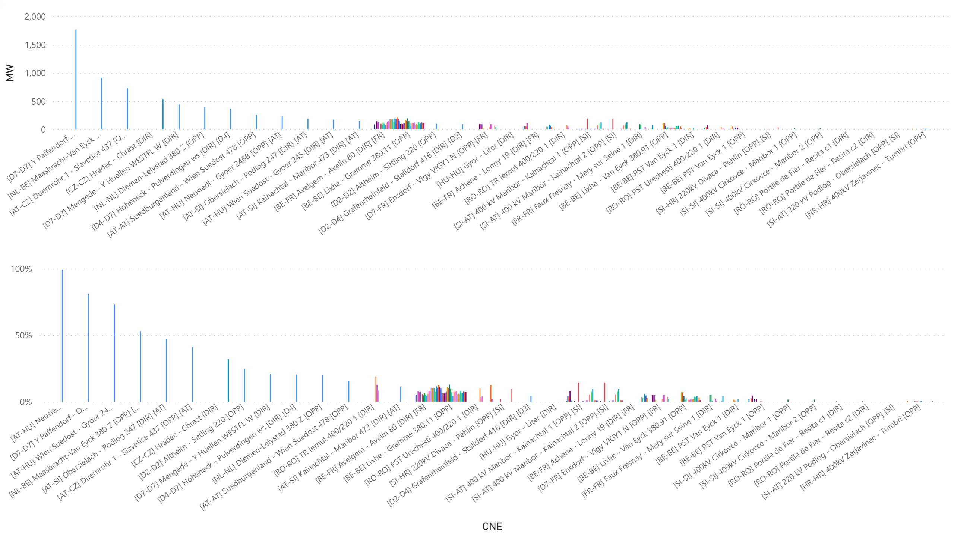
KPI6_1021
KPI 6: Total IVA applied per MTU for each CNE affected by TSO intervention
BD: 20211021 (top: in MW, bottom: in % of Fmax)
Notes:
clusteredColumnChart
No alt text provided.
clusteredColumnChart
No alt text provided.

Slide 53
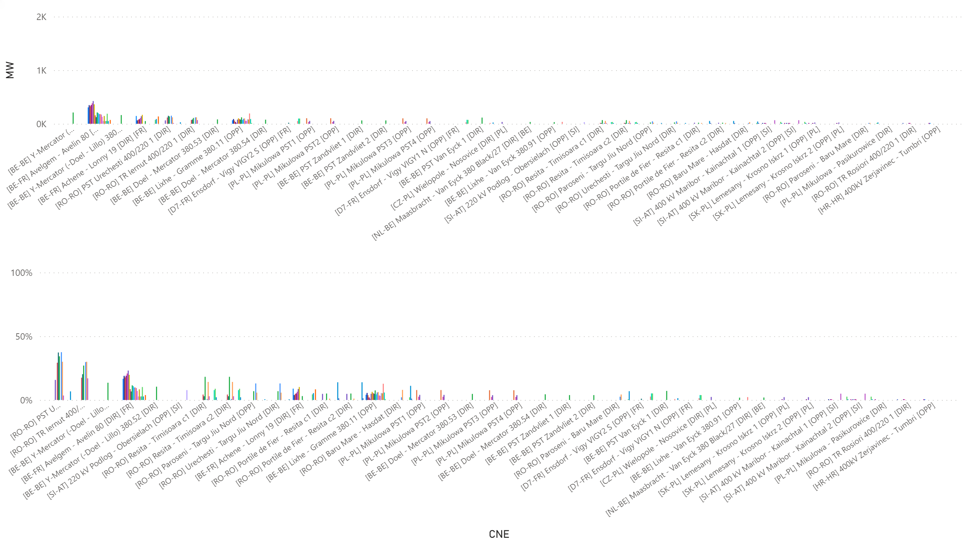
KPI6_1022
KPI 6: Total IVA applied per MTU for each CNE affected by TSO intervention
BD: 20211022 (top: in MW, bottom: in % of Fmax)
Notes:
clusteredColumnChart
No alt text provided.
clusteredColumnChart
No alt text provided.

Slide 54
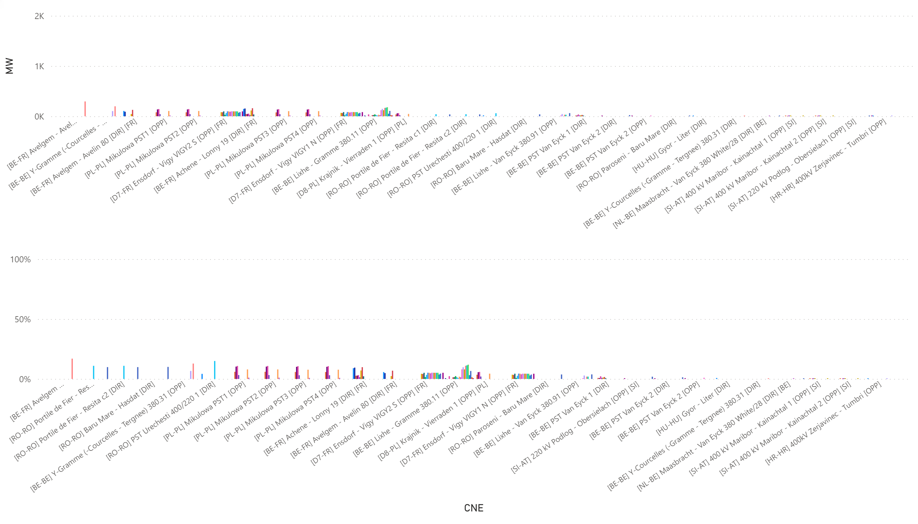
KPI6_1023
KPI 6: Total IVA applied per MTU for each CNE affected by TSO intervention
BD: 20211023 (top: in MW, bottom: in % of Fmax)
Notes:
clusteredColumnChart
No alt text provided.
clusteredColumnChart
No alt text provided.

Slide 55
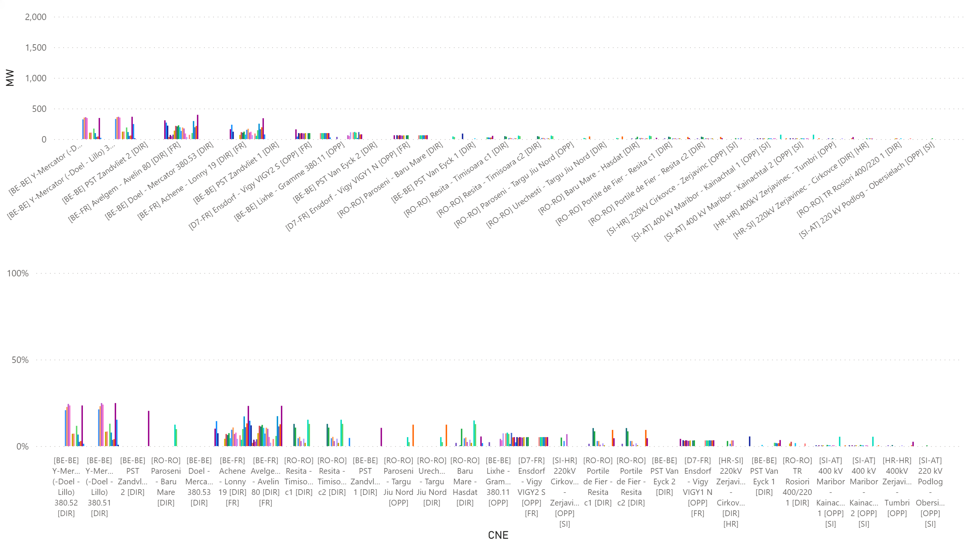
KPI6_1025
KPI 6: Total IVA applied per MTU for each CNE affected by TSO intervention
BD: 20211025 (top: in MW, bottom: in % of Fmax)
Notes:
clusteredColumnChart
No alt text provided.
clusteredColumnChart
No alt text provided.

Slide 56
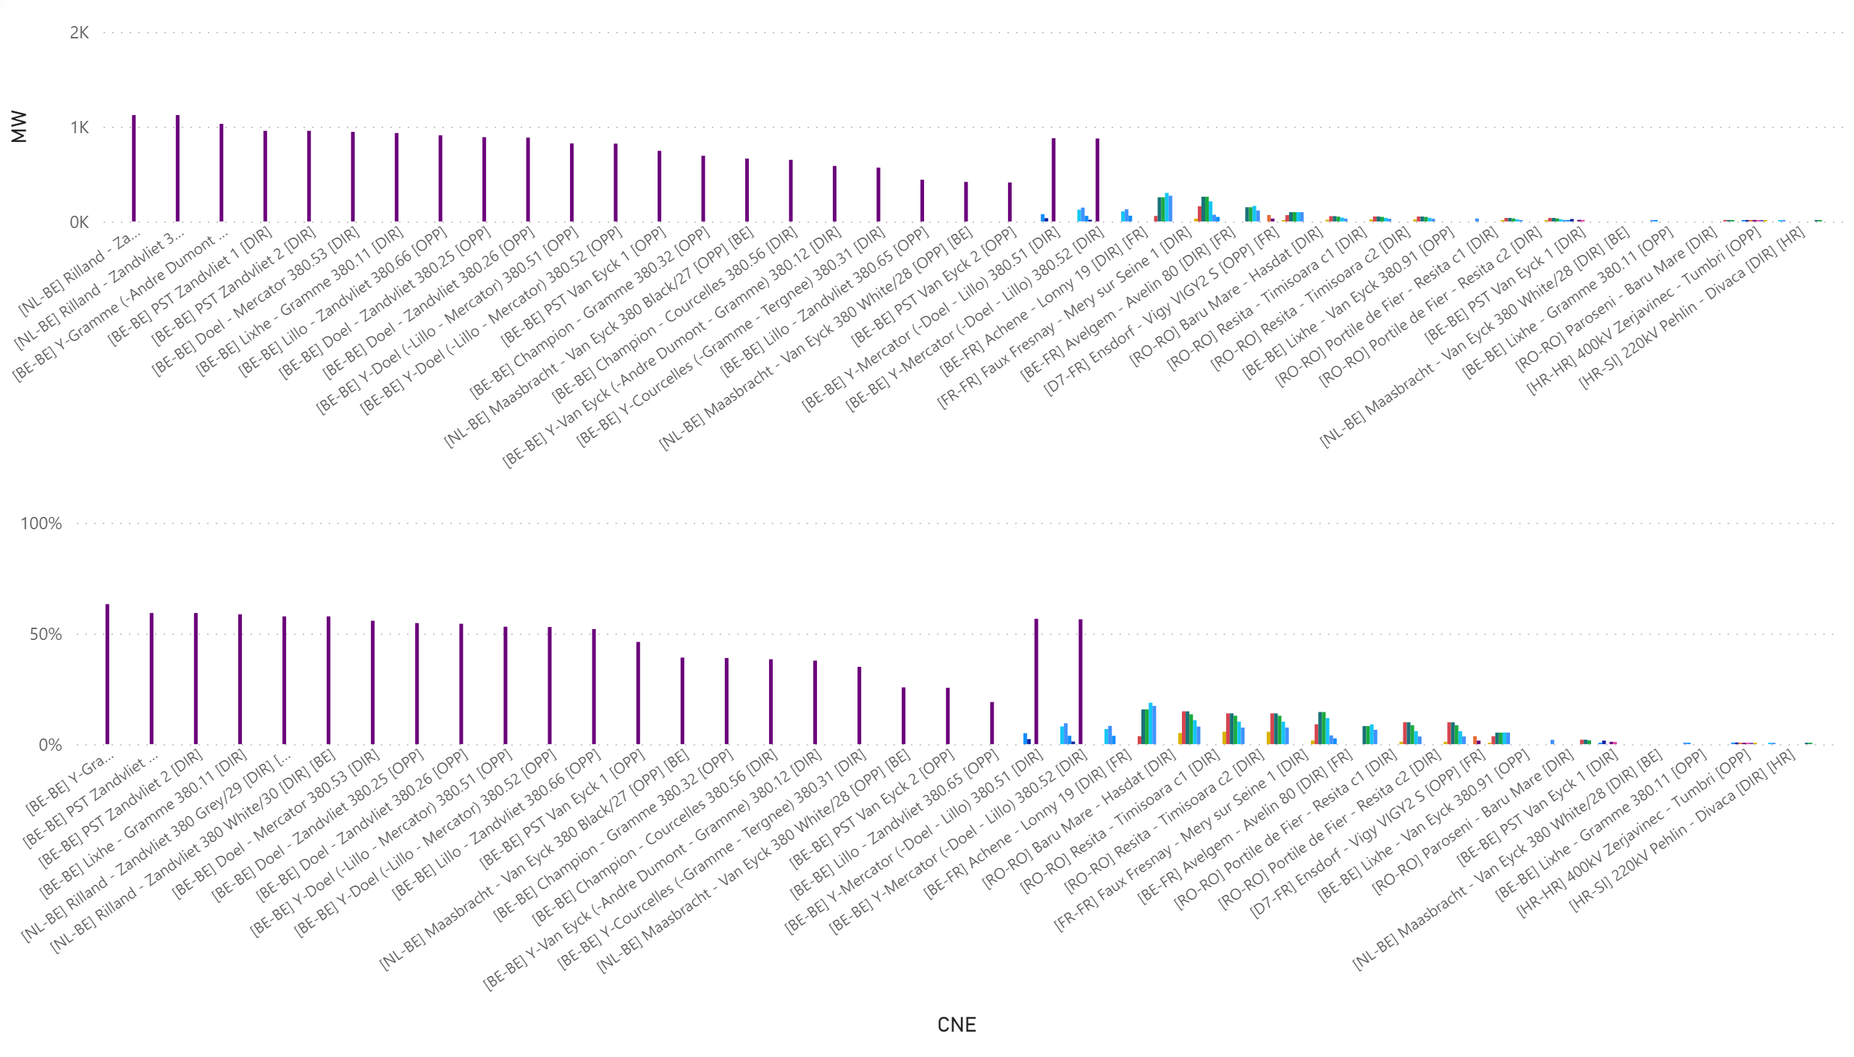
KPI6_1026_00-11
KPI 6: Total IVA applied per MTU for each CNE affected by TSO intervention
BD: 20211026_0-11 (top: in MW, bottom: in % of Fmax)
Notes:
clusteredColumnChart
No alt text provided.
clusteredColumnChart
No alt text provided.

Slide 57

KPI6_1026_12-23
KPI 6: Total IVA applied per MTU for each CNE affected by TSO intervention
BD: 20211026_12-23 (top: in MW, bottom: in % of Fmax)
Notes:
clusteredColumnChart
No alt text provided.
clusteredColumnChart
No alt text provided.

Slide 58

KPI6_1028
KPI 6: Total IVA applied per MTU for each CNE affected by TSO intervention
BD: 20211028 (top: in MW, bottom: in % of Fmax)
Notes:
clusteredColumnChart
No alt text provided.
clusteredColumnChart
No alt text provided.

Slide 59

KPI6_1029
KPI 6: Total IVA applied per MTU for each CNE affected by TSO intervention
BD: 20211029 (top: in MW, bottom: in % of Fmax)
Notes:
clusteredColumnChart
No alt text provided.
clusteredColumnChart
No alt text provided.

Slide 60

AT + BE
KPI 13: Min & max net positions per BZ hub
Notes:
AT
No alt text provided.
BE
No alt text provided.

Slide 61

CZ+DE
KPI 13: Min & max net positions per BZ hub
Notes:
CZ
No alt text provided.
DE
No alt text provided.

Slide 62

FR + HR
KPI 13: Min & max net positions per BZ hub
Notes:
FR
No alt text provided.
HR
No alt text provided.

Slide 63

HU + NL
KPI 13: Min & max net positions per BZ hub
Notes:
HU
No alt text provided.
NL
No alt text provided.

Slide 64

PL + RO
KPI 13: Min & max net positions per BZ hub
Notes:
PL
No alt text provided.
RO
No alt text provided.

Slide 65

SI + SK
KPI 13: Min & max net positions per BZ hub
Notes:
SK
No alt text provided.
SI
No alt text provided.

Slide 66


KPI 14a: Highest virtual margins at market balance for CORE TSOs
CORE TSOs

Slide 67


CORE TSOs
KPI 14b: AT: Virtual margins at market balance

Slide 68


KPI 14b: BE: Virtual margins at market balance
CORE TSOs

Slide 69


CORE TSOs
KPI 14b: CZ: Virtual margins at market balance

Slide 70


KPI 14b: D2: Virtual margins at market balance
CORE TSOs

Slide 71


CORE TSOs
KPI 14b: D4: Virtual margins at market balance

Slide 72


CORE TSOs
KPI 14b: D7: Virtual margins at market balance

Slide 73


CORE TSOs
KPI 14b: D8: Virtual margins at market balance

Slide 74


CORE TSOs
KPI 14b: FR: Virtual margins at market balance

Slide 75


CORE TSOs
KPI 14b: HR: Virtual margins at market balance

Slide 76


KPI 14b: HU: Virtual margins at market balance
CORE TSOs

Slide 77


KPI 14b: PL: Virtual margins at market balance
CORE TSOs

Slide 78


KPI 14b: NL: Virtual margins at market balance
CORE TSOs

Slide 79


CORE TSOs
KPI 14b: RO: Virtual margins at market balance

Slide 80


KPI 14b: SI: Virtual margins at market balance
CORE TSOs

Slide 81


KPI 14b: SK: Virtual margins at market balance
CORE TSOs

Slide 82

KPI 15: Non-Core exchanges delta flow
BD20211001 – BD20211031

Slide 83

KPI 15: Non-Core exchanges delta flow
BD20211001 – BD20211031

Slide 84

KPI 15: Non-Core delta exchanges
BD20211001– BD20211031

Slide 85

Boxplot recap

Slide 86

NRAO – Applied Remedial Actions
Overview
The total number of MTUs (720 hours) was distributed as shown in the pie chart
In the following plots, the relative time share relates to the hours labeled ‘NRAO Ran and Applied RAs’ (220 hours)

Slide 87

KPI 16: Relative Time Share of Applied RAs, by TSO, Type and Mode

Slide 88

KPI 16: Relative Time Share of Applied RAs, by TSO, Type and Mode

Slide 89

KPI 16: Relative Time Share of Applied RAs, by TSO, Type and Mode
Relative Time Share of Applied Topological RAs in Preventive Mode

Slide 90

KPI 16: Relative Time Share of Applied RAs, by TSO, Type and Mode
Relative Time Share of Applied PSTs in Curative Mode

Slide 91

KPI 16: Relative Time Share of Applied RAs, by TSO, Type and Mode
Relative Time Share of Applied Topological RAs in Curative Mode

Slide 92

KPI 17: Most limiting CNEC per TSO (NRAO)
TSCNET
The graph below shows the distribution of CNECs which are the most limiting from NRAO perspective, these are the CNECs with lowest relative RAM per MTUs.
As expected, there is redistributing of the most limiting CNECs. This is because the application of Remedial Actions does not eliminate flows but re-routes, reducing the flows on some limiting CNECs and increasing the load on others, which at the end impacts also the RAM values.
In case of HU, there were no most limiting elements from NRAO perspective

Slide 93

KPI 18: Average variation of relative RAM before and after NRAO
TSCNET
The graph shows average values of relative RAM before and after NRAO, per TSO on the most limiting CNECs from NRAO perspective. Selected CNECs before RAO are the same as after RAO, and average computed for MTUs when NRAO was used further in the process.
Most limiting element from NRAO perspective is the one which has the lowest relRAM per MTU.
To determent value of relative RAM, the following formula was used:
$${RAM}_{rel}=\frac{{RAM}_{nrao}}{\sum_{\left(A, B\right) ∈ neighbouring Core bidding zones pairs }{\left|{PTDF}_{A→B, nrao}\right|}} if {RAM}_{nrao}≥0$$
$${RAM}_{rel}={RAM}_{nrao} if {RAM}_{nrao}< 0$$
The increment of relRAM values after RAO shows that the optimization performed did increase the capacity on some areas.
In case of PL, it is obvious that RAM before RAO was negative and therefore relRAM= negativeRAM. After application of RAs, the flow on the element decreased leading to an increased RAM (equal or above 0), and this results in relRAM no longer being absolute (RAM) but proper calculated relative value.
In case of HU, there were no most limiting elements from NRAO perspective.

Slide 94
Parallel Run KPI report
CORE FB MC
KPI 7: Most often presolved CNEs (TOP 20) 202110
Total BDs: 24 (576 hours)
CNE | Distinct Hours | Hours CNE was presolved | Average RAM | Max of RAM | Min of RAM | Max of z2zPTDF | Max of sum z2z PTDF
[AT-AT] Strass - Zell 273A [OPP] [AT] | 552 | 553 | 36% | 85% | 14% | 0,17373 | 0,66964
[HU-HU] Gonyu - Gyor [DIR] | 550 | 894 | 70% | 91% | 53% | 0,21481 | 1,31663
[HR-SI] 220kV Pehlin - Divaca [OPP] [HR] | 548 | 1091 | 97% | 176% | 64% | 0,0335 | 0,60062
[CZ-PL] Wielopole - Nosovice [DIR] [PL] | 531 | 800 | 53% | 83% | 8% | 0,12065 | 1,26469
[CZ-SK] Nosovice - Varin [OPP] [SK] | 531 | 1135 | 101% | 132% | 61% | 0,39185 | 1,33261
[AT-HU] Wien Suedost - Gyoer 245 [DIR] [AT] | 505 | 845 | 67% | 94% | 0% | 0,07903 | 0,30291
[CZ-D2] Hradec - Etzenricht 441 [DIR] [D2] | 486 | 849 | 76% | 105% | 50% | 0,32295 | 1,34934
[HR-HR] 400kV Zerjavinec - Tumbri [OPP] | 479 | 933 | 78% | 106% | 50% | 0,31651 | 1,19106
[NL-NL] Diemen-Lelystad 380 Z [OPP] | 478 | 1244 | 27% | 73% | 0% | 0,31701 | 0,70935
[CZ-SK] Sokolnice - Stupava [DIR] [SK] | 472 | 569 | 67% | 90% | 53% | 0,29018 | 1,15957
[CZ-SK] Nosovice - Varin [DIR] [SK] | 447 | 583 | 75% | 112% | 57% | 0,34825 | 1,33231
[HR-HR] 400kV Zerjavinec - Tumbri [DIR] | 444 | 807 | 101% | 129% | 73% | 0,20531 | 1,19106
[AT-AT] Westtirol 1 - Westtirol 2 WTRHU41 [DIR] | 443 | 732 | 84% | 145% | 46% | 0,04258 | 0,86953
[HU-HU] Dunamenti - Oroszlany [DIR] | 439 | 890 | 67% | 124% | 35% | 0,03175 | 0,37446
[NL-D7] Maasbracht - Siersdorf SELFK SW [DIR] [D7] | 335 | 1097 | 69% | 103% | 24% | 0,23727 | 0,65448
[BE-BE] PST Van Eyck 1 [OPP] | 316 | 1237 | 64% | 119% | 26% | 0,3752 | 0,89273
[BE-BE] PST Van Eyck 1 [DIR] | 287 | 807 | 104% | 159% | 20% | 0,15977 | 0,88588
[BE-BE] PST Van Eyck 2 [OPP] | 201 | 722 | 66% | 124% | 19% | 0,41499 | 0,97405
*Please note that the shown z2zPTDF values do not correspond to the maximum zone-to-zone PTDFs according to equation 5 of the Day-ahead CCM and hence are not the ones used for the CNEC Selection. The z2zPTDFs are calculated only between neighbouring BZs by the scripts used for external parallel run reporting. See KPI reading guide on JAO.

Slide 95
Parallel Run KPI report
CORE FB MC
KPI 8a: Most limiting CNEs (TOP 20) 202110
Total BDs: 24 (576 hours)
CNE | Distinct Hours | Hours CNE has ShadowPrice | Max of Shadow Price | Average of RAM | Min of RAM | Max of RAM | Max of z2zPTDF | Max of sum z2z PTDF
[AT-D2] St. Peter 2 - Pleinting 258 [OPP] [AT] | 205 | 205 | 1334,029 | 57% | 23% | 98% | 0,06396 | 0,42064
[CZ-PL] Wielopole - Nosovice [DIR] [PL] | 168 | 168 | 589,101 | 44% | 8% | 75% | 0,0676 | 1,226
[AT-CZ] Duernrohr 1 - Slavetice 437 [OPP] [AT] | 162 | 162 | 400,068 | 54% | 0% | 73% | 0,18738 | 1,21668
[NL-NL] Diemen-Lelystad 380 Z [OPP] | 151 | 155 | 1492,656 | 23% | 0% | 49% | 0,30873 | 0,6991
[SK-PL] Lemesany - Krosno Iskrz 2 [OPP] [PL] | 119 | 119 | 523,374 | 74% | 47% | 87% | 0,1417 | 1,06973
[SI-AT] 220 kV Podlog - Obersielach [OPP] [SI] | 106 | 106 | 590,103 | 40% | 12% | 84% | 0,17777 | 0,51613
[CZ-SK] Nosovice - Varin [DIR] [SK] | 93 | 93 | 578,703 | 69% | 58% | 84% | 0,32516 | 1,32906
[SK-HU] Levice - God [DIR] [SK] | 86 | 86 | 750,715 | 54% | 43% | 72% | 0,34528 | 1,09557
[CZ-SK] Sokolnice - Stupava [DIR] [SK] | 79 | 79 | 896,864 | 62% | 53% | 76% | 0,28304 | 1,13141
[D4-D7] Hoheneck - Pulverdingen ws [DIR] [D4] | 58 | 58 | 1784,869 | 20% | 5% | 40% | 0,0983 | 0,30108
[RO-RO] TR Rosiori 400 | 56 | 56 | 535,928 | 35% | 18% | 66% | 0,01428 | 0,23963
[CZ-SK] Sokolnice - Stupava [DIR] [CZ] | 42 | 42 | 658,002 | 60% | 54% | 67% | 0,2828 | 1,12329
[BE-BE] Achene - Gramme 380.10 [OPP] | 41 | 41 | 788,428 | 78% | 16% | 106% | 0,41199 | 0,98401
[D4-D4] PST Buers BMT37 [OPP] | 40 | 41 | 1772,058 | 46% | 18% | 94% | 0,05236 | 0,28367
[NL-D2] Meeden-Diele 380 Z [OPP] [NL] | 37 | 37 | 1512,570 | 28% | 20% | 40% | 0,3246 | 0,7051
[NL-NL] Krimpen a | 33 | 33 | 278,496 | 33% | 20% | 73% | 0,55499 | 1,19773
[BE-BE] PST Van Eyck 1 [OPP] | 33 | 39 | 267,737 | 60% | 33% | 85% | 0,36885 | 0,87733
[D7-D7] Y Paffendorf - Oberzier SECHTM S [DIR] | 33 | 33 | 239,182 | 53% | 40% | 74% | 0,21759 | 0,66734
[D7-D7] Paffendorf - Rommerskirchen PAFFEN N [OPP] | 33 | 33 | 848,634 | 20% | 20% | 27% | 0,08635 | 0,38291
[D7-D7] Y Paffendorf - Oberzier SECHTM N [DIR] | 30 | 30 | 329,720 | 56% | 44% | 67% | 0,23858 | 0,66109
[BE-FR] Achene - Lonny 380.19 [DIR] [BE] | 27 | 27 | 872,568 | 28% | 5% | 91% | 0,3683 | 0,88127
Note 1: the shown z2zPTDF values do not correspond to the maximum zone-to-zone PTDFs according to equation 5 of the Day-ahead CCM and hence are not the ones used for the CNEC Selection. The z2zPTDFs are calculated only between neighbouring BZs by the scripts used for external parallel run reporting. See KPI reading guide on JAO.
Note 2: the RAM values (expressed as % of Fmax) should not be interpreted as “the capacities offered by the Core TSOs to the market coupling”. Indeed, since the introduction of Ext LTA inclusion Euphemia performs an optimization where it takes a portion of the FB domain and a portion of the LTA domain to maximize welfare. The RAM values shown in this KPI report correspond to the “portion of the FB domain” resulting from this optimization. Example
RAM = 500 MW
Portion of FB domain = 40%
➔ RAM offered by Core TSOs = 500 MW / 0.4 = 1250 MW

Slide 96


Parallel Run KPI report
CORE FB MC
KPI 8b: Allocation Constraints 202110
Please note that Belgium only uses import constraints.

Slide 97


Parallel Run KPI report
KPI 9: Clearing prices, price spreads and price convergence
BD2021
BD20211001

Slide 98


Parallel Run KPI report
KPI 9: Clearing prices, price spreads and price convergence
BD2021
BD20211002

Slide 99


Parallel Run KPI report
KPI 9: Clearing prices, price spreads and price convergence
BD2021
BD20211003

Slide 100


Parallel Run KPI report
KPI 9: Clearing prices, price spreads and price convergence
BD2021
BD20211004

Slide 101


Parallel Run KPI report
KPI 9: Clearing prices, price spreads and price convergence
BD20211005

Slide 102


Parallel Run KPI report
KPI 9: Clearing prices, price spreads and price convergence
BD2021
BD20211006

Slide 103


Parallel Run KPI report
KPI 9: Clearing prices, price spreads and price convergence
BD2021
BD20211007

Slide 104


Parallel Run KPI report
KPI 9: Clearing prices, price spreads and price convergence
BD2021
BD20211008

Slide 105


Parallel Run KPI report
KPI 9: Clearing prices, price spreads and price convergence
BD2021
BD20211013

Slide 106


Parallel Run KPI report
KPI 9: Clearing prices, price spreads and price convergence
BD2021
BD20211014

Slide 107


Parallel Run KPI report
KPI 9: Clearing prices, price spreads and price convergence
BD2021
BD20211015

Slide 108


Parallel Run KPI report
KPI 9: Clearing prices, price spreads and price convergence
BD2021
BD20211016

Slide 109


Parallel Run KPI report
KPI 9: Clearing prices, price spreads and price convergence
BD2021
BD20211017

Slide 110


Parallel Run KPI report
KPI 9: Clearing prices, price spreads and price convergence
BD2021
BD20211018

Slide 111


Parallel Run KPI report
KPI 9: Clearing prices, price spreads and price convergence
BD2021
BD20211019

Slide 112


Parallel Run KPI report
KPI 9: Clearing prices, price spreads and price convergence
BD2021
BD20211021

Slide 113


Parallel Run KPI report
KPI 9: Clearing prices, price spreads and price convergence
BD2021
BD20211022

Slide 114


Parallel Run KPI report
KPI 9: Clearing prices, price spreads and price convergence
BD2021
BD20211023

Slide 115


Parallel Run KPI report
KPI 9: Clearing prices, price spreads and price convergence
BD2021
BD20211024

Slide 116


Parallel Run KPI report
KPI 9: Clearing prices, price spreads and price convergence
BD2021
BD20211025

Slide 117


Parallel Run KPI report
KPI 9: Clearing prices, price spreads and price convergence
BD2021
BD20211026

Slide 118


Parallel Run KPI report
KPI 9: Clearing prices, price spreads and price convergence
BD2021
BD20211028

Slide 119


Parallel Run KPI report
KPI 9: Clearing prices, price spreads and price convergence
BD2021
BD20211029

Slide 120


Parallel Run KPI report
KPI 9: Clearing prices, price spreads and price convergence
BD2021
BD20211030

Slide 121
CORE FB MC
Parallel Run KPI report
KPI 10: Highest non-zero shadow prices in each hour for the simulated BD20211001 (part I)
Hour | MAX of ShadowPrice | RAM %
1 | 1419,57 | 98%
[SK-PL] Lemesany - Krosno Iskrz 2 [OPP] [PL] / N-1 Lemesany - Krosno Iskrz 1 | 13,24 | 74%
[D4-CH] Kuehmoos - Laufenburg br (Heimbach) [DIR] [D4] / N-1 Kuehmoos - Laufenburg ge (Seelbach) | 1419,57 | 23%
2 | 1275,41 | 263%
[SK-PL] Lemesany - Krosno Iskrz 2 [OPP] [PL] / N-1 Lemesany - Krosno Iskrz 1 | 42,74 | 74%
[D2-D2] Altheim - Sittling 219 [OPP] / N-1 Altheim - Sittling 220 | 17,05 | 75%
[D4-CH] Kuehmoos - Laufenburg br (Heimbach) [DIR] [D4] / N-1 Kuehmoos - Laufenburg ge (Seelbach) | 1275,41 | 20%
[PL-PL] Mikulowa PST1 [OPP] / N-1 Hagenwerder - Mikulowa 1 | 9,25 | 19%
[NL-D7] Maasbracht - Siersdorf SELFK SW [DIR] [D7] / N-1 Avelgem - Avelin 380.80 | 25,49 | 75%
3 | 550,89 | 244%
[SK-PL] Lemesany - Krosno Iskrz 2 [OPP] [PL] / N-1 Lemesany - Krosno Iskrz 1 | 13,26 | 77%
[D2-D2] Altheim - Sittling 219 [OPP] / N-1 Altheim - Sittling 220 | 550,89 | 74%
[D4-CH] Kuehmoos - Laufenburg br (Heimbach) [DIR] [D4] / N-1 Kuehmoos - Laufenburg ge (Seelbach) | 160,85 | 20%
[NL-D7] Maasbracht - Siersdorf SELFK SW [DIR] [D7] / N-1 Achene - Gramme 380.10 | 2,7 | 74%
4 | 938,96 | 233%
[SK-PL] Lemesany - Krosno Iskrz 2 [OPP] [PL] / N-1 Lemesany - Krosno Iskrz 1 | 15,61 | 75%
[D2-D2] Altheim - Sittling 219 [OPP] / N-1 Altheim - Sittling 220 | 938,96 | 75%
[BE-BE] PST Van Eyck 2 [OPP] / N-1 Achene - Gramme 380.10 | 2,61 | 84%
5 | 1324,48 | 405%
[CZ-SK] Liskovec - P. Bystrica [DIR] [CZ] / N-1 Nosovice - Varin | 185,45 | 81%
[SK-PL] Lemesany - Krosno Iskrz 2 [OPP] [PL] / N-1 Lemesany - Krosno Iskrz 1 | 7,21 | 76%
[D2-D2] Altheim - Sittling 219 [OPP] / N-1 Altheim - Sittling 220 | 1324,48 | 72%
[BE-BE] PST Van Eyck 2 [OPP] / N-1 Achene - Gramme 380.10 | 1,01 | 83%
[BE-BE] PST Van Eyck 2 [OPP] / N-1 PST Zandvliet 2 | 2,88 | 92%
6 | 1472,67 | 225%
[CZ-SK] Liskovec - P. Bystrica [DIR] [CZ] / N-1 Nosovice - Varin | 175,53 | 79%
[SK-PL] Lemesany - Krosno Iskrz 2 [OPP] [PL] / N-1 Lemesany - Krosno Iskrz 1 | 65,68 | 76%
[D2-D2] Altheim - Sittling 219 [OPP] / N-1 Altheim - Sittling 220 | 1472,67 | 69%

Slide 122
CORE FB MC
Parallel Run KPI report
KPI 10: Highest non-zero shadow prices in each hour for the simulated BD20211001 (part II)
7 | 1047,98 | 229%
[SK-PL] Lemesany - Krosno Iskrz 2 [OPP] [PL] / N-1 Lemesany - Krosno Iskrz 1 | 62,17 | 72%
[D2-D2] Altheim - Sittling 219 [OPP] / N-1 Altheim - Sittling 220 | 1047,98 | 64%
[D4-CH] Kuehmoos - Laufenburg br (Heimbach) [DIR] [D4] / N-1 Kuehmoos - Laufenburg ge (Seelbach) | 306,25 | 25%
[BE-BE] Achene - Gramme 380.10 [OPP] / N-1 Avelgem - Avelin 380.80 | 30,91 | 68%
8 | 874,35 | 341%
[HR-SI] 220kV Pehlin - Divaca [OPP] [HR] / N-1 Melina - Divaca | 1,83 | 108%
[SK-PL] Lemesany - Krosno Iskrz 2 [OPP] [PL] / N-1 Lemesany - Krosno Iskrz 1 | 89,2 | 77%
[D2-D2] Altheim - Sittling 220 [OPP] / N-1 St. Peter - Pleinting 258 | 874,35 | 53%
[D4-D4] PST Buers BMT37 [OPP] / N-1 Buers - Westtirol ws (421) | 484,9 | 18%
[D7-D7] Niederstedem - Y Dahlem SELHN W [OPP] / N-1 Dahlem - Rommersheim SELHN O | 99,46 | 20%
[BE-BE] Achene - Gramme 380.10 [OPP] / N-1 Avelgem - Avelin 380.80 | 102,75 | 66%
9 | 565,96 | 242%
[AT-D2] St. Peter 2 - Pleinting 258 [OPP] [AT] / N-1 Pleinting - Pirach 257 | 564,94 | 61%
[SK-PL] Lemesany - Krosno Iskrz 2 [OPP] [PL] / N-1 Lemesany - Krosno Iskrz 1 | 97,18 | 73%
[D4-D4] PST Buers BMT37 [OPP] / N-1 Buers - Westtirol ws (421) | 565,96 | 18%
[D7-D7] Niederstedem - Y Dahlem SELHN W [OPP] / N-1 Dahlem - Rommersheim SELHN O | 102,68 | 27%
[BE-BE] Achene - Gramme 380.10 [OPP] / N-1 Avelgem - Avelin 380.80 | 117,93 | 62%
10 | 803,83 | 353%
[AT-D2] St. Peter 2 - Pleinting 258 [OPP] [AT] / N-1 Pleinting - Pirach 257 | 803,83 | 65%
[CZ-SK] Liskovec - P. Bystrica [DIR] [CZ] / N-1 Nosovice - Varin | 135,13 | 77%
[SK-PL] Lemesany - Krosno Iskrz 2 [OPP] [PL] / N-1 Lemesany - Krosno Iskrz 1 | 53,63 | 74%
[D4-D4] PST Buers BMT37 [OPP] / N-1 Buers - Westtirol ws (421) | 763,16 | 18%
[D7-D7] Niederstedem - Y Dahlem SELHN W [OPP] / N-1 Dahlem - Rommersheim SELHN O | 153,8 | 26%
[BE-BE] Achene - Gramme 380.10 [OPP] / N-1 Avelgem - Avelin 380.80 | 161,06 | 69%
[RO-RO] Baru Mare - Hasdat [DIR] / N-1 Sibiu Sud - Mintia | 8,06 | 24%
11 | 1009,74 | 292%
[AT-D2] St. Peter 2 - Pleinting 258 [OPP] [AT] / N-1 Pleinting - Pirach 257 | 1009,74 | 69%
[CZ-SK] Liskovec - P. Bystrica [DIR] [CZ] / N-1 Nosovice - Varin | 63,81 | 80%
[D4-D4] PST Buers BMT37 [OPP] / N-1 Buers - Westtirol ws (421) | 992,27 | 18%
[D7-D7] Niederstedem - Y Dahlem SELHN W [OPP] / N-1 Dahlem - Rommersheim SELHN O | 166,42 | 29%
[BE-BE] Achene - Gramme 380.10 [OPP] / N-1 Avelgem - Avelin 380.80 | 191,78 | 75%
[RO-RO] Baru Mare - Hasdat [DIR] / N-1 Sibiu Sud - Mintia | 25,33 | 22%
12 | 1497,23 | 270%
[AT-D2] St. Peter 2 - Pleinting 258 [OPP] [AT] / N-1 Pleinting - Pirach 257 | 1188,38 | 70%
[CZ-SK] Liskovec - P. Bystrica [DIR] [CZ] / N-1 Nosovice - Varin | 233,82 | 78%
[D4-D4] PST Buers BMT37 [OPP] / N-1 Buers - Westtirol ws (421) | 1497,23 | 18%
[BE-BE] Achene - Gramme 380.10 [OPP] / N-1 Avelgem - Avelin 380.80 | 207,1 | 83%
[RO-RO] Baru Mare - Hasdat [DIR] / N-1 Sibiu Sud - Mintia | 23,65 | 21%

Slide 123
CORE FB MC
Parallel Run KPI report
KPI 10: Highest non-zero shadow prices in each hour for the simulated BD20211001 (part III)
13 | 1586,29 | 301%
[AT-CZ] Duernrohr 1 - Slavetice 437 [OPP] [AT] / N-1 Slavetice - Durnrohr 2 | 23,88 | 44%
[AT-D2] St. Peter 2 - Pleinting 258 [OPP] [AT] / N-1 Pleinting - Pirach 257 | 1115,61 | 72%
[CZ-SK] Liskovec - P. Bystrica [DIR] [CZ] / N-1 Nosovice - Varin | 510,4 | 76%
[D4-D4] PST Buers BMT37 [OPP] / N-1 Buers - Westtirol ws (421) | 1586,29 | 18%
[BE-BE] Achene - Gramme 380.10 [OPP] / N-1 Avelgem - Avelin 380.80 | 146,46 | 92%
14 | 1541,05 | 303%
[AT-CZ] Duernrohr 1 - Slavetice 437 [OPP] [AT] / N-1 Slavetice - Durnrohr 2 | 15,02 | 48%
[AT-D2] St. Peter 2 - Pleinting 258 [OPP] [AT] / N-1 Pleinting - Pirach 257 | 1215,34 | 74%
[CZ-SK] Liskovec - P. Bystrica [DIR] [CZ] / N-1 Nosovice - Varin | 483,48 | 75%
[D4-D4] PST Buers BMT37 [OPP] / N-1 Buers - Westtirol ws (421) | 1541,05 | 18%
[BE-BE] Achene - Gramme 380.10 [OPP] / N-1 Avelgem - Avelin 380.80 | 133,88 | 89%
15 | 1222,77 | 440%
[AT-CZ] Duernrohr 1 - Slavetice 437 [OPP] [AT] / N-1 Slavetice - Durnrohr 2 | 20,07 | 47%
[AT-D2] St. Peter 2 - Pleinting 258 [OPP] [AT] / N-1 Pleinting - Pirach 257 | 1094,12 | 78%
[CZ-SK] Liskovec - P. Bystrica [DIR] [CZ] / N-1 Nosovice - Varin | 452,89 | 77%
[SK-PL] Lemesany - Krosno Iskrz 2 [OPP] [PL] / N-1 Lemesany - Krosno Iskrz 1 | 26,75 | 77%
[NL-NL] Krimpen a/d IJssel-Geertruidenberg 380 W [OPP] / N-1 Krimpen a/d IJssel-Geertruidenberg 380 Z | 22,54 | 40%
[D4-D4] PST Buers BMT37 [OPP] / N-1 Buers - Westtirol ws (421) | 1222,77 | 18%
[BE-FR] Achene - Lonny 380.19 [DIR] [BE] / N-1 Avelgem - Avelin 380.80 | 112,23 | 77%
[RO-RO] Baru Mare - Hasdat [DIR] / N-1 Sibiu Sud - Mintia | 2,35 | 27%
16 | 1132,82 | 453%
[AT-CZ] Duernrohr 1 - Slavetice 437 [OPP] [AT] / N-1 Slavetice - Durnrohr 2 | 9,61 | 48%
[AT-D2] St. Peter 2 - Pleinting 258 [OPP] [AT] / N-1 Pleinting - Pirach 257 | 973,33 | 76%
[CZ-SK] Liskovec - P. Bystrica [DIR] [CZ] / N-1 Nosovice - Varin | 362,78 | 75%
[SK-PL] Lemesany - Krosno Iskrz 2 [OPP] [PL] / N-1 Lemesany - Krosno Iskrz 1 | 94,77 | 77%
[AT-SI] Obersielach - Podlog 247 [DIR] [AT] / N-1 Obersielach - Obersielach OSRHU41 | 35,14 | 52%
[D4-D4] PST Buers BMT37 [OPP] / N-1 Buers - Westtirol ws (421) | 1132,82 | 18%
[NL-NL] Diemen-Lelystad 380 Z [OPP] / N-1 Krimpen a/d IJssel-Geertruidenberg 380 W | 24,71 | 28%
[BE-BE] Achene - Gramme 380.10 [OPP] / N-1 Avelgem - Avelin 380.80 | 86,25 | 79%
17 | 1467,49 | 386%
[AT-D2] St. Peter 2 - Pleinting 258 [OPP] [AT] / N-1 Pleinting - Pirach 257 | 901,85 | 76%
[CZ-SK] Liskovec - P. Bystrica [DIR] [CZ] / N-1 Nosovice - Varin | 297,69 | 78%
[SK-PL] Lemesany - Krosno Iskrz 2 [OPP] [PL] / N-1 Lemesany - Krosno Iskrz 1 | 133,13 | 79%
[AT-SI] Obersielach - Podlog 247 [DIR] [AT] / N-1 Obersielach - Obersielach OSRHU41 | 35,5 | 49%
[D4-D4] PST Buers BMT37 [OPP] / N-1 Buers - Westtirol ws (421) | 1467,49 | 18%
[NL-NL] Diemen-Lelystad 380 Z [OPP] / N-1 Krimpen a/d IJssel-Geertruidenberg 380 W | 12,33 | 27%
[BE-BE] PST Van Eyck 2 [OPP] / N-1 Achene - Lonny 380.19 | 32,75 | 59%
18 | 70,87 | 274%
[AT-D2] St. Peter 2 - Pleinting 258 [OPP] [AT] / N-1 Pleinting - Pirach 257 | 70,87 | 76%
[CZ-SK] Liskovec - P. Bystrica [DIR] [CZ] / N-1 Nosovice - Varin | 24,95 | 78%
[SK-PL] Lemesany - Krosno Iskrz 2 [OPP] [PL] / N-1 Lemesany - Krosno Iskrz 1 | 12,45 | 80%
[AT-SI] Obersielach - Podlog 247 [DIR] [AT] / N-1 Obersielach - Obersielach OSRHU41 | 17,62 | 39%

Slide 124
CORE FB MC
Parallel Run KPI report
KPI 10: Highest non-zero shadow prices in each hour for the simulated BD20211001 (part IV)
22 | 2,94 | 148%
[SK-PL] Lemesany - Krosno Iskrz 1 [OPP] [PL] / N-1 Lemesany - Krosno Iskrz 2 | 2,94 | 74%
[BE-FR] Achene - Lonny 19 [DIR] [FR] / N-1 Avelgem - Avelin 380.80 | 0,03 | 75%
23 | 439,69 | 100%
[D2-D7] Grosskrotzenburg - Urberach UMAIN N2 [DIR] [D7] / N-1 Dettingen - Grosskrotzenburg UMAIN S1 | 439,69 | 26%
[SK-PL] Lemesany - Krosno Iskrz 1 [OPP] [PL] / N-1 Lemesany - Krosno Iskrz 2 | 118,98 | 74%
24 | 366,39 | 244%
[SK-PL] Lemesany - Krosno Iskrz 2 [OPP] [PL] / N-1 Lemesany - Krosno Iskrz 1 | 73,75 | 77%
[BE-FR] Avelgem - Avelin 80 [DIR] [FR] / N-1 Achene - Lonny 380.19 | 248,78 | 68%
[BE-FR] Achene - Lonny 19 [DIR] [FR] / N-1 Avelgem - Avelin 380.80 | 18,17 | 62%
[NL-NL] Diemen-Lelystad 380 Z [OPP] / N-1 Doetinchem-Hengelo 380 W | 366,39 | 36%
Total sum | 1586,29 | 5843%

Slide 125
CORE FB MC
Parallel Run KPI report
KPI 10: Highest non-zero shadow prices in each hour for the simulated BD20211002 (part I)
Hour | MAX of ShadowPrice | RAM %
1 | 338,55 | 171%
[D2-D7] Grosskrotzenburg - Urberach UMAIN N2 [DIR] [D7] / N-1 Dettingen - Grosskrotzenburg UMAIN S1 | 338,55 | 21%
[SK-PL] Lemesany - Krosno Iskrz 2 [OPP] [PL] / N-1 Lemesany - Krosno Iskrz 1 | 71,39 | 73%
[CZ-SK] Nosovice - Varin [DIR] [SK] / N-1 Sokolnice - Stupava | 97,08 | 78%
2 | 91,16 | 54%
[CZ-PL] Wielopole - Nosovice [DIR] [PL] / N-1 Albrechtice - Dobrzen | 91,16 | 54%
3 | 109,2 | 56%
[CZ-PL] Wielopole - Nosovice [DIR] [PL] / N-1 Albrechtice - Dobrzen | 109,2 | 56%
4 | 67,18 | 59%
[CZ-PL] Wielopole - Nosovice [DIR] [PL] / N-1 Albrechtice - Dobrzen | 67,18 | 59%
5 | 52,29 | 57%
[CZ-PL] Wielopole - Nosovice [DIR] [PL] / N-1 Albrechtice - Dobrzen | 52,29 | 57%
6 | 84,84 | 60%
[CZ-PL] Wielopole - Nosovice [DIR] [PL] / N-1 Albrechtice - Dobrzen | 84,84 | 60%
7 | 170,74 | 114%
[SK-PL] Lemesany - Krosno Iskrz 2 [OPP] [PL] / N-1 Lemesany - Krosno Iskrz 1 | 170,74 | 76%
[D4-D4] PST Buers BMT37 [OPP] / N-1 Westtirol 1 - Westtirol 2 WTRHU41 | 5,94 | 38%
8 | 433,16 | 85%
[PL-CZ] Kopanina - Liskovec [DIR] [PL] / N-1 Nosovice - Wielopole | 433,16 | 58%
[D4-D4] PST Buers BMT37 [OPP] / N-1 Westtirol 1 - Westtirol 2 WTRHU41 | 277,39 | 27%
9 | 33,78 | 90%
[PL-CZ] Kopanina - Liskovec [DIR] [PL] / N-1 Nosovice - Wielopole | 33,78 | 59%
[D4-D4] PST Buers BMT37 [OPP] / N-1 Westtirol 1 - Westtirol 2 WTRHU41 | 1,11 | 31%

Slide 126
CORE FB MC
Parallel Run KPI report
KPI 10: Highest non-zero shadow prices in each hour for the simulated BD20211002 (part II)
10 | 73,08 | 55%
[PL-CZ] Kopanina - Liskovec [DIR] [PL] / N-1 Nosovice - Wielopole | 73,08 | 55%
11 | 37,28 | 88%
[PL-CZ] Kopanina - Liskovec [DIR] [PL] / N-1 Nosovice - Wielopole | 37,28 | 55%
[D4-D4] PST Buers BMT37 [OPP] / N-1 Westtirol 1 - Westtirol 2 WTRHU41 | 20 | 33%
12 | 11,42 | 112%
[D4-D4] PST Buers BMT37 [OPP] / N-1 Westtirol 1 - Westtirol 2 WTRHU41 | 1,11 | 53%
[CZ-PL] Wielopole - Nosovice [DIR] [PL] / N-2 Tucznawa - Skawina and Byczyna - Skawina | 11,42 | 59%
13 | 391,57 | 415%
[AT-SI] Kainachtal - Maribor 473 [DIR] [AT] / N-1 Maribor-Kainachtal 2 | 11,21 | 60%
[D4-D4] PST Buers BMT37 [OPP] / N-1 Westtirol 1 - Westtirol 2 WTRHU41 | 391,57 | 45%
[CZ-SK] Sokolnice - Stupava [DIR] [SK] / N-1 Nosovice - Varin | 16,4 | 66%
[BE-BE] Achene - Gramme 380.10 [OPP] / N-1 Avelgem - Avelin 380.80 | 10 | 89%
[CZ-PL] Wielopole - Nosovice [DIR] [PL] / N-2 Tucznawa - Skawina and Byczyna - Skawina | 20,68 | 60%
[PL-PL] Krosno Iskrzynia - Rzeszow [OPP] / N-1 Krosno Iskrzynia - Tarnow | 28,87 | 94%
14 | 165,93 | 291%
[AT-D2] St. Peter 2 - Pleinting 258 [OPP] [AT] / N-1 Pleinting - Pirach 257 | 165,93 | 89%
[AT-SI] Kainachtal - Maribor 473 [DIR] [AT] / N-1 Maribor-Kainachtal 2 | 4,64 | 60%
[NL-NL] Krimpen a/d IJssel-Geertruidenberg 380 W [OPP] / N-1 Krimpen a/d IJssel-Geertruidenberg 380 Z | 2,01 | 20%
[CZ-SK] Sokolnice - Stupava [DIR] [SK] / N-1 Nosovice - Varin | 6,93 | 65%
[CZ-PL] Wielopole - Nosovice [DIR] [PL] / N-2 Tucznawa - Skawina and Byczyna - Skawina | 7,69 | 57%
15 | 425,98 | 292%
[AT-D2] St. Peter 2 - Pleinting 258 [OPP] [AT] / N-1 Pleinting - Pirach 257 | 425,98 | 86%
[CZ-SK] Liskovec - P. Bystrica [DIR] [CZ] / N-1 Nosovice - Varin | 25,03 | 78%
[AT-SI] Kainachtal - Maribor 473 [DIR] [AT] / N-1 Maribor-Kainachtal 2 | 10,77 | 58%
[NL-NL] Krimpen a/d IJssel-Geertruidenberg 380 W [OPP] / N-1 Krimpen a/d IJssel-Geertruidenberg 380 Z | 113,77 | 20%
[CZ-PL] Wielopole - Nosovice [DIR] [PL] / N-2 Tucznawa - Skawina and Byczyna - Skawina | 19,46 | 49%
16 | 555,49 | 213%
[AT-D2] St. Peter 2 - Pleinting 258 [OPP] [AT] / N-1 Pleinting - Pirach 257 | 555,49 | 86%
[AT-SI] Kainachtal - Maribor 473 [DIR] [AT] / N-1 Maribor-Kainachtal 2 | 13,93 | 58%
[NL-NL] Krimpen a/d IJssel-Geertruidenberg 380 W [OPP] / N-1 Krimpen a/d IJssel-Geertruidenberg 380 Z | 260,92 | 20%
[CZ-PL] Wielopole - Nosovice [DIR] [PL] / N-2 Tucznawa - Skawina and Byczyna - Skawina | 1,84 | 49%

Slide 127
CORE FB MC
Parallel Run KPI report
KPI 10: Highest non-zero shadow prices in each hour for the simulated BD20211002 (part III)
17 | 567,67 | 424%
[AT-D2] St. Peter 2 - Pleinting 258 [OPP] [AT] / N-1 Pleinting - Pirach 257 | 567,67 | 73%
[CZ-SK] Liskovec - P. Bystrica [DIR] [CZ] / N-1 Nosovice - Varin | 98,97 | 78%
[D7-FR] Ensdorf - Vigy VIGY2 S [OPP] [FR] / N-1 Ensdorf - Vigy VIGY1 N | 28,65 | 49%
[NL-NL] Krimpen a/d IJssel-Geertruidenberg 380 W [OPP] / N-1 Krimpen a/d IJssel-Geertruidenberg 380 Z | 278,5 | 20%
[AT-SI] Obersielach - Podlog 247 [DIR] [AT] / N-1 Obersielach - Obersielach OSRHU41 | 20,45 | 63%
[CZ-SK] Sokolnice - Stupava [DIR] [SK] / N-1 Nosovice - Varin | 21,66 | 62%
[PL-PL] Krosno Iskrzynia - Rzeszow [OPP] / N-1 Krosno Iskrzynia - Tarnow | 5,68 | 79%
18 | 321,55 | 221%
[AT-D2] St. Peter 2 - Pleinting 258 [OPP] [AT] / N-1 Pleinting - Pirach 257 | 321,55 | 73%
[D7-FR] Ensdorf - Vigy VIGY2 S [OPP] [FR] / N-1 Ensdorf - Vigy VIGY1 N | 24,26 | 49%
[NL-NL] Krimpen a/d IJssel-Geertruidenberg 380 W [OPP] / N-1 Krimpen a/d IJssel-Geertruidenberg 380 Z | 211,15 | 20%
[PL-PL] Krosno Iskrzynia - Rzeszow [OPP] / N-1 Krosno Iskrzynia - Tarnow | 46,91 | 79%
19 | 518,33 | 318%
[AT-CZ] Duernrohr 1 - Slavetice 437 [OPP] [AT] / N-1 Slavetice - Durnrohr 2 | 26,33 | 50%
[AT-D2] St. Peter 2 - Pleinting 258 [OPP] [AT] / N-1 Pleinting - Pirach 257 | 518,33 | 56%
[D7-FR] Ensdorf - Vigy VIGY2 S [OPP] [FR] / N-1 Ensdorf - Vigy VIGY1 N | 163,47 | 22%
[NL-NL] Krimpen a/d IJssel-Geertruidenberg 380 W [OPP] / N-1 Krimpen a/d IJssel-Geertruidenberg 380 Z | 81,03 | 20%
[AT-SI] Obersielach - Podlog 247 [DIR] [AT] / N-1 Obersielach - Obersielach OSRHU41 | 22,9 | 40%
[CZ-SK] Sokolnice - Stupava [DIR] [SK] / N-1 Nosovice - Varin | 59,93 | 60%
[PL-PL] Krosno Iskrzynia - Rzeszow [OPP] / N-1 Krosno Iskrzynia - Tarnow | 106,27 | 72%
20 | 714,83 | 276%
[HU-AT] Gyor - Wien [OPP] [HU] / N-1 Gyor - Zurndorf | 244,22 | 70%
[D2-D2] Altheim - Sittling 219 [OPP] / N-1 Altheim - Sittling 220 | 714,83 | 41%
[CZ-SK] Nosovice - Varin [DIR] [SK] / N-1 Sokolnice - Stupava | 316,68 | 69%
[NL-NL] Krimpen a/d IJssel-Geertruidenberg 380 W [OPP] / N-1 Krimpen a/d IJssel-Geertruidenberg 380 Z | 68,87 | 20%
[SK-UA] V.Kapusany - Mukachevo (WPS) [DIR] [SK] / N-1 R.Sobota - Sajoivanka | 76 | 76%

Slide 128
CORE FB MC
Parallel Run KPI report
KPI 10: Highest non-zero shadow prices in each hour for the simulated BD20211002 (part IV)
21 | 539,95 | 298%
[D8-D8] Pasewalk - Vierraden 306 [DIR] / N-1 Vierraden - Neuenhagen 304 | 204,05 | 19%
[HU-AT] Gyor - Wien [OPP] [HU] / N-1 Gyor - Zurndorf | 128,38 | 68%
[D2-D2] Altheim - Sittling 219 [OPP] / N-1 Altheim - Sittling 220 | 539,95 | 49%
[CZ-SK] Nosovice - Varin [DIR] [SK] / N-1 Sokolnice - Stupava | 363,77 | 65%
[NL-NL] Krimpen a/d IJssel-Geertruidenberg 380 W [OPP] / N-1 Krimpen a/d IJssel-Geertruidenberg 380 Z | 79,59 | 20%
[SK-UA] V.Kapusany - Mukachevo (WPS) [DIR] [SK] / N-1 R.Sobota - Sajoivanka | 86,14 | 76%
22 | 782,83 | 323%
[D8-D8] Pasewalk - Vierraden 306 [DIR] / N-1 Vierraden - Neuenhagen 304 | 172,82 | 19%
[D2-D2] Altheim - Sittling 219 [OPP] / N-1 Altheim - Sittling 220 | 782,83 | 57%
[CZ-SK] Nosovice - Varin [DIR] [SK] / N-1 Sokolnice - Stupava | 307,98 | 66%
[NL-NL] Krimpen a/d IJssel-Geertruidenberg 380 W [OPP] / N-1 Krimpen a/d IJssel-Geertruidenberg 380 Z | 24,49 | 32%
[HU-HU] Gyor - Liter [DIR] / N-1 Bicske Del - Gonyu | 28,98 | 70%
[SK-UA] V.Kapusany - Mukachevo (WPS) [DIR] [SK] / N-1 R.Sobota - Sajoivanka | 56,97 | 80%
23 | 1134,78 | 383%
[D2-D2] Altheim - Sittling 219 [OPP] / N-1 Altheim - Sittling 220 | 1134,78 | 60%
[CZ-SK] Nosovice - Varin [DIR] [SK] / N-1 Sokolnice - Stupava | 375 | 63%
[NL-NL] Krimpen a/d IJssel-Geertruidenberg 380 W [OPP] / N-1 Krimpen a/d IJssel-Geertruidenberg 380 Z | 6,85 | 39%
[HU-HU] Gyor - Liter [DIR] / N-1 Bicske Del - Gonyu | 19,61 | 65%
[SK-UA] V.Kapusany - Mukachevo (WPS) [DIR] [SK] / N-1 R.Sobota - Sajoivanka | 98,49 | 76%
[BE-BE] PST Van Eyck 2 [OPP] / N-1 Achene - Gramme 380.10 | 1,34 | 80%
24 | 640,81 | 193%
[D8-D8] Pasewalk - Vierraden 306 [DIR] / N-1 Vierraden - Neuenhagen 304 | 640,81 | 19%
[CZ-SK] Nosovice - Varin [DIR] [SK] / N-1 Sokolnice - Stupava | 336,81 | 66%
[D7-D7] Mengede - Y Huellen WESTFL W [DIR] / N-1 Hattingen - Witten KEMNAD S | 152 | 21%
[NL-D2] Meeden-Diele 380 Z [OPP] [NL] / N-1 COBRA HVDC | 9,54 | 20%
[BE-FR] Avelgem - Avelin 80 [DIR] [FR] / N-1 Achene - Lonny 380.19 | 104,24 | 67%
Total sum | 1134,78 | 4648%

Slide 129
CORE FB MC
Parallel Run KPI report
KPI 10: Highest non-zero shadow prices in each hour for the simulated BD20211003 (part I)
Hour | MAX of ShadowPrice | RAM %
1 | 764,03 | 392%
[CZ-SK] Nosovice - Varin [DIR] [CZ] / N-1 Sokolnice - Stupava | 186,96 | 61%
[D8-D8] Pasewalk - Vierraden 306 [DIR] / N-1 Vierraden - Neuenhagen 304 | 764,03 | 19%
[NL-D2] Meeden-Diele 380 Z [OPP] [NL] / N-1 COBRA HVDC | 19,62 | 20%
[HU-HU] Gyor - Liter [DIR] / N-1 Bicske Del - Gonyu | 77,31 | 63%
[SK-UA] V.Kapusany - Mukachevo (WPS) [DIR] [SK] / N-1 R.Sobota - Sajoivanka | 16,96 | 75%
[BE-FR] Achene - Lonny 380.19 [DIR] [BE] / N-1 Avelgem - Avelin 380.80 | 2,94 | 66%
[BE-BE] PST Van Eyck 2 [OPP] / N-1 Achene - Gramme 380.10 | 1,94 | 89%
2 | 244,61 | 273%
[CZ-SK] Nosovice - Varin [DIR] [CZ] / N-1 Sokolnice - Stupava | 146,78 | 61%
[D8-D8] Pasewalk - Vierraden 306 [DIR] / N-1 Vierraden - Neuenhagen 304 | 244,61 | 19%
[SI-AT] 400 kV Maribor - Kainachtal 1 [OPP] [SI] / N-1 Maribor-Kainachtal 2 | 36,48 | 58%
[NL-D2] Meeden-Diele 380 Z [OPP] [NL] / N-1 COBRA HVDC | 1,62 | 20%
[CZ-PL] Wielopole - Nosovice [DIR] [PL] / N-1 Albrechtice - Dobrzen | 26,27 | 19%
[BE-BE] PST Van Eyck 2 [OPP] / N-1 Achene - Gramme 380.10 | 1,43 | 95%
3 | 215,15 | 400%
[CZ-SK] Nosovice - Varin [DIR] [CZ] / N-1 Sokolnice - Stupava | 28,73 | 61%
[D8-D8] Pasewalk - Vierraden 306 [DIR] / N-1 Vierraden - Neuenhagen 304 | 215,15 | 19%
[SI-AT] 400 kV Maribor - Kainachtal 1 [OPP] [SI] / N-1 Maribor-Kainachtal 2 | 0,64 | 60%
[NL-NL] Krimpen a/d IJssel-Geertruidenberg 380 W [OPP] / N-1 Krimpen a/d IJssel-Geertruidenberg 380 Z | 0,42 | 53%
[NL-D2] Meeden-Diele 380 Z [OPP] [NL] / N-1 COBRA HVDC | 4,7 | 20%
[CZ-PL] Wielopole - Nosovice [DIR] [PL] / N-1 Albrechtice - Dobrzen | 36,9 | 23%
[SK-UA] V.Kapusany - Mukachevo (WPS) [DIR] [SK] / N-1 R.Sobota - Sajoivanka | 24,49 | 78%
[BE-BE] PST Van Eyck 2 [OPP] / N-1 Achene - Gramme 380.10 | 0,74 | 85%
4 | 273,39 | 269%
[D8-D8] Pasewalk - Vierraden 306 [DIR] / N-1 Vierraden - Neuenhagen 304 | 273,39 | 19%
[SI-AT] 400 kV Maribor - Kainachtal 1 [OPP] [SI] / N-1 Maribor-Kainachtal 2 | 18,27 | 63%
[NL-D2] Meeden-Diele 380 Z [OPP] [NL] / N-1 Diele - Meeden WEISS/W | 3,6 | 27%
[HU-HU] Gyor - Liter [DIR] / N-1 Bicske Del - Gonyu | 19,82 | 66%
[CZ-PL] Wielopole - Nosovice [DIR] [PL] / N-1 Albrechtice - Dobrzen | 91,23 | 13%
[BE-BE] PST Van Eyck 2 [OPP] / N-1 Achene - Gramme 380.10 | 1,1 | 81%
5 | 128,88 | 366%
[CZ-SK] Nosovice - Varin [DIR] [CZ] / N-1 Sokolnice - Stupava | 9,72 | 62%
[SI-AT] 400 kV Maribor - Kainachtal 1 [OPP] [SI] / N-1 Maribor-Kainachtal 2 | 23,75 | 62%
[HU-HU] Gyor - Liter [DIR] / N-1 Bicske Del - Gonyu | 19,13 | 66%
[CZ-PL] Wielopole - Nosovice [DIR] [PL] / N-1 Albrechtice - Dobrzen | 71,07 | 8%
[D8-PL] Krajnik - Vierraden 1 [OPP] [PL] / N-1 Mikulowa - Pasikurowice | 128,88 | 10%
[BE-BE] PST Van Eyck 2 [OPP] / N-1 Achene - Gramme 380.10 | 0,88 | 74%
[BE-BE] PST Van Eyck 2 [OPP] / N-1 ALEGRO DC | 2,02 | 83%

Slide 130
CORE FB MC
Parallel Run KPI report
KPI 10: Highest non-zero shadow prices in each hour for the simulated BD20211003 (part II)
6 | 375,15 | 322%
[D8-D8] Pasewalk - Vierraden 306 [DIR] / N-1 Vierraden - Neuenhagen 304 | 375,15 | 19%
[SI-AT] 400 kV Maribor - Kainachtal 1 [OPP] [SI] / N-1 Maribor-Kainachtal 2 | 31,74 | 62%
[NL-NL] Krimpen a/d IJssel-Geertruidenberg 380 W [OPP] / N-1 Krimpen a/d IJssel-Geertruidenberg 380 Z | 4,03 | 63%
[NL-D2] Meeden-Diele 380 Z [OPP] [NL] / N-1 Diele - Meeden WEISS/W | 1,04 | 26%
[HU-HU] Gyor - Liter [DIR] / N-1 Bicske Del - Gonyu | 25,57 | 66%
[CZ-PL] Wielopole - Nosovice [DIR] [PL] / N-1 Albrechtice - Dobrzen | 136,97 | 9%
[BE-BE] PST Van Eyck 2 [OPP] / N-1 Y-Courcelles (-Gramme - Tergnee) 380.31 | 0,72 | 77%
7 | 585,87 | 370%
[CZ-SK] Nosovice - Varin [DIR] [CZ] / N-1 Sokolnice - Stupava | 51,44 | 61%
[D8-D8] Pasewalk - Vierraden 306 [DIR] / N-1 Vierraden - Neuenhagen 304 | 585,87 | 19%
[SI-AT] 400 kV Maribor - Kainachtal 1 [OPP] [SI] / N-1 Maribor-Kainachtal 2 | 16,44 | 60%
[NL-D2] Meeden-Diele 380 Z [OPP] [NL] / N-1 COBRA HVDC | 21,06 | 20%
[HU-HU] Gyor - Liter [DIR] / N-1 Bicske Del - Gonyu | 20,07 | 65%
[SK-UA] V.Kapusany - Mukachevo (WPS) [DIR] [SK] / N-1 R.Sobota - Sajoivanka | 16,85 | 76%
[BE-BE] PST Van Eyck 2 [OPP] / N-1 Achene - Gramme 380.10 | 1,65 | 69%
8 | 1086,61 | 434%
[AT-CZ] Duernrohr 1 - Slavetice 437 [OPP] [AT] / N-1 Slavetice - Durnrohr 2 | 203,36 | 49%
[CZ-SK] Nosovice - Varin [DIR] [CZ] / N-1 Sokolnice - Stupava | 95,99 | 62%
[D8-D8] Pasewalk - Vierraden 306 [DIR] / N-1 Vierraden - Neuenhagen 304 | 1086,61 | 19%
[SI-AT] 400 kV Maribor - Kainachtal 1 [OPP] [SI] / N-1 Maribor-Kainachtal 2 | 38,47 | 58%
[HR-BA] 220kV Zakucac - Mostar [OPP] [HR] / BASECASE | 25,95 | 57%
[NL-D2] Meeden-Diele 380 Z [OPP] [NL] / N-1 Diele - Meeden WEISS/W | 647,17 | 26%
[HU-HU] Gyor - Liter [DIR] / N-1 Bicske Del - Gonyu | 18,13 | 65%
[CZ-PL] Wielopole - Nosovice [DIR] [PL] / N-1 Albrechtice - Dobrzen | 206,32 | 22%
[BE-BE] PST Van Eyck 2 [OPP] / N-1 Achene - Gramme 380.10 | 43,57 | 75%
9 | 897,13 | 373%
[AT-CZ] Duernrohr 1 - Slavetice 437 [OPP] [AT] / N-1 Slavetice - Durnrohr 2 | 310,49 | 48%
[CZ-SK] Nosovice - Varin [DIR] [CZ] / N-1 Sokolnice - Stupava | 106,53 | 61%
[D8-D8] Pasewalk - Vierraden 306 [DIR] / N-1 Vierraden - Neuenhagen 304 | 897,13 | 19%
[HR-SI] 220kV Pehlin - Divaca [OPP] [HR] / N-1 Melina - Divaca | 7,8 | 114%
[NL-D2] Meeden-Diele 380 Z [OPP] [NL] / N-1 Diele - Meeden WEISS/W | 866,98 | 37%
[CZ-PL] Wielopole - Nosovice [DIR] [PL] / N-1 Albrechtice - Dobrzen | 268,74 | 22%
[BE-BE] PST Van Eyck 2 [OPP] / N-1 Y-Courcelles (-Gramme - Tergnee) 380.31 | 19,99 | 72%
10 | 1458,75 | 303%
[AT-CZ] Duernrohr 1 - Slavetice 437 [OPP] [AT] / N-1 Slavetice - Durnrohr 2 | 21,79 | 53%
[SI-AT] 400 kV Maribor - Kainachtal 1 [OPP] [SI] / N-1 Maribor-Kainachtal 2 | 57,18 | 59%
[CZ-SK] Nosovice - Varin [DIR] [SK] / N-1 Sokolnice - Stupava | 54,9 | 65%
[NL-D2] Meeden-Diele 380 Z [OPP] [NL] / N-1 Diele - Meeden WEISS/W | 1458,75 | 32%
[HU-HU] Gyor - Liter [DIR] / N-1 Bicske Del - Gonyu | 45,38 | 70%
[CZ-PL] Wielopole - Nosovice [DIR] [PL] / N-1 Albrechtice - Dobrzen | 313,26 | 13%
[D8-PL] Krajnik - Vierraden 1 [OPP] [PL] / N-1 Kromolice - Ostrow | 487,76 | 12%

Slide 131
CORE FB MC
Parallel Run KPI report
KPI 10: Highest non-zero shadow prices in each hour for the simulated BD20211003 (part III)
11 | 1512,57 | 442%
[SI-AT] 400 kV Maribor - Kainachtal 1 [OPP] [SI] / N-1 Maribor-Kainachtal 2 | 37,16 | 55%
[RO-RO] TR Rosiori 400/220 1 [DIR] / N-1 Rosiori - Gadalin | 0,15 | 61%
[CZ-SK] Nosovice - Varin [DIR] [SK] / N-1 Sokolnice - Stupava | 29,34 | 64%
[NL-NL] Krimpen a/d IJssel-Geertruidenberg 380 W [OPP] / N-1 Krimpen a/d IJssel-Geertruidenberg 380 Z | 59,8 | 73%
[NL-D2] Meeden-Diele 380 Z [OPP] [NL] / N-1 Diele - Meeden WEISS/W | 1512,57 | 26%
[HU-HU] Gyor - Liter [DIR] / N-1 Bicske Del - Gonyu | 30,59 | 68%
[CZ-PL] Wielopole - Nosovice [DIR] [PL] / N-1 Albrechtice - Dobrzen | 219,71 | 18%
[BE-BE] PST Van Eyck 2 [OPP] / N-1 Achene - Gramme 380.10 | 84,37 | 67%
[D8-PL] Krajnik - Vierraden 1 [OPP] [PL] / N-1 Kromolice - Ostrow | 353,49 | 10%
12 | 1217,52 | 403%
[AT-CZ] Duernrohr 1 - Slavetice 437 [OPP] [AT] / N-1 Slavetice - Durnrohr 2 | 24,44 | 51%
[SI-AT] 400 kV Maribor - Kainachtal 1 [OPP] [SI] / N-1 Maribor-Kainachtal 2 | 41,5 | 52%
[RO-RO] TR Rosiori 400/220 1 [DIR] / N-1 Rosiori - Gadalin | 3,79 | 64%
[NL-NL] Krimpen a/d IJssel-Geertruidenberg 380 W [OPP] / N-1 Krimpen a/d IJssel-Geertruidenberg 380 Z | 143,55 | 55%
[NL-D2] Meeden-Diele 380 Z [OPP] [NL] / N-1 Diele - Meeden WEISS/W | 1217,52 | 28%
[HU-HU] Gyor - Liter [DIR] / N-1 Bicske Del - Gonyu | 31,3 | 69%
[CZ-PL] Wielopole - Nosovice [DIR] [PL] / N-1 Albrechtice - Dobrzen | 270,63 | 10%
[CZ-SK] Sokolnice - Stupava [DIR] [SK] / N-1 Nosovice - Varin | 25,41 | 62%
[D8-PL] Krajnik - Vierraden 1 [OPP] [PL] / N-1 Kromolice - Ostrow | 395,94 | 12%
13 | 1112,52 | 352%
[SI-AT] 400 kV Maribor - Kainachtal 1 [OPP] [SI] / N-1 Maribor-Kainachtal 2 | 30,14 | 52%
[RO-RO] TR Rosiori 400/220 1 [DIR] / N-1 Rosiori - Gadalin | 0,93 | 64%
[HU-HU] Gyor - Liter [DIR] / N-1 Bicske Del - Gonyu | 14,28 | 68%
[NL-NL] Diemen-Lelystad 380 Z [OPP] / N-1 Zwolle-Hengelo 380 W | 1112,52 | 20%
[CZ-PL] Wielopole - Nosovice [DIR] [PL] / N-1 Albrechtice - Dobrzen | 69,08 | 16%
[CZ-SK] Sokolnice - Stupava [DIR] [SK] / N-1 Nosovice - Varin | 98,88 | 63%
[BE-BE] Achene - Gramme 380.10 [OPP] / N-1 Avelgem - Avelin 380.80 | 92,48 | 70%
14 | 1266,06 | 369%
[D8-D8] Pasewalk - Vierraden 306 [DIR] / N-1 Vierraden - Neuenhagen 304 | 7,55 | 19%
[SI-AT] 400 kV Maribor - Kainachtal 1 [OPP] [SI] / N-1 Maribor-Kainachtal 2 | 0,72 | 52%
[RO-RO] TR Rosiori 400/220 1 [DIR] / N-1 Rosiori - Gadalin | 0,79 | 66%
[NL-D2] Meeden-Diele 380 Z [OPP] [NL] / N-1 Diele - Meeden WEISS/W | 1266,06 | 32%
[HU-HU] Gyor - Liter [DIR] / N-1 Bicske Del - Gonyu | 0,75 | 65%
[CZ-SK] Sokolnice - Stupava [DIR] [SK] / N-1 Nosovice - Varin | 55,18 | 62%
[BE-BE] Achene - Gramme 380.10 [OPP] / N-1 Avelgem - Avelin 380.80 | 14,43 | 71%
15 | 760,01 | 364%
[HU-AT] Gyor - Neusiedl [OPP] [HU] / N-1 Gyor - Zurndorf | 2,46 | 63%
[SI-AT] 400 kV Maribor - Kainachtal 1 [OPP] [SI] / N-1 Maribor-Kainachtal 2 | 0,12 | 54%
[RO-RO] TR Rosiori 400/220 1 [DIR] / N-1 Rosiori - Gadalin | 0,81 | 60%
[NL-D2] Meeden-Diele 380 Z [OPP] [NL] / N-1 Diele - Meeden WEISS/W | 760,01 | 31%
[CZ-PL] Wielopole - Nosovice [DIR] [PL] / N-1 Albrechtice - Dobrzen | 0,41 | 21%
[CZ-SK] Sokolnice - Stupava [DIR] [SK] / N-1 Nosovice - Varin | 33,55 | 62%
[BE-BE] Achene - Gramme 380.10 [OPP] / N-1 Avelgem - Avelin 380.80 | 14,37 | 73%

Slide 132
CORE FB MC
Parallel Run KPI report
KPI 10: Highest non-zero shadow prices in each hour for the simulated BD20211003 (part IV)
16 | 454,09 | 297%
[AT-CZ] Duernrohr 1 - Slavetice 437 [OPP] [AT] / N-1 Slavetice - Durnrohr 2 | 9,64 | 58%
[SI-AT] 400 kV Maribor - Kainachtal 1 [OPP] [SI] / N-1 Maribor-Kainachtal 2 | 5,4 | 55%
[NL-D2] Meeden-Diele 380 Z [OPP] [NL] / N-1 Diele - Meeden WEISS/W | 454,09 | 29%
[HU-HU] Gyor - Liter [DIR] / N-1 Bicske Del - Gonyu | 12,06 | 64%
[CZ-PL] Wielopole - Nosovice [DIR] [PL] / N-1 Albrechtice - Dobrzen | 149,57 | 13%
[BE-BE] PST Van Eyck 2 [OPP] / N-1 Achene - Gramme 380.10 | 22,39 | 78%
17 | 254,14 | 244%
[RO-RO] TR Rosiori 400/220 1 [DIR] / N-1 Rosiori - Gadalin | 17,65 | 54%
[CZ-SK] Nosovice - Varin [DIR] [SK] / N-1 Sokolnice - Stupava | 159,26 | 63%
[NL-D2] Meeden-Diele 380 Z [OPP] [NL] / N-1 Diele - Meeden WEISS/W | 254,14 | 34%
[HU-HU] Gyor - Liter [DIR] / N-1 Bicske Del - Gonyu | 3,98 | 65%
[CZ-PL] Wielopole - Nosovice [DIR] [PL] / N-1 Albrechtice - Dobrzen | 108,79 | 28%
18 | 165,4 | 262%
[RO-RO] TR Rosiori 400/220 1 [DIR] / N-1 Rosiori - Gadalin | 15,25 | 51%
[CZ-SK] Nosovice - Varin [DIR] [SK] / N-1 Sokolnice - Stupava | 80,54 | 63%
[NL-NL] Krimpen a/d IJssel-Geertruidenberg 380 W [OPP] / N-1 Krimpen a/d IJssel-Geertruidenberg 380 Z | 2,49 | 44%
[CZ-PL] Wielopole - Nosovice [DIR] [PL] / N-1 Albrechtice - Dobrzen | 165,4 | 23%
[SK-UA] V.Kapusany - Mukachevo (WPS) [DIR] [SK] / N-1 R.Sobota - Sajoivanka | 2,92 | 81%
19 | 384,09 | 259%
[AT-CZ] Duernrohr 1 - Slavetice 437 [OPP] [AT] / N-1 Slavetice - Durnrohr 2 | 34,77 | 42%
[HU-AT] Gyor - Neusiedl [OPP] [HU] / N-1 Gyor - Zurndorf | 1,19 | 66%
[CZ-SK] Nosovice - Varin [DIR] [SK] / N-1 Sokolnice - Stupava | 384,09 | 61%
[CZ-PL] Wielopole - Nosovice [DIR] [PL] / N-1 Albrechtice - Dobrzen | 152,44 | 17%
[SK-UA] V.Kapusany - Mukachevo (WPS) [DIR] [SK] / N-1 R.Sobota - Sajoivanka | 70,08 | 74%

Slide 133
CORE FB MC
Parallel Run KPI report
KPI 10: Highest non-zero shadow prices in each hour for the simulated BD20211003 (part V)
20 | 477,02 | 171%
[CZ-SK] Nosovice - Varin [DIR] [CZ] / N-1 Sokolnice - Stupava | 477,02 | 59%
[SI-AT] 220 kV Podlog - Obersielach [OPP] [SI] / N-1 Maribor-Kainachtal 1 | 181,66 | 49%
[NL-D2] Meeden-Diele 380 Z [OPP] [NL] / N-1 Diele - Meeden WEISS/W | 22,46 | 38%
[CZ-PL] Wielopole - Nosovice [DIR] [PL] / N-1 Albrechtice - Dobrzen | 137,64 | 25%
21 | 433,33 | 157%
[CZ-SK] Nosovice - Varin [DIR] [SK] / N-1 Sokolnice - Stupava | 433,33 | 60%
[CZ-PL] Wielopole - Nosovice [DIR] [PL] / N-1 Albrechtice - Dobrzen | 113,89 | 26%
[SK-UA] V.Kapusany - Mukachevo (WPS) [DIR] [SK] / N-1 R.Sobota - Sajoivanka | 78,2 | 70%
22 | 419,47 | 253%
[SI-AT] 220 kV Podlog - Obersielach [OPP] [SI] / N-1 Maribor-Kainachtal 1 | 23,83 | 57%
[CZ-SK] Nosovice - Varin [DIR] [SK] / N-1 Sokolnice - Stupava | 419,47 | 60%
[CZ-PL] Wielopole - Nosovice [DIR] [PL] / N-1 Albrechtice - Dobrzen | 105,99 | 26%
[BE-BE] Achene - Gramme 380.10 [OPP] / N-1 Avelgem - Avelin 380.80 | 7,45 | 73%
[SI-SI] 400kV Cirkovce - Maribor 1 [OPP] / N-1 Maribor-Cirkovce 2 | 38,8 | 37%
23 | 352,9 | 196%
[D7-D2] Urberach - Grosskrotzenburg [OPP] [D2] / N-1 Dettingen - Grosskrotzenburg UMAIN S1 | 50,47 | 20%
[CZ-SK] Nosovice - Varin [DIR] [SK] / N-1 Sokolnice - Stupava | 352,9 | 64%
[NL-NL] Diemen-Lelystad 380 Z [OPP] / N-1 Boxmeer-Dodewaard 380 Z | 12,41 | 20%
[CZ-PL] Wielopole - Nosovice [DIR] [PL] / N-1 Albrechtice - Dobrzen | 76,72 | 29%
[BE-FR] Avelgem - Avelin 380.80 [DIR] [BE] / N-1 Achene - Lonny 380.19 | 29,62 | 64%
24 | 357,89 | 180%
[D7-D2] Urberach - Grosskrotzenburg [OPP] [D2] / N-1 Dettingen - Grosskrotzenburg UMAIN S1 | 357,89 | 20%
[CZ-SK] Nosovice - Varin [DIR] [SK] / N-1 Sokolnice - Stupava | 269,01 | 67%
[NL-D2] Meeden-Diele 380 Z [OPP] [NL] / N-1 Diele - Meeden WEISS/W | 11,73 | 23%
[BE-BE] Achene - Gramme 380.10 [OPP] / N-1 Avelgem - Avelin 380.80 | 28,39 | 71%
Total sum | 1512,57 | 7452%

Slide 134
CORE FB MC
Parallel Run KPI report
KPI 10: Highest non-zero shadow prices in each hour for the simulated BD20211004 (part I)
Hour | MAX of ShadowPrice | RAM %
1 | 55,32 | 72%
[SK-PL] Lemesany - Krosno Iskrz 2 [OPP] [PL] / N-1 Lemesany - Krosno Iskrz 1 | 55,32 | 72%
6 | 486,92 | 151%
[SK-PL] Lemesany - Krosno Iskrz 2 [OPP] [PL] / N-1 Lemesany - Krosno Iskrz 1 | 103,69 | 84%
[D2-D2] Altheim - Sittling 219 [OPP] / N-1 Altheim - Sittling 220 | 486,92 | 68%
7 | 378,43 | 198%
[SK-PL] Lemesany - Krosno Iskrz 2 [OPP] [PL] / N-1 Lemesany - Krosno Iskrz 1 | 97,97 | 79%
[D2-D2] Altheim - Sittling 219 [OPP] / N-1 Altheim - Sittling 220 | 378,43 | 65%
[NL-D7] Maasbracht - Siersdorf SELFK SW [DIR] [D7] / N-1 Achene - Gramme 380.10 | 1,59 | 55%
8 | 80,74 | 329%
[AT-CZ] Duernrohr 1 - Slavetice 437 [OPP] [AT] / N-1 Slavetice - Durnrohr 2 | 10,86 | 48%
[FR-D7] Vigy - Ensdorf VIGY2 S [DIR] [D7] / N-1 Ensdorf - Vigy VIGY1 N | 1,09 | 55%
[AT-SI] Obersielach - Podlog 247 [DIR] [AT] / N-1 Obersielach - Obersielach OSRHU41 | 13,77 | 32%
[D2-D2] Altheim - Sittling 220 [OPP] / N-1 St. Peter - Pleinting 258 | 80,74 | 57%
[BE-BE] PST Van Eyck 1 [OPP] / N-1 PST Zandvliet 2 | 0,1 | 76%
[CZ-SK] Sokolnice - Stupava [DIR] [SK] / N-1 Nosovice - Varin | 26,09 | 62%
12 | 248,21 | 140%
[AT-CZ] Duernrohr 1 - Slavetice 437 [OPP] [AT] / N-1 Slavetice - Durnrohr 2 | 76,7 | 52%
[AT-D2] St. Peter 2 - Pleinting 258 [OPP] [AT] / N-1 Pleinting - Pirach 257 | 25,8 | 67%
[NL-NL] Zwolle-Hengelo 380 W [DIR] / N-1 Zwolle-Hengelo 380 Z | 248,21 | 21%
13 | 218,56 | 279%
[AT-CZ] Duernrohr 1 - Slavetice 437 [OPP] [AT] / N-1 Slavetice - Durnrohr 2 | 218,56 | 53%
[AT-D2] St. Peter 2 - Pleinting 258 [OPP] [AT] / N-1 Pleinting - Pirach 257 | 104,93 | 70%
[NL-NL] Zwolle-Hengelo 380 W [DIR] / N-1 Zwolle-Hengelo 380 Z | 161,25 | 20%
[NL-D7] Maasbracht - Siersdorf SELFK SW [DIR] [D7] / N-1 ALEGRO DC | 87,11 | 59%
[BE-FR] Achene - Lonny 380.19 [DIR] [BE] / N-1 Avelgem - Avelin 380.80 | 15,49 | 77%
14 | 518,6 | 205%
[AT-CZ] Duernrohr 1 - Slavetice 437 [OPP] [AT] / N-1 Slavetice - Durnrohr 2 | 196,01 | 52%
[AT-D2] St. Peter 2 - Pleinting 258 [OPP] [AT] / N-1 Pleinting - Pirach 257 | 80,92 | 72%
[D4-D7] Daxlanden - Weingarten GERMHM S [OPP] [D7] / N-1 Rheinau - Hoheneck KUGELB W | 518,6 | 24%
[NL-D7] Maasbracht - Siersdorf SELFK SW [DIR] [D7] / N-1 Avelgem - Avelin 380.80 | 48,95 | 57%
15 | 414,66 | 288%
[AT-CZ] Duernrohr 1 - Slavetice 437 [OPP] [AT] / N-1 Slavetice - Durnrohr 2 | 208,94 | 54%
[D4-D7] Daxlanden - Weingarten GERMHM S [OPP] [D7] / N-1 Rheinau - Hoheneck KUGELB W | 414,66 | 25%
[D2-D2] Altheim - Sittling 220 [OPP] / N-1 St. Peter - Pleinting 258 | 323,06 | 73%
[NL-D7] Maasbracht - Siersdorf SELFK SW [DIR] [D7] / N-1 Avelgem - Avelin 380.80 | 28,48 | 61%
[BE-FR] Achene - Lonny 380.19 [DIR] [BE] / N-1 Avelgem - Avelin 380.80 | 27,85 | 75%

Slide 135
CORE FB MC
Parallel Run KPI report
KPI 10: Highest non-zero shadow prices in each hour for the simulated BD20211004 (part II)
16 | 624,53 | 312%
[AT-CZ] Duernrohr 1 - Slavetice 437 [OPP] [AT] / N-1 Slavetice - Durnrohr 2 | 141,34 | 52%
[CZ-SK] Liskovec - P. Bystrica [DIR] [CZ] / N-1 Nosovice - Varin | 229,04 | 77%
[AT-AT] Hessenberg - Weissenbach 223 [OPP] / N-1 Hessenberg - Weissenbach 224 | 104,97 | 32%
[D2-D2] Altheim - Sittling 220 [OPP] / N-1 St. Peter - Pleinting 258 | 624,53 | 66%
[NL-NL] Zwolle-Hengelo 380 W [DIR] / N-1 Zwolle-Hengelo 380 Z | 189,42 | 20%
[NL-D7] Maasbracht - Siersdorf SELFK SW [DIR] [D7] / N-1 ALEGRO DC | 14,53 | 64%
17 | 525,85 | 426%
[AT-CZ] Duernrohr 1 - Slavetice 437 [OPP] [AT] / N-1 Slavetice - Durnrohr 2 | 126,3 | 49%
[CZ-SK] Liskovec - P. Bystrica [DIR] [CZ] / N-1 Nosovice - Varin | 338,72 | 74%
[CZ-SK] Nosovice - Varin [DIR] [SK] / N-1 Sokolnice - Stupava | 73,71 | 79%
[AT-AT] Hessenberg - Weissenbach 223 [OPP] / N-1 Hessenberg - Weissenbach 224 | 299,95 | 25%
[D2-D2] Altheim - Sittling 220 [OPP] / N-1 St. Peter - Pleinting 258 | 525,85 | 56%
[NL-NL] Zwolle-Hengelo 380 W [DIR] / N-1 Zwolle-Hengelo 380 Z | 31,79 | 20%
[BE-BE] PST Van Eyck 1 [OPP] / N-1 ALEGRO DC | 15,33 | 64%
[BE-BE] PST Van Eyck 1 [OPP] / N-1 Achene - Gramme 380.10 | 1,29 | 60%
18 | 209,6 | 215%
[AT-D2] St. Peter 2 - Pleinting 258 [OPP] [AT] / N-1 Pleinting - Pirach 257 | 209,6 | 68%
[FR-D7] Vigy - Ensdorf VIGY2 S [DIR] [D7] / N-1 Ensdorf - Vigy VIGY1 N | 34,53 | 37%
[CZ-SK] Nosovice - Varin [DIR] [SK] / N-1 Sokolnice - Stupava | 38,52 | 80%
[AT-AT] Hessenberg - Weissenbach 223 [OPP] / N-1 Hessenberg - Weissenbach 224 | 57,87 | 31%
19 | 49,98 | 184%
[FR-D7] Vigy - Ensdorf VIGY2 S [DIR] [D7] / N-1 Ensdorf - Vigy VIGY1 N | 6,06 | 49%
[D2-D2] Altheim - Sittling 219 [OPP] / N-1 Altheim - Sittling 220 | 49,98 | 53%
[CZ-SK] Nosovice - Varin [DIR] [SK] / N-1 Sokolnice - Stupava | 2,43 | 83%
22 | 208,94 | 199%
[D2-D2] Altheim - Sittling 219 [OPP] / N-1 Altheim - Sittling 220 | 189,05 | 60%
[CZ-SK] Nosovice - Varin [DIR] [SK] / N-1 Sokolnice - Stupava | 208,94 | 80%
[BE-BE] PST Van Eyck 1 [OPP] / N-1 Achene - Gramme 380.10 | 1,8 | 59%
23 | 293,92 | 162%
[SK-PL] Lemesany - Krosno Iskrz 2 [OPP] [PL] / N-1 Lemesany - Krosno Iskrz 1 | 2,76 | 81%
[CZ-SK] Nosovice - Varin [DIR] [SK] / N-1 Sokolnice - Stupava | 293,92 | 81%
24 | 232,32 | 77%
[SK-PL] Lemesany - Krosno Iskrz 2 [OPP] [PL] / N-1 Lemesany - Krosno Iskrz 1 | 232,32 | 77%
Total sum | 624,53 | 3238%

Slide 136
CORE FB MC
Parallel Run KPI report
KPI 10: Highest non-zero shadow prices in each hour for the simulated BD20211005 (part I)
Hour | MAX of ShadowPrice | RAM %
1 | 250,3 | 149%
[SK-PL] Lemesany - Krosno Iskrz 2 [OPP] [PL] / N-1 Lemesany - Krosno Iskrz 1 | 165,27 | 80%
[D2-D2] Altheim - Sittling 219 [OPP] / N-1 Altheim - Sittling 220 | 250,3 | 69%
2 | 68,35 | 156%
[SK-PL] Lemesany - Krosno Iskrz 2 [OPP] [PL] / N-1 Lemesany - Krosno Iskrz 1 | 68,35 | 86%
[BE-BE] PST Van Eyck 1 [OPP] / N-1 Achene - Gramme 380.10 | 0,27 | 70%
3 | 29,96 | 146%
[SK-PL] Lemesany - Krosno Iskrz 2 [OPP] [PL] / N-1 Lemesany - Krosno Iskrz 1 | 29,96 | 82%
[BE-BE] PST Van Eyck 1 [OPP] / N-1 Achene - Gramme 380.10 | 0,12 | 64%
5 | 94,2 | 69%
[BE-BE] PST Van Eyck 1 [OPP] / N-1 ALEGRO DC | 94,2 | 69%
6 | 60,24 | 126%
[D7-FR] Ensdorf - Vigy VIGY2 S [OPP] [FR] / N-1 Ensdorf - Vigy VIGY1 N | 5,69 | 48%
[SK-PL] Lemesany - Krosno Iskrz 2 [OPP] [PL] / N-1 Lemesany - Krosno Iskrz 1 | 60,24 | 78%
7 | 26,33 | 113%
[D7-FR] Ensdorf - Vigy VIGY2 S [OPP] [FR] / N-1 Ensdorf - Vigy VIGY1 N | 0,32 | 44%
[SK-PL] Lemesany - Krosno Iskrz 2 [OPP] [PL] / N-1 Lemesany - Krosno Iskrz 1 | 26,33 | 69%
14 | 16,82 | 53%
[CZ-PL] Wielopole - Nosovice [DIR] [PL] / N-1 Albrechtice - Dobrzen | 16,82 | 53%
15 | 150,56 | 55%
[CZ-PL] Wielopole - Nosovice [DIR] [PL] / N-1 Albrechtice - Dobrzen | 150,56 | 55%
16 | 223,44 | 50%
[CZ-PL] Wielopole - Nosovice [DIR] [PL] / N-1 Albrechtice - Dobrzen | 223,44 | 50%
17 | 536,57 | 177%
[NL-NL] Krimpen a/d IJssel-Geertruidenberg 380 W [OPP] / N-1 Krimpen a/d IJssel-Geertruidenberg 380 Z | 2,18 | 32%
[D2-D2] Altheim - Sittling 220 [OPP] / N-1 St. Peter - Pleinting 258 | 536,57 | 45%
[CZ-PL] Wielopole - Nosovice [DIR] [PL] / N-1 Albrechtice - Dobrzen | 306,42 | 46%
[BE-BE] PST Van Eyck 1 [OPP] / N-1 Achene - Lonny 380.19 | 2,58 | 54%
18 | 284 | 158%
[AT-D2] St. Peter 2 - Pleinting 258 [OPP] [AT] / N-1 Pleinting - Pirach 257 | 94,04 | 58%
[BE-BE] PST Van Eyck 1 [OPP] / N-1 PST Zandvliet 2 | 1,3 | 47%
[CZ-PL] Wielopole - Nosovice [DIR] [PL] / N-1 Albrechtice - Dobrzen | 284 | 54%
19 | 268,69 | 188%
[SK-PL] Lemesany - Krosno Iskrz 2 [OPP] [PL] / N-1 Lemesany - Krosno Iskrz 1 | 22,03 | 79%
[BE-BE] PST Van Eyck 1 [OPP] / N-1 PST Zandvliet 2 | 1,1 | 54%
[CZ-PL] Wielopole - Nosovice [DIR] [PL] / N-1 Albrechtice - Dobrzen | 268,69 | 56%

Slide 137
CORE FB MC
Parallel Run KPI report
KPI 10: Highest non-zero shadow prices in each hour for the simulated BD20211005 (part II)
20 | 212,93 | 128%
[SK-PL] Lemesany - Krosno Iskrz 2 [OPP] [PL] / N-1 Lemesany - Krosno Iskrz 1 | 212,93 | 76%
[CZ-PL] Wielopole - Nosovice [DIR] [PL] / N-1 Albrechtice - Dobrzen | 142,34 | 52%
21 | 523,37 | 71%
[SK-PL] Lemesany - Krosno Iskrz 2 [OPP] [PL] / N-1 Lemesany - Krosno Iskrz 1 | 523,37 | 71%
22 | 324,55 | 151%
[SK-PL] Lemesany - Krosno Iskrz 2 [OPP] [PL] / N-1 Lemesany - Krosno Iskrz 1 | 324,55 | 72%
[CZ-SK] Nosovice - Varin [DIR] [SK] / N-1 Sokolnice - Stupava | 131,68 | 79%
23 | 297,66 | 158%
[SK-PL] Lemesany - Krosno Iskrz 2 [OPP] [PL] / N-1 Lemesany - Krosno Iskrz 1 | 128,91 | 75%
[CZ-SK] Nosovice - Varin [DIR] [SK] / N-1 Sokolnice - Stupava | 297,66 | 83%
24 | 378,99 | 216%
[SK-PL] Lemesany - Krosno Iskrz 2 [OPP] [PL] / N-1 Lemesany - Krosno Iskrz 1 | 24,48 | 72%
[D2-D2] Altheim - Sittling 219 [OPP] / N-1 Altheim - Sittling 220 | 121,68 | 65%
[CZ-SK] Nosovice - Varin [DIR] [SK] / N-1 Sokolnice - Stupava | 378,99 | 79%
Total sum | 536,57 | 2165%

Slide 138
CORE FB MC
Parallel Run KPI report
KPI 10: Highest non-zero shadow prices in each hour for the simulated BD20211006 (part I)
Hour | MAX of ShadowPrice | RAM %
1 | 204,75 | 197%
[D8-D8] Pasewalk - Vierraden 306 [DIR] / N-1 Vierraden - Neuenhagen 304 | 44,94 | 19%
[CZ-SK] Nosovice - Varin [DIR] [SK] / N-1 Sokolnice - Stupava | 204,75 | 76%
[CZ-PL] Wielopole - Nosovice [DIR] [PL] / N-1 Albrechtice - Dobrzen | 41,79 | 42%
[BE-BE] PST Van Eyck 1 [OPP] / N-1 Achene - Gramme 380.10 | 1,34 | 60%
2 | 244,93 | 167%
[CZ-SK] Liskovec - P. Bystrica [DIR] [CZ] / N-1 Nosovice - Varin | 244,93 | 68%
[CZ-PL] Wielopole - Nosovice [DIR] [PL] / N-1 Albrechtice - Dobrzen | 28,92 | 38%
[BE-BE] PST Van Eyck 1 [OPP] / N-1 Achene - Gramme 380.10 | 0,36 | 61%
3 | 101,86 | 181%
[AT-AT] Westtirol 1 - Westtirol 2 WTRHU41 [DIR] / N-1 Westtirol - Kempten | 101,86 | 76%
[SK-PL] Lemesany - Krosno Iskrz 2 [OPP] [PL] / N-1 Lemesany - Krosno Iskrz 1 | 83,1 | 61%
[NL-NL] Krimpen a/d IJssel-Geertruidenberg 380 W [OPP] / N-1 Krimpen a/d IJssel-Geertruidenberg 380 Z | 3,55 | 44%
4 | 18,19 | 116%
[NL-NL] Krimpen a/d IJssel-Geertruidenberg 380 W [OPP] / N-1 Krimpen a/d IJssel-Geertruidenberg 380 Z | 1,31 | 52%
[BE-BE] PST Van Eyck 1 [OPP] / N-1 ALEGRO DC | 18,19 | 64%
5 | 548,93 | 241%
[CZ-SK] Liskovec - P. Bystrica [DIR] [CZ] / N-1 Nosovice - Varin | 547,82 | 70%
[D2-D2] Altheim - Sittling 219 [OPP] / N-1 Altheim - Sittling 220 | 548,93 | 70%
[BE-BE] PST Van Eyck 1 [OPP] / N-1 PST Zandvliet 2 | 2,32 | 49%
[BE-BE] PST Van Eyck 1 [OPP] / N-1 ALEGRO DC | 267,74 | 51%
6 | 1238,48 | 362%
[AT-AT] Westtirol 1 - Westtirol 2 WTRHU41 [DIR] / N-1 PST Buers BMT37 | 8,99 | 79%
[D8-D8] Pasewalk - Vierraden 306 [DIR] / N-1 Vierraden - Neuenhagen 304 | 1238,48 | 19%
[SK-PL] Lemesany - Krosno Iskrz 2 [OPP] [PL] / N-1 Lemesany - Krosno Iskrz 1 | 10,79 | 57%
[D2-D2] Altheim - Sittling 219 [OPP] / N-1 Altheim - Sittling 220 | 204,32 | 70%
[BE-BE] PST Van Eyck 1 [OPP] / N-1 PST Zandvliet 2 | 5,48 | 52%
[BE-BE] PST Van Eyck 1 [OPP] / N-1 ALEGRO DC | 68,6 | 53%
[CZ-PL] Wielopole - Nosovice [DIR] [PL] / N-1 Albrechtice - Dobrzen | 589,1 | 31%
7 | 922,45 | 220%
[SK-PL] Lemesany - Krosno Iskrz 2 [OPP] [PL] / N-1 Lemesany - Krosno Iskrz 1 | 446,75 | 64%
[D2-D2] Altheim - Sittling 219 [OPP] / N-1 Altheim - Sittling 220 | 922,45 | 58%
[BE-BE] PST Van Eyck 1 [OPP] / N-1 PST Zandvliet 2 | 0,28 | 48%
[BE-BE] PST Van Eyck 1 [OPP] / N-1 Achene - Lonny 380.19 | 4,06 | 51%

Slide 139
CORE FB MC
Parallel Run KPI report
KPI 10: Highest non-zero shadow prices in each hour for the simulated BD20211006(part II)
8 | 295,58 | 240%
[SK-PL] Lemesany - Krosno Iskrz 2 [OPP] [PL] / N-1 Lemesany - Krosno Iskrz 1 | 175,9 | 67%
[AT-SI] Obersielach - Podlog 247 [DIR] [AT] / N-1 Obersielach - Obersielach OSRHU41 | 18,51 | 25%
[D2-D2] Altheim - Sittling 220 [OPP] / N-1 St. Peter - Pleinting 258 | 295,58 | 51%
[BE-BE] PST Van Eyck 1 [OPP] / N-1 PST Zandvliet 2 | 0,24 | 47%
[BE-BE] PST Van Eyck 1 [OPP] / N-1 Achene - Lonny 380.19 | 1,65 | 51%
12 | 91,46 | 174%
[AT-D2] St. Peter 2 - Pleinting 258 [OPP] [AT] / N-1 Pleinting - Pirach 257 | 91,46 | 78%
[BE-BE] PST Van Eyck 1 [OPP] / N-1 PST Zandvliet 2 | 0,61 | 52%
[CZ-PL] Wielopole - Nosovice [DIR] [PL] / N-1 Albrechtice - Dobrzen | 66,61 | 44%
13 | 166,76 | 232%
[AT-CZ] Duernrohr 1 - Slavetice 437 [OPP] [AT] / N-1 Slavetice - Durnrohr 2 | 18,42 | 47%
[AT-D2] St. Peter 2 - Pleinting 258 [OPP] [AT] / N-1 Pleinting - Pirach 257 | 166,76 | 87%
[CZ-PL] Wielopole - Nosovice [DIR] [PL] / N-1 Albrechtice - Dobrzen | 91,32 | 43%
[BE-BE] PST Van Eyck 1 [OPP] / N-1 Achene - Lonny 380.19 | 1,05 | 55%
14 | 325,71 | 194%
[AT-D2] St. Peter 2 - Pleinting 258 [OPP] [AT] / N-1 Pleinting - Pirach 257 | 35,62 | 98%
[CZ-PL] Wielopole - Nosovice [DIR] [PL] / N-1 Albrechtice - Dobrzen | 325,71 | 37%
[BE-BE] PST Van Eyck 1 [OPP] / N-1 Achene - Gramme 380.10 | 1,4 | 59%
15 | 94,73 | 114%
[BE-BE] PST Van Eyck 1 [OPP] / N-1 Aubange - Moulaine 220.513 | 0,39 | 59%
[PL-PL] Krosno Iskrzynia - Rzeszow [OPP] / N-1 Krosno Iskrzynia - Tarnow | 94,73 | 55%
17 | 161,55 | 54%
[BE-BE] PST Van Eyck 1 [OPP] / N-1 ALEGRO DC | 161,55 | 54%
18 | 82,57 | 93%
[FR-D7] Vigy - Ensdorf VIGY2 S [DIR] [D7] / N-1 Ensdorf - Vigy VIGY1 N | 29,34 | 42%
[BE-BE] PST Van Eyck 1 [OPP] / N-1 ALEGRO DC | 82,57 | 52%
19 | 21,53 | 38%
[FR-D7] Vigy - Ensdorf VIGY2 S [DIR] [D7] / N-1 Ensdorf - Vigy VIGY1 N | 21,53 | 38%
20 | 98,13 | 35%
[RO-RO] Paroseni - Targu Jiu Nord [OPP] / N-1 Sibiu Sud - Mintia | 98,13 | 35%
Total sum | 1238,48 | 2658%

Slide 140
CORE FB MC
Parallel Run KPI report
KPI 10: Highest non-zero shadow prices in each hour for the simulated BD20211007 (part I)
Hour | MAX of ShadowPrice | RAM %
1 | 595,16 | 176%
[PL-PL] Mikulowa AT1 [OPP] / N-1 Mikulowa AT2 | 595,16 | 104%
[NL-D7] Maasbracht - Siersdorf SELFK SW [OPP] [D7] / N-1 Diemen-Lelystad 380 Z | 1,34 | 72%
2 | 244,19 | 289%
[PL-PL] Mikulowa AT1 [OPP] / N-1 Mikulowa AT2 | 244,19 | 112%
[NL-NL] Krimpen a/d IJssel-Geertruidenberg 380 W [OPP] / N-1 Krimpen a/d IJssel-Geertruidenberg 380 Z | 0,09 | 31%
[CZ-PL] Wielopole - Nosovice [DIR] [PL] / N-1 Albrechtice - Dobrzen | 112,67 | 72%
[NL-D7] Maasbracht - Siersdorf SELFK SW [OPP] [D7] / N-1 Diemen-Lelystad 380 Z | 0,03 | 74%
3 | 205,02 | 167%
[NL-NL] Krimpen a/d IJssel-Geertruidenberg 380 W [OPP] / N-1 Krimpen a/d IJssel-Geertruidenberg 380 Z | 2,17 | 20%
[CZ-D2] Hradec - Etzenricht 441 [DIR] [D2] / N-1 Prestice - Kocin | 105,34 | 74%
[CZ-PL] Wielopole - Nosovice [DIR] [PL] / N-1 Albrechtice - Dobrzen | 205,02 | 73%
4 | 185,49 | 170%
[NL-NL] Krimpen a/d IJssel-Geertruidenberg 380 W [OPP] / N-1 Krimpen a/d IJssel-Geertruidenberg 380 Z | 2,11 | 26%
[CZ-D2] Hradec - Etzenricht 441 [DIR] [D2] / N-1 Prestice - Kocin | 185,49 | 69%
[CZ-PL] Wielopole - Nosovice [DIR] [PL] / N-1 Albrechtice - Dobrzen | 42,93 | 75%
5 | 252,9 | 207%
[PL-PL] Mikulowa AT1 [OPP] / N-1 Mikulowa AT2 | 252,9 | 109%
[NL-NL] Krimpen a/d IJssel-Geertruidenberg 380 W [OPP] / N-1 Krimpen a/d IJssel-Geertruidenberg 380 Z | 1,66 | 29%
[CZ-D2] Hradec - Etzenricht 441 [DIR] [D2] / N-1 Prestice - Kocin | 21,2 | 70%
6 | 1067,98 | 143%
[PL-PL] Mikulowa AT1 [OPP] / N-1 Mikulowa AT2 | 1067,98 | 85%
[BE-FR] Avelgem - Avelin 80 [OPP] [FR] / N-1 Achene - Lonny 380.19 | 0,99 | 58%
7 | 40,7 | 93%
[RO-RO] Paroseni - Targu Jiu Nord [OPP] / N-1 Portile de Fier - Djerdap | 40,7 | 28%
[BE-FR] Avelgem - Avelin 80 [OPP] [FR] / N-1 Achene - Lonny 380.19 | 0,02 | 65%
8 | 550,04 | 136%
[FR-D7] Vigy - Ensdorf VIGY2 S [DIR] [D7] / N-1 Ensdorf - Vigy VIGY1 N | 8,27 | 33%
[BE-FR] Avelgem - Avelin 80 [OPP] [FR] / N-1 Achene - Lonny 380.19 | 10,35 | 74%
[RO-RO] Paroseni - Targu Jiu Nord [OPP] / N-1 Iernut - Sibiu Sud | 550,04 | 28%

Slide 141
CORE FB MC
Parallel Run KPI report
KPI 10: Highest non-zero shadow prices in each hour for the simulated BD20211007 (part II)
9 | 906,77 | 339%
[AT-CZ] Duernrohr 1 - Slavetice 437 [OPP] [AT] / N-1 Slavetice - Durnrohr 2 | 21,6 | 60%
[D2-NL] Diele - Meeden SCHWARZ [OPP] [D2] / N-1 Diele - Meeden WEISS/W | 2,3 | 47%
[D7-FR] Ensdorf - Vigy VIGY2 S [OPP] [FR] / N-1 Ensdorf - Vigy VIGY1 N | 13,67 | 44%
[PL-PL] Mikulowa AT1 [OPP] / N-1 Mikulowa AT2 | 65,02 | 82%
[AT-AT] Ernsthofen 2 - Ernsthofen 1 EHRHU42 [OPP] / N-1 Ernsthofen 2 - Ernsthofen 1 EHRHU41 | 19,25 | 44%
[BE-FR] Avelgem - Avelin 80 [OPP] [FR] / N-1 Achene - Lonny 380.19 | 13,92 | 56%
[RO-RO] Paroseni - Targu Jiu Nord [OPP] / N-1 Iernut - Sibiu Sud | 906,77 | 6%
10 | 607,21 | 29%
[RO-RO] Paroseni - Targu Jiu Nord [OPP] / N-1 Portile de Fier - Djerdap | 607,21 | 29%
11 | 236,95 | 30%
[RO-RO] Paroseni - Targu Jiu Nord [OPP] / N-1 Portile de Fier - Djerdap | 236,95 | 30%
12 | 256,88 | 29%
[RO-RO] Paroseni - Targu Jiu Nord [OPP] / N-1 Iernut - Sibiu Sud | 256,88 | 29%
13 | 238,87 | 27%
[RO-RO] Paroseni - Targu Jiu Nord [OPP] / N-1 Iernut - Sibiu Sud | 238,87 | 27%
14 | 325,76 | 27%
[RO-RO] Paroseni - Targu Jiu Nord [OPP] / N-1 Iernut - Sibiu Sud | 325,76 | 27%
15 | 285,24 | 87%
[AT-CZ] Duernrohr 1 - Slavetice 437 [OPP] [AT] / N-1 Slavetice - Durnrohr 2 | 1,7 | 59%
[RO-RO] Paroseni - Targu Jiu Nord [OPP] / N-1 Iernut - Sibiu Sud | 285,24 | 28%
16 | 815,47 | 157%
[AT-CZ] Duernrohr 1 - Slavetice 437 [OPP] [AT] / N-1 Slavetice - Durnrohr 2 | 8,25 | 60%
[HU-HU] Gonyu - Gyor [DIR] / N-1 Gabcikovo - Gyor | 0,19 | 76%
[RO-RO] Paroseni - Targu Jiu Nord [OPP] / N-1 Iernut - Sibiu Sud | 815,47 | 20%
17 | 497,05 | 79%
[AT-CZ] Duernrohr 1 - Slavetice 437 [OPP] [AT] / N-1 Slavetice - Durnrohr 2 | 4,84 | 58%
[RO-RO] Paroseni - Targu Jiu Nord [OPP] / N-1 Iernut - Sibiu Sud | 497,05 | 20%

Slide 142
CORE FB MC
Parallel Run KPI report
KPI 10: Highest non-zero shadow prices in each hour for the simulated BD2021107 (part III)
18 | 660,58 | 91%
[FR-D7] Vigy - Ensdorf VIGY2 S [DIR] [D7] / N-1 Ensdorf - Vigy VIGY1 N | 1,78 | 26%
[RO-RO] Paroseni - Targu Jiu Nord [OPP] / N-1 Sibiu Sud - Mintia | 660,58 | 19%
[BE-FR] Avelgem - Avelin 80 [OPP] [FR] / N-1 Achene - Lonny 380.19 | 2,64 | 46%
19 | 573,96 | 323%
[AT-CZ] Duernrohr 1 - Slavetice 437 [OPP] [AT] / N-1 Slavetice - Durnrohr 2 | 7,99 | 72%
[D2-NL] Diele - Meeden SCHWARZ [OPP] [D2] / N-1 Diele - Meeden WEISS/W | 29,5 | 26%
[D7-FR] Ensdorf - Vigy VIGY2 S [OPP] [FR] / N-1 Ensdorf - Vigy VIGY1 N | 74,3 | 19%
[AT-AT] Ernsthofen 2 - Ernsthofen 1 EHRHU42 [OPP] / N-1 Ernsthofen 2 - Ernsthofen 1 EHRHU41 | 12,33 | 68%
[CZ-D2] Hradec - Etzenricht 441 [DIR] [D2] / N-1 Prestice - Kocin | 1,77 | 79%
[RO-RO] Paroseni - Targu Jiu Nord [OPP] / N-1 Sibiu Sud - Mintia | 573,96 | 24%
[BE-FR] Avelgem - Avelin 80 [OPP] [FR] / N-1 Achene - Lonny 380.19 | 57,06 | 35%
20 | 1277,16 | 234%
[FR-D7] Vigy - Ensdorf VIGY2 S [DIR] [D7] / N-1 Ensdorf - Vigy VIGY1 N | 172,37 | 20%
[PL-PL] Mikulowa AT1 [OPP] / N-1 Mikulowa AT2 | 512,26 | 77%
[CZ-D2] Hradec - Etzenricht 441 [DIR] [D2] / N-1 Prestice - Kocin | 107,36 | 77%
[RO-RO] Paroseni - Targu Jiu Nord [OPP] / N-1 Sibiu Sud - Mintia | 1277,16 | 24%
[BE-FR] Avelgem - Avelin 80 [OPP] [FR] / N-1 Achene - Lonny 380.19 | 210,9 | 36%
21 | 259,57 | 129%
[CZ-D2] Hradec - Etzenricht 441 [DIR] [D2] / N-1 Prestice - Kocin | 3,42 | 76%
[RO-RO] Paroseni - Targu Jiu Nord [OPP] / N-1 Sibiu Sud - Mintia | 259,57 | 26%
[BE-FR] Avelgem - Avelin 380.80 [OPP] [BE] / N-1 Y-Horta (Mercator - Rodenhuize) 380.74 | 17,91 | 27%
23 | 939,97 | 173%
[PL-PL] Mikulowa AT1 [OPP] / N-1 Mikulowa AT2 | 939,97 | 79%
[NL-D7] Maasbracht - Siersdorf SELFK SW [OPP] [D7] / N-1 Diemen-Lelystad 380 Z | 2,31 | 94%
24 | 1015,95 | 174%
[PL-PL] Mikulowa AT1 [OPP] / N-1 Mikulowa AT2 | 1015,95 | 84%
[NL-D7] Maasbracht - Siersdorf SELFK SW [OPP] [D7] / N-1 Diemen-Lelystad 380 Z | 2,5 | 90%
Total sum | 1277,16 | 3308%

Slide 143
CORE FB MC
Parallel Run KPI report
KPI 10: Highest non-zero shadow prices in each hour for the simulated BD20211008
Hour | MAX of ShadowPrice | RAM %
1 | 692,54 | 82%
[PL-PL] Mikulowa AT1 [OPP] / N-1 Mikulowa AT2 | 692,54 | 82%
2 | 529,21 | 79%
[PL-PL] Mikulowa AT1 [OPP] / N-1 Mikulowa AT2 | 529,21 | 79%
3 | 453,07 | 74%
[PL-PL] Mikulowa AT1 [OPP] / N-1 Mikulowa AT2 | 453,07 | 74%
4 | 373,45 | 79%
[PL-PL] Mikulowa AT1 [OPP] / N-1 Mikulowa AT2 | 373,45 | 79%
5 | 386,96 | 83%
[PL-PL] Mikulowa AT1 [OPP] / N-1 Mikulowa AT2 | 386,96 | 83%
6 | 488,65 | 124%
[PL-PL] Mikulowa AT1 [OPP] / N-1 Mikulowa AT2 | 488,65 | 82%
[BE-FR] Avelgem - Avelin 80 [OPP] [FR] / N-1 Achene - Lonny 380.19 | 4,05 | 42%
18 | 5,46 | 296%
[AT-AT] Westtirol 1 - Westtirol 2 WTRHU41 [DIR] / N-1 Buers - Westtirol ws (421) | 1,64 | 87%
[AT-CZ] Duernrohr 1 - Slavetice 437 [OPP] [AT] / N-1 Slavetice - Durnrohr 2 | 0,2 | 66%
[FR-D7] Vigy - Ensdorf VIGY2 S [DIR] [D7] / N-1 Ensdorf - Vigy VIGY1 N | 4,6 | 21%
[BE-BE] PST Van Eyck 1 [OPP] / N-1 ALEGRO DC | 0,27 | 33%
[BE-FR] Avelgem - Avelin 80 [OPP] [FR] / N-1 Achene - Lonny 380.19 | 5,46 | 22%
[CZ-PL] Wielopole - Nosovice [DIR] [PL] / N-1 Albrechtice - Nosovice | 1,9 | 65%
19 | 6,19 | 411%
[AT-CZ] Duernrohr 1 - Slavetice 437 [OPP] [AT] / N-1 Slavetice - Durnrohr 2 | 0,4 | 59%
[AT-D2] St. Peter 2 - Pleinting 258 [OPP] [AT] / N-1 Pleinting - Pirach 257 | 2,01 | 59%
[D7-FR] Ensdorf - Vigy VIGY2 S [OPP] [FR] / N-1 Ensdorf - Vigy VIGY1 N | 6,19 | 2%
[SI-AT] 220 kV Podlog - Obersielach [OPP] [SI] / N-1 Maribor-Kainachtal 1 | 0,21 | 46%
[BE-FR] Avelgem - Avelin 80 [OPP] [FR] / N-1 Achene - Lonny 380.19 | 3,8 | 25%
[HU-HU] Gonyu - Gyor [DIR] / N-1 Gabcikovo - Gyor | 0,34 | 65%
[CZ-PL] Wielopole - Nosovice [DIR] [PL] / N-1 Albrechtice - Nosovice | 2,28 | 65%
[SK-UA] V.Kapusany - Mukachevo (WPS) [DIR] [SK] / N-1 R.Sobota - Sajoivanka | 0,02 | 90%
24 | 242,1 | 170%
[PL-PL] Mikulowa AT1 [OPP] / N-1 Mikulowa AT2 | 242,1 | 78%
[NL-D7] Maasbracht - Siersdorf SELFK SW [OPP] [D7] / N-1 Diemen-Lelystad 380 Z | 0,59 | 92%
Total sum | 692,54 | 1397%

Slide 144
CORE FB MC
Parallel Run KPI report
KPI 10: Highest non-zero shadow prices in each hour for the simulated BD20211013 (part I)
Hour | MAX of ShadowPrice | RAM %
1 | 357,42 | 240%
[D7-D7] Y Paffendorf - Oberzier SECHTM S [DIR] / N-1 Sechtem - Paffendorf - Oberzier SECHTM N | 10,37 | 74%
[BE-BE] PST Zandvliet 2 [DIR] / N-1 PST Zandvliet 1 | 2,98 | 66%
[CZ-SK] Nosovice - Varin [DIR] [CZ] / N-1 Prosenice - Nosovice | 357,42 | 69%
[NL-NL] Diemen-Lelystad 380 Z [OPP] / N-1 Doetinchem-Hengelo 380 W | 18,54 | 32%
2 | 209,89 | 140%
[CZ-SK] Nosovice - Varin [DIR] [CZ] / N-1 Prosenice - Nosovice | 209,89 | 74%
[CZ-PL] Wielopole - Nosovice [DIR] [PL] / N-1 Albrechtice - Nosovice | 70 | 66%
3 | 173,03 | 66%
[CZ-PL] Wielopole - Nosovice [DIR] [PL] / N-1 Albrechtice - Nosovice | 173,03 | 66%
4 | 87,23 | 67%
[CZ-PL] Wielopole - Nosovice [DIR] [PL] / N-1 Albrechtice - Nosovice | 87,23 | 67%
5 | 161,79 | 67%
[CZ-PL] Wielopole - Nosovice [DIR] [PL] / N-1 Albrechtice - Nosovice | 161,79 | 67%
6 | 151,03 | 63%
[CZ-PL] Wielopole - Nosovice [DIR] [PL] / N-1 Albrechtice - Nosovice | 151,03 | 63%
10 | 7,34 | 76%
[HR-SI] 220kV Pehlin - Divaca [DIR] [HR] / N-1 Melina - Divaca | 0,14 | 11%
[D4-AT] Buers - Meiningen gn [DIR] [D4] / N-1 Buers - Walgau or (405A) | 7,34 | 19%
[D7-D7] Paffendorf - Rommerskirchen PAFFEN S [OPP] / N-1 Knapsack - Sechtem WABERG W | 2,18 | 20%
[BE-BE] PST Zandvliet 1 [DIR] / N-1 PST Zandvliet 2 | 5,23 | 26%
13 | 106,18 | 246%
[RO-RO] TR Rosiori 400/220 1 [DIR] / N-1 Rosiori - Gadalin | 16,09 | 18%
[SI-AT] 220 kV Podlog - Obersielach [OPP] [SI] / N-1 Maribor-Kainachtal 1 | 54,14 | 56%
[CZ-SK] Nosovice - Varin [DIR] [SK] / N-1 Sokolnice - Stupava | 50,66 | 69%
[SK-UA] V.Kapusany - Mukachevo (WPS) [DIR] [SK] / N-1 R.Sobota - Sajoivanka | 13,6 | 73%
[BE-BE] PST Zandvliet 1 [DIR] / N-1 PST Zandvliet 2 | 106,18 | 30%

Slide 145
CORE FB MC
Parallel Run KPI report
KPI 10: Highest non-zero shadow prices in each hour for the simulated BD20211013 (part II)
14 | 33,39 | 230%
[RO-RO] TR Rosiori 400/220 1 [DIR] / N-1 Rosiori - Gadalin | 21,68 | 18%
[SK-SK] V.Dur - Levice 2 [DIR] / N-1 V.Dur - Levice 1 | 2,98 | 37%
[SI-AT] 220 kV Podlog - Obersielach [OPP] [SI] / N-1 Maribor-Kainachtal 1 | 29,02 | 56%
[CZ-SK] Nosovice - Varin [DIR] [SK] / N-1 Sokolnice - Stupava | 33,39 | 68%
[D7-D7] Paffendorf - Rommerskirchen PAFFEN S [OPP] / N-1 Knapsack - Sechtem WABERG W | 30,12 | 22%
[BE-BE] PST Zandvliet 2 [DIR] / N-1 PST Zandvliet 1 | 32,73 | 29%
15 | 235,23 | 129%
[D8-D8] Pasewalk - Vierraden 306 [DIR] / N-1 Vierraden - Neuenhagen 304 | 7,18 | 19%
[RO-RO] TR Rosiori 400/220 1 [DIR] / N-1 Rosiori - Gadalin | 235,23 | 21%
[CZ-SK] Nosovice - Varin [DIR] [SK] / N-1 Sokolnice - Stupava | 15,69 | 69%
[D7-D7] Paffendorf - Rommerskirchen PAFFEN S [OPP] / N-1 Knapsack - Sechtem WABERG W | 0,88 | 20%
16 | 626,87 | 116%
[CZ-SK] Nosovice - Varin [DIR] [SK] / N-1 Sokolnice - Stupava | 28,1 | 69%
[AT-AT] Hessenberg - Weissenbach 223 [OPP] / N-1 Hessenberg - Weissenbach 224 | 626,87 | 22%
[AT-HU] Wien Suedost - Gyoer 245 [DIR] [AT] / N-1 Neusiedl - Wien Suedost 246A | 133,36 | 26%
17 | 433,98 | 245%
[AT-D2] St. Peter 2 - Pleinting 258 [OPP] [AT] / N-1 Pleinting - Pirach 257 | 50,39 | 66%
[CZ-D2] Prestice - Etzenricht 442 [DIR] [D2] / N-1 Hradec - Etzenricht | 10,63 | 4%
[RO-RO] TR Rosiori 400/220 1 [DIR] / N-1 Rosiori - Gadalin | 39,28 | 45%
[CZ-SK] Nosovice - Varin [DIR] [SK] / N-1 Sokolnice - Stupava | 1,54 | 69%
[AT-HU] Wien Suedost - Gyoer 245 [DIR] [AT] / N-1 Neusiedl - Wien Suedost 246A | 433,98 | 21%
[BE-FR] Avelgem - Avelin 380.80 [OPP] [BE] / N-1 Achene - Lonny 380.19 | 0,23 | 41%
[D4-D7] Hoheneck - Pulverdingen ws [OPP] [D4] / N-1 Daxlanden - Weingarten ge | 4,06 | 1%
18 | 1016,62 | 181%
[AT-CZ] Duernrohr 1 - Slavetice 437 [OPP] [AT] / N-1 Slavetice - Durnrohr 2 | 28,56 | 17%
[RO-RO] TR Rosiori 400/220 1 [DIR] / N-1 Rosiori - Gadalin | 244,15 | 46%
[D4-FR] Eichstetten - Muhlbach rt [OPP] [D4] / N-1 Muhlbach - Sierentz 1 | 53,22 | 16%
[AT-HU] Wien Suedost - Gyoer 245 [DIR] [AT] / N-1 Neusiedl - Wien Suedost 246A | 1016,62 | 0%
[AT-SI] Obersielach - Podlog 247 [DIR] [AT] / N-1 Obersielach - Obersielach OSRHU41 | 44,42 | 29%
[D8-D2] Remptendorf - Redwitz 414 [DIR] [D8] / N-1 Remptendorf - Redwitz 413 | 213,58 | 5%
[BE-FR] Avelgem - Avelin 380.80 [OPP] [BE] / N-1 Achene - Lonny 380.19 | 4,29 | 37%
[BE-FR] Avelgem - Avelin 380.80 [OPP] [BE] / N-1 Y-Horta (Mercator - Rodenhuize) 380.74 | 2,12 | 27%
[D8-D8] Hagenwerder - Schmoelln 553 [DIR] / N-1 Baerwalde - Schmoelln 551 | 44,88 | 4%
19 | 1277,32 | 301%
[AT-CZ] Duernrohr 1 - Slavetice 437 [OPP] [AT] / N-1 Slavetice - Durnrohr 2 | 4,33 | 44%
[AT-D2] St. Peter 2 - Pleinting 258 [OPP] [AT] / N-1 Pleinting - Pirach 257 | 181,34 | 48%
[FR-D7] Vigy - Ensdorf VIGY2 S [DIR] [D7] / N-1 Ensdorf - Vigy VIGY1 N | 1,59 | 25%
[RO-RO] TR Rosiori 400/220 1 [DIR] / N-1 Rosiori - Gadalin | 258,47 | 50%
[AT-HU] Wien Suedost - Gyoer 245 [DIR] [AT] / N-1 Neusiedl - Wien Suedost 246A | 1277,32 | 7%
[NL-D7] Maasbracht - Siersdorf SELFK SW [DIR] [D7] / N-1 Maasbracht-Dodewaard 380 W | 0,23 | 48%
[NL-D7] Maasbracht - Siersdorf SELFK SW [DIR] [D7] / N-1 ALEGRO DC | 3,57 | 43%
[BE-FR] Avelgem - Avelin 380.80 [OPP] [BE] / N-1 Y-Horta (Mercator - Rodenhuize) 380.74 | 2,31 | 30%
[D8-D8] Neuenhagen - Vierraden 304 [OPP] / N-1 Vierraden - Pasewalk 306 | 283,26 | 6%

Slide 146
CORE FB MC
Parallel Run KPI report
KPI 10: Highest non-zero shadow prices in each hour for the simulated BD20211013 (part III)
20 | 938,71 | 178%
[AT-CZ] Duernrohr 1 - Slavetice 437 [OPP] [AT] / N-1 Slavetice - Durnrohr 2 | 31,2 | 54%
[RO-RO] TR Rosiori 400/220 1 [DIR] / N-1 Rosiori - Gadalin | 59,51 | 55%
[AT-HU] Wien Suedost - Gyoer 245 [DIR] [AT] / N-1 Neusiedl - Wien Suedost 246A | 938,71 | 11%
[D8-D2] Remptendorf - Redwitz 414 [DIR] [D8] / N-1 Remptendorf - Redwitz 413 | 106,8 | 8%
[NL-BE] Rilland-Zandvliet 380 W [DIR] [NL] / N-1 PST Zandvliet 2 | 18,45 | 49%
22 | 71,24 | 283%
[CZ-SK] Nosovice - Varin [DIR] [SK] / N-1 Sokolnice - Stupava | 71,24 | 64%
[D7-D7] Paffendorf - Rommerskirchen PAFFEN S [OPP] / N-1 Knapsack - Sechtem WABERG W | 8,33 | 20%
[SK-HU] Levice - God [DIR] [SK] / N-1 R.Sobota - Sajoivanka | 14,88 | 52%
[SK-UA] V.Kapusany - Mukachevo (WPS) [DIR] [SK] / N-1 R.Sobota - Sajoivanka | 2,03 | 78%
[BE-BE] PST Zandvliet 1 [DIR] / N-1 PST Zandvliet 2 | 4,47 | 69%
23 | 239,75 | 172%
[CZ-SK] Nosovice - Varin [DIR] [SK] / N-1 Sokolnice - Stupava | 239,75 | 68%
[D7-D7] Paffendorf - Rommerskirchen PAFFEN S [OPP] / N-1 Knapsack - Sechtem WABERG W | 203,28 | 20%
[NL-NL] Diemen-Lelystad 380 Z [OPP] / N-1 Boxmeer-Dodewaard 380 Z | 94,72 | 20%
[BE-BE] PST Zandvliet 1 [DIR] / N-1 PST Zandvliet 2 | 74,72 | 65%
24 | 377,55 | 215%
[CZ-SK] Nosovice - Varin [DIR] [SK] / N-1 Sokolnice - Stupava | 219,15 | 67%
[D7-D7] Paffendorf - Rommerskirchen PAFFEN S [OPP] / N-1 Knapsack - Sechtem WABERG W | 377,55 | 20%
[BE-BE] PST Zandvliet 2 [DIR] / N-1 PST Zandvliet 1 | 149,88 | 51%
[NL-NL] Diemen-Lelystad 380 Z [OPP] / N-1 Boxmeer-Dodewaard 380 Z | 162,65 | 20%
[CZ-PL] Wielopole - Nosovice [DIR] [PL] / N-1 Albrechtice - Nosovice | 15,54 | 57%
Total sum | 1277,32 | 3016%

Slide 147
CORE FB MC
Parallel Run KPI report
KPI 10: Highest non-zero shadow prices in each hour for the simulated BD20211014 (part I)
Hour | MAX of ShadowPrice | RAM %
1 | 1478,62 | 242%
[AT-CZ] Duernrohr 1 - Slavetice 437 [OPP] [AT] / N-1 Slavetice - Durnrohr 2 | 128,25 | 62%
[D7-D7] Y Paffendorf - Oberzier SECHTM S [DIR] / N-1 Sechtem - Paffendorf - Oberzier SECHTM N | 121,64 | 44%
[AT-HU] Wien Suedost - Gyoer 245 [DIR] [AT] / N-1 Neusiedl - Wien Suedost 246A | 1478,62 | 3%
[NL-NL] Diemen-Lelystad 380 Z [OPP] / N-1 Boxmeer-Dodewaard 380 Z | 292,23 | 20%
[CZ-PL] Wielopole - Nosovice [DIR] [PL] / N-1 Albrechtice - Nosovice | 72,95 | 56%
[NL-BE] Rilland-Zandvliet 380 W [DIR] [NL] / N-1 PST Zandvliet 2 | 40,76 | 58%
2 | 273,13 | 257%
[D7-D7] Y Paffendorf - Oberzier SECHTM S [DIR] / N-1 Sechtem - Paffendorf - Oberzier SECHTM N | 98,84 | 41%
[SK-PL] Lemesany - Krosno Iskrz 2 [OPP] [PL] / N-1 Lemesany - Krosno Iskrz 1 | 146,81 | 75%
[CZ-SK] Nosovice - Varin [DIR] [SK] / N-1 Sokolnice - Stupava | 33,19 | 72%
[D7-D7] Paffendorf - Rommerskirchen PAFFEN S [OPP] / N-1 Knapsack - Sechtem WABERG W | 131,92 | 21%
[D7-D7] Niederstedem - Y Dahlem SELHN W [OPP] / N-1 Dahlem - Rommersheim SELHN O | 128,06 | 29%
[NL-NL] Diemen-Lelystad 380 Z [OPP] / N-1 Boxmeer-Dodewaard 380 Z | 273,13 | 20%
3 | 242,73 | 169%
[D7-D7] Y Paffendorf - Oberzier SECHTM S [DIR] / N-1 Sechtem - Paffendorf - Oberzier SECHTM N | 112,09 | 43%
[SK-PL] Lemesany - Krosno Iskrz 2 [OPP] [PL] / N-1 Lemesany - Krosno Iskrz 1 | 173,54 | 76%
[D7-D7] Niederstedem - Y Dahlem SELHN W [OPP] / N-1 Dahlem - Rommersheim SELHN O | 71,79 | 30%
[NL-NL] Diemen-Lelystad 380 Z [OPP] / N-1 Boxmeer-Dodewaard 380 Z | 242,73 | 20%
4 | 414,34 | 138%
[D7-D7] Y Paffendorf - Oberzier SECHTM S [DIR] / N-1 Sechtem - Paffendorf - Oberzier SECHTM N | 165,2 | 40%
[SK-PL] Lemesany - Krosno Iskrz 2 [OPP] [PL] / N-1 Lemesany - Krosno Iskrz 1 | 70,87 | 76%
[D7-D7] Niederstedem - Y Dahlem SELHN W [OPP] / N-1 Dahlem - Rommersheim SELHN O | 414,34 | 21%
5 | 145,1 | 209%
[D7-D7] Y Paffendorf - Oberzier SECHTM S [DIR] / N-1 Sechtem - Paffendorf - Oberzier SECHTM N | 1,31 | 52%
[SK-PL] Lemesany - Krosno Iskrz 2 [OPP] [PL] / N-1 Lemesany - Krosno Iskrz 1 | 145,1 | 79%
[CZ-SK] Nosovice - Varin [DIR] [SK] / N-1 Sokolnice - Stupava | 39,31 | 77%
6 | 266,76 | 251%
[D7-D7] Y Paffendorf - Oberzier SECHTM S [DIR] / N-1 Sechtem - Paffendorf - Oberzier SECHTM N | 50,4 | 49%
[SK-PL] Lemesany - Krosno Iskrz 2 [OPP] [PL] / N-1 Lemesany - Krosno Iskrz 1 | 61,42 | 69%
[CZ-SK] Nosovice - Varin [DIR] [SK] / N-1 Sokolnice - Stupava | 266,76 | 67%
[NL-NL] Diemen-Lelystad 380 Z [OPP] / N-1 Boxmeer-Dodewaard 380 Z | 138,79 | 20%
[CZ-PL] Wielopole - Nosovice [DIR] [PL] / N-1 Albrechtice - Nosovice | 66,13 | 47%

Slide 148
CORE FB MC
Parallel Run KPI report
KPI 10: Highest non-zero shadow prices in each hour for the simulated BD20211014 (part II)
8 | 40,94 | 228%
[AT-D2] St. Peter 2 - Pleinting 258 [OPP] [AT] / N-1 Pleinting - Pirach 257 | 40,33 | 38%
[SK-SK] V.Dur - Levice 2 [DIR] / N-1 V.Dur - Levice 1 | 16,26 | 38%
[SI-AT] 220 kV Podlog - Obersielach [OPP] [SI] / N-1 Maribor-Kainachtal 1 | 24,53 | 44%
[CZ-SK] Nosovice - Varin [DIR] [SK] / N-1 Sokolnice - Stupava | 40,94 | 68%
[BE-BE] PST Zandvliet 1 [DIR] / N-1 PST Van Eyck 1 | 1,8 | 39%
10 | 74,3 | 216%
[AT-CZ] Duernrohr 1 - Slavetice 437 [OPP] [AT] / N-1 Slavetice - Durnrohr 2 | 45,8 | 39%
[RO-RO] TR Rosiori 400/220 1 [DIR] / N-1 Rosiori - Gadalin | 10,95 | 37%
[AT-SI] Obersielach - Podlog 247 [DIR] [AT] / N-1 Obersielach - Obersielach OSRHU41 | 74,3 | 25%
[AT-HU] Zurndorf - Gyoer 439B [DIR] [AT] / N-1 Gabcikovo - Gyor | 37,67 | 20%
[NL-NL] Diemen-Lelystad 380 Z [OPP] / N-1 Zwolle-Hengelo 380 W | 1,07 | 22%
[BE-BE] PST Zandvliet 1 [DIR] / N-1 PST Zandvliet 2 | 4,53 | 61%
[D7-D7] Paffendorf - Rommerskirchen PAFFEN S [OPP] / N-1 Brauweiler - Rommerskirchen BRAUWL W | 9,43 | 12%
11 | 486,58 | 224%
[RO-RO] TR Rosiori 400/220 1 [DIR] / N-1 Rosiori - Gadalin | 97,13 | 36%
[SI-AT] 220 kV Podlog - Obersielach [OPP] [SI] / N-1 Maribor-Kainachtal 1 | 107,77 | 40%
[AT-AT] Ernsthofen 2 - Ernsthofen 1 EHRHU42 [OPP] / N-1 Ernsthofen 2 - Ernsthofen 1 EHRHU41 | 486,58 | 12%
[AT-HU] Zurndorf - Gyoer 439B [DIR] [AT] / N-1 Gabcikovo - Gyor | 73,1 | 29%
[D7-D7] Paffendorf - Rommerskirchen PAFFEN S [OPP] / N-1 Brauweiler - Rommerskirchen BRAUWL W | 46,94 | 15%
[NL-BE] Rilland-Zandvliet 380 W [DIR] [NL] / N-1 PST Zandvliet 2 | 31,23 | 64%
[SI-HR] 220kV Divaca - Pehlin [OPP] [SI] / N-1 Melina - Divaca | 11,83 | 29%
12 | 238,83 | 344%
[AT-CZ] Duernrohr 1 - Slavetice 437 [OPP] [AT] / N-1 Slavetice - Durnrohr 2 | 33,16 | 65%
[AT-D2] St. Peter 2 - Pleinting 258 [OPP] [AT] / N-1 Pleinting - Pirach 257 | 155,69 | 52%
[RO-RO] TR Rosiori 400/220 1 [DIR] / N-1 Rosiori - Gadalin | 238,83 | 35%
[SK-SK] V.Dur - Levice 2 [DIR] / N-1 V.Dur - Levice 1 | 32,09 | 41%
[CZ-SK] Nosovice - Varin [DIR] [SK] / N-1 Sokolnice - Stupava | 36,26 | 75%
[NL-D7] Maasbracht - Siersdorf SELFK SW [DIR] [D7] / N-1 Achene - Gramme 380.10 | 7,59 | 43%
[BE-BE] PST Zandvliet 1 [DIR] / N-1 Maasbracht - Van Eyck 380 Black/27 | 155,49 | 33%
13 | 402,8 | 253%
[AT-D2] St. Peter 2 - Pleinting 258 [OPP] [AT] / N-1 Pleinting - Pirach 257 | 143,14 | 44%
[RO-RO] TR Rosiori 400/220 1 [DIR] / N-1 Rosiori - Gadalin | 402,8 | 34%
[SK-SK] V.Dur - Levice 2 [DIR] / N-1 V.Dur - Levice 1 | 18,3 | 39%
[CZ-SK] Nosovice - Varin [DIR] [SK] / N-1 Sokolnice - Stupava | 44,09 | 66%
[BE-BE] PST Zandvliet 1 [DIR] / N-1 PST Van Eyck 1 | 127,14 | 31%
[SI-HR] 220kV Divaca - Pehlin [OPP] [SI] / N-1 Melina - Divaca | 26,29 | 22%
[BE-FR] Avelgem - Avelin 380.80 [DIR] [BE] / N-1 Maasbracht - Van Eyck 380 Black/27 | 64,28 | 16%

Slide 149
CORE FB MC
Parallel Run KPI report
KPI 10: Highest non-zero shadow prices in each hour for the simulated BD20211014 (part III)
14 | 332,27 | 314%
[AT-CZ] Duernrohr 1 - Slavetice 437 [OPP] [AT] / N-1 Slavetice - Durnrohr 2 | 21,22 | 56%
[AT-D2] St. Peter 2 - Pleinting 258 [OPP] [AT] / N-1 Pleinting - Pirach 257 | 318,59 | 46%
[RO-RO] TR Rosiori 400/220 1 [DIR] / N-1 Rosiori - Gadalin | 332,27 | 35%
[SK-SK] V.Dur - Levice 2 [DIR] / N-1 V.Dur - Levice 1 | 40,11 | 40%
[CZ-SK] Nosovice - Varin [DIR] [SK] / N-1 Sokolnice - Stupava | 61,68 | 67%
[NL-NL] Diemen-Lelystad 380 Z [OPP] / N-1 Boxmeer-Dodewaard 380 Z | 132,32 | 20%
[BE-BE] PST Zandvliet 1 [DIR] / N-1 Maasbracht - Van Eyck 380 Black/27 | 133,94 | 35%
[BE-FR] Avelgem - Avelin 380.80 [DIR] [BE] / N-1 PST Van Eyck 1 | 107,44 | 16%
15 | 355,84 | 417%
[AT-CZ] Duernrohr 1 - Slavetice 437 [OPP] [AT] / N-1 Slavetice - Durnrohr 2 | 48,94 | 57%
[AT-D2] St. Peter 2 - Pleinting 258 [OPP] [AT] / N-1 Pleinting - Pirach 257 | 355,84 | 48%
[RO-RO] TR Rosiori 400/220 1 [DIR] / N-1 Rosiori - Gadalin | 326 | 35%
[CZ-SK] Nosovice - Varin [DIR] [SK] / N-1 Sokolnice - Stupava | 123,67 | 65%
[D7-D7] Paffendorf - Rommerskirchen PAFFEN S [OPP] / N-1 Knapsack - Sechtem WABERG W | 162,3 | 25%
[D7-D7] Niederstedem - Y Dahlem SELHN W [OPP] / N-1 Dahlem - Rommersheim SELHN O | 53,29 | 36%
[NL-NL] Diemen-Lelystad 380 Z [OPP] / N-1 Boxmeer-Dodewaard 380 Z | 13,16 | 20%
[SK-UA] V.Kapusany - Mukachevo (WPS) [DIR] [SK] / N-1 R.Sobota - Sajoivanka | 5,77 | 74%
[BE-BE] PST Zandvliet 1 [DIR] / N-1 PST Zandvliet 2 | 61,18 | 58%
16 | 360,06 | 568%
[AT-CZ] Duernrohr 1 - Slavetice 437 [OPP] [AT] / N-1 Slavetice - Durnrohr 2 | 101,62 | 54%
[AT-D2] St. Peter 2 - Pleinting 258 [OPP] [AT] / N-1 Pleinting - Pirach 257 | 360,06 | 44%
[HR-SI] 400kV Tumbri - Krsko 1 [OPP] [HR] / N-1 Tumbri - Krsko 2 | 1,62 | 28%
[RO-RO] TR Rosiori 400/220 1 [DIR] / N-1 Rosiori - Gadalin | 175,65 | 61%
[SI-AT] 220 kV Podlog - Obersielach [OPP] [SI] / N-1 Maribor-Kainachtal 1 | 44,71 | 51%
[CZ-SK] Nosovice - Varin [DIR] [SK] / N-1 Sokolnice - Stupava | 147,02 | 64%
[D7-D7] Paffendorf - Rommerskirchen PAFFEN S [OPP] / N-1 Knapsack - Sechtem WABERG W | 132,23 | 25%
[CZ-PL] Wielopole - Nosovice [DIR] [PL] / N-1 Albrechtice - Nosovice | 119,55 | 44%
[SK-UA] V.Kapusany - Mukachevo (WPS) [DIR] [SK] / N-1 R.Sobota - Sajoivanka | 11,1 | 78%
[BE-BE] Achene - Gramme 380.10 [OPP] / N-1 Avelgem - Avelin 380.80 | 8,33 | 84%
[D7-D7] Paffendorf - Rommerskirchen PAFFEN S [OPP] / N-1 Brauweiler - Rommerskirchen BRAUWL W | 4,83 | 20%
[BE-BE] PST Zandvliet 1 [DIR] / N-1 PST Van Eyck 1 | 69,31 | 16%
17 | 356,88 | 510%
[AT-CZ] Duernrohr 1 - Slavetice 437 [OPP] [AT] / N-1 Slavetice - Durnrohr 2 | 28,93 | 51%
[AT-D2] St. Peter 2 - Pleinting 258 [OPP] [AT] / N-1 Pleinting - Pirach 257 | 356,88 | 43%
[HR-SI] 400kV Tumbri - Krsko 1 [OPP] [HR] / N-1 Tumbri - Krsko 2 | 0,33 | 62%
[RO-RO] TR Rosiori 400/220 1 [DIR] / N-1 Rosiori - Gadalin | 52,57 | 45%
[SI-AT] 220 kV Podlog - Obersielach [OPP] [SI] / N-1 Maribor-Kainachtal 1 | 144,43 | 30%
[CZ-SK] Nosovice - Varin [DIR] [SK] / N-1 Sokolnice - Stupava | 161,87 | 61%
[D7-D7] Paffendorf - Rommerskirchen PAFFEN S [OPP] / N-1 Knapsack - Sechtem WABERG W | 58 | 25%
[NL-NL] Diemen-Lelystad 380 Z [OPP] / N-1 Boxmeer-Dodewaard 380 Z | 4,76 | 20%
[CZ-PL] Wielopole - Nosovice [DIR] [PL] / N-1 Albrechtice - Nosovice | 112,57 | 40%
[SK-UA] V.Kapusany - Mukachevo (WPS) [DIR] [SK] / N-1 R.Sobota - Sajoivanka | 41,33 | 72%
[BE-BE] PST Zandvliet 1 [DIR] / N-1 PST Zandvliet 2 | 29,71 | 62%

Slide 150
CORE FB MC
Parallel Run KPI report
KPI 10: Highest non-zero shadow prices in each hour for the simulated BD20211014 (part IV)
18 | 188,58 | 269%
[AT-D2] St. Peter 2 - Pleinting 258 [OPP] [AT] / N-1 Pleinting - Pirach 257 | 188,58 | 49%
[RO-RO] TR Rosiori 400/220 1 [DIR] / N-1 Rosiori - Gadalin | 7,13 | 45%
[SK-SK] V.Dur - Levice 2 [DIR] / N-1 V.Dur - Levice 1 | 70,98 | 35%
[SI-AT] 220 kV Podlog - Obersielach [OPP] [SI] / N-1 Maribor-Kainachtal 1 | 93,08 | 33%
[CZ-SK] Nosovice - Varin [DIR] [SK] / N-1 Sokolnice - Stupava | 179,94 | 66%
[CZ-PL] Wielopole - Nosovice [DIR] [PL] / N-1 Albrechtice - Nosovice | 0,42 | 42%
19 | 280,99 | 328%
[AT-D2] St. Peter 2 - Pleinting 258 [OPP] [AT] / N-1 Pleinting - Pirach 257 | 245,02 | 23%
[RO-RO] TR Rosiori 400/220 1 [DIR] / N-1 Rosiori - Gadalin | 44,07 | 38%
[SK-SK] V.Dur - Levice 2 [DIR] / N-1 V.Dur - Levice 1 | 261,26 | 33%
[SI-AT] 220 kV Podlog - Obersielach [OPP] [SI] / N-1 Maribor-Kainachtal 1 | 101,28 | 38%
[CZ-SK] Nosovice - Varin [DIR] [SK] / N-1 Sokolnice - Stupava | 280,99 | 69%
[NL-NL] Diemen-Lelystad 380 Z [OPP] / N-1 Boxmeer-Dodewaard 380 Z | 160,21 | 20%
[D7-D7] Paffendorf - Rommerskirchen PAFFEN S [OPP] / N-1 Brauweiler - Rommerskirchen BRAUWL W | 152,24 | 17%
[BE-FR] Achene - Lonny 380.19 [DIR] [BE] / N-1 Avelgem - Avelin 380.80 | 14,81 | 91%
20 | 935,97 | 253%
[AT-D2] St. Peter 2 - Pleinting 258 [OPP] [AT] / N-1 Pleinting - Pirach 257 | 124,63 | 50%
[SK-SK] V.Dur - Levice 2 [DIR] / N-1 V.Dur - Levice 1 | 1,9 | 34%
[SI-AT] 220 kV Podlog - Obersielach [OPP] [SI] / N-1 Maribor-Kainachtal 1 | 147,4 | 33%
[CZ-SK] Nosovice - Varin [DIR] [SK] / N-1 Sokolnice - Stupava | 364,98 | 66%
[AT-HU] Wien Suedost - Gyoer 245 [DIR] [AT] / N-1 Neusiedl - Wien Suedost 246A | 935,97 | 33%
[NL-NL] Diemen-Lelystad 380 Z [OPP] / N-1 Boxmeer-Dodewaard 380 Z | 344,84 | 20%
[D7-D7] Paffendorf - Rommerskirchen PAFFEN S [OPP] / N-1 Brauweiler - Rommerskirchen BRAUWL W | 368,73 | 17%
21 | 578,7 | 332%
[AT-D2] St. Peter 2 - Pleinting 258 [OPP] [AT] / N-1 Pleinting - Pirach 257 | 205,77 | 52%
[D7-D7] Y Paffendorf - Oberzier SECHTM S [DIR] / N-1 Sechtem - Paffendorf - Oberzier SECHTM N | 124,86 | 57%
[SI-AT] 220 kV Podlog - Obersielach [OPP] [SI] / N-1 Maribor-Kainachtal 1 | 75,55 | 28%
[CZ-SK] Nosovice - Varin [DIR] [SK] / N-1 Sokolnice - Stupava | 578,7 | 58%
[BE-BE] PST Zandvliet 2 [DIR] / N-1 PST Zandvliet 1 | 26,84 | 41%
[NL-NL] Diemen-Lelystad 380 Z [OPP] / N-1 Boxmeer-Dodewaard 380 Z | 401,72 | 20%
[BE-FR] Avelgem - Avelin 380.80 [DIR] [BE] / N-1 Achene - Lonny 380.19 | 77,41 | 77%
22 | 625,99 | 165%
[AT-D2] St. Peter 2 - Pleinting 258 [OPP] [AT] / N-1 Pleinting - Pirach 257 | 248,28 | 62%
[CZ-SK] Nosovice - Varin [DIR] [CZ] / N-1 Sokolnice - Stupava | 575,81 | 57%
[D7-D7] Niederstedem - Y Dahlem SELHN W [OPP] / N-1 Dahlem - Rommersheim SELHN O | 625,99 | 26%
[NL-NL] Diemen-Lelystad 380 Z [OPP] / N-1 Boxmeer-Dodewaard 380 Z | 301,74 | 20%
23 | 707,29 | 102%
[CZ-SK] Nosovice - Varin [DIR] [CZ] / N-1 Sokolnice - Stupava | 500,91 | 58%
[D7-D7] Niederstedem - Y Dahlem SELHN W [OPP] / N-1 Dahlem - Rommersheim SELHN O | 707,29 | 24%
[NL-NL] Diemen-Lelystad 380 Z [OPP] / N-1 Boxmeer-Dodewaard 380 Z | 268,01 | 20%
24 | 778,19 | 217%
[AT-D2] St. Peter 2 - Pleinting 258 [OPP] [AT] / N-1 Pleinting - Pirach 257 | 161,51 | 68%
[CZ-SK] Nosovice - Varin [DIR] [CZ] / N-1 Sokolnice - Stupava | 463,41 | 60%
[D7-D7] Y Paffendorf - Oberzier SECHTM N [DIR] / N-1 Sechtem - Paffendorf - Oberzier SECHTM S | 321,16 | 49%
[D7-D7] Niederstedem - Y Dahlem SELHN W [OPP] / N-1 Dahlem - Rommersheim SELHN O | 778,19 | 20%
[NL-NL] Diemen-Lelystad 380 Z [OPP] / N-1 Boxmeer-Dodewaard 380 Z | 46,49 | 20%
Total sum | 1478,62 | 6005%

Slide 151
CORE FB MC
Parallel Run KPI report
KPI 10: Highest non-zero shadow prices in each hour for the simulated BD20211015 (part I)
Hour | MAX of ShadowPrice | RAM %
1 | 843,69 | 259%
[AT-D2] St. Peter 2 - Pleinting 258 [OPP] [AT] / N-1 Pleinting - Pirach 257 | 338,61 | 76%
[D7-D7] Y Paffendorf - Oberzier SECHTM N [DIR] / N-1 Sechtem - Paffendorf - Oberzier SECHTM S | 329,72 | 52%
[CZ-SK] Nosovice - Varin [DIR] [SK] / N-1 Sokolnice - Stupava | 252,12 | 70%
[PL-PL] Mikulowa PST1 [OPP] / N-1 Hagenwerder - Mikulowa 1 | 10,16 | 21%
[D7-D7] Niederstedem - Y Dahlem SELHN W [OPP] / N-1 Dahlem - Rommersheim SELHN O | 843,69 | 20%
[NL-NL] Diemen-Lelystad 380 Z [OPP] / N-1 Boxmeer-Dodewaard 380 Z | 2,14 | 20%
2 | 1141,55 | 188%
[AT-D2] St. Peter 2 - Pleinting 258 [OPP] [AT] / N-1 Pleinting - Pirach 257 | 329,58 | 77%
[CZ-SK] Nosovice - Varin [DIR] [SK] / N-1 Sokolnice - Stupava | 65,87 | 70%
[D7-D7] Niederstedem - Y Dahlem SELHN W [OPP] / N-1 Dahlem - Rommersheim SELHN O | 1141,55 | 20%
[NL-NL] Diemen-Lelystad 380 Z [OPP] / N-1 Boxmeer-Dodewaard 380 Z | 287,04 | 20%
3 | 1257,6 | 114%
[AT-D2] St. Peter 2 - Pleinting 258 [OPP] [AT] / N-1 Pleinting - Pirach 257 | 546,82 | 74%
[D7-D7] Niederstedem - Y Dahlem SELHN W [OPP] / N-1 Dahlem - Rommersheim SELHN O | 1257,6 | 20%
[NL-NL] Diemen-Lelystad 380 Z [OPP] / N-1 Boxmeer-Dodewaard 380 Z | 334,49 | 20%
4 | 1006,97 | 116%
[AT-D2] St. Peter 2 - Pleinting 258 [OPP] [AT] / N-1 Pleinting - Pirach 257 | 375,04 | 76%
[D7-D7] Niederstedem - Y Dahlem SELHN W [OPP] / N-1 Dahlem - Rommersheim SELHN O | 1006,97 | 20%
[NL-NL] Diemen-Lelystad 380 Z [OPP] / N-1 Boxmeer-Dodewaard 380 Z | 230,63 | 20%
5 | 903,2 | 187%
[AT-D2] St. Peter 2 - Pleinting 258 [OPP] [AT] / N-1 Pleinting - Pirach 257 | 737,96 | 78%
[CZ-SK] Nosovice - Varin [DIR] [SK] / N-1 Sokolnice - Stupava | 93,6 | 69%
[NL-NL] Diemen-Lelystad 380 Z [OPP] / N-1 Boxmeer-Dodewaard 380 Z | 143,26 | 20%
[D4-D7] Hoheneck - Pulverdingen ws [DIR] [D4] / N-1 Grossgartach - Pulverdingen ws | 903,2 | 20%
6 | 1096,92 | 178%
[AT-D2] St. Peter 2 - Pleinting 258 [OPP] [AT] / N-1 Pleinting - Pirach 257 | 355,35 | 73%
[CZ-SK] Nosovice - Varin [DIR] [SK] / N-1 Sokolnice - Stupava | 260,76 | 65%
[D7-D7] Niederstedem - Y Dahlem SELHN W [OPP] / N-1 Dahlem - Rommersheim SELHN O | 1096,92 | 20%
[NL-NL] Diemen-Lelystad 380 Z [OPP] / N-1 Boxmeer-Dodewaard 380 Z | 281,58 | 20%
7 | 819,75 | 194%
[AT-D2] St. Peter 2 - Pleinting 258 [OPP] [AT] / N-1 Pleinting - Pirach 257 | 388,63 | 59%
[CZ-SK] Nosovice - Varin [DIR] [SK] / N-1 Sokolnice - Stupava | 394,52 | 58%
[D7-D7] Niederstedem - Y Dahlem SELHN W [OPP] / N-1 Dahlem - Rommersheim SELHN O | 819,75 | 23%
[NL-NL] Diemen-Lelystad 380 Z [OPP] / N-1 Boxmeer-Dodewaard 380 Z | 338,2 | 20%
[CZ-PL] Wielopole - Nosovice [DIR] [PL] / N-1 Albrechtice - Nosovice | 144,19 | 34%

Slide 152
CORE FB MC
Parallel Run KPI report
KPI 10: Highest non-zero shadow prices in each hour for the simulated BD20211015 (part II)
8 | 622 | 249%
[AT-D2] St. Peter 2 - Pleinting 258 [OPP] [AT] / N-1 Pleinting - Pirach 257 | 473,57 | 42%
[RO-RO] TR Rosiori 400/220 1 [DIR] / N-1 Rosiori - Gadalin | 78,15 | 19%
[CZ-SK] Nosovice - Varin [DIR] [SK] / N-1 Sokolnice - Stupava | 331,23 | 59%
[NL-NL] Diemen-Lelystad 380 Z [OPP] / N-1 Boxmeer-Dodewaard 380 Z | 622 | 20%
[CZ-PL] Wielopole - Nosovice [DIR] [PL] / N-1 Albrechtice - Nosovice | 77,91 | 38%
[BE-FR] Avelgem - Avelin 380.80 [DIR] [BE] / N-1 Achene - Lonny 380.19 | 164,28 | 71%
9 | 796,43 | 297%
[AT-D2] St. Peter 2 - Pleinting 258 [OPP] [AT] / N-1 Pleinting - Pirach 257 | 680,37 | 38%
[CZ-SK] Nosovice - Varin [DIR] [CZ] / N-1 Sokolnice - Stupava | 102,3 | 59%
[SK-PL] Lemesany - Krosno Iskrz 2 [OPP] [PL] / N-1 Lemesany - Krosno Iskrz 1 | 297,05 | 62%
[RO-RO] TR Rosiori 400/220 1 [DIR] / N-1 Rosiori - Gadalin | 307 | 19%
[NL-D2] Meeden-Diele 380 Z [OPP] [NL] / N-1 Diele - Meeden WEISS/W | 39,85 | 36%
[NL-NL] Diemen-Lelystad 380 Z [OPP] / N-1 Boxmeer-Dodewaard 380 Z | 796,43 | 20%
[BE-BE] Achene - Gramme 380.10 [OPP] / N-1 Avelgem - Avelin 380.80 | 220,97 | 63%
10 | 881,4 | 358%
[AT-D2] St. Peter 2 - Pleinting 258 [OPP] [AT] / N-1 Pleinting - Pirach 257 | 833,96 | 35%
[SK-PL] Lemesany - Krosno Iskrz 2 [OPP] [PL] / N-1 Lemesany - Krosno Iskrz 1 | 237,01 | 63%
[RO-RO] TR Rosiori 400/220 1 [DIR] / N-1 Rosiori - Gadalin | 421,11 | 19%
[D2-NL] Diele - Meeden SCHWARZ [DIR] [D2] / N-1 Diele - Meeden WEISS/W | 569,02 | 39%
[CZ-SK] Nosovice - Varin [DIR] [SK] / N-1 Sokolnice - Stupava | 97,67 | 61%
[NL-NL] Diemen-Lelystad 380 Z [OPP] / N-1 Boxmeer-Dodewaard 380 Z | 881,4 | 20%
[CZ-PL] Wielopole - Nosovice [DIR] [PL] / N-1 Albrechtice - Nosovice | 109,27 | 44%
[BE-BE] Achene - Gramme 380.10 [OPP] / N-1 Avelgem - Avelin 380.80 | 157,18 | 78%
11 | 1167,66 | 355%
[AT-CZ] Duernrohr 1 - Slavetice 437 [OPP] [AT] / N-1 Slavetice - Durnrohr 2 | 151,91 | 48%
[AT-D2] St. Peter 2 - Pleinting 258 [OPP] [AT] / N-1 Pleinting - Pirach 257 | 749,99 | 38%
[RO-RO] TR Rosiori 400/220 1 [DIR] / N-1 Rosiori - Gadalin | 323,72 | 19%
[CZ-SK] Nosovice - Varin [DIR] [SK] / N-1 Sokolnice - Stupava | 267,71 | 60%
[NL-D2] Meeden-Diele 380 Z [OPP] [NL] / N-1 Diele - Meeden WEISS/W | 460,79 | 40%
[NL-NL] Diemen-Lelystad 380 Z [OPP] / N-1 Boxmeer-Dodewaard 380 Z | 1167,66 | 20%
[CZ-PL] Wielopole - Nosovice [DIR] [PL] / N-1 Albrechtice - Nosovice | 126,3 | 39%
[BE-BE] Achene - Gramme 380.10 [OPP] / N-1 Avelgem - Avelin 380.80 | 139,87 | 92%
12 | 1492,66 | 320%
[AT-CZ] Duernrohr 1 - Slavetice 437 [OPP] [AT] / N-1 Slavetice - Durnrohr 2 | 166,09 | 50%
[AT-D2] St. Peter 2 - Pleinting 258 [OPP] [AT] / N-1 Pleinting - Pirach 257 | 710,84 | 38%
[RO-RO] TR Rosiori 400/220 1 [DIR] / N-1 Rosiori - Gadalin | 179,88 | 19%
[CZ-SK] Nosovice - Varin [DIR] [SK] / N-1 Sokolnice - Stupava | 253,12 | 59%
[NL-NL] Diemen-Lelystad 380 Z [OPP] / N-1 Zwolle-Hengelo 380 W | 1492,66 | 20%
[CZ-PL] Wielopole - Nosovice [DIR] [PL] / N-1 Albrechtice - Nosovice | 129,04 | 39%
[BE-BE] Achene - Gramme 380.10 [OPP] / N-1 Avelgem - Avelin 380.80 | 146 | 95%

Slide 153
CORE FB MC
Parallel Run KPI report
KPI 10: Highest non-zero shadow prices in each hour for the simulated BD20211015 (part III)
13 | 989,89 | 403%
[AT-CZ] Duernrohr 1 - Slavetice 437 [OPP] [AT] / N-1 Slavetice - Durnrohr 2 | 31,28 | 49%
[AT-D2] St. Peter 2 - Pleinting 258 [OPP] [AT] / N-1 Pleinting - Pirach 257 | 989,89 | 31%
[RO-RO] TR Rosiori 400/220 1 [DIR] / N-1 Rosiori - Gadalin | 479,95 | 19%
[SI-AT] 220 kV Podlog - Obersielach [OPP] [SI] / N-1 Maribor-Kainachtal 1 | 44,97 | 21%
[CZ-SK] Nosovice - Varin [DIR] [SK] / N-1 Sokolnice - Stupava | 58,9 | 60%
[NL-NL] Diemen-Lelystad 380 Z [OPP] / N-1 Boxmeer-Dodewaard 380 Z | 957,75 | 20%
[CZ-PL] Wielopole - Nosovice [DIR] [PL] / N-1 Albrechtice - Nosovice | 191,51 | 42%
[BE-BE] Achene - Gramme 380.10 [OPP] / N-1 Avelgem - Avelin 380.80 | 210,34 | 101%
[BE-BE] PST Zandvliet 1 [DIR] / N-1 PST Zandvliet 2 | 194,68 | 61%
14 | 1084,6 | 329%
[AT-CZ] Duernrohr 1 - Slavetice 437 [OPP] [AT] / N-1 Slavetice - Durnrohr 2 | 56,52 | 52%
[AT-D2] St. Peter 2 - Pleinting 258 [OPP] [AT] / N-1 Pleinting - Pirach 257 | 1084,6 | 41%
[RO-RO] TR Rosiori 400/220 1 [DIR] / N-1 Rosiori - Gadalin | 99,85 | 19%
[NL-NL] Diemen-Lelystad 380 Z [OPP] / N-1 Zwolle-Hengelo 380 W | 989,07 | 22%
[CZ-PL] Wielopole - Nosovice [DIR] [PL] / N-1 Albrechtice - Nosovice | 205,96 | 44%
[BE-BE] Achene - Gramme 380.10 [OPP] / N-1 Avelgem - Avelin 380.80 | 149,54 | 96%
[BE-BE] PST Zandvliet 1 [DIR] / N-1 PST Zandvliet 2 | 296,07 | 56%
15 | 944,52 | 309%
[AT-CZ] Duernrohr 1 - Slavetice 437 [OPP] [AT] / N-1 Slavetice - Durnrohr 2 | 40,68 | 52%
[AT-D2] St. Peter 2 - Pleinting 258 [OPP] [AT] / N-1 Pleinting - Pirach 257 | 944,52 | 42%
[CZ-SK] Nosovice - Varin [DIR] [SK] / N-1 Sokolnice - Stupava | 89,05 | 58%
[NL-NL] Diemen-Lelystad 380 Z [OPP] / N-1 Zwolle-Hengelo 380 W | 428,33 | 25%
[CZ-PL] Wielopole - Nosovice [DIR] [PL] / N-1 Albrechtice - Nosovice | 200,92 | 42%
[BE-BE] PST Zandvliet 1 [DIR] / N-1 PST Zandvliet 2 | 272,82 | 61%
[D7-D7] Paffendorf - Rommerskirchen PAFFEN S [OPP] / N-1 Brauweiler - Rommerskirchen BRAUWL W | 771,11 | 28%
16 | 780,52 | 477%
[AT-CZ] Duernrohr 1 - Slavetice 437 [OPP] [AT] / N-1 Slavetice - Durnrohr 2 | 62,49 | 52%
[AT-D2] St. Peter 2 - Pleinting 258 [OPP] [AT] / N-1 Pleinting - Pirach 257 | 780,52 | 45%
[RO-RO] TR Rosiori 400/220 1 [DIR] / N-1 Rosiori - Gadalin | 22,54 | 32%
[SI-AT] 220 kV Podlog - Obersielach [OPP] [SI] / N-1 Maribor-Kainachtal 1 | 21,91 | 31%
[CZ-SK] Nosovice - Varin [DIR] [SK] / N-1 Sokolnice - Stupava | 152,27 | 60%
[CZ-PL] Wielopole - Nosovice [DIR] [PL] / N-1 Albrechtice - Nosovice | 166,13 | 42%
[SK-UA] V.Kapusany - Mukachevo (WPS) [DIR] [SK] / N-1 R.Sobota - Sajoivanka | 8,65 | 75%
[BE-BE] Achene - Gramme 380.10 [OPP] / N-1 Avelgem - Avelin 380.80 | 139,46 | 100%
[BE-BE] PST Zandvliet 1 [DIR] / N-1 PST Zandvliet 2 | 507,05 | 16%
[NL-NL] Diemen-Lelystad 380 Z [OPP] / N-1 Krimpen a/d IJssel-Geertruidenberg 380 Z | 476,38 | 26%
17 | 437,51 | 270%
[AT-CZ] Duernrohr 1 - Slavetice 437 [OPP] [AT] / N-1 Slavetice - Durnrohr 2 | 114,51 | 49%
[AT-D2] St. Peter 2 - Pleinting 258 [OPP] [AT] / N-1 Pleinting - Pirach 257 | 437,51 | 47%
[CZ-SK] Nosovice - Varin [DIR] [SK] / N-1 Sokolnice - Stupava | 126,52 | 58%
[NL-NL] Diemen-Lelystad 380 Z [OPP] / N-1 Zwolle-Hengelo 380 W | 322,03 | 27%
[CZ-PL] Wielopole - Nosovice [DIR] [PL] / N-1 Albrechtice - Nosovice | 214,79 | 38%
[D7-D7] Paffendorf - Rommerskirchen PAFFEN S [OPP] / N-1 Brauweiler - Rommerskirchen BRAUWL W | 416,56 | 23%
[NL-NL] Diemen-Lelystad 380 Z [OPP] / N-1 Krimpen a/d IJssel-Geertruidenberg 380 Z | 170,26 | 27%

Slide 154
CORE FB MC
Parallel Run KPI report
KPI 10: Highest non-zero shadow prices in each hour for the simulated BD20211015 (part IV)
18 | 391,5 | 189%
[AT-D2] St. Peter 2 - Pleinting 258 [OPP] [AT] / N-1 Pleinting - Pirach 257 | 241,86 | 51%
[CZ-SK] Nosovice - Varin [DIR] [SK] / N-1 Sokolnice - Stupava | 37,41 | 66%
[NL-NL] Diemen-Lelystad 380 Z [OPP] / N-1 Zwolle-Hengelo 380 W | 391,5 | 29%
[CZ-PL] Wielopole - Nosovice [DIR] [PL] / N-1 Albrechtice - Nosovice | 263,99 | 43%
19 | 56,51 | 96%
[SK-SK] V.Dur - Levice 2 [DIR] / N-1 V.Dur - Levice 1 | 56,51 | 33%
[CZ-SK] Nosovice - Varin [DIR] [SK] / N-1 Sokolnice - Stupava | 0,28 | 63%
21 | 139,73 | 152%
[D7-D7] Y Paffendorf - Oberzier SECHTM S [DIR] / N-1 Sechtem - Paffendorf - Oberzier SECHTM N | 46,34 | 49%
[SK-SK] V.Dur - Levice 2 [DIR] / N-1 V.Dur - Levice 1 | 22,35 | 36%
[SI-AT] 220 kV Podlog - Obersielach [OPP] [SI] / N-1 Maribor-Kainachtal 1 | 19,12 | 40%
[NL-NL] Diemen-Lelystad 380 Z [OPP] / N-1 Boxmeer-Dodewaard 380 Z | 139,73 | 26%
22 | 45,42 | 122%
[D7-D7] Y Paffendorf - Oberzier SECHTM S [DIR] / N-1 Sechtem - Paffendorf - Oberzier SECHTM N | 15,04 | 53%
[SK-SK] V.Dur - Levice 2 [DIR] / N-1 V.Dur - Levice 1 | 1,23 | 39%
[NL-NL] Diemen-Lelystad 380 Z [OPP] / N-1 Boxmeer-Dodewaard 380 Z | 45,42 | 30%
23 | 317,2 | 175%
[D7-D7] Y Paffendorf - Oberzier SECHTM S [DIR] / N-1 Sechtem - Paffendorf - Oberzier SECHTM N | 50,17 | 55%
[SK-PL] Lemesany - Krosno Iskrz 2 [OPP] [PL] / N-1 Lemesany - Krosno Iskrz 1 | 317,2 | 78%
[NL-NL] Diemen-Lelystad 380 Z [OPP] / N-1 Boxmeer-Dodewaard 380 Z | 145,51 | 43%
24 | 433,26 | 239%
[D7-D7] Y Paffendorf - Oberzier SECHTM S [DIR] / N-1 Sechtem - Paffendorf - Oberzier SECHTM N | 239,18 | 52%
[SK-PL] Lemesany - Krosno Iskrz 2 [OPP] [PL] / N-1 Lemesany - Krosno Iskrz 1 | 201,31 | 81%
[NL-NL] Diemen-Lelystad 380 Z [OPP] / N-1 Boxmeer-Dodewaard 380 Z | 433,26 | 41%
[BE-BE] PST Van Eyck 1 [DIR] / N-1 PST Zandvliet 1 | 60,95 | 65%
Total sum | 1492,66 | 5576%

Slide 155
CORE FB MC
Parallel Run KPI report
KPI 10: Highest non-zero shadow prices in each hour for the simulated BD20211016 (part I)
Hour | MAX of ShadowPrice | RAM %
1 | 590,39 | 231%
[D7-D7] Y Paffendorf - Oberzier SECHTM S [DIR] / N-1 Sechtem - Paffendorf - Oberzier SECHTM N | 199,15 | 47%
[SK-PL] Lemesany - Krosno Iskrz 2 [OPP] [PL] / N-1 Lemesany - Krosno Iskrz 1 | 173,29 | 74%
[CZ-SK] Nosovice - Varin [DIR] [SK] / N-1 Sokolnice - Stupava | 346,1 | 77%
[NL-NL] Diemen-Lelystad 380 Z [OPP] / N-1 Boxmeer-Dodewaard 380 Z | 590,39 | 32%
2 | 407,43 | 246%
[D7-D7] Y Paffendorf - Oberzier SECHTM S [DIR] / N-1 Sechtem - Paffendorf - Oberzier SECHTM N | 137,74 | 50%
[SK-PL] Lemesany - Krosno Iskrz 2 [OPP] [PL] / N-1 Lemesany - Krosno Iskrz 1 | 158,78 | 81%
[CZ-SK] Nosovice - Varin [DIR] [SK] / N-1 Sokolnice - Stupava | 247,72 | 79%
[NL-NL] Diemen-Lelystad 380 Z [OPP] / N-1 Boxmeer-Dodewaard 380 Z | 407,43 | 35%
3 | 872,61 | 256%
[D7-D7] Y Paffendorf - Oberzier SECHTM S [DIR] / N-1 Sechtem - Paffendorf - Oberzier SECHTM N | 84,39 | 52%
[SK-PL] Lemesany - Krosno Iskrz 2 [OPP] [PL] / N-1 Lemesany - Krosno Iskrz 1 | 55,97 | 80%
[CZ-SK] Nosovice - Varin [DIR] [SK] / N-1 Sokolnice - Stupava | 147,13 | 77%
[D8-D2] Remptendorf - Redwitz 414 [DIR] [D8] / N-1 Remptendorf - Redwitz 413 | 872,61 | 13%
[NL-NL] Diemen-Lelystad 380 Z [OPP] / N-1 Boxmeer-Dodewaard 380 Z | 193,31 | 34%
4 | 344,68 | 168%
[D7-D7] Y Paffendorf - Oberzier SECHTM S [DIR] / N-1 Sechtem - Paffendorf - Oberzier SECHTM N | 60,09 | 55%
[SK-PL] Lemesany - Krosno Iskrz 2 [OPP] [PL] / N-1 Lemesany - Krosno Iskrz 1 | 344,68 | 77%
[NL-NL] Diemen-Lelystad 380 Z [OPP] / N-1 Boxmeer-Dodewaard 380 Z | 175,12 | 36%
5 | 317,22 | 230%
[D7-D7] Y Paffendorf - Oberzier SECHTM S [DIR] / N-1 Sechtem - Paffendorf - Oberzier SECHTM N | 36,55 | 54%
[CZ-SK] Nosovice - Varin [DIR] [SK] / N-1 Sokolnice - Stupava | 317,22 | 83%
[NL-NL] Diemen-Lelystad 380 Z [OPP] / N-1 Boxmeer-Dodewaard 380 Z | 100,2 | 35%
[CZ-PL] Wielopole - Nosovice [DIR] [PL] / N-1 Albrechtice - Dobrzen | 88,67 | 59%
6 | 394,22 | 237%
[D7-D7] Y Paffendorf - Oberzier SECHTM S [DIR] / N-1 Sechtem - Paffendorf - Oberzier SECHTM N | 19,14 | 59%
[CZ-SK] Nosovice - Varin [DIR] [SK] / N-1 Sokolnice - Stupava | 394,22 | 77%
[NL-NL] Diemen-Lelystad 380 Z [OPP] / N-1 Boxmeer-Dodewaard 380 Z | 46,03 | 40%
[CZ-PL] Wielopole - Nosovice [DIR] [PL] / N-1 Albrechtice - Dobrzen | 63,57 | 61%
7 | 289,34 | 269%
[D7-D7] Y Paffendorf - Oberzier SECHTM S [DIR] / N-1 Sechtem - Paffendorf - Oberzier SECHTM N | 98,05 | 62%
[SK-PL] Lemesany - Krosno Iskrz 2 [OPP] [PL] / N-1 Lemesany - Krosno Iskrz 1 | 250,75 | 83%
[CZ-SK] Nosovice - Varin [DIR] [SK] / N-1 Sokolnice - Stupava | 102,07 | 82%
[NL-NL] Diemen-Lelystad 380 Z [OPP] / N-1 Boxmeer-Dodewaard 380 Z | 289,34 | 42%

Slide 156
CORE FB MC
Parallel Run KPI report
KPI 10: Highest non-zero shadow prices in each hour for the simulated BD20211016 (part II)
8 | 210,59 | 177%
[AT-CZ] Duernrohr 1 - Slavetice 437 [OPP] [AT] / N-1 Slavetice - Durnrohr 2 | 210,59 | 66%
[D7-D7] Y Paffendorf - Oberzier SECHTM S [DIR] / N-1 Sechtem - Paffendorf - Oberzier SECHTM N | 45,68 | 62%
[NL-NL] Diemen-Lelystad 380 Z [OPP] / N-1 Boxmeer-Dodewaard 380 Z | 130,71 | 49%
9 | 1051,02 | 56%
[D4-D4] PST Buers BMT37 [OPP] / N-1 Buers - Obermooweiler ws | 1051,02 | 56%
10 | 1200,55 | 261%
[AT-CZ] Duernrohr 1 - Slavetice 437 [OPP] [AT] / N-1 Slavetice - Durnrohr 2 | 21,58 | 67%
[SK-PL] Lemesany - Krosno Iskrz 2 [OPP] [PL] / N-1 Lemesany - Krosno Iskrz 1 | 62,32 | 87%
[D4-D4] PST Buers BMT37 [OPP] / N-1 Westtirol 1 - Westtirol 2 WTRHU41 | 12,45 | 61%
[D4-D4] PST Buers BMT37 [OPP] / N-1 Buers - Obermooweiler ws | 1200,55 | 46%
11 | 535,93 | 171%
[AT-CZ] Duernrohr 1 - Slavetice 437 [OPP] [AT] / N-1 Slavetice - Durnrohr 2 | 1,42 | 65%
[D7-D7] Y Paffendorf - Oberzier SECHTM S [DIR] / N-1 Sechtem - Paffendorf - Oberzier SECHTM N | 0,5 | 69%
[RO-RO] TR Rosiori 400/220 1 [DIR] / N-1 Rosiori - Gadalin | 535,93 | 38%
12 | 669,9 | 335%
[AT-CZ] Duernrohr 1 - Slavetice 437 [OPP] [AT] / N-1 Slavetice - Durnrohr 2 | 16,15 | 65%
[D7-D7] Y Paffendorf - Oberzier SECHTM S [DIR] / N-1 Sechtem - Paffendorf - Oberzier SECHTM N | 14,61 | 68%
[SK-PL] Lemesany - Krosno Iskrz 2 [OPP] [PL] / N-1 Lemesany - Krosno Iskrz 1 | 206,02 | 83%
[RO-RO] TR Rosiori 400/220 1 [DIR] / N-1 Rosiori - Gadalin | 521,17 | 37%
[D4-D4] PST Buers BMT37 [OPP] / N-1 Westtirol 1 - Westtirol 2 WTRHU41 | 669,9 | 82%
13 | 508,72 | 346%
[AT-CZ] Duernrohr 1 - Slavetice 437 [OPP] [AT] / N-1 Slavetice - Durnrohr 2 | 151,86 | 66%
[D7-D7] Y Paffendorf - Oberzier SECHTM S [DIR] / N-1 Sechtem - Paffendorf - Oberzier SECHTM N | 11,09 | 67%
[SK-PL] Lemesany - Krosno Iskrz 2 [OPP] [PL] / N-1 Lemesany - Krosno Iskrz 1 | 219,9 | 82%
[RO-RO] TR Rosiori 400/220 1 [DIR] / N-1 Rosiori - Gadalin | 508,72 | 37%
[D4-D4] PST Buers BMT37 [OPP] / N-1 Westtirol 1 - Westtirol 2 WTRHU41 | 391,65 | 94%
14 | 1321,57 | 208%
[SK-PL] Lemesany - Krosno Iskrz 2 [OPP] [PL] / N-1 Lemesany - Krosno Iskrz 1 | 211,23 | 81%
[RO-RO] TR Rosiori 400/220 1 [DIR] / N-1 Rosiori - Gadalin | 136,8 | 42%
[D4-D4] PST Buers BMT37 [OPP] / N-1 Westtirol 1 - Westtirol 2 WTRHU41 | 1321,57 | 86%

Slide 157
CORE FB MC
Parallel Run KPI report
KPI 10: Highest non-zero shadow prices in each hour for the simulated BD20211016 (part III)
15 | 505,49 | 244%
[AT-D2] St. Peter 2 - Pleinting 258 [OPP] [AT] / N-1 Pleinting - Pirach 257 | 505,49 | 79%
[SK-PL] Lemesany - Krosno Iskrz 2 [OPP] [PL] / N-1 Lemesany - Krosno Iskrz 1 | 220,12 | 78%
[D4-D4] PST Buers BMT37 [OPP] / N-1 Westtirol 1 - Westtirol 2 WTRHU41 | 89,93 | 86%
16 | 537,69 | 232%
[AT-D2] St. Peter 2 - Pleinting 258 [OPP] [AT] / N-1 Pleinting - Pirach 257 | 537,69 | 69%
[SK-PL] Lemesany - Krosno Iskrz 2 [OPP] [PL] / N-1 Lemesany - Krosno Iskrz 1 | 250,78 | 85%
[D4-D4] PST Buers BMT37 [OPP] / N-1 Westtirol 1 - Westtirol 2 WTRHU41 | 215,73 | 78%
17 | 302,07 | 215%
[AT-CZ] Duernrohr 1 - Slavetice 437 [OPP] [AT] / N-1 Slavetice - Durnrohr 2 | 211,96 | 65%
[AT-D2] St. Peter 2 - Pleinting 258 [OPP] [AT] / N-1 Pleinting - Pirach 257 | 302,07 | 69%
[SK-PL] Lemesany - Krosno Iskrz 2 [OPP] [PL] / N-1 Lemesany - Krosno Iskrz 1 | 287 | 80%
18 | 231,03 | 184%
[AT-D2] St. Peter 2 - Pleinting 258 [OPP] [AT] / N-1 Pleinting - Pirach 257 | 112,61 | 63%
[CZ-SK] Sokolnice - Stupava [DIR] [SK] / N-1 Nosovice - Varin | 119,65 | 74%
[D4-D4] PST Buers BMT37 [OPP] / N-1 Buers - Obermooweiler ws | 231,03 | 47%
19 | 47,83 | 234%
[AT-D2] St. Peter 2 - Pleinting 258 [OPP] [AT] / N-1 Pleinting - Pirach 257 | 7,71 | 59%
[AT-HU] Wien Suedost - Gyoer 245 [DIR] [AT] / N-1 Neusiedl - Wien Suedost 246A | 47,83 | 59%
[CZ-SK] Sokolnice - Stupava [DIR] [SK] / N-1 Nosovice - Varin | 1,23 | 76%
[BE-FR] Avelgem - Avelin 380.80 [OPP] [BE] / N-1 Achene - Lonny 380.19 | 11,13 | 39%
20 | 73,96 | 133%
[AT-HU] Wien Suedost - Gyoer 245 [DIR] [AT] / N-1 Neusiedl - Wien Suedost 246A | 73,96 | 59%
[CZ-SK] Sokolnice - Stupava [DIR] [SK] / N-1 Nosovice - Varin | 5,12 | 73%
21 | 33,91 | 125%
[AT-HU] Wien Suedost - Gyoer 245 [DIR] [AT] / N-1 Neusiedl - Wien Suedost 246A | 33,91 | 54%
[CZ-SK] Sokolnice - Stupava [DIR] [SK] / N-1 Nosovice - Varin | 3,65 | 71%
23 | 494,1 | 167%
[D7-D7] Y Paffendorf - Oberzier SECHTM S [DIR] / N-1 Sechtem - Paffendorf - Oberzier SECHTM N | 62,35 | 52%
[SK-PL] Lemesany - Krosno Iskrz 2 [OPP] [PL] / N-1 Lemesany - Krosno Iskrz 1 | 494,1 | 84%
[NL-NL] Diemen-Lelystad 380 Z [OPP] / N-1 Boxmeer-Dodewaard 380 Z | 178,94 | 31%
24 | 541,46 | 161%
[D7-D7] Y Paffendorf - Oberzier SECHTM S [DIR] / N-1 Sechtem - Paffendorf - Oberzier SECHTM N | 180,31 | 50%
[SK-PL] Lemesany - Krosno Iskrz 2 [OPP] [PL] / N-1 Lemesany - Krosno Iskrz 1 | 228,52 | 82%
[NL-NL] Diemen-Lelystad 380 Z [OPP] / N-1 Boxmeer-Dodewaard 380 Z | 541,46 | 29%
Total sum | 1321,57 | 4885%

Slide 158
CORE FB MC
Parallel Run KPI report
KPI 10: Highest non-zero shadow prices in each hour for the simulated BD20211017 (part I)
Hour | MAX of ShadowPrice | RAM %
1 | 350,95 | 247%
[AT-CZ] Duernrohr 1 - Slavetice 437 [OPP] [AT] / N-1 Slavetice - Durnrohr 2 | 72,75 | 73%
[D7-D7] Y Paffendorf - Oberzier SECHTM N [DIR] / N-1 Sechtem - Paffendorf - Oberzier SECHTM S | 152,56 | 47%
[SK-PL] Lemesany - Krosno Iskrz 2 [OPP] [PL] / N-1 Lemesany - Krosno Iskrz 1 | 246,97 | 74%
[NL-NL] Diemen-Lelystad 380 Z [OPP] / N-1 Boxmeer-Dodewaard 380 Z | 350,95 | 28%
[D4-D7] Hoheneck - Pulverdingen ws [DIR] [D4] / N-1 Grossgartach - Pulverdingen ws | 290,21 | 24%
2 | 404,89 | 170%
[D7-D7] Y Paffendorf - Oberzier SECHTM N [DIR] / N-1 Sechtem - Paffendorf - Oberzier SECHTM S | 154,34 | 48%
[SK-PL] Lemesany - Krosno Iskrz 2 [OPP] [PL] / N-1 Lemesany - Krosno Iskrz 1 | 261,77 | 75%
[NL-NL] Diemen-Lelystad 380 Z [OPP] / N-1 Boxmeer-Dodewaard 380 Z | 404,89 | 23%
[D4-D7] Hoheneck - Pulverdingen ws [DIR] [D4] / N-1 Grossgartach - Pulverdingen ws | 173,3 | 24%
3 | 450,04 | 144%
[D7-D7] Y Paffendorf - Oberzier SECHTM N [DIR] / N-1 Sechtem - Paffendorf - Oberzier SECHTM S | 146,88 | 50%
[SK-PL] Lemesany - Krosno Iskrz 2 [OPP] [PL] / N-1 Lemesany - Krosno Iskrz 1 | 263,22 | 75%
[NL-NL] Diemen-Lelystad 380 Z [OPP] / N-1 Boxmeer-Dodewaard 380 Z | 450,04 | 20%
4 | 285,87 | 152%
[D7-D7] Y Paffendorf - Oberzier SECHTM N [DIR] / N-1 Sechtem - Paffendorf - Oberzier SECHTM S | 82,77 | 55%
[SK-PL] Lemesany - Krosno Iskrz 2 [OPP] [PL] / N-1 Lemesany - Krosno Iskrz 1 | 272,24 | 76%
[NL-NL] Diemen-Lelystad 380 Z [OPP] / N-1 Zwolle-Hengelo 380 W | 285,87 | 21%
5 | 347,19 | 133%
[D7-D7] Y Paffendorf - Oberzier SECHTM N [DIR] / N-1 Sechtem - Paffendorf - Oberzier SECHTM S | 2,24 | 57%
[SK-PL] Lemesany - Krosno Iskrz 2 [OPP] [PL] / N-1 Lemesany - Krosno Iskrz 1 | 347,19 | 76%
6 | 352,47 | 136%
[D7-D7] Y Paffendorf - Oberzier SECHTM N [DIR] / N-1 Sechtem - Paffendorf - Oberzier SECHTM S | 2,28 | 58%
[SK-PL] Lemesany - Krosno Iskrz 2 [OPP] [PL] / N-1 Lemesany - Krosno Iskrz 1 | 352,47 | 78%
7 | 406,61 | 159%
[D7-D7] Y Paffendorf - Oberzier SECHTM N [DIR] / N-1 Sechtem - Paffendorf - Oberzier SECHTM S | 66,19 | 58%
[SK-PL] Lemesany - Krosno Iskrz 2 [OPP] [PL] / N-1 Lemesany - Krosno Iskrz 1 | 406,61 | 71%
[NL-NL] Diemen-Lelystad 380 Z [OPP] / N-1 Boxmeer-Dodewaard 380 Z | 197,05 | 30%
8 | 384,06 | 225%
[AT-CZ] Duernrohr 1 - Slavetice 437 [OPP] [AT] / N-1 Slavetice - Durnrohr 2 | 384,06 | 58%
[D7-D7] Y Paffendorf - Oberzier SECHTM N [DIR] / N-1 Sechtem - Paffendorf - Oberzier SECHTM S | 33,22 | 63%
[SK-PL] Lemesany - Krosno Iskrz 2 [OPP] [PL] / N-1 Lemesany - Krosno Iskrz 1 | 242,46 | 68%
[NL-NL] Diemen-Lelystad 380 Z [OPP] / N-1 Boxmeer-Dodewaard 380 Z | 84,27 | 37%

Slide 159
CORE FB MC
Parallel Run KPI report
KPI 10: Highest non-zero shadow prices in each hour for the simulated BD20211017 (part II)
9 | 380,81 | 194%
[AT-CZ] Duernrohr 1 - Slavetice 437 [OPP] [AT] / N-1 Slavetice - Durnrohr 2 | 380,81 | 57%
[D7-D7] Y Paffendorf - Oberzier SECHTM N [DIR] / N-1 Sechtem - Paffendorf - Oberzier SECHTM S | 5,86 | 63%
[SK-PL] Lemesany - Krosno Iskrz 2 [OPP] [PL] / N-1 Lemesany - Krosno Iskrz 1 | 220,98 | 74%
10 | 428,78 | 196%
[AT-CZ] Duernrohr 1 - Slavetice 437 [OPP] [AT] / N-1 Slavetice - Durnrohr 2 | 39,42 | 61%
[D7-D7] Y Paffendorf - Oberzier SECHTM N [DIR] / N-1 Sechtem - Paffendorf - Oberzier SECHTM S | 3,23 | 63%
[SK-PL] Lemesany - Krosno Iskrz 2 [OPP] [PL] / N-1 Lemesany - Krosno Iskrz 1 | 428,78 | 73%
11 | 281,31 | 158%
[AT-CZ] Duernrohr 1 - Slavetice 437 [OPP] [AT] / N-1 Slavetice - Durnrohr 2 | 217,13 | 59%
[SK-PL] Lemesany - Krosno Iskrz 2 [OPP] [PL] / N-1 Lemesany - Krosno Iskrz 1 | 281,31 | 73%
[NL-NL] Diemen-Lelystad 380 Z [OPP] / N-1 Krimpen a/d IJssel-Geertruidenberg 380 W | 11,31 | 26%
12 | 600,29 | 217%
[AT-CZ] Duernrohr 1 - Slavetice 437 [OPP] [AT] / N-1 Slavetice - Durnrohr 2 | 138,14 | 63%
[SK-PL] Lemesany - Krosno Iskrz 2 [OPP] [PL] / N-1 Lemesany - Krosno Iskrz 1 | 241,7 | 75%
[D4-D4] PST Buers BMT37 [OPP] / N-1 Westtirol 1 - Westtirol 2 WTRHU41 | 600,29 | 79%
13 | 872,44 | 220%
[AT-CZ] Duernrohr 1 - Slavetice 437 [OPP] [AT] / N-1 Slavetice - Durnrohr 2 | 45,05 | 65%
[SK-PL] Lemesany - Krosno Iskrz 2 [OPP] [PL] / N-1 Lemesany - Krosno Iskrz 1 | 243,38 | 77%
[D4-D4] PST Buers BMT37 [OPP] / N-1 Westtirol 1 - Westtirol 2 WTRHU41 | 872,44 | 78%
14 | 259,12 | 303%
[AT-CZ] Duernrohr 1 - Slavetice 437 [OPP] [AT] / N-1 Slavetice - Durnrohr 2 | 115,64 | 69%
[AT-D2] St. Peter 2 - Pleinting 258 [OPP] [AT] / N-1 Pleinting - Pirach 257 | 259,12 | 70%
[SK-PL] Lemesany - Krosno Iskrz 2 [OPP] [PL] / N-1 Lemesany - Krosno Iskrz 1 | 130,94 | 80%
[D4-D4] PST Buers BMT37 [OPP] / N-1 Westtirol 1 - Westtirol 2 WTRHU41 | 9,63 | 84%
15 | 505,01 | 251%
[AT-CZ] Duernrohr 1 - Slavetice 437 [OPP] [AT] / N-1 Slavetice - Durnrohr 2 | 32,75 | 67%
[AT-D2] St. Peter 2 - Pleinting 258 [OPP] [AT] / N-1 Pleinting - Pirach 257 | 505,01 | 64%
[SK-PL] Lemesany - Krosno Iskrz 2 [OPP] [PL] / N-1 Lemesany - Krosno Iskrz 1 | 178,68 | 78%
[SI-AT] 220 kV Podlog - Obersielach [OPP] [SI] / N-1 Maribor-Kainachtal 1 | 19,8 | 44%

Slide 160
CORE FB MC
Parallel Run KPI report
KPI 10: Highest non-zero shadow prices in each hour for the simulated BD20211017 (part III)
16 | 448,46 | 236%
[AT-CZ] Duernrohr 1 - Slavetice 437 [OPP] [AT] / N-1 Slavetice - Durnrohr 2 | 71,11 | 62%
[AT-D2] St. Peter 2 - Pleinting 258 [OPP] [AT] / N-1 Pleinting - Pirach 257 | 448,46 | 60%
[SK-PL] Lemesany - Krosno Iskrz 2 [OPP] [PL] / N-1 Lemesany - Krosno Iskrz 1 | 221,86 | 75%
[SI-AT] 220 kV Podlog - Obersielach [OPP] [SI] / N-1 Maribor-Kainachtal 1 | 16,45 | 39%
17 | 379,9 | 301%
[AT-CZ] Duernrohr 1 - Slavetice 437 [OPP] [AT] / N-1 Slavetice - Durnrohr 2 | 151,85 | 63%
[AT-D2] St. Peter 2 - Pleinting 258 [OPP] [AT] / N-1 Pleinting - Pirach 257 | 61,29 | 66%
[CZ-SK] Nosovice - Varin [DIR] [SK] / N-1 Sokolnice - Stupava | 379,9 | 72%
[SK-UA] V.Kapusany - Mukachevo (WPS) [DIR] [SK] / N-1 R.Sobota - Sajoivanka | 6,71 | 73%
[NL-NL] Diemen-Lelystad 380 Z [OPP] / N-1 Krimpen a/d IJssel-Geertruidenberg 380 Z | 31,8 | 27%
18 | 288,23 | 151%
[AT-CZ] Duernrohr 1 - Slavetice 437 [OPP] [AT] / N-1 Slavetice - Durnrohr 2 | 237,19 | 57%
[SK-PL] Lemesany - Krosno Iskrz 2 [OPP] [PL] / N-1 Lemesany - Krosno Iskrz 1 | 288,23 | 74%
[NL-NL] Ens-Zwolle 380 W [OPP] / N-1 Ens-Zwolle 380 Z | 52,69 | 20%
19 | 232,72 | 71%
[SK-PL] Lemesany - Krosno Iskrz 2 [OPP] [PL] / N-1 Lemesany - Krosno Iskrz 1 | 232,72 | 71%
20 | 324,27 | 74%
[SK-PL] Lemesany - Krosno Iskrz 2 [OPP] [PL] / N-1 Lemesany - Krosno Iskrz 1 | 324,27 | 74%
21 | 498,33 | 90%
[SK-PL] Lemesany - Krosno Iskrz 2 [OPP] [PL] / N-1 Lemesany - Krosno Iskrz 1 | 498,33 | 68%
[NL-NL] Diemen-Lelystad 380 Z [OPP] / N-1 Zwolle-Hengelo 380 W | 61,65 | 22%
22 | 496,65 | 224%
[D7-D7] Y Paffendorf - Oberzier SECHTM N [DIR] / N-1 Sechtem - Paffendorf - Oberzier SECHTM S | 83,33 | 57%
[SK-PL] Lemesany - Krosno Iskrz 2 [OPP] [PL] / N-1 Lemesany - Krosno Iskrz 1 | 80,77 | 75%
[CZ-SK] Nosovice - Varin [DIR] [SK] / N-1 Sokolnice - Stupava | 496,65 | 72%
[NL-NL] Diemen-Lelystad 380 Z [OPP] / N-1 Boxmeer-Dodewaard 380 Z | 243,75 | 20%
23 | 523,14 | 146%
[D7-D7] Y Paffendorf - Oberzier SECHTM N [DIR] / N-1 Sechtem - Paffendorf - Oberzier SECHTM S | 15,62 | 58%
[SK-PL] Lemesany - Krosno Iskrz 2 [OPP] [PL] / N-1 Lemesany - Krosno Iskrz 1 | 523,14 | 68%
[NL-NL] Diemen-Lelystad 380 Z [OPP] / N-1 Boxmeer-Dodewaard 380 Z | 38,21 | 20%
24 | 402,11 | 214%
[D7-D7] Y Paffendorf - Oberzier SECHTM N [DIR] / N-1 Sechtem - Paffendorf - Oberzier SECHTM S | 76,55 | 53%
[SK-PL] Lemesany - Krosno Iskrz 2 [OPP] [PL] / N-1 Lemesany - Krosno Iskrz 1 | 402,11 | 68%
[CZ-SK] Nosovice - Varin [DIR] [SK] / N-1 Sokolnice - Stupava | 33,58 | 73%
[NL-NL] Diemen-Lelystad 380 Z [OPP] / N-1 Boxmeer-Dodewaard 380 Z | 228,56 | 20%
Total sum | 872,44 | 4411%

Slide 161
CORE FB MC
Parallel Run KPI report
KPI 10: Highest non-zero shadow prices in each hour for the simulated BD20211018 (part I)
Hour | MAX of ShadowPrice | RAM %
1 | 335,7 | 179%
[D7-D7] Y Paffendorf - Oberzier SECHTM S [DIR] / N-1 Sechtem - Paffendorf - Oberzier SECHTM N | 80,28 | 45%
[SK-PL] Lemesany - Krosno Iskrz 2 [OPP] [PL] / N-1 Lemesany - Krosno Iskrz 1 | 335,7 | 77%
[BE-BE] PST Van Eyck 1 [DIR] / N-1 PST Zandvliet 1 | 50,26 | 57%
2 | 303,45 | 207%
[D7-D7] Y Paffendorf - Oberzier SECHTM S [DIR] / N-1 Sechtem - Paffendorf - Oberzier SECHTM N | 23,37 | 47%
[SK-PL] Lemesany - Krosno Iskrz 2 [OPP] [PL] / N-1 Lemesany - Krosno Iskrz 1 | 303,45 | 80%
[NL-NL] Diemen-Lelystad 380 Z [OPP] / N-1 Boxmeer-Dodewaard 380 Z | 45,17 | 20%
[BE-BE] PST Van Eyck 1 [DIR] / N-1 PST Zandvliet 1 | 4,17 | 61%
3 | 676,24 | 316%
[AT-D2] St. Peter 2 - Pleinting 258 [OPP] [AT] / N-1 Pleinting - Pirach 257 | 35,45 | 72%
[D7-D7] Y Paffendorf - Oberzier SECHTM S [DIR] / N-1 Sechtem - Paffendorf - Oberzier SECHTM N | 109,31 | 40%
[SK-PL] Lemesany - Krosno Iskrz 2 [OPP] [PL] / N-1 Lemesany - Krosno Iskrz 1 | 101,03 | 81%
[CZ-SK] Nosovice - Varin [DIR] [SK] / N-1 Sokolnice - Stupava | 172,38 | 83%
[NL-NL] Diemen-Lelystad 380 Z [OPP] / N-1 Boxmeer-Dodewaard 380 Z | 6,27 | 20%
[D4-D7] Hoheneck - Pulverdingen ws [DIR] [D4] / N-1 Herbertingen - Hoheneck - Metzingen sw | 676,24 | 20%
4 | 108,64 | 206%
[D7-D7] Y Paffendorf - Oberzier SECHTM S [DIR] / N-1 Sechtem - Paffendorf - Oberzier SECHTM N | 1,53 | 41%
[SK-PL] Lemesany - Krosno Iskrz 2 [OPP] [PL] / N-1 Lemesany - Krosno Iskrz 1 | 108,64 | 81%
[CZ-SK] Nosovice - Varin [DIR] [SK] / N-1 Sokolnice - Stupava | 98,08 | 84%
5 | 203,51 | 231%
[AT-D2] St. Peter 2 - Pleinting 258 [OPP] [AT] / N-1 Pleinting - Pirach 257 | 170,25 | 67%
[SK-PL] Lemesany - Krosno Iskrz 2 [OPP] [PL] / N-1 Lemesany - Krosno Iskrz 1 | 203,51 | 81%
[CZ-SK] Nosovice - Varin [DIR] [SK] / N-1 Sokolnice - Stupava | 89,32 | 84%
6 | 288,52 | 163%
[SK-PL] Lemesany - Krosno Iskrz 2 [OPP] [PL] / N-1 Lemesany - Krosno Iskrz 1 | 288,52 | 81%
[CZ-SK] Nosovice - Varin [DIR] [SK] / N-1 Sokolnice - Stupava | 178,79 | 82%
7 | 169,98 | 189%
[AT-D2] St. Peter 2 - Pleinting 258 [OPP] [AT] / N-1 Pleinting - Pirach 257 | 169,98 | 51%
[CZ-SK] Nosovice - Varin [DIR] [SK] / N-1 Sokolnice - Stupava | 162,01 | 74%
[SK-HU] Levice - God [DIR] [SK] / N-1 R.Sobota - Sajoivanka | 33,76 | 63%
8 | 196,27 | 210%
[AT-D2] St. Peter 2 - Pleinting 258 [OPP] [AT] / N-1 Pleinting - Pirach 257 | 72,73 | 47%
[AT-SI] Obersielach - Podlog 247 [DIR] [AT] / N-1 Obersielach - Obersielach OSRHU41 | 1,44 | 36%
[SK-HU] Levice - God [DIR] [SK] / N-1 R.Sobota - Sajoivanka | 75,19 | 59%
[CZ-SK] Sokolnice - Stupava [DIR] [SK] / N-1 Nosovice - Varin | 196,27 | 68%

Slide 162
CORE FB MC
Parallel Run KPI report
KPI 10: Highest non-zero shadow prices in each hour for the simulated BD20211018 (part II)
9 | 165,39 | 178%
[AT-D2] St. Peter 2 - Pleinting 258 [OPP] [AT] / N-1 Pleinting - Pirach 257 | 165,39 | 34%
[AT-SI] Obersielach - Podlog 247 [DIR] [AT] / N-1 Obersielach - Obersielach OSRHU41 | 163,28 | 26%
[SK-HU] Levice - God [DIR] [SK] / N-1 R.Sobota - Sajoivanka | 62,18 | 56%
[CZ-SK] Sokolnice - Stupava [DIR] [SK] / N-1 Nosovice - Varin | 151,72 | 62%
10 | 197,41 | 238%
[AT-D2] St. Peter 2 - Pleinting 258 [OPP] [AT] / N-1 Pleinting - Pirach 257 | 197,41 | 39%
[RO-RO] TR Rosiori 400/220 1 [DIR] / N-1 Rosiori - Gadalin | 4,74 | 34%
[AT-SI] Obersielach - Podlog 247 [DIR] [AT] / N-1 Obersielach - Obersielach OSRHU41 | 138,26 | 35%
[SK-HU] Levice - God [DIR] [SK] / N-1 R.Sobota - Sajoivanka | 15,51 | 63%
[CZ-SK] Sokolnice - Stupava [DIR] [SK] / N-1 Nosovice - Varin | 182,31 | 68%
11 | 258,34 | 447%
[AT-CZ] Duernrohr 1 - Slavetice 437 [OPP] [AT] / N-1 Slavetice - Durnrohr 2 | 32,71 | 59%
[AT-D2] St. Peter 2 - Pleinting 258 [OPP] [AT] / N-1 Pleinting - Pirach 257 | 258,34 | 45%
[RO-RO] TR Rosiori 400/220 1 [DIR] / N-1 Rosiori - Gadalin | 79,52 | 28%
[SI-AT] 220 kV Podlog - Obersielach [OPP] [SI] / N-1 Maribor-Kainachtal 1 | 107,47 | 49%
[SK-HU] Levice - God [DIR] [SK] / N-1 R.Sobota - Sajoivanka | 5,68 | 67%
[CZ-SK] Sokolnice - Stupava [DIR] [SK] / N-1 Nosovice - Varin | 166,78 | 67%
[BE-BE] Achene - Gramme 380.10 [OPP] / N-1 Avelgem - Avelin 380.80 | 5,18 | 72%
[BE-BE] PST Zandvliet 2 [DIR] / N-1 Rilland - Zandvliet 380 White/30 | 1,5 | 61%
12 | 306,25 | 371%
[AT-CZ] Duernrohr 1 - Slavetice 437 [OPP] [AT] / N-1 Slavetice - Durnrohr 2 | 60,8 | 59%
[AT-D2] St. Peter 2 - Pleinting 258 [OPP] [AT] / N-1 Pleinting - Pirach 257 | 258,87 | 44%
[RO-RO] TR Rosiori 400/220 1 [DIR] / N-1 Rosiori - Gadalin | 133,2 | 29%
[AT-AT] Hessenberg - Weissenbach 223 [OPP] / N-1 Hessenberg - Weissenbach 224 | 306,25 | 36%
[CZ-SK] Sokolnice - Stupava [DIR] [SK] / N-1 Nosovice - Varin | 180,44 | 67%
[BE-BE] Achene - Gramme 380.10 [OPP] / N-1 Avelgem - Avelin 380.80 | 9,96 | 81%
[BE-BE] PST Zandvliet 1 [DIR] / N-1 PST Zandvliet 2 | 0,85 | 56%
13 | 353,32 | 460%
[AT-CZ] Duernrohr 1 - Slavetice 437 [OPP] [AT] / N-1 Slavetice - Durnrohr 2 | 57,46 | 65%
[AT-D2] St. Peter 2 - Pleinting 258 [OPP] [AT] / N-1 Pleinting - Pirach 257 | 353,32 | 48%
[RO-RO] TR Rosiori 400/220 1 [DIR] / N-1 Rosiori - Gadalin | 39,3 | 33%
[BE-BE] PST Zandvliet 2 [DIR] / N-1 PST Zandvliet 1 | 9,61 | 64%
[SK-HU] Levice - God [DIR] [SK] / N-1 R.Sobota - Sajoivanka | 5,27 | 68%
[CZ-SK] Sokolnice - Stupava [DIR] [SK] / N-1 Nosovice - Varin | 191,66 | 70%
[BE-BE] Achene - Gramme 380.10 [OPP] / N-1 Avelgem - Avelin 380.80 | 16,46 | 92%
[D4-AT] Buers - Meiningen gn [DIR] [D4] / N-1 Walgau - Werben 405B | 88,94 | 21%

Slide 163
CORE FB MC
Parallel Run KPI report
KPI 10: Highest non-zero shadow prices in each hour for the simulated BD20211018 (part III)
14 | 364,75 | 423%
[AT-CZ] Duernrohr 1 - Slavetice 437 [OPP] [AT] / N-1 Slavetice - Durnrohr 2 | 68,47 | 60%
[AT-D2] St. Peter 2 - Pleinting 258 [OPP] [AT] / N-1 Pleinting - Pirach 257 | 364,75 | 40%
[RO-RO] TR Rosiori 400/220 1 [DIR] / N-1 Rosiori - Gadalin | 162,73 | 28%
[AT-AT] Hessenberg - Weissenbach 223 [OPP] / N-1 Hessenberg - Weissenbach 224 | 57,91 | 34%
[BE-BE] PST Zandvliet 2 [DIR] / N-1 PST Zandvliet 1 | 12,18 | 67%
[CZ-SK] Sokolnice - Stupava [DIR] [SK] / N-1 Nosovice - Varin | 187,82 | 67%
[BE-BE] Achene - Gramme 380.10 [OPP] / N-1 Avelgem - Avelin 380.80 | 19,62 | 101%
[D4-AT] Buers - Meiningen gn [DIR] [D4] / N-1 Walgau - Werben 405B | 103,46 | 26%
15 | 307,11 | 418%
[AT-CZ] Duernrohr 1 - Slavetice 437 [OPP] [AT] / N-1 Slavetice - Durnrohr 2 | 84,13 | 54%
[AT-D2] St. Peter 2 - Pleinting 258 [OPP] [AT] / N-1 Pleinting - Pirach 257 | 307,11 | 26%
[HR-SI] 220kV Pehlin - Divaca [OPP] [HR] / N-1 Melina - Divaca | 8,62 | 90%
[RO-RO] TR Rosiori 400/220 1 [DIR] / N-1 Rosiori - Gadalin | 135,63 | 22%
[SI-AT] 220 kV Podlog - Obersielach [OPP] [SI] / N-1 Maribor-Kainachtal 1 | 160,38 | 33%
[BE-BE] PST Zandvliet 2 [DIR] / N-1 PST Zandvliet 1 | 5,88 | 76%
[CZ-PL] Wielopole - Nosovice [DIR] [PL] / N-1 Albrechtice - Dobrzen | 86,89 | 56%
[CZ-SK] Sokolnice - Stupava [DIR] [SK] / N-1 Nosovice - Varin | 214,39 | 59%
16 | 267,11 | 345%
[AT-D2] St. Peter 2 - Pleinting 258 [OPP] [AT] / N-1 Pleinting - Pirach 257 | 261,46 | 32%
[D2-NL] Diele - Meeden SCHWARZ [OPP] [D2] / N-1 Diele - Meeden WEISS/W | 5,98 | 48%
[FR-D7] Vigy - Ensdorf VIGY2 S [DIR] [D7] / N-1 Ensdorf - Vigy VIGY1 N | 4,88 | 20%
[RO-RO] TR Rosiori 400/220 1 [DIR] / N-1 Rosiori - Gadalin | 27,35 | 31%
[SI-AT] 220 kV Podlog - Obersielach [OPP] [SI] / N-1 Maribor-Kainachtal 1 | 195,88 | 37%
[CZ-PL] Wielopole - Nosovice [DIR] [PL] / N-1 Albrechtice - Dobrzen | 8,42 | 55%
[SK-HU] Levice - God [DIR] [SK] / N-1 R.Sobota - Sajoivanka | 21,58 | 59%
[CZ-SK] Sokolnice - Stupava [DIR] [SK] / N-1 Nosovice - Varin | 267,11 | 63%
17 | 188,2 | 342%
[AT-D2] St. Peter 2 - Pleinting 258 [OPP] [AT] / N-1 Pleinting - Pirach 257 | 188,2 | 37%
[D2-NL] Diele - Meeden SCHWARZ [OPP] [D2] / N-1 Diele - Meeden WEISS/W | 4,53 | 54%
[RO-RO] TR Rosiori 400/220 1 [DIR] / N-1 Rosiori - Gadalin | 33,54 | 36%
[AT-AT] Hessenberg - Weissenbach 223 [OPP] / N-1 Hessenberg - Weissenbach 224 | 144,21 | 32%
[BE-FR] Avelgem - Avelin 80 [OPP] [FR] / N-1 Achene - Lonny 380.19 | 2,54 | 45%
[SK-HU] Levice - God [DIR] [SK] / N-1 R.Sobota - Sajoivanka | 103,81 | 57%
[CZ-SK] Sokolnice - Stupava [DIR] [SK] / N-1 Nosovice - Varin | 186,19 | 62%
[FR-D7] Vigy - Ensdorf VIGY2 S [DIR] [D7] / N-1 Vigy - Bezaumont 2 | 19,87 | 20%
18 | 392,55 | 218%
[AT-D2] St. Peter 2 - Pleinting 258 [OPP] [AT] / N-1 Pleinting - Pirach 257 | 214,5 | 41%
[SI-AT] 220 kV Podlog - Obersielach [OPP] [SI] / N-1 Maribor-Kainachtal 1 | 57,34 | 39%
[AT-HU] Wien Suedost - Gyoer 245 [DIR] [AT] / N-1 Neusiedl - Wien Suedost 246A | 392,55 | 54%
[CZ-SK] Sokolnice - Stupava [DIR] [SK] / N-1 Nosovice - Varin | 207,44 | 65%
[FR-D7] Vigy - Ensdorf VIGY2 S [DIR] [D7] / N-1 Vigy - Bezaumont 2 | 22,57 | 20%

Slide 164
CORE FB MC
Parallel Run KPI report
KPI 10: Highest non-zero shadow prices in each hour for the simulated BD20211018 (part IV)
19 | 2345,89 | 167%
[AT-CZ] Duernrohr 1 - Slavetice 437 [OPP] [AT] / N-1 Slavetice - Durnrohr 2 | 105,9 | 38%
[AT-HU] Wien Suedost - Gyoer 245 [DIR] [AT] / N-1 Neusiedl - Wien Suedost 246A | 2345,89 | 27%
[AT-SI] Obersielach - Podlog 247 [DIR] [AT] / N-1 Obersielach - Obersielach OSRHU41 | 227,79 | 22%
[D8-D2] Remptendorf - Redwitz 414 [DIR] [D8] / N-1 Remptendorf - Redwitz 413 | 346,28 | 2%
[D7-D7] St. Peter - Rommerskirchen PETER S [OPP] / N-1 Eiberg - Ohligs - Opladen OERKHS O | 31,16 | 13%
[BE-FR] Avelgem - Avelin 380.80 [OPP] [BE] / N-1 Achene - Lonny 380.19 | 9,34 | 43%
[FR-D7] Vigy - Ensdorf VIGY2 S [DIR] [D7] / N-1 Vigy - Bezaumont 2 | 72,51 | 22%
20 | 3152,24 | 143%
[SI-AT] 220 kV Podlog - Obersielach [OPP] [SI] / N-1 Maribor-Kainachtal 1 | 386,76 | 28%
[AT-HU] Wien Suedost - Gyoer 245 [DIR] [AT] / N-1 Neusiedl - Wien Suedost 246A | 3152,24 | 13%
[D8-D2] Remptendorf - Redwitz 414 [DIR] [D8] / N-1 Remptendorf - Redwitz 413 | 918,29 | 5%
[D7-D7] St. Peter - Rommerskirchen PETER S [OPP] / N-1 Eiberg - Ohligs - Opladen OERKHS O | 75,95 | 10%
[CZ-PL] Wielopole - Nosovice [DIR] [PL] / N-1 Albrechtice - Dobrzen | 9,99 | 60%
[D4-D7] Hoheneck - Pulverdingen ws [OPP] [D4] / N-1 Donau Ost | 152,96 | 3%
[AT-AT] Duernrohr 1 - Etzersdorf 434B [DIR] / BASECASE | 413,38 | 2%
[FR-D7] Vigy - Ensdorf VIGY2 S [DIR] [D7] / N-1 Vigy - Bezaumont 2 | 75,24 | 22%
21 | 2140,92 | 240%
[AT-CZ] Duernrohr 1 - Slavetice 437 [OPP] [AT] / N-1 Slavetice - Durnrohr 2 | 17,55 | 60%
[AT-D2] St. Peter 2 - Pleinting 258 [OPP] [AT] / N-1 Pleinting - Pirach 257 | 398,62 | 46%
[SI-AT] 220 kV Podlog - Obersielach [OPP] [SI] / N-1 Maribor-Kainachtal 1 | 399,75 | 29%
[AT-HU] Wien Suedost - Gyoer 245 [DIR] [AT] / N-1 Neusiedl - Wien Suedost 246A | 2140,92 | 29%
[BE-BE] PST Zandvliet 1 [DIR] / N-1 PST Zandvliet 2 | 67,76 | 37%
[NL-D7] Maasbracht - Siersdorf SELFK SW [DIR] [D7] / N-1 Y-Horta (Mercator - Rodenhuize) 380.74 | 27,35 | 40%
22 | 292,42 | 243%
[AT-D2] St. Peter 2 - Pleinting 258 [OPP] [AT] / N-1 Pleinting - Pirach 257 | 292,42 | 47%
[SI-AT] 220 kV Podlog - Obersielach [OPP] [SI] / N-1 Maribor-Kainachtal 1 | 161,21 | 29%
[SK-HU] Levice - God [DIR] [SK] / N-1 R.Sobota - Sajoivanka | 11,97 | 59%
[CZ-SK] Sokolnice - Stupava [DIR] [SK] / N-1 Nosovice - Varin | 224,01 | 65%
[BE-BE] PST Zandvliet 1 [DIR] / N-1 PST Zandvliet 2 | 4,5 | 44%
23 | 294,64 | 233%
[AT-D2] St. Peter 2 - Pleinting 258 [OPP] [AT] / N-1 Pleinting - Pirach 257 | 294,64 | 55%
[SK-HU] Levice - God [DIR] [SK] / N-1 R.Sobota - Sajoivanka | 164,15 | 59%
[CZ-SK] Sokolnice - Stupava [DIR] [SK] / N-1 Nosovice - Varin | 181,65 | 67%
[BE-BE] PST Zandvliet 1 [DIR] / N-1 PST Zandvliet 2 | 6,43 | 51%
24 | 236,65 | 251%
[AT-CZ] Duernrohr 1 - Slavetice 437 [OPP] [AT] / N-1 Slavetice - Durnrohr 2 | 236,65 | 64%
[CZ-SK] Nosovice - Varin [DIR] [SK] / N-1 Sokolnice - Stupava | 223,05 | 67%
[CZ-PL] Wielopole - Nosovice [DIR] [PL] / N-1 Albrechtice - Dobrzen | 82,96 | 58%
[SK-HU] Levice - God [DIR] [SK] / N-1 R.Sobota - Sajoivanka | 145,45 | 62%
Total sum | 3152,24 | 6420%

Slide 165
CORE FB MC
Parallel Run KPI report
KPI 10: Highest non-zero shadow prices in each hour for the simulated BD20211019 (part I)
Hour | MAX of ShadowPrice | RAM %
1 | 368,35 | 188%
[AT-D2] St. Peter 2 - Pleinting 258 [OPP] [AT] / N-1 Pleinting - Pirach 257 | 368,35 | 68%
[CZ-PL] Wielopole - Nosovice [DIR] [PL] / N-1 Albrechtice - Nosovice | 68,25 | 61%
[SK-HU] Levice - God [DIR] [SK] / N-1 R.Sobota - Sajoivanka | 267,44 | 59%
2 | 411,69 | 195%
[AT-D2] St. Peter 2 - Pleinting 258 [OPP] [AT] / N-1 Pleinting - Pirach 257 | 411,69 | 74%
[CZ-PL] Wielopole - Nosovice [DIR] [PL] / N-1 Albrechtice - Nosovice | 100,89 | 60%
[SK-HU] Levice - God [DIR] [SK] / N-1 R.Sobota - Sajoivanka | 141,91 | 61%
3 | 475,26 | 197%
[AT-D2] St. Peter 2 - Pleinting 258 [OPP] [AT] / N-1 Pleinting - Pirach 257 | 475,26 | 76%
[CZ-PL] Wielopole - Nosovice [DIR] [PL] / N-1 Albrechtice - Nosovice | 92,93 | 60%
[SK-HU] Levice - God [DIR] [SK] / N-1 R.Sobota - Sajoivanka | 119,76 | 61%
4 | 581,9 | 220%
[AT-D2] St. Peter 2 - Pleinting 258 [OPP] [AT] / N-1 Pleinting - Pirach 257 | 581,9 | 78%
[NL-NL] Diemen-Lelystad 380 Z [OPP] / N-1 Krimpen a/d IJssel-Geertruidenberg 380 W | 2,05 | 20%
[CZ-PL] Wielopole - Nosovice [DIR] [PL] / N-1 Albrechtice - Nosovice | 84,85 | 60%
[SK-HU] Levice - God [DIR] [SK] / N-1 R.Sobota - Sajoivanka | 25,85 | 62%
5 | 559,17 | 200%
[AT-D2] St. Peter 2 - Pleinting 258 [OPP] [AT] / N-1 Pleinting - Pirach 257 | 559,17 | 77%
[CZ-PL] Wielopole - Nosovice [DIR] [PL] / N-1 Albrechtice - Nosovice | 72,62 | 60%
[SK-HU] Levice - God [DIR] [SK] / N-1 R.Sobota - Sajoivanka | 143,37 | 62%
6 | 613,36 | 164%
[AT-D2] St. Peter 2 - Pleinting 258 [OPP] [AT] / N-1 Pleinting - Pirach 257 | 613,36 | 70%
[CZ-PL] Wielopole - Nosovice [DIR] [PL] / N-1 Albrechtice - Nosovice | 124,42 | 42%
[SK-HU] Levice - God [DIR] [SK] / N-1 R.Sobota - Sajoivanka | 223,16 | 52%
7 | 629,87 | 270%
[AT-D2] St. Peter 2 - Pleinting 258 [OPP] [AT] / N-1 Pleinting - Pirach 257 | 629,87 | 60%
[SI-AT] 220 kV Podlog - Obersielach [OPP] [SI] / N-1 Maribor-Kainachtal 1 | 40,89 | 45%
[CZ-SK] Nosovice - Varin [DIR] [SK] / N-1 Sokolnice - Stupava | 30,72 | 65%
[CZ-PL] Wielopole - Nosovice [DIR] [PL] / N-1 Albrechtice - Nosovice | 55,03 | 44%
[SK-HU] Levice - God [DIR] [SK] / N-1 R.Sobota - Sajoivanka | 367,92 | 56%
8 | 373,96 | 237%
[AT-D2] St. Peter 2 - Pleinting 258 [OPP] [AT] / N-1 Pleinting - Pirach 257 | 373,2 | 50%
[SI-AT] 220 kV Podlog - Obersielach [OPP] [SI] / N-1 Maribor-Kainachtal 1 | 11,21 | 51%
[SK-HU] Levice - God [DIR] [SK] / N-1 R.Sobota - Sajoivanka | 373,96 | 63%
[CZ-SK] Sokolnice - Stupava [DIR] [SK] / N-1 Nosovice - Varin | 51,69 | 74%

Slide 166
CORE FB MC
Parallel Run KPI report
KPI 10: Highest non-zero shadow prices in each hour for the simulated BD20211019 (part II)
9 | 353,26 | 174%
[AT-D2] St. Peter 2 - Pleinting 258 [OPP] [AT] / N-1 Pleinting - Pirach 257 | 353,26 | 50%
[SI-AT] 220 kV Podlog - Obersielach [OPP] [SI] / N-1 Maribor-Kainachtal 1 | 143,42 | 56%
[SK-HU] Levice - God [DIR] [HU] / N-1 R.Sobota - Sajoivanka | 183,22 | 68%
10 | 314,85 | 233%
[AT-CZ] Duernrohr 1 - Slavetice 437 [OPP] [AT] / N-1 Slavetice - Durnrohr 2 | 22,71 | 51%
[AT-D2] St. Peter 2 - Pleinting 258 [OPP] [AT] / N-1 Pleinting - Pirach 257 | 314,85 | 47%
[SI-AT] 220 kV Podlog - Obersielach [OPP] [SI] / N-1 Maribor-Kainachtal 1 | 188,44 | 51%
[NL-NL] Diemen-Lelystad 380 Z [OPP] / N-1 Boxmeer-Dodewaard 380 Z | 85,17 | 20%
[SK-HU] Levice - God [DIR] [SK] / N-1 R.Sobota - Sajoivanka | 171,61 | 64%
11 | 170,65 | 271%
[AT-CZ] Duernrohr 1 - Slavetice 437 [OPP] [AT] / N-1 Slavetice - Durnrohr 2 | 75,3 | 51%
[AT-D2] St. Peter 2 - Pleinting 258 [OPP] [AT] / N-1 Pleinting - Pirach 257 | 170,65 | 46%
[SI-AT] 220 kV Podlog - Obersielach [OPP] [SI] / N-1 Maribor-Kainachtal 1 | 107,05 | 42%
[NL-NL] Diemen-Lelystad 380 Z [OPP] / N-1 Boxmeer-Dodewaard 380 Z | 10,72 | 20%
[NL-NL] Diemen-Lelystad 380 Z [OPP] / N-1 Krimpen a/d IJssel-Geertruidenberg 380 W | 14,67 | 20%
[CZ-PL] Wielopole - Nosovice [DIR] [PL] / N-1 Albrechtice - Nosovice | 36,76 | 35%
[SK-HU] Levice - God [DIR] [SK] / N-1 R.Sobota - Sajoivanka | 78,03 | 58%
12 | 186,94 | 247%
[AT-CZ] Duernrohr 1 - Slavetice 437 [OPP] [AT] / N-1 Slavetice - Durnrohr 2 | 86,16 | 53%
[AT-D2] St. Peter 2 - Pleinting 258 [OPP] [AT] / N-1 Pleinting - Pirach 257 | 186,94 | 55%
[SI-AT] 220 kV Podlog - Obersielach [OPP] [SI] / N-1 Maribor-Kainachtal 1 | 93,12 | 37%
[CZ-PL] Wielopole - Nosovice [DIR] [PL] / N-1 Albrechtice - Nosovice | 40,78 | 43%
[SK-HU] Levice - God [DIR] [SK] / N-1 R.Sobota - Sajoivanka | 37,39 | 59%
13 | 138,82 | 450%
[AT-CZ] Duernrohr 1 - Slavetice 437 [OPP] [AT] / N-1 Slavetice - Durnrohr 2 | 52,01 | 52%
[AT-D2] St. Peter 2 - Pleinting 258 [OPP] [AT] / N-1 Pleinting - Pirach 257 | 138,82 | 48%
[HR-SI] 220kV Pehlin - Divaca [OPP] [HR] / N-1 Melina - Divaca | 4,96 | 111%
[RO-RO] TR Rosiori 400/220 1 [DIR] / N-1 TR Iernut 400/220 1 | 1,76 | 22%
[SI-AT] 220 kV Podlog - Obersielach [OPP] [SI] / N-1 Maribor-Kainachtal 1 | 61,42 | 37%
[CZ-SK] Nosovice - Varin [DIR] [SK] / N-1 Sokolnice - Stupava | 66,08 | 62%
[NL-NL] Krimpen a/d IJssel-Geertruidenberg 380 Z [OPP] / N-1 Krimpen a/d IJssel-Geertruidenberg 380 W | 2 | 21%
[CZ-PL] Wielopole - Nosovice [DIR] [PL] / N-1 Albrechtice - Nosovice | 31,68 | 43%
[SK-HU] Levice - God [DIR] [SK] / N-1 R.Sobota - Sajoivanka | 3,34 | 54%

Slide 167
CORE FB MC
Parallel Run KPI report
KPI 10: Highest non-zero shadow prices in each hour for the simulated BD20211019 (part III)
14 | 228,47 | 463%
[AT-CZ] Duernrohr 1 - Slavetice 437 [OPP] [AT] / N-1 Slavetice - Durnrohr 2 | 80,89 | 53%
[AT-D2] St. Peter 2 - Pleinting 258 [OPP] [AT] / N-1 Pleinting - Pirach 257 | 228,47 | 51%
[HR-SI] 220kV Pehlin - Divaca [OPP] [HR] / N-1 Melina - Divaca | 10,08 | 112%
[RO-RO] TR Rosiori 400/220 1 [DIR] / N-1 TR Iernut 400/220 1 | 3,46 | 22%
[SI-AT] 220 kV Podlog - Obersielach [OPP] [SI] / N-1 Maribor-Kainachtal 1 | 85,54 | 44%
[CZ-SK] Nosovice - Varin [DIR] [SK] / N-1 Sokolnice - Stupava | 100,79 | 62%
[NL-NL] Krimpen a/d IJssel-Geertruidenberg 380 Z [OPP] / N-1 Krimpen a/d IJssel-Geertruidenberg 380 W | 2,95 | 21%
[CZ-PL] Wielopole - Nosovice [DIR] [PL] / N-1 Albrechtice - Nosovice | 39,82 | 42%
[SK-HU] Levice - God [DIR] [SK] / N-1 R.Sobota - Sajoivanka | 4,59 | 57%
15 | 758,82 | 356%
[AT-CZ] Duernrohr 1 - Slavetice 437 [OPP] [AT] / N-1 Slavetice - Durnrohr 2 | 151,16 | 42%
[D7-FR] Ensdorf - Vigy VIGY2 S [OPP] [FR] / N-1 Ensdorf - Vigy VIGY1 N | 58,52 | 52%
[RO-RO] TR Rosiori 400/220 1 [DIR] / N-1 Rosiori - Gadalin | 28,31 | 31%
[AT-AT] Hessenberg - Weissenbach 223 [OPP] / N-1 Hessenberg - Weissenbach 224 | 449 | 1%
[AT-HU] Wien Suedost - Gyoer 245 [DIR] [AT] / N-1 Neusiedl - Wien Suedost 246A | 758,82 | 0%
[D8-D2] Remptendorf - Redwitz 413 [DIR] [D8] / N-1 Remptendorf - Redwitz 414 | 360,15 | 1%
[NL-NL] Krimpen a/d IJssel-Geertruidenberg 380 Z [OPP] / N-1 Krimpen a/d IJssel-Geertruidenberg 380 W | 2,55 | 25%
[BE-FR] Avelgem - Avelin 80 [OPP] [FR] / N-1 Achene - Lonny 380.19 | 9,31 | 87%
[HU-HU] Gonyu - Gyor [DIR] / N-1 Gabcikovo - Gyor | 80,52 | 63%
[SK-HU] Levice - God [DIR] [SK] / N-1 R.Sobota - Sajoivanka | 15,78 | 54%
16 | 426,02 | 417%
[AT-CZ] Duernrohr 1 - Slavetice 437 [OPP] [AT] / N-1 Slavetice - Durnrohr 2 | 152,87 | 53%
[AT-D2] St. Peter 2 - Pleinting 258 [OPP] [AT] / N-1 Pleinting - Pirach 257 | 426,02 | 48%
[HR-SI] 220kV Pehlin - Divaca [OPP] [HR] / N-1 Melina - Divaca | 29,42 | 111%
[SI-AT] 220 kV Podlog - Obersielach [OPP] [SI] / N-1 Maribor-Kainachtal 1 | 180,02 | 43%
[CZ-PL] Wielopole - Nosovice [DIR] [PL] / N-1 Albrechtice - Nosovice | 37,12 | 43%
[SK-HU] Levice - God [DIR] [SK] / N-1 R.Sobota - Sajoivanka | 187,38 | 53%
[BE-BE] PST Van Eyck 1 [OPP] / N-1 Aubange - Moulaine 220.513 | 2,83 | 66%
17 | 427,56 | 445%
[AT-CZ] Duernrohr 1 - Slavetice 437 [OPP] [AT] / N-1 Slavetice - Durnrohr 2 | 72,43 | 51%
[AT-D2] St. Peter 2 - Pleinting 258 [OPP] [AT] / N-1 Pleinting - Pirach 257 | 427,56 | 49%
[CZ-SK] Nosovice - Varin [DIR] [CZ] / N-1 Sokolnice - Stupava | 273 | 59%
[RO-RO] TR Rosiori 400/220 1 [DIR] / N-1 Rosiori - Gadalin | 2,86 | 32%
[SI-AT] 220 kV Podlog - Obersielach [OPP] [SI] / N-1 Maribor-Kainachtal 1 | 229,06 | 45%
[BE-BE] PST Van Eyck 1 [OPP] / N-1 PST Zandvliet 2 | 3,55 | 59%
[CZ-PL] Wielopole - Nosovice [DIR] [PL] / N-1 Albrechtice - Nosovice | 19,43 | 41%
[SK-HU] Levice - God [DIR] [SK] / N-1 R.Sobota - Sajoivanka | 201,38 | 49%
[BE-BE] PST Van Eyck 1 [OPP] / N-1 Achene - Lonny 380.19 | 0,35 | 60%
18 | 516,72 | 257%
[AT-D2] St. Peter 2 - Pleinting 258 [OPP] [AT] / N-1 Pleinting - Pirach 257 | 516,72 | 42%
[SI-AT] 220 kV Podlog - Obersielach [OPP] [SI] / N-1 Maribor-Kainachtal 1 | 337,78 | 49%
[CZ-SK] Nosovice - Varin [DIR] [SK] / N-1 Sokolnice - Stupava | 18,75 | 66%
[CZ-PL] Wielopole - Nosovice [DIR] [PL] / N-1 Albrechtice - Nosovice | 30,14 | 46%
[SK-HU] Levice - God [DIR] [SK] / N-1 R.Sobota - Sajoivanka | 461,23 | 53%

Slide 168
CORE FB MC
Parallel Run KPI report
KPI 10: Highest non-zero shadow prices in each hour for the simulated BD20211019 (part IV)
19 | 723,85 | 192%
[AT-D2] St. Peter 2 - Pleinting 258 [OPP] [AT] / N-1 Pleinting - Pirach 257 | 723,85 | 40%
[HR-BA] 220kV Zakucac - Mostar [OPP] [HR] / N-1 Konjsko - Mostar | 130,84 | 23%
[SI-AT] 220 kV Podlog - Obersielach [OPP] [SI] / N-1 Maribor-Kainachtal 1 | 383,19 | 43%
[D4-D7] Dellmensingen - Voehringen gn (Donau West) [OPP] [D4] / N-1 Donau Ost | 67,62 | 11%
[NL-NL] Diemen-Lelystad 380 Z [OPP] / N-1 Boxmeer-Dodewaard 380 Z | 173,25 | 20%
[SK-HU] Levice - God [DIR] [SK] / N-1 R.Sobota - Sajoivanka | 474,61 | 56%
20 | 670,13 | 303%
[AT-D2] St. Peter 2 - Pleinting 258 [OPP] [AT] / N-1 Pleinting - Pirach 257 | 641,43 | 45%
[SI-AT] 220 kV Podlog - Obersielach [OPP] [SI] / N-1 Maribor-Kainachtal 1 | 590,1 | 38%
[BE-FR] Achene - Lonny 19 [DIR] [FR] / N-1 Avelgem - Avelin 380.80 | 36,3 | 87%
[NL-NL] Diemen-Lelystad 380 Z [OPP] / N-1 Boxmeer-Dodewaard 380 Z | 670,13 | 20%
[SK-HU] Levice - God [DIR] [SK] / N-1 R.Sobota - Sajoivanka | 494,73 | 50%
[CZ-SK] Sokolnice - Stupava [DIR] [SK] / N-1 Nosovice - Varin | 0,46 | 63%
21 | 909,63 | 239%
[AT-D2] St. Peter 2 - Pleinting 258 [OPP] [AT] / N-1 Pleinting - Pirach 257 | 909,63 | 55%
[D7-D7] Y Paffendorf - Oberzier SECHTM S [DIR] / N-1 Sechtem - Paffendorf - Oberzier SECHTM N | 85,67 | 55%
[SI-AT] 220 kV Podlog - Obersielach [OPP] [SI] / N-1 Maribor-Kainachtal 1 | 385,36 | 39%
[NL-NL] Diemen-Lelystad 380 Z [OPP] / N-1 Boxmeer-Dodewaard 380 Z | 152,93 | 20%
[SK-HU] Levice - God [DIR] [SK] / N-1 R.Sobota - Sajoivanka | 437,75 | 50%
[D4-D7] Hoheneck - Pulverdingen ws [DIR] [D4] / N-1 Herbertingen - Hoheneck - Metzingen sw | 163,22 | 20%
22 | 1304,26 | 287%
[AT-D2] St. Peter 2 - Pleinting 258 [OPP] [AT] / N-1 Pleinting - Pirach 257 | 264,93 | 59%
[CZ-SK] Nosovice - Varin [DIR] [CZ] / N-1 Sokolnice - Stupava | 351,07 | 59%
[SI-AT] 220 kV Podlog - Obersielach [OPP] [SI] / N-1 Maribor-Kainachtal 1 | 430,46 | 41%
[D4-D4] PST Buers BMT37 [OPP] / N-1 Westtirol 1 - Westtirol 2 WTRHU41 | 1304,26 | 53%
[CZ-PL] Wielopole - Nosovice [DIR] [PL] / N-1 Albrechtice - Nosovice | 79,56 | 31%
[SK-HU] Levice - God [DIR] [SK] / N-1 R.Sobota - Sajoivanka | 305,81 | 45%
23 | 1166,63 | 343%
[AT-CZ] Duernrohr 1 - Slavetice 437 [OPP] [AT] / N-1 Slavetice - Durnrohr 2 | 78,58 | 58%
[AT-D2] St. Peter 2 - Pleinting 258 [OPP] [AT] / N-1 Pleinting - Pirach 257 | 1166,63 | 60%
[D7-D7] Y Paffendorf - Oberzier SECHTM S [DIR] / N-1 Sechtem - Paffendorf - Oberzier SECHTM N | 9,67 | 43%
[D2-D4] Grafenrheinfeld - Stalldorf 416 [DIR] [D2] / N-1 Grafenrheinfeld - Hoepfingen ge (411) | 336,29 | 20%
[SI-AT] 220 kV Podlog - Obersielach [OPP] [SI] / N-1 Maribor-Kainachtal 1 | 240,78 | 47%
[SK-HU] Levice - God [DIR] [SK] / N-1 R.Sobota - Sajoivanka | 489,37 | 45%
[BE-FR] Achene - Lonny 380.19 [DIR] [BE] / N-1 Avelgem - Avelin 380.80 | 31,44 | 71%
24 | 1153,55 | 355%
[AT-D2] St. Peter 2 - Pleinting 258 [OPP] [AT] / N-1 Pleinting - Pirach 257 | 939,41 | 60%
[CZ-SK] Nosovice - Varin [DIR] [CZ] / N-1 Sokolnice - Stupava | 67,89 | 62%
[D2-D4] Grafenrheinfeld - Stalldorf 416 [DIR] [D2] / N-1 Grafenrheinfeld - Hoepfingen ge (411) | 528,82 | 20%
[SI-AT] 220 kV Podlog - Obersielach [OPP] [SI] / N-1 Maribor-Kainachtal 1 | 295,28 | 45%
[D4-D4] PST Buers BMT37 [OPP] / N-1 Westtirol 1 - Westtirol 2 WTRHU41 | 1153,55 | 60%
[SK-HU] Levice - God [DIR] [SK] / N-1 R.Sobota - Sajoivanka | 396,67 | 48%
[SK-SK] V.Dur - Krizovany [OPP] / N-1 Gabcikovo - P.Biskupice | 9,19 | 62%
Total sum | 1304,26 | 6702%

Slide 169
CORE FB MC
Parallel Run KPI report
KPI 10: Highest non-zero shadow prices in each hour for the simulated BD20211021 (part I)
Hour | MAX of ShadowPrice | RAM %
1 | 1332,62 | 580%
[AT-D2] St. Peter 2 - Pleinting 258 [OPP] [AT] / N-1 Pleinting - Pirach 257 | 1332,62 | 60%
[HR-SI] 220kV Pehlin - Divaca [OPP] [HR] / N-1 Melina - Divaca | 42,4 | 94%
[SK-PL] Lemesany - Krosno Iskrz 2 [OPP] [PL] / N-1 Lemesany - Krosno Iskrz 1 | 151,63 | 65%
[D4-FR] Eichstetten - Muhlbach rt [OPP] [D4] / N-1 Daxlanden - Weingarten ge | 53,74 | 39%
[SI-AT] 220 kV Podlog - Obersielach [OPP] [SI] / N-1 Maribor-Kainachtal 1 | 177,94 | 61%
[CZ-SK] Nosovice - Varin [DIR] [SK] / N-1 Sokolnice - Stupava | 124,09 | 68%
[D4-D7] Daxlanden - Weingarten GERMHM S [OPP] [D7] / N-1 Eichstetten - Muhlbach rt | 173,16 | 23%
[NL-D2] Meeden-Diele 380 Z [OPP] [NL] / N-1 COBRA HVDC | 781,12 | 20%
[BE-BE] PST Van Eyck 1 [OPP] / N-1 PST Zandvliet 2 | 18,79 | 85%
[CZ-SK] Sokolnice - Stupava [DIR] [SK] / N-1 Nosovice - Varin | 11,02 | 67%
2 | 1209,38 | 338%
[AT-D2] St. Peter 2 - Pleinting 258 [OPP] [AT] / N-1 Pleinting - Pirach 257 | 1209,38 | 66%
[SK-PL] Lemesany - Krosno Iskrz 2 [OPP] [PL] / N-1 Lemesany - Krosno Iskrz 1 | 156,16 | 68%
[SI-AT] 220 kV Podlog - Obersielach [OPP] [SI] / N-1 Maribor-Kainachtal 1 | 113,74 | 63%
[D4-D7] Daxlanden - Weingarten GERMHM S [OPP] [D7] / N-1 Eichstetten - Muhlbach rt | 268,38 | 24%
[NL-D2] Meeden-Diele 380 Z [OPP] [NL] / N-1 Diele - Meeden WEISS/W | 390,27 | 34%
[BE-BE] PST Van Eyck 1 [OPP] / N-1 PST Zandvliet 2 | 17,12 | 83%
3 | 1334,03 | 401%
[AT-D2] St. Peter 2 - Pleinting 258 [OPP] [AT] / N-1 Pleinting - Pirach 257 | 1334,03 | 65%
[RO-RS] Portile de Fier - Djerdap [DIR] [RO] / N-1 Portile de Fier - Resita | 86,1 | 55%
[SK-PL] Lemesany - Krosno Iskrz 2 [OPP] [PL] / N-1 Lemesany - Krosno Iskrz 1 | 123,63 | 68%
[SI-AT] 220 kV Podlog - Obersielach [OPP] [SI] / N-1 Maribor-Kainachtal 1 | 114,93 | 57%
[NL-NL] Krimpen a/d IJssel-Geertruidenberg 380 W [OPP] / N-1 Krimpen a/d IJssel-Geertruidenberg 380 Z | 35,59 | 41%
[NL-D2] Meeden-Diele 380 Z [OPP] [NL] / N-1 Diele - Meeden WEISS/W | 38,04 | 38%
[BE-BE] PST Van Eyck 1 [OPP] / N-1 ALEGRO DC | 54,63 | 77%
4 | 1111,83 | 250%
[AT-D2] St. Peter 2 - Pleinting 258 [OPP] [AT] / N-1 Pleinting - Pirach 257 | 1111,83 | 67%
[SK-PL] Lemesany - Krosno Iskrz 2 [OPP] [PL] / N-1 Lemesany - Krosno Iskrz 1 | 64,93 | 71%
[SI-AT] 220 kV Podlog - Obersielach [OPP] [SI] / N-1 Maribor-Kainachtal 1 | 111,29 | 61%
[NL-NL] Krimpen a/d IJssel-Geertruidenberg 380 W [OPP] / N-1 Krimpen a/d IJssel-Geertruidenberg 380 Z | 90,51 | 30%
[D4-D7] Daxlanden - Weingarten GERMHM S [OPP] [D7] / N-1 Marlenheim - Scheer MARL671SCHEE | 211,73 | 21%
5 | 1140,28 | 254%
[AT-D2] St. Peter 2 - Pleinting 258 [OPP] [AT] / N-1 Pleinting - Pirach 257 | 1140,28 | 66%
[SK-PL] Lemesany - Krosno Iskrz 2 [OPP] [PL] / N-1 Lemesany - Krosno Iskrz 1 | 55,14 | 71%
[SI-AT] 220 kV Podlog - Obersielach [OPP] [SI] / N-1 Maribor-Kainachtal 1 | 108,8 | 60%
[NL-NL] Krimpen a/d IJssel-Geertruidenberg 380 W [OPP] / N-1 Krimpen a/d IJssel-Geertruidenberg 380 Z | 81 | 31%
[D4-D7] Daxlanden - Weingarten GERMHM S [OPP] [D7] / N-1 Eichstetten - Muhlbach rt | 228,3 | 26%

Slide 170
CORE FB MC
Parallel Run KPI report
KPI 10: Highest non-zero shadow prices in each hour for the simulated BD20211021 (part II)
6 | 1263,35 | 278%
[AT-D2] St. Peter 2 - Pleinting 258 [OPP] [AT] / N-1 Pleinting - Pirach 257 | 1263,35 | 63%
[SK-PL] Lemesany - Krosno Iskrz 2 [OPP] [PL] / N-1 Lemesany - Krosno Iskrz 1 | 106,55 | 73%
[D4-FR] Eichstetten - Muhlbach rt [OPP] [D4] / N-1 Daxlanden - Weingarten ge | 38,04 | 34%
[SI-AT] 220 kV Podlog - Obersielach [OPP] [SI] / N-1 Maribor-Kainachtal 1 | 125,19 | 59%
[NL-NL] Krimpen a/d IJssel-Geertruidenberg 380 W [OPP] / N-1 Krimpen a/d IJssel-Geertruidenberg 380 Z | 119,29 | 25%
[D4-D7] Daxlanden - Weingarten GERMHM S [OPP] [D7] / N-1 Eichstetten - Muhlbach rt | 210,63 | 24%
7 | 1109,09 | 380%
[AT-D2] St. Peter 2 - Pleinting 258 [OPP] [AT] / N-1 Pleinting - Pirach 257 | 1109,09 | 55%
[HR-BA] 220kV Zakucac - Mostar [OPP] [HR] / N-1 Konjsko - Mostar | 49,69 | 15%
[D4-FR] Eichstetten - Muhlbach rt [OPP] [D4] / N-1 Daxlanden - Weingarten ge | 71,22 | 33%
[SI-AT] 220 kV Podlog - Obersielach [OPP] [SI] / N-1 Maribor-Kainachtal 1 | 177,03 | 31%
[NL-NL] Krimpen a/d IJssel-Geertruidenberg 380 W [OPP] / N-1 Krimpen a/d IJssel-Geertruidenberg 380 Z | 8,5 | 24%
[BE-FR] Avelgem - Avelin 80 [OPP] [FR] / N-1 Achene - Lonny 380.19 | 7,82 | 56%
[CZ-PL] Wielopole - Nosovice [DIR] [PL] / N-1 Albrechtice - Dobrzen | 218,04 | 45%
[SK-HU] Levice - God [DIR] [SK] / N-1 R.Sobota - Sajoivanka | 6,07 | 56%
[CZ-SK] Sokolnice - Stupava [DIR] [SK] / N-1 Nosovice - Varin | 270,06 | 64%
8 | 556,45 | 245%
[SI-AT] 220 kV Podlog - Obersielach [OPP] [SI] / N-1 Maribor-Kainachtal 1 | 353,74 | 18%
[D2-D2] Altheim - Sittling 220 [OPP] / N-1 St. Peter - Pleinting 258 | 556,45 | 27%
[D7-D7] Mengede - Y Huellen WESTFL W [DIR] / N-1 Hattingen - Witten KEMNAD S | 496,51 | 20%
[NL-NL] Diemen-Lelystad 380 Z [OPP] / N-1 Krimpen a/d IJssel-Geertruidenberg 380 W | 65,37 | 20%
[CZ-PL] Wielopole - Nosovice [DIR] [PL] / N-1 Albrechtice - Dobrzen | 281,59 | 36%
[SK-HU] Levice - God [DIR] [SK] / N-1 R.Sobota - Sajoivanka | 45,63 | 48%
[CZ-SK] Sokolnice - Stupava [DIR] [SK] / N-1 Nosovice - Varin | 505,59 | 56%
[D4-D7] Hoheneck - Pulverdingen ws [DIR] [D4] / N-1 Grafenrheinfeld - Hoepfingen ge (411) | 95,37 | 19%
9 | 1126,56 | 226%
[HR-BA] 220kV Zakucac - Mostar [OPP] [HR] / N-1 Konjsko - Mostar | 136,19 | 23%
[SI-AT] 220 kV Podlog - Obersielach [OPP] [SI] / N-1 Maribor-Kainachtal 1 | 285,85 | 24%
[D2-D2] Altheim - Sittling 220 [OPP] / N-1 St. Peter - Pleinting 258 | 1126,56 | 25%
[NL-NL] Diemen-Lelystad 380 Z [OPP] / N-1 Krimpen a/d IJssel-Geertruidenberg 380 W | 572,61 | 20%
[CZ-PL] Wielopole - Nosovice [DIR] [PL] / N-1 Albrechtice - Dobrzen | 139,91 | 35%
[SK-HU] Levice - God [DIR] [SK] / N-1 R.Sobota - Sajoivanka | 338,47 | 48%
[D4-D7] Hoheneck - Pulverdingen ws [DIR] [D4] / N-1 Grafenrheinfeld - Hoepfingen ge (411) | 905,24 | 19%
[SI-SI] 400kV Cirkovce - Maribor 1 [OPP] / N-1 Maribor-Cirkovce 2 | 1,39 | 32%
10 | 1233,83 | 292%
[HR-BA] 220kV Zakucac - Mostar [OPP] [HR] / N-1 Konjsko - Mostar | 45,93 | 28%
[SI-AT] 220 kV Podlog - Obersielach [OPP] [SI] / N-1 Maribor-Kainachtal 1 | 139,11 | 26%
[D2-D2] Altheim - Sittling 220 [OPP] / N-1 St. Peter - Pleinting 258 | 1135,5 | 21%
[NL-NL] Diemen-Lelystad 380 Z [OPP] / N-1 Krimpen a/d IJssel-Geertruidenberg 380 W | 453,01 | 20%
[CZ-PL] Wielopole - Nosovice [DIR] [PL] / N-1 Albrechtice - Dobrzen | 132,9 | 28%
[SK-HU] Levice - God [DIR] [SK] / N-1 R.Sobota - Sajoivanka | 242,86 | 47%
[BE-BE] PST Van Eyck 1 [OPP] / N-1 Achene - Gramme 380.10 | 25,66 | 59%
[D4-D7] Hoheneck - Pulverdingen ws [DIR] [D4] / N-1 Grafenrheinfeld - Hoepfingen ge (411) | 1233,83 | 19%
[RO-RO] PST Urechesti 400/220 1 [DIR] / N-1 Tantareni - Urechesti | 20,07 | 43%

Slide 171
CORE FB MC
Parallel Run KPI report
KPI 10: Highest non-zero shadow prices in each hour for the simulated BD20211021 (part III)
11 | 1278,71 | 285%
[SI-AT] 220 kV Podlog - Obersielach [OPP] [SI] / N-1 Maribor-Kainachtal 1 | 166,4 | 33%
[D2-D2] Altheim - Sittling 220 [OPP] / N-1 St. Peter - Pleinting 258 | 1278,71 | 20%
[NL-NL] Diemen-Lelystad 380 Z [OPP] / N-1 Krimpen a/d IJssel-Geertruidenberg 380 W | 316,68 | 20%
[CZ-PL] Wielopole - Nosovice [DIR] [PL] / N-1 Albrechtice - Dobrzen | 177,65 | 30%
[BE-BE] PST Van Eyck 1 [OPP] / N-1 Achene - Gramme 380.10 | 56,3 | 62%
[D4-D7] Hoheneck - Pulverdingen ws [DIR] [D4] / N-1 Grafenrheinfeld - Hoepfingen ge (411) | 1260,5 | 19%
[CZ-SK] Sokolnice - Stupava [DIR] [CZ] / N-1 Nosovice - Varin | 285,59 | 61%
[RO-RO] PST Urechesti 400/220 1 [DIR] / N-1 Tantareni - Urechesti | 286,57 | 40%
12 | 1365,94 | 429%
[AT-CZ] Duernrohr 1 - Slavetice 437 [OPP] [AT] / N-1 Slavetice - Durnrohr 2 | 199,6 | 0%
[HR-SI] 220kV Pehlin - Divaca [OPP] [HR] / N-1 Melina - Divaca | 94,31 | 101%
[SK-SK] Gabcikovo - P.Biskupice [DIR] / N-1 V.Dur - Krizovany | 14,81 | 108%
[CZ-D8] Hradec - Rohrsdorf 446 [OPP] [D8] / N-1 Hradec - Rohrsdorf 1 | 28,66 | 44%
[AT-SI] Obersielach - Podlog 247 [DIR] [AT] / BASECASE | 401,38 | 2%
[PL-PL] Mikulowa PST1 [OPP] / N-1 Hagenwerder - Mikulowa 1 | 298,67 | 19%
[NL-BE] Maasbracht-Van Eyck 380 Z [OPP] [NL] / N-1 Achene - Gramme 380.10 | 359,32 | 21%
[NL-NL] Diemen-Lelystad 380 Z [OPP] / N-1 Krimpen a/d IJssel-Geertruidenberg 380 W | 707,16 | 0%
[CZ-PL] Wielopole - Nosovice [DIR] [PL] / N-1 Albrechtice - Dobrzen | 456,23 | 33%
[D4-D7] Hoheneck - Pulverdingen ws [DIR] [D4] / N-1 Grafenrheinfeld - Hoepfingen ge (411) | 1249,28 | 5%
[CZ-SK] Sokolnice - Stupava [DIR] [CZ] / N-1 Nosovice - Varin | 186,85 | 62%
[RO-RO] PST Urechesti 400/220 1 [DIR] / N-1 Tantareni - Urechesti | 1365,94 | 34%
13 | 1898,5 | 447%
[HR-SI] 220kV Pehlin - Divaca [OPP] [HR] / N-1 Melina - Divaca | 53,8 | 95%
[SK-PL] Lemesany - Krosno Iskrz 2 [OPP] [PL] / N-1 Lemesany - Krosno Iskrz 1 | 239,34 | 55%
[SI-AT] 220 kV Podlog - Obersielach [OPP] [SI] / N-1 Maribor-Kainachtal 1 | 93,38 | 39%
[D2-D2] Altheim - Sittling 220 [OPP] / N-1 St. Peter - Pleinting 258 | 1898,5 | 26%
[BE-BE] PST Van Eyck 1 [OPP] / N-1 Achene - Gramme 380.10 | 134,55 | 67%
[NL-NL] Diemen-Lelystad 380 Z [OPP] / N-1 Krimpen a/d IJssel-Geertruidenberg 380 Z | 275,26 | 20%
[D4-D7] Hoheneck - Pulverdingen ws [DIR] [D4] / N-1 Grafenrheinfeld - Hoepfingen ge (411) | 1428,52 | 19%
[CZ-SK] Sokolnice - Stupava [DIR] [CZ] / N-1 Nosovice - Varin | 7,78 | 62%
[RO-RO] PST Urechesti 400/220 1 [DIR] / N-1 Tantareni - Urechesti | 1149,94 | 24%
[NL-NL] Krimpen a/d IJssel-Geertruidenberg 380 Z [OPP] / N-1 Rilland-Geertruidenberg 380 W | 47,12 | 39%
14 | 2299,72 | 492%
[HR-SI] 220kV Pehlin - Divaca [OPP] [HR] / N-1 Melina - Divaca | 72,39 | 93%
[SK-PL] Lemesany - Krosno Iskrz 2 [OPP] [PL] / N-1 Lemesany - Krosno Iskrz 1 | 136,06 | 55%
[SI-AT] 220 kV Podlog - Obersielach [OPP] [SI] / N-1 Maribor-Kainachtal 1 | 182,36 | 39%
[D2-D2] Altheim - Sittling 220 [OPP] / N-1 St. Peter - Pleinting 258 | 2299,72 | 27%
[SK-HU] Levice - God [DIR] [SK] / N-1 R.Sobota - Sajoivanka | 51,23 | 49%
[BE-BE] Achene - Gramme 380.10 [OPP] / N-1 Avelgem - Avelin 380.80 | 290,07 | 106%
[BE-BE] PST Zandvliet 2 [OPP] / N-1 PST Zandvliet 1 | 88,71 | 53%
[NL-NL] Diemen-Lelystad 380 Z [OPP] / N-1 Krimpen a/d IJssel-Geertruidenberg 380 Z | 379,22 | 20%
[D4-D7] Hoheneck - Pulverdingen ws [DIR] [D4] / N-1 Grafenrheinfeld - Hoepfingen ge (411) | 867,54 | 19%
[RO-RO] PST Urechesti 400/220 1 [DIR] / N-1 Tantareni - Urechesti | 580,94 | 30%

Slide 172
CORE FB MC
Parallel Run KPI report
KPI 10: Highest non-zero shadow prices in each hour for the simulated BD20211021 (part IV)
15 | 2033,57 | 482%
[HR-SI] 220kV Pehlin - Divaca [OPP] [HR] / N-1 Melina - Divaca | 42,99 | 92%
[HU-AT] Gyor - Wien [OPP] [HU] / N-1 Gyor - Zurndorf | 401,47 | 67%
[SI-AT] 220 kV Podlog - Obersielach [OPP] [SI] / N-1 Maribor-Kainachtal 1 | 366,12 | 38%
[D2-D2] Altheim - Sittling 220 [OPP] / N-1 St. Peter - Pleinting 258 | 2033,57 | 32%
[SK-HU] Levice - God [DIR] [SK] / N-1 R.Sobota - Sajoivanka | 213,05 | 50%
[BE-BE] PST Van Eyck 1 [OPP] / N-1 Achene - Gramme 380.10 | 63,19 | 74%
[NL-NL] Diemen-Lelystad 380 Z [OPP] / N-1 Krimpen a/d IJssel-Geertruidenberg 380 Z | 320,14 | 20%
[D4-D7] Hoheneck - Pulverdingen ws [DIR] [D4] / N-1 Grafenrheinfeld - Hoepfingen ge (411) | 1376,85 | 19%
[CZ-SK] Sokolnice - Stupava [DIR] [CZ] / N-1 Nosovice - Varin | 27,32 | 63%
[RO-RO] PST Urechesti 400/220 1 [DIR] / N-1 Tantareni - Urechesti | 102,68 | 28%
16 | 1143,37 | 389%
[HR-SI] 220kV Pehlin - Divaca [OPP] [HR] / N-1 Melina - Divaca | 22,11 | 95%
[SI-AT] 220 kV Podlog - Obersielach [OPP] [SI] / N-1 Maribor-Kainachtal 1 | 325,05 | 38%
[D2-D2] Altheim - Sittling 220 [OPP] / N-1 St. Peter - Pleinting 258 | 1143,37 | 39%
[PL-PL] Mikulowa PST1 [OPP] / N-1 Hagenwerder - Mikulowa 1 | 157,04 | 19%
[CZ-PL] Wielopole - Nosovice [DIR] [PL] / N-1 Albrechtice - Dobrzen | 273,74 | 30%
[SK-HU] Levice - God [DIR] [SK] / N-1 R.Sobota - Sajoivanka | 20,47 | 48%
[NL-NL] Diemen-Lelystad 380 Z [OPP] / N-1 Krimpen a/d IJssel-Geertruidenberg 380 Z | 249,14 | 20%
[D4-D7] Hoheneck - Pulverdingen ws [DIR] [D4] / N-1 Grafenrheinfeld - Hoepfingen ge (411) | 922,91 | 19%
[CZ-SK] Sokolnice - Stupava [DIR] [CZ] / N-1 Nosovice - Varin | 406,12 | 61%
[D7-D7] Mengede - Y Huellen WESTFL W [DIR] / N-1 Eiberg - Hattingen WEITMR W | 492,01 | 20%
17 | 1066,08 | 334%
[RO-RO] TR Rosiori 400/220 1 [DIR] / N-1 Rosiori - Gadalin | 20,35 | 34%
[SI-AT] 220 kV Podlog - Obersielach [OPP] [SI] / N-1 Maribor-Kainachtal 1 | 381,73 | 33%
[D2-D2] Altheim - Sittling 220 [OPP] / N-1 St. Peter - Pleinting 258 | 431,19 | 39%
[PL-PL] Mikulowa PST1 [OPP] / N-1 Hagenwerder - Mikulowa 1 | 68,54 | 19%
[NL-NL] Diemen-Lelystad 380 Z [OPP] / N-1 Boxmeer-Dodewaard 380 Z | 28,88 | 20%
[NL-NL] Diemen-Lelystad 380 Z [OPP] / N-1 Krimpen a/d IJssel-Geertruidenberg 380 W | 96,26 | 20%
[SK-HU] Levice - God [DIR] [SK] / N-1 R.Sobota - Sajoivanka | 44,28 | 46%
[D4-D7] Hoheneck - Pulverdingen ws [DIR] [D4] / N-1 Grafenrheinfeld - Hoepfingen ge (411) | 272,5 | 19%
[CZ-SK] Sokolnice - Stupava [DIR] [CZ] / N-1 Nosovice - Varin | 514,8 | 60%
[CZ-PL] Dobrzen - Albrechtice [DIR] [PL] / N-1 Nosovice - Wielopole | 292,76 | 24%
[D7-D7] Mengede - Y Huellen WESTFL W [DIR] / N-1 Eiberg - Hattingen WEITMR W | 1066,08 | 20%
18 | 1071,55 | 392%
[AT-D2] St. Peter 2 - Pleinting 258 [OPP] [AT] / N-1 Pleinting - Pirach 257 | 251,28 | 41%
[HU-AT] Gyor - Wien [OPP] [HU] / N-1 Gyor - Zurndorf | 483,94 | 62%
[RO-RO] TR Rosiori 400/220 1 [DIR] / N-1 Rosiori - Gadalin | 97,14 | 32%
[SI-AT] 220 kV Podlog - Obersielach [OPP] [SI] / N-1 Maribor-Kainachtal 1 | 194,81 | 24%
[D7-D7] Mengede - Y Huellen WESTFL W [DIR] / N-1 Hattingen - Witten KEMNAD S | 1071,55 | 20%
[BE-FR] Achene - Lonny 19 [DIR] [FR] / N-1 Avelgem - Avelin 380.80 | 3,72 | 97%
[NL-NL] Diemen-Lelystad 380 Z [OPP] / N-1 Krimpen a/d IJssel-Geertruidenberg 380 W | 136,8 | 20%
[D4-D7] Hoheneck - Pulverdingen ws [DIR] [D4] / N-1 Grafenrheinfeld - Hoepfingen ge (411) | 313,19 | 19%
[CZ-SK] Sokolnice - Stupava [DIR] [CZ] / N-1 Nosovice - Varin | 466,18 | 58%
[CZ-PL] Dobrzen - Albrechtice [DIR] [PL] / N-1 Nosovice - Wielopole | 333,61 | 20%

Slide 173
CORE FB MC
Parallel Run KPI report
KPI 10: Highest non-zero shadow prices in each hour for the simulated BD20211021 (part V)
19 | 877,69 | 342%
[AT-CZ] Duernrohr 1 - Slavetice 437 [OPP] [AT] / N-1 Slavetice - Durnrohr 2 | 83,94 | 35%
[AT-D2] St. Peter 2 - Pleinting 258 [OPP] [AT] / N-1 Pleinting - Pirach 257 | 103,04 | 40%
[HR-BA] 220kV Zakucac - Mostar [OPP] [HR] / N-1 Konjsko - Mostar | 23,92 | 22%
[AT-HU] Wien Suedost - Gyoer 245 [DIR] [AT] / N-1 Neusiedl - Wien Suedost 246A | 98,7 | 50%
[AT-SI] Obersielach - Podlog 247 [DIR] [AT] / N-1 Obersielach - Obersielach OSRHU41 | 33,1 | 17%
[D7-D7] Mengede - Y Huellen WESTFL W [DIR] / N-1 Hattingen - Witten KEMNAD S | 877,69 | 20%
[NL-NL] Diemen-Lelystad 380 Z [OPP] / N-1 Krimpen a/d IJssel-Geertruidenberg 380 W | 144,9 | 20%
[CZ-PL] Wielopole - Nosovice [DIR] [PL] / N-1 Albrechtice - Dobrzen | 72,74 | 20%
[SK-HU] Levice - God [DIR] [SK] / N-1 R.Sobota - Sajoivanka | 750,72 | 43%
[D4-D7] Hoheneck - Pulverdingen ws [DIR] [D4] / N-1 Grafenrheinfeld - Hoepfingen ge (411) | 385,21 | 19%
[CZ-SK] Sokolnice - Stupava [DIR] [CZ] / N-1 Nosovice - Varin | 160,14 | 57%
20 | 1288,52 | 243%
[SI-AT] 220 kV Podlog - Obersielach [OPP] [SI] / N-1 Maribor-Kainachtal 1 | 93,64 | 36%
[D7-D7] Mengede - Y Huellen WESTFL W [DIR] / N-1 Hattingen - Witten KEMNAD S | 1288,52 | 20%
[D7-D7] Niederstedem - Y Dahlem SELHN W [OPP] / N-1 Dahlem - Rommersheim SELHN O | 29,62 | 20%
[NL-NL] Diemen-Lelystad 380 Z [OPP] / N-1 Boxmeer-Dodewaard 380 Z | 181,54 | 20%
[CZ-PL] Wielopole - Nosovice [DIR] [PL] / N-1 Albrechtice - Dobrzen | 177,26 | 23%
[SK-HU] Levice - God [DIR] [SK] / N-1 R.Sobota - Sajoivanka | 664,96 | 45%
[D4-D7] Hoheneck - Pulverdingen ws [DIR] [D4] / N-1 Grafenrheinfeld - Hoepfingen ge (411) | 208,85 | 19%
[CZ-SK] Sokolnice - Stupava [DIR] [CZ] / N-1 Nosovice - Varin | 158,33 | 60%
21 | 1336,8 | 395%
[AT-CZ] Duernrohr 1 - Slavetice 437 [OPP] [AT] / N-1 Slavetice - Durnrohr 2 | 71,34 | 44%
[SI-AT] 400 kV Maribor - Kainachtal 1 [OPP] [SI] / N-1 Maribor-Kainachtal 2 | 50,28 | 28%
[D2-D2] Altheim - Sittling 219 [OPP] / N-1 Altheim - Sittling 220 | 500,71 | 42%
[D7-D7] Mengede - Y Huellen WESTFL W [DIR] / N-1 Hattingen - Witten KEMNAD S | 1336,8 | 20%
[BE-FR] Achene - Lonny 19 [DIR] [FR] / N-1 Avelgem - Avelin 380.80 | 4,67 | 93%
[NL-NL] Diemen-Lelystad 380 Z [OPP] / N-1 Krimpen a/d IJssel-Geertruidenberg 380 W | 168,39 | 20%
[CZ-PL] Wielopole - Nosovice [DIR] [PL] / N-1 Albrechtice - Dobrzen | 163,68 | 22%
[SK-HU] Levice - God [DIR] [SK] / N-1 R.Sobota - Sajoivanka | 403,28 | 46%
[D4-D7] Hoheneck - Pulverdingen ws [DIR] [D4] / N-1 Grafenrheinfeld - Hoepfingen ge (411) | 394,42 | 19%
[CZ-SK] Sokolnice - Stupava [DIR] [CZ] / N-1 Nosovice - Varin | 96,53 | 60%

Slide 174
CORE FB MC
Parallel Run KPI report
KPI 10: Highest non-zero shadow prices in each hour for the simulated BD20211021 (part VI)
22 | 1406,52 | 293%
[AT-CZ] Duernrohr 1 - Slavetice 437 [OPP] [AT] / N-1 Slavetice - Durnrohr 2 | 154,18 | 50%
[AT-D2] St. Peter 2 - Pleinting 258 [OPP] [AT] / N-1 Pleinting - Pirach 257 | 240,45 | 63%
[SK-PL] Lemesany - Krosno Iskrz 2 [OPP] [PL] / N-1 Lemesany - Krosno Iskrz 1 | 240,01 | 48%
[SI-AT] 220 kV Podlog - Obersielach [OPP] [SI] / N-1 Maribor-Kainachtal 1 | 76,58 | 45%
[D7-D7] Mengede - Y Huellen WESTFL W [DIR] / N-1 Hattingen - Witten KEMNAD S | 1406,52 | 20%
[D7-D7] Niederstedem - Y Dahlem SELHN W [OPP] / N-1 Dahlem - Rommersheim SELHN O | 268,93 | 20%
[SK-HU] Levice - God [DIR] [SK] / N-1 R.Sobota - Sajoivanka | 202,5 | 48%
23 | 1280,93 | 204%
[AT-D2] St. Peter 2 - Pleinting 258 [OPP] [AT] / N-1 Pleinting - Pirach 257 | 617,12 | 64%
[D2-D4] Grafenrheinfeld - Stalldorf 416 [DIR] [D2] / N-1 Grafenrheinfeld - Hoepfingen ge (411) | 425,35 | 20%
[D7-D7] Mengede - Y Huellen WESTFL W [DIR] / N-1 Hattingen - Witten KEMNAD S | 1280,93 | 20%
[D7-D7] Niederstedem - Y Dahlem SELHN W [OPP] / N-1 Dahlem - Rommersheim SELHN O | 172,76 | 20%
[CZ-PL] Wielopole - Nosovice [DIR] [PL] / N-1 Albrechtice - Dobrzen | 42,16 | 33%
[SK-HU] Levice - God [DIR] [SK] / N-1 R.Sobota - Sajoivanka | 375,98 | 48%
24 | 1298,89 | 221%
[AT-D2] St. Peter 2 - Pleinting 258 [OPP] [AT] / N-1 Pleinting - Pirach 257 | 453,98 | 65%
[SK-PL] Lemesany - Krosno Iskrz 2 [OPP] [PL] / N-1 Lemesany - Krosno Iskrz 1 | 491,2 | 47%
[D2-D4] Grafenrheinfeld - Stalldorf 416 [DIR] [D2] / N-1 Grafenrheinfeld - Hoepfingen ge (411) | 112,32 | 20%
[D7-D7] Mengede - Y Huellen WESTFL W [DIR] / N-1 Hattingen - Witten KEMNAD S | 1298,89 | 21%
[D7-D7] Niederstedem - Y Dahlem SELHN W [OPP] / N-1 Dahlem - Rommersheim SELHN O | 229,13 | 20%
[SK-HU] Levice - God [DIR] [SK] / N-1 R.Sobota - Sajoivanka | 33,37 | 48%
Total sum | 2299,72 | 8191%

Slide 175
CORE FB MC
Parallel Run KPI report
KPI 10: Highest non-zero shadow prices in each hour for the simulated BD20211022 (part I)
Hour | MAX of ShadowPrice | RAM %
1 | 1068,43 | 167%
[AT-D2] St. Peter 2 - Pleinting 258 [OPP] [AT] / N-1 Pleinting - Pirach 257 | 1068,43 | 65%
[D2-D4] Grafenrheinfeld - Stalldorf 416 [DIR] [D2] / N-1 Grafenrheinfeld - Hoepfingen ge (411) | 592,77 | 20%
[NL-NL] Diemen-Lelystad 380 Z [OPP] / N-1 Boxmeer-Dodewaard 380 Z | 347,88 | 20%
[CZ-PL] Wielopole - Nosovice [DIR] [PL] / N-1 Albrechtice - Dobrzen | 41,26 | 43%
[D4-D7] Hoheneck - Pulverdingen ws [DIR] [D4] / N-1 Grafenrheinfeld - Hoepfingen ge (411) | 787,2 | 19%
2 | 977,79 | 169%
[AT-D2] St. Peter 2 - Pleinting 258 [OPP] [AT] / N-1 Pleinting - Pirach 257 | 977,79 | 63%
[D2-D4] Grafenrheinfeld - Stalldorf 416 [DIR] [D2] / N-1 Grafenrheinfeld - Hoepfingen ge (411) | 347,88 | 20%
[NL-NL] Diemen-Lelystad 380 Z [OPP] / N-1 Boxmeer-Dodewaard 380 Z | 420,75 | 20%
[CZ-PL] Wielopole - Nosovice [DIR] [PL] / N-1 Albrechtice - Dobrzen | 69,56 | 48%
[D4-D7] Hoheneck - Pulverdingen ws [DIR] [D4] / N-1 Grafenrheinfeld - Hoepfingen ge (411) | 917,81 | 19%
3 | 1156,51 | 124%
[AT-D2] St. Peter 2 - Pleinting 258 [OPP] [AT] / N-1 Pleinting - Pirach 257 | 857,31 | 63%
[D2-D4] Grafenrheinfeld - Stalldorf 416 [DIR] [D2] / N-1 Grafenrheinfeld - Hoepfingen ge (411) | 340,42 | 21%
[NL-D2] Meeden-Diele 380 Z [OPP] [NL] / N-1 COBRA HVDC | 386,6 | 20%
[D4-D7] Hoheneck - Pulverdingen ws [DIR] [D4] / N-1 Grafenrheinfeld - Hoepfingen ge (411) | 1156,51 | 19%
4 | 965,99 | 174%
[AT-D2] St. Peter 2 - Pleinting 258 [OPP] [AT] / N-1 Pleinting - Pirach 257 | 815,24 | 66%
[NL-D2] Meeden-Diele 380 Z [OPP] [NL] / N-1 Diele - Meeden WEISS/W | 215,14 | 33%
[CZ-PL] Wielopole - Nosovice [DIR] [PL] / N-1 Albrechtice - Dobrzen | 65,62 | 55%
[D4-D7] Hoheneck - Pulverdingen ws [DIR] [D4] / N-1 Grafenrheinfeld - Hoepfingen ge (411) | 965,99 | 19%
5 | 900,17 | 255%
[AT-D2] St. Peter 2 - Pleinting 258 [OPP] [AT] / N-1 Pleinting - Pirach 257 | 900,17 | 63%
[SK-PL] Lemesany - Krosno Iskrz 2 [OPP] [PL] / N-1 Lemesany - Krosno Iskrz 1 | 110,23 | 71%
[D2-D4] Grafenrheinfeld - Stalldorf 416 [DIR] [D2] / N-1 Grafenrheinfeld - Hoepfingen ge (411) | 70,95 | 21%
[NL-D2] Meeden-Diele 380 Z [OPP] [NL] / N-1 Diele - Meeden WEISS/W | 184,31 | 27%
[CZ-PL] Wielopole - Nosovice [DIR] [PL] / N-1 Albrechtice - Dobrzen | 31,84 | 54%
[D4-D7] Hoheneck - Pulverdingen ws [DIR] [D4] / N-1 Grafenrheinfeld - Hoepfingen ge (411) | 683,01 | 19%
6 | 1138,31 | 198%
[AT-D2] St. Peter 2 - Pleinting 258 [OPP] [AT] / N-1 Pleinting - Pirach 257 | 932,18 | 62%
[SK-PL] Lemesany - Krosno Iskrz 2 [OPP] [PL] / N-1 Lemesany - Krosno Iskrz 1 | 249,75 | 69%
[D2-D4] Grafenrheinfeld - Stalldorf 416 [DIR] [D2] / N-1 Grafenrheinfeld - Hoepfingen ge (411) | 44 | 22%
[NL-D2] Meeden-Diele 380 Z [OPP] [NL] / N-1 Diele - Meeden WEISS/W | 145,12 | 25%
[D4-D7] Hoheneck - Pulverdingen ws [DIR] [D4] / N-1 Grafenrheinfeld - Hoepfingen ge (411) | 1138,31 | 19%

Slide 176
CORE FB MC
Parallel Run KPI report
KPI 10: Highest non-zero shadow prices in each hour for the simulated BD20211022 (part II)
7 | 1156,44 | 156%
[AT-D2] St. Peter 2 - Pleinting 258 [OPP] [AT] / N-1 Pleinting - Pirach 257 | 1012,6 | 57%
[NL-D2] Meeden-Diele 380 Z [OPP] [NL] / N-1 Diele - Meeden WEISS/W | 44,02 | 35%
[CZ-PL] Wielopole - Nosovice [DIR] [PL] / N-1 Albrechtice - Dobrzen | 220,18 | 44%
[D4-D7] Hoheneck - Pulverdingen ws [DIR] [D4] / N-1 Grafenrheinfeld - Hoepfingen ge (411) | 1156,44 | 19%
8 | 1775,91 | 257%
[AT-CZ] Duernrohr 1 - Slavetice 437 [OPP] [AT] / N-1 Slavetice - Durnrohr 2 | 175,3 | 42%
[D4-AT] Buers - Meiningen gn [DIR] [D4] / N-1 Buers - Walgau or (405A) | 1775,91 | 18%
[D2-D2] Altheim - Sittling 220 [OPP] / N-1 St. Peter - Pleinting 258 | 1372,98 | 43%
[D4-D4] PST Buers BMT37 [OPP] / N-1 Westtirol 1 - Westtirol 2 WTRHU41 | 327,28 | 56%
[NL-NL] Diemen-Lelystad 380 Z [OPP] / N-1 Boxmeer-Dodewaard 380 Z | 128,12 | 20%
[CZ-PL] Wielopole - Nosovice [DIR] [PL] / N-1 Albrechtice - Dobrzen | 338,67 | 30%
[SK-HU] Levice - God [DIR] [SK] / N-1 R.Sobota - Sajoivanka | 144,92 | 47%
9 | 1712 | 253%
[AT-CZ] Duernrohr 1 - Slavetice 437 [OPP] [AT] / N-1 Slavetice - Durnrohr 2 | 339,11 | 42%
[D4-AT] Buers - Meiningen gn [DIR] [D4] / N-1 Buers - Walgau or (405A) | 1712 | 18%
[D2-D2] Altheim - Sittling 220 [OPP] / N-1 St. Peter - Pleinting 258 | 1300,21 | 42%
[D4-D4] PST Buers BMT37 [OPP] / N-1 Westtirol 1 - Westtirol 2 WTRHU41 | 296,69 | 52%
[NL-NL] Diemen-Lelystad 380 Z [OPP] / N-1 Boxmeer-Dodewaard 380 Z | 179,91 | 20%
[CZ-PL] Wielopole - Nosovice [DIR] [PL] / N-1 Albrechtice - Dobrzen | 289,14 | 31%
[SK-HU] Levice - God [DIR] [SK] / N-1 R.Sobota - Sajoivanka | 207,45 | 48%
10 | 836,41 | 298%
[AT-CZ] Duernrohr 1 - Slavetice 437 [OPP] [AT] / N-1 Slavetice - Durnrohr 2 | 157,41 | 39%
[AT-SI] Obersielach - Podlog 247 [DIR] [AT] / N-1 Obersielach - Obersielach OSRHU41 | 207,63 | 29%
[D2-D2] Altheim - Sittling 220 [OPP] / N-1 St. Peter - Pleinting 258 | 741 | 41%
[D7-D7] Mengede - Y Huellen WESTFL W [DIR] / N-1 Hattingen - Witten KEMNAD S | 836,41 | 20%
[SK-HU] Levice - God [DIR] [SK] / N-1 R.Sobota - Sajoivanka | 73,49 | 47%
[NL-NL] Diemen-Lelystad 380 Z [OPP] / N-1 Krimpen a/d IJssel-Geertruidenberg 380 Z | 200,87 | 20%
[D4-D7] Hoheneck - Pulverdingen ws [DIR] [D4] / N-1 Grafenrheinfeld - Hoepfingen ge (411) | 773,85 | 19%
[CZ-SK] Sokolnice - Stupava [DIR] [CZ] / N-1 Nosovice - Varin | 394,7 | 62%
[CZ-PL] Dobrzen - Albrechtice [DIR] [PL] / N-1 Nosovice - Wielopole | 303,2 | 20%
11 | 1530,48 | 333%
[AT-CZ] Duernrohr 1 - Slavetice 437 [OPP] [AT] / N-1 Slavetice - Durnrohr 2 | 274,05 | 37%
[AT-D2] St. Peter 2 - Pleinting 258 [OPP] [AT] / N-1 Pleinting - Pirach 257 | 800,66 | 49%
[AT-HU] Wien Suedost - Gyoer 245 [DIR] [AT] / N-1 Neusiedl - Wien Suedost 246A | 400,78 | 56%
[D7-D7] Mengede - Y Huellen WESTFL W [DIR] / N-1 Hattingen - Witten KEMNAD S | 249,99 | 21%
[CZ-PL] Wielopole - Nosovice [DIR] [PL] / N-1 Albrechtice - Dobrzen | 157,5 | 20%
[SK-HU] Levice - God [DIR] [SK] / N-1 R.Sobota - Sajoivanka | 109,45 | 49%
[NL-NL] Diemen-Lelystad 380 Z [OPP] / N-1 Krimpen a/d IJssel-Geertruidenberg 380 Z | 236,33 | 20%
[D4-D7] Hoheneck - Pulverdingen ws [DIR] [D4] / N-1 Grafenrheinfeld - Hoepfingen ge (411) | 1530,48 | 19%
[CZ-SK] Sokolnice - Stupava [DIR] [CZ] / N-1 Nosovice - Varin | 49,86 | 62%

Slide 177
CORE FB MC
Parallel Run KPI report
KPI 10: Highest non-zero shadow prices in each hour for the simulated BD20211022 (part III)
12 | 1737,46 | 418%
[AT-CZ] Duernrohr 1 - Slavetice 437 [OPP] [AT] / N-1 Slavetice - Durnrohr 2 | 265,83 | 41%
[AT-D2] St. Peter 2 - Pleinting 258 [OPP] [AT] / N-1 Pleinting - Pirach 257 | 1105,25 | 47%
[HR-SI] 400kV Tumbri - Krsko 1 [OPP] [HR] / N-1 Tumbri - Krsko 2 | 0,32 | 59%
[HU-AT] Gyor - Wien [OPP] [HU] / N-1 Gyor - Zurndorf | 401,87 | 61%
[SK-HU] Levice - God [DIR] [SK] / N-1 R.Sobota - Sajoivanka | 108,55 | 50%
[BE-BE] Achene - Gramme 380.10 [OPP] / N-1 Avelgem - Avelin 380.80 | 30,24 | 97%
[NL-NL] Diemen-Lelystad 380 Z [OPP] / N-1 Krimpen a/d IJssel-Geertruidenberg 380 Z | 327,89 | 20%
[D4-D7] Hoheneck - Pulverdingen ws [DIR] [D4] / N-1 Grafenrheinfeld - Hoepfingen ge (411) | 1737,46 | 19%
[CZ-PL] Dobrzen - Albrechtice [DIR] [PL] / N-1 Nosovice - Wielopole | 130,37 | 25%
13 | 1784,87 | 427%
[AT-CZ] Duernrohr 1 - Slavetice 437 [OPP] [AT] / N-1 Slavetice - Durnrohr 2 | 225,22 | 41%
[AT-D2] St. Peter 2 - Pleinting 258 [OPP] [AT] / N-1 Pleinting - Pirach 257 | 1231,83 | 45%
[HR-SI] 400kV Tumbri - Krsko 1 [OPP] [HR] / N-1 Tumbri - Krsko 2 | 3,19 | 62%
[HU-AT] Gyor - Wien [OPP] [HU] / N-1 Gyor - Zurndorf | 390,28 | 59%
[SK-HU] Levice - God [DIR] [SK] / N-1 R.Sobota - Sajoivanka | 83,34 | 50%
[BE-BE] Achene - Gramme 380.10 [OPP] / N-1 Avelgem - Avelin 380.80 | 70,33 | 103%
[NL-NL] Diemen-Lelystad 380 Z [OPP] / N-1 Krimpen a/d IJssel-Geertruidenberg 380 Z | 296,57 | 20%
[D4-D7] Hoheneck - Pulverdingen ws [DIR] [D4] / N-1 Grafenrheinfeld - Hoepfingen ge (411) | 1784,87 | 20%
[CZ-PL] Dobrzen - Albrechtice [DIR] [PL] / N-1 Nosovice - Wielopole | 67,58 | 27%
14 | 1009,5 | 555%
[AT-CZ] Duernrohr 1 - Slavetice 437 [OPP] [AT] / N-1 Slavetice - Durnrohr 2 | 264,15 | 43%
[AT-D2] St. Peter 2 - Pleinting 258 [OPP] [AT] / N-1 Pleinting - Pirach 257 | 1009,5 | 50%
[HR-SI] 220kV Pehlin - Divaca [OPP] [HR] / N-1 Melina - Divaca | 12,24 | 96%
[HU-AT] Gyor - Wien [OPP] [HU] / N-1 Gyor - Zurndorf | 263,76 | 58%
[D7-D7] Mengede - Y Huellen WESTFL W [DIR] / N-1 Hattingen - Witten KEMNAD S | 729,59 | 20%
[SK-HU] Levice - God [DIR] [SK] / N-1 R.Sobota - Sajoivanka | 95,04 | 49%
[BE-BE] Achene - Gramme 380.10 [OPP] / N-1 Avelgem - Avelin 380.80 | 126,01 | 101%
[NL-NL] Diemen-Lelystad 380 Z [OPP] / N-1 Krimpen a/d IJssel-Geertruidenberg 380 Z | 106,15 | 20%
[D4-D7] Hoheneck - Pulverdingen ws [DIR] [D4] / N-1 Grafenrheinfeld - Hoepfingen ge (411) | 726,48 | 26%
[CZ-SK] Sokolnice - Stupava [DIR] [CZ] / N-1 Nosovice - Varin | 0,37 | 63%
[CZ-PL] Dobrzen - Albrechtice [DIR] [PL] / N-1 Nosovice - Wielopole | 88,16 | 29%
15 | 1517,55 | 513%
[AT-CZ] Duernrohr 1 - Slavetice 437 [OPP] [AT] / N-1 Slavetice - Durnrohr 2 | 174,56 | 44%
[AT-D2] St. Peter 2 - Pleinting 258 [OPP] [AT] / N-1 Pleinting - Pirach 257 | 1299,59 | 46%
[HR-SI] 220kV Pehlin - Divaca [OPP] [HR] / N-1 Melina - Divaca | 6,9 | 96%
[HU-AT] Gyor - Wien [OPP] [HU] / N-1 Gyor - Zurndorf | 361,44 | 57%
[SI-AT] 220 kV Podlog - Obersielach [OPP] [SI] / N-1 Maribor-Kainachtal 1 | 69,93 | 39%
[CZ-PL] Wielopole - Nosovice [DIR] [PL] / N-1 Albrechtice - Dobrzen | 48,63 | 37%
[SK-HU] Levice - God [DIR] [SK] / N-1 R.Sobota - Sajoivanka | 106,57 | 49%
[BE-BE] Achene - Gramme 380.10 [OPP] / N-1 Avelgem - Avelin 380.80 | 44,34 | 102%
[NL-NL] Diemen-Lelystad 380 Z [OPP] / N-1 Krimpen a/d IJssel-Geertruidenberg 380 Z | 277,79 | 20%
[D4-D7] Hoheneck - Pulverdingen ws [DIR] [D4] / N-1 Grafenrheinfeld - Hoepfingen ge (411) | 1517,55 | 22%

Slide 178
CORE FB MC
Parallel Run KPI report
KPI 10: Highest non-zero shadow prices in each hour for the simulated BD20211022 (part IV)
16 | 1535,55 | 454%
[AT-CZ] Duernrohr 1 - Slavetice 437 [OPP] [AT] / N-1 Slavetice - Durnrohr 2 | 210,54 | 45%
[AT-D2] St. Peter 2 - Pleinting 258 [OPP] [AT] / N-1 Pleinting - Pirach 257 | 1153,55 | 46%
[HR-SI] 220kV Pehlin - Divaca [OPP] [HR] / N-1 Melina - Divaca | 14,79 | 97%
[HU-AT] Gyor - Wien [OPP] [HU] / N-1 Gyor - Zurndorf | 482,55 | 55%
[SI-AT] 220 kV Podlog - Obersielach [OPP] [SI] / N-1 Maribor-Kainachtal 1 | 170,91 | 32%
[SK-HU] Levice - God [DIR] [SK] / N-1 R.Sobota - Sajoivanka | 135,99 | 49%
[BE-BE] PST Van Eyck 1 [OPP] / N-1 Achene - Gramme 380.10 | 29,93 | 63%
[NL-NL] Diemen-Lelystad 380 Z [OPP] / N-1 Krimpen a/d IJssel-Geertruidenberg 380 Z | 242,51 | 20%
[D4-D7] Hoheneck - Pulverdingen ws [DIR] [D4] / N-1 Grafenrheinfeld - Hoepfingen ge (411) | 1535,55 | 19%
[CZ-PL] Dobrzen - Albrechtice [DIR] [PL] / N-1 Nosovice - Wielopole | 70,9 | 29%
17 | 1772,06 | 460%
[AT-CZ] Duernrohr 1 - Slavetice 437 [OPP] [AT] / N-1 Slavetice - Durnrohr 2 | 12,77 | 46%
[HR-SI] 220kV Pehlin - Divaca [OPP] [HR] / N-1 Melina - Divaca | 21,43 | 101%
[SI-AT] 220 kV Podlog - Obersielach [OPP] [SI] / N-1 Maribor-Kainachtal 1 | 366,24 | 39%
[D2-D2] Altheim - Sittling 220 [OPP] / N-1 St. Peter - Pleinting 258 | 206,59 | 45%
[D4-D4] PST Buers BMT37 [OPP] / N-1 Westtirol 1 - Westtirol 2 WTRHU41 | 1772,06 | 52%
[NL-NL] Diemen-Lelystad 380 Z [OPP] / N-1 Boxmeer-Dodewaard 380 Z | 442,01 | 20%
[SK-HU] Levice - God [DIR] [SK] / N-1 R.Sobota - Sajoivanka | 29,79 | 47%
[D4-D7] Hoheneck - Pulverdingen ws [DIR] [D4] / N-1 Grafenrheinfeld - Hoepfingen ge (411) | 301,89 | 20%
[CZ-SK] Sokolnice - Stupava [DIR] [CZ] / N-1 Nosovice - Varin | 572,82 | 61%
[CZ-PL] Dobrzen - Albrechtice [DIR] [PL] / N-1 Nosovice - Wielopole | 254,48 | 28%
18 | 593,29 | 318%
[AT-CZ] Duernrohr 1 - Slavetice 437 [OPP] [AT] / N-1 Slavetice - Durnrohr 2 | 55,75 | 46%
[AT-D2] St. Peter 2 - Pleinting 258 [OPP] [AT] / N-1 Pleinting - Pirach 257 | 498,15 | 48%
[SI-AT] 220 kV Podlog - Obersielach [OPP] [SI] / N-1 Maribor-Kainachtal 1 | 76,22 | 33%
[D7-D7] Mengede - Y Huellen WESTFL W [DIR] / N-1 Hattingen - Witten KEMNAD S | 593,29 | 22%
[NL-NL] Diemen-Lelystad 380 Z [OPP] / N-1 Boxmeer-Dodewaard 380 Z | 324,51 | 20%
[SK-HU] Levice - God [DIR] [SK] / N-1 R.Sobota - Sajoivanka | 506,7 | 46%
[D4-D7] Hoheneck - Pulverdingen ws [DIR] [D4] / N-1 Grafenrheinfeld - Hoepfingen ge (411) | 372,64 | 19%
[CZ-SK] Sokolnice - Stupava [DIR] [CZ] / N-1 Nosovice - Varin | 339,41 | 59%
[CZ-PL] Dobrzen - Albrechtice [DIR] [PL] / N-1 Nosovice - Wielopole | 161,74 | 26%
19 | 1633,59 | 191%
[AT-CZ] Duernrohr 1 - Slavetice 437 [OPP] [AT] / N-1 Slavetice - Durnrohr 2 | 131,25 | 43%
[AT-D2] St. Peter 2 - Pleinting 258 [OPP] [AT] / N-1 Pleinting - Pirach 257 | 867,21 | 40%
[D4-AT] Buers - Meiningen gn [DIR] [D4] / N-1 Buers - Walgau or (405A) | 1633,59 | 20%
[NL-NL] Diemen-Lelystad 380 Z [OPP] / N-1 Boxmeer-Dodewaard 380 Z | 184,99 | 20%
[SK-HU] Levice - God [DIR] [SK] / N-1 R.Sobota - Sajoivanka | 653,85 | 44%
[CZ-PL] Dobrzen - Albrechtice [DIR] [PL] / N-1 Nosovice - Wielopole | 225,21 | 25%

Slide 179
CORE FB MC
Parallel Run KPI report
KPI 10: Highest non-zero shadow prices in each hour for the simulated BD20211022 (part V)
20 | 1104,9 | 198%
[D7-D7] Mengede - Y Huellen WESTFL W [DIR] / N-1 Hattingen - Witten KEMNAD S | 1104,9 | 22%
[NL-NL] Diemen-Lelystad 380 Z [OPP] / N-1 Boxmeer-Dodewaard 380 Z | 130,4 | 20%
[SK-HU] Levice - God [DIR] [SK] / N-1 R.Sobota - Sajoivanka | 210,36 | 51%
[D4-D7] Hoheneck - Pulverdingen ws [DIR] [D4] / N-1 Grafenrheinfeld - Hoepfingen ge (411) | 303,32 | 20%
[CZ-SK] Sokolnice - Stupava [DIR] [CZ] / N-1 Nosovice - Varin | 524,4 | 58%
[CZ-PL] Dobrzen - Albrechtice [DIR] [PL] / N-1 Nosovice - Wielopole | 360,19 | 27%
21 | 1106,51 | 242%
[AT-D2] St. Peter 2 - Pleinting 258 [OPP] [AT] / N-1 Pleinting - Pirach 257 | 221,11 | 55%
[D7-D7] Mengede - Y Huellen WESTFL W [DIR] / N-1 Hattingen - Witten KEMNAD S | 1106,51 | 21%
[CZ-PL] Wielopole - Nosovice [DIR] [PL] / N-1 Albrechtice - Dobrzen | 279,77 | 35%
[SK-HU] Levice - God [DIR] [SK] / N-1 R.Sobota - Sajoivanka | 7,39 | 51%
[CZ-SK] Sokolnice - Stupava [DIR] [CZ] / N-1 Nosovice - Varin | 487,76 | 61%
[D4-D7] Hoheneck - Pulverdingen ws [DIR] [D4] / N-1 Hoepfingen - Hueffenhardt ge | 551,84 | 19%
22 | 1030,54 | 224%
[AT-D2] St. Peter 2 - Pleinting 258 [OPP] [AT] / N-1 Pleinting - Pirach 257 | 930,82 | 47%
[D7-D7] Y Paffendorf - Oberzier SECHTM N [DIR] / N-1 Sechtem - Paffendorf - Oberzier SECHTM S | 273,66 | 53%
[NL-NL] Diemen-Lelystad 380 Z [OPP] / N-1 Boxmeer-Dodewaard 380 Z | 323,55 | 20%
[CZ-PL] Wielopole - Nosovice [DIR] [PL] / N-1 Albrechtice - Dobrzen | 92,05 | 38%
[SK-HU] Levice - God [DIR] [SK] / N-1 R.Sobota - Sajoivanka | 160,33 | 47%
[D4-D7] Hoheneck - Pulverdingen ws [DIR] [D4] / N-1 Grafenrheinfeld - Hoepfingen ge (411) | 1030,54 | 19%
23 | 1582,94 | 226%
[D7-D7] Y Paffendorf - Oberzier SECHTM N [DIR] / N-1 Sechtem - Paffendorf - Oberzier SECHTM S | 220,96 | 53%
[D2-D2] Altheim - Sittling 219 [OPP] / N-1 Altheim - Sittling 220 | 1582,94 | 51%
[D2-D4] Grafenrheinfeld - Stalldorf 416 [DIR] [D2] / N-1 Grafenrheinfeld - Hoepfingen ge (411) | 823,97 | 20%
[NL-NL] Diemen-Lelystad 380 Z [OPP] / N-1 Boxmeer-Dodewaard 380 Z | 359,73 | 20%
[CZ-SK] Sokolnice - Stupava [DIR] [SK] / N-1 Nosovice - Varin | 211,85 | 63%
[D4-D7] Hoheneck - Pulverdingen ws [DIR] [D4] / N-1 Grafenrheinfeld - Hoepfingen ge (411) | 243,37 | 19%
24 | 915,26 | 270%
[AT-D2] St. Peter 2 - Pleinting 258 [OPP] [AT] / N-1 Pleinting - Pirach 257 | 915,26 | 59%
[D7-D7] Y Paffendorf - Oberzier SECHTM N [DIR] / N-1 Sechtem - Paffendorf - Oberzier SECHTM S | 244,54 | 44%
[D2-D4] Grafenrheinfeld - Stalldorf 416 [DIR] [D2] / N-1 Grafenrheinfeld - Hoepfingen ge (411) | 765,86 | 20%
[NL-NL] Diemen-Lelystad 380 Z [OPP] / N-1 Boxmeer-Dodewaard 380 Z | 421,57 | 20%
[SK-HU] Levice - God [DIR] [SK] / N-1 R.Sobota - Sajoivanka | 77,91 | 48%
[CZ-SK] Sokolnice - Stupava [DIR] [SK] / N-1 Nosovice - Varin | 35,97 | 60%
[D4-D7] Hoheneck - Pulverdingen ws [DIR] [D4] / N-1 Grafenrheinfeld - Hoepfingen ge (411) | 336,8 | 20%
Total sum | 1784,87 | 6878%

Slide 180
CORE FB MC
Parallel Run KPI report
KPI 10: Highest non-zero shadow prices in each hour for the simulated BD20211023 (part I)
Hour | MAX of ShadowPrice | RAM %
1 | 1519,53 | 210%
[D7-D7] Mengede - Y Huellen WESTFL W [DIR] / N-1 Hattingen - Witten KEMNAD S | 1519,53 | 20%
[NL-NL] Diemen-Lelystad 380 Z [OPP] / N-1 Boxmeer-Dodewaard 380 Z | 208,81 | 20%
[CZ-PL] Wielopole - Nosovice [DIR] [PL] / N-1 Albrechtice - Dobrzen | 175,8 | 37%
[SK-HU] Levice - God [DIR] [SK] / N-1 R.Sobota - Sajoivanka | 1,61 | 51%
[D4-D7] Hoheneck - Pulverdingen ws [DIR] [D4] / N-1 Grafenrheinfeld - Hoepfingen ge (411) | 408,53 | 20%
[CZ-SK] Sokolnice - Stupava [DIR] [CZ] / N-1 Nosovice - Varin | 184,07 | 62%
2 | 1616,83 | 183%
[D7-D7] Mengede - Y Huellen WESTFL W [DIR] / N-1 Hattingen - Witten KEMNAD S | 1616,83 | 20%
[D7-D7] Niederstedem - Y Dahlem SELHN W [OPP] / N-1 Dahlem - Rommersheim SELHN O | 237,26 | 23%
[NL-NL] Diemen-Lelystad 380 Z [OPP] / N-1 Boxmeer-Dodewaard 380 Z | 41,14 | 20%
[CZ-PL] Wielopole - Nosovice [DIR] [PL] / N-1 Albrechtice - Dobrzen | 201,31 | 37%
[CZ-SK] Sokolnice - Stupava [DIR] [SK] / N-1 Nosovice - Varin | 161,65 | 63%
[D4-D7] Hoheneck - Pulverdingen ws [DIR] [D4] / N-1 Grafenrheinfeld - Hoepfingen ge (411) | 117,16 | 20%
3 | 1514,52 | 229%
[CZ-SK] Nosovice - Varin [DIR] [CZ] / N-1 Sokolnice - Stupava | 17,63 | 63%
[D7-D7] Mengede - Y Huellen WESTFL W [DIR] / N-1 Hattingen - Witten KEMNAD S | 1514,52 | 20%
[D7-D7] Niederstedem - Y Dahlem SELHN W [OPP] / N-1 Dahlem - Rommersheim SELHN O | 248,67 | 22%
[CZ-PL] Wielopole - Nosovice [DIR] [PL] / N-1 Albrechtice - Dobrzen | 193,15 | 39%
[CZ-SK] Sokolnice - Stupava [DIR] [SK] / N-1 Nosovice - Varin | 94,37 | 65%
[D4-D7] Hoheneck - Pulverdingen ws [DIR] [D4] / N-1 Grafenrheinfeld - Hoepfingen ge (411) | 109,58 | 20%
4 | 1368,29 | 170%
[CZ-SK] Nosovice - Varin [DIR] [CZ] / N-1 Sokolnice - Stupava | 104,6 | 63%
[D7-D7] Mengede - Y Huellen WESTFL W [DIR] / N-1 Hattingen - Witten KEMNAD S | 1368,29 | 20%
[D7-D7] Niederstedem - Y Dahlem SELHN W [OPP] / N-1 Dahlem - Rommersheim SELHN O | 83,24 | 25%
[CZ-PL] Wielopole - Nosovice [DIR] [PL] / N-1 Albrechtice - Dobrzen | 162,44 | 42%
[D4-D7] Hoheneck - Pulverdingen ws [DIR] [D4] / N-1 Grafenrheinfeld - Hoepfingen ge (411) | 212,87 | 20%
5 | 1227,7 | 225%
[CZ-SK] Nosovice - Varin [DIR] [CZ] / N-1 Sokolnice - Stupava | 141,05 | 62%
[D7-D7] Mengede - Y Huellen WESTFL W [DIR] / N-1 Hattingen - Witten KEMNAD S | 1227,7 | 20%
[D7-D7] Niederstedem - Y Dahlem SELHN W [OPP] / N-1 Dahlem - Rommersheim SELHN O | 223,65 | 23%
[NL-NL] Diemen-Lelystad 380 Z [OPP] / N-1 Boxmeer-Dodewaard 380 Z | 11,89 | 20%
[CZ-PL] Wielopole - Nosovice [DIR] [PL] / N-1 Albrechtice - Dobrzen | 174,18 | 42%
[SK-HU] Levice - God [DIR] [SK] / N-1 R.Sobota - Sajoivanka | 3,6 | 58%
6 | 899,34 | 128%
[D8-D2] Remptendorf - Redwitz 414 [DIR] [D8] / N-1 Remptendorf - Redwitz 413 | 238,53 | 20%
[D7-D7] Mengede - Y Huellen WESTFL W [DIR] / N-1 Hattingen - Witten KEMNAD S | 899,34 | 26%
[NL-NL] Diemen-Lelystad 380 Z [OPP] / N-1 Boxmeer-Dodewaard 380 Z | 74,07 | 20%
[CZ-PL] Wielopole - Nosovice [DIR] [PL] / N-1 Albrechtice - Dobrzen | 148,52 | 42%
[D4-D7] Hoheneck - Pulverdingen ws [DIR] [D4] / N-1 Grafenrheinfeld - Hoepfingen ge (411) | 291,65 | 20%

Slide 181
CORE FB MC
Parallel Run KPI report
KPI 10: Highest non-zero shadow prices in each hour for the simulated BD20211023 (part II)
7 | 751,05 | 267%
[AT-D2] St. Peter 2 - Pleinting 258 [OPP] [AT] / N-1 Pleinting - Pirach 257 | 263,42 | 76%
[CZ-SK] Nosovice - Varin [DIR] [CZ] / N-1 Sokolnice - Stupava | 388,59 | 60%
[D7-D7] Y Paffendorf - Oberzier SECHTM N [DIR] / N-1 Sechtem - Paffendorf - Oberzier SECHTM S | 230,04 | 52%
[NL-NL] Diemen-Lelystad 380 Z [OPP] / N-1 Zwolle-Hengelo 380 W | 381,01 | 20%
[CZ-PL] Wielopole - Nosovice [DIR] [PL] / N-1 Albrechtice - Dobrzen | 2,71 | 39%
[D4-D7] Hoheneck - Pulverdingen ws [DIR] [D4] / N-1 Grafenrheinfeld - Hoepfingen ge (411) | 751,05 | 20%
8 | 989,92 | 299%
[AT-CZ] Duernrohr 1 - Slavetice 437 [OPP] [AT] / N-1 Slavetice - Durnrohr 2 | 9,44 | 54%
[AT-D2] St. Peter 2 - Pleinting 258 [OPP] [AT] / N-1 Pleinting - Pirach 257 | 198,67 | 65%
[D7-D7] Y Paffendorf - Oberzier SECHTM N [DIR] / N-1 Sechtem - Paffendorf - Oberzier SECHTM S | 197,45 | 50%
[NL-D2] Meeden-Diele 380 Z [OPP] [NL] / N-1 Diele - Meeden WEISS/W | 333,69 | 27%
[CZ-PL] Wielopole - Nosovice [DIR] [PL] / N-1 Albrechtice - Dobrzen | 39,51 | 35%
[SK-HU] Levice - God [DIR] [SK] / N-1 R.Sobota - Sajoivanka | 555,4 | 48%
[D4-D7] Hoheneck - Pulverdingen ws [DIR] [D4] / N-1 Grafenrheinfeld - Hoepfingen ge (411) | 989,92 | 20%
9 | 702,92 | 305%
[AT-CZ] Duernrohr 1 - Slavetice 437 [OPP] [AT] / N-1 Slavetice - Durnrohr 2 | 226,35 | 52%
[AT-D2] St. Peter 2 - Pleinting 258 [OPP] [AT] / N-1 Pleinting - Pirach 257 | 163,14 | 58%
[D7-D7] Y Paffendorf - Oberzier SECHTM N [DIR] / N-1 Sechtem - Paffendorf - Oberzier SECHTM S | 89,98 | 58%
[D7-D2] Urberach - Grosskrotzenburg [OPP] [D2] / N-1 Dettingen - Grosskrotzenburg UMAIN S1 | 702,92 | 20%
[NL-D2] Meeden-Diele 380 Z [OPP] [NL] / N-1 Diele - Meeden WEISS/W | 656,58 | 30%
[CZ-PL] Wielopole - Nosovice [DIR] [PL] / N-1 Albrechtice - Dobrzen | 53,44 | 37%
[SK-HU] Levice - God [DIR] [SK] / N-1 R.Sobota - Sajoivanka | 402,2 | 50%
10 | 1022,12 | 325%
[AT-CZ] Duernrohr 1 - Slavetice 437 [OPP] [AT] / N-1 Slavetice - Durnrohr 2 | 84,73 | 50%
[AT-D2] St. Peter 2 - Pleinting 258 [OPP] [AT] / N-1 Pleinting - Pirach 257 | 506,17 | 52%
[D7-D7] Y Paffendorf - Oberzier SECHTM N [DIR] / N-1 Sechtem - Paffendorf - Oberzier SECHTM S | 60,66 | 57%
[D2-D2] Conneforde - Diele ROT [DIR] / N-1 Conneforde - Diele WEISS | 915,06 | 20%
[D7-D2] Urberach - Grosskrotzenburg [OPP] [D2] / N-1 Dettingen - Grosskrotzenburg UMAIN S1 | 1022,12 | 20%
[SI-AT] 220 kV Podlog - Obersielach [OPP] [SI] / N-1 Maribor-Kainachtal 1 | 203,4 | 31%
[CZ-PL] Wielopole - Nosovice [DIR] [PL] / N-1 Albrechtice - Dobrzen | 121,56 | 37%
[CZ-SK] Sokolnice - Stupava [DIR] [SK] / N-1 Nosovice - Varin | 98,39 | 58%

Slide 182
CORE FB MC
Parallel Run KPI report
KPI 10: Highest non-zero shadow prices in each hour for the simulated BD20211023 (part III)
11 | 1649,79 | 251%
[AT-D2] St. Peter 2 - Pleinting 258 [OPP] [AT] / N-1 Pleinting - Pirach 257 | 677,21 | 58%
[D2-D7] Grosskrotzenburg - Urberach UMAIN N2 [DIR] [D7] / N-1 Dettingen - Grosskrotzenburg UMAIN S1 | 1649,79 | 20%
[D7-D7] Y Paffendorf - Oberzier SECHTM N [DIR] / N-1 Sechtem - Paffendorf - Oberzier SECHTM S | 61,42 | 67%
[D2-D2] Conneforde - Diele ROT [DIR] / N-1 Conneforde - Diele WEISS | 221,89 | 20%
[SI-AT] 220 kV Podlog - Obersielach [OPP] [SI] / N-1 Maribor-Kainachtal 1 | 36,05 | 45%
[CZ-PL] Wielopole - Nosovice [DIR] [PL] / N-1 Albrechtice - Dobrzen | 45,62 | 41%
12 | 1249,54 | 192%
[AT-D2] St. Peter 2 - Pleinting 258 [OPP] [AT] / N-1 Pleinting - Pirach 257 | 847,45 | 65%
[D2-D7] Grosskrotzenburg - Urberach UMAIN N2 [DIR] [D7] / N-1 Dettingen - Grosskrotzenburg UMAIN S1 | 1249,54 | 22%
[D2-D2] Conneforde - Diele ROT [DIR] / N-1 Conneforde - Diele WEISS | 801,14 | 20%
[SI-AT] 220 kV Podlog - Obersielach [OPP] [SI] / N-1 Maribor-Kainachtal 1 | 71,44 | 44%
[CZ-PL] Wielopole - Nosovice [DIR] [PL] / N-1 Albrechtice - Dobrzen | 36,42 | 41%
13 | 1313,68 | 155%
[AT-D2] St. Peter 2 - Pleinting 258 [OPP] [AT] / N-1 Pleinting - Pirach 257 | 960,43 | 48%
[D2-D7] Grosskrotzenburg - Urberach UMAIN N2 [DIR] [D7] / N-1 Dettingen - Grosskrotzenburg UMAIN S1 | 786,15 | 27%
[D2-D2] Conneforde - Diele WEISS [DIR] / N-1 Conneforde - Diele ROT | 1313,68 | 20%
[SI-AT] 220 kV Podlog - Obersielach [OPP] [SI] / N-1 Maribor-Kainachtal 1 | 35,66 | 24%
[CZ-PL] Wielopole - Nosovice [DIR] [PL] / N-1 Albrechtice - Dobrzen | 20,02 | 37%
14 | 1762,76 | 202%
[AT-D2] St. Peter 2 - Pleinting 258 [OPP] [AT] / N-1 Pleinting - Pirach 257 | 986,25 | 53%
[D2-D7] Grosskrotzenburg - Urberach UMAIN N2 [DIR] [D7] / N-1 Dettingen - Grosskrotzenburg UMAIN S1 | 1762,76 | 21%
[RO-RO] TR Rosiori 400/220 1 [DIR] / N-1 Rosiori - Gadalin | 3,19 | 25%
[D2-D2] Conneforde - Diele ROT [DIR] / N-1 Conneforde - Diele WEISS | 94,12 | 20%
[SI-AT] 220 kV Podlog - Obersielach [OPP] [SI] / N-1 Maribor-Kainachtal 1 | 30,92 | 45%
[CZ-PL] Wielopole - Nosovice [DIR] [PL] / N-1 Albrechtice - Dobrzen | 5,43 | 38%
15 | 775,53 | 177%
[AT-D2] St. Peter 2 - Pleinting 258 [OPP] [AT] / N-1 Pleinting - Pirach 257 | 627,27 | 55%
[RO-RO] TR Rosiori 400/220 1 [DIR] / N-1 Rosiori - Gadalin | 101,26 | 22%
[D2-D2] Conneforde - Diele ROT [DIR] / N-1 Conneforde - Diele WEISS | 775,53 | 21%
[CZ-PL] Wielopole - Nosovice [DIR] [PL] / N-1 Albrechtice - Dobrzen | 124,89 | 40%
[CH-D7] Beznau - Tiengen AARE W [OPP] [D7] / N-1 Laufenburg - Tiengen ANDLSB | 495,22 | 39%
16 | 388,65 | 184%
[AT-D2] St. Peter 2 - Pleinting 258 [OPP] [AT] / N-1 Pleinting - Pirach 257 | 388,65 | 60%
[RO-RO] TR Rosiori 400/220 1 [DIR] / N-1 Rosiori - Gadalin | 342,06 | 25%
[D2-D2] Conneforde - Diele ROT [DIR] / N-1 Conneforde - Diele WEISS | 208,99 | 20%
[CZ-PL] Wielopole - Nosovice [DIR] [PL] / N-1 Albrechtice - Dobrzen | 213,39 | 44%
[CH-D7] Beznau - Tiengen AARE W [OPP] [D7] / N-1 Laufenburg - Tiengen ANDLSB | 165,34 | 36%

Slide 183
CORE FB MC
Parallel Run KPI report
KPI 10: Highest non-zero shadow prices in each hour for the simulated BD20211023 (part IV)
17 | 264,52 | 109%
[AT-CZ] Duernrohr 1 - Slavetice 437 [OPP] [AT] / N-1 Slavetice - Durnrohr 2 | 264,52 | 59%
[CZ-PL] Wielopole - Nosovice [DIR] [PL] / N-1 Albrechtice - Dobrzen | 142,68 | 50%
18 | 172,18 | 55%
[CZ-PL] Wielopole - Nosovice [DIR] [PL] / N-1 Albrechtice - Dobrzen | 172,18 | 55%
19 | 215,13 | 63%
[SK-HU] Levice - God [DIR] [HU] / N-1 R.Sobota - Sajoivanka | 215,13 | 63%
20 | 130,15 | 66%
[SK-HU] Levice - God [DIR] [HU] / N-1 R.Sobota - Sajoivanka | 130,15 | 66%
21 | 264,3 | 163%
[BE-BE] PST Zandvliet 2 [DIR] / N-1 PST Zandvliet 1 | 24,98 | 74%
[SK-HU] Levice - God [DIR] [HU] / N-1 R.Sobota - Sajoivanka | 41,28 | 71%
[AT-D4] Meiningen - Buers 406A [OPP] [AT] / N-1 Walgau - Werben 405B | 264,3 | 18%
22 | 162,18 | 181%
[D7-D7] Y Paffendorf - Oberzier SECHTM S [DIR] / N-1 Sechtem - Paffendorf - Oberzier SECHTM N | 1,86 | 60%
[CZ-PL] Wielopole - Nosovice [DIR] [PL] / N-1 Albrechtice - Dobrzen | 162,18 | 58%
[SK-HU] Levice - God [DIR] [HU] / N-1 R.Sobota - Sajoivanka | 33,8 | 63%
23 | 230,53 | 118%
[D7-D7] Y Paffendorf - Oberzier SECHTM S [DIR] / N-1 Sechtem - Paffendorf - Oberzier SECHTM N | 2,28 | 59%
[CZ-PL] Wielopole - Nosovice [DIR] [PL] / N-1 Albrechtice - Dobrzen | 230,53 | 58%
24 | 250,84 | 242%
[D7-D7] Y Paffendorf - Oberzier SECHTM N [DIR] / N-1 Sechtem - Paffendorf - Oberzier SECHTM S | 20,91 | 65%
[CZ-PL] Wielopole - Nosovice [DIR] [PL] / N-1 Albrechtice - Dobrzen | 187,8 | 59%
[BE-BE] Achene - Gramme 380.10 [OPP] / N-1 Avelgem - Avelin 380.80 | 29,47 | 78%
[D4-D7] Hoheneck - Pulverdingen ws [DIR] [D4] / N-1 Grafenrheinfeld - Hoepfingen ge (411) | 250,84 | 40%
Total sum | 1762,76 | 4497%

Slide 184
CORE FB MC
Parallel Run KPI report
KPI 10: Highest non-zero shadow prices in each hour for the simulated BD20211024 (part I)
Hour | MAX of ShadowPrice | RAM %
1 | 391,23 | 198%
[AT-AT] Westtirol 1 - Westtirol 2 WTRHU41 [DIR] / N-1 Westtirol - Kempten | 2,88 | 75%
[BE-BE] PST Zandvliet 2 [DIR] / N-1 PST Zandvliet 1 | 301,05 | 33%
[NL-NL] Diemen-Lelystad 380 Z [OPP] / N-1 Boxmeer-Dodewaard 380 Z | 391,23 | 20%
[CZ-PL] Wielopole - Nosovice [DIR] [PL] / N-1 Albrechtice - Dobrzen | 142,01 | 60%
[BE-FR] Achene - Lonny 380.19 [DIR] [BE] / N-1 Lillo - Zandvliet 380.65 | 390,68 | 10%
2 | 753,22 | 264%
[AT-AT] Westtirol 1 - Westtirol 2 WTRHU41 [DIR] / N-1 Westtirol - Kempten | 137,07 | 67%
[AT-CZ] Duernrohr 1 - Slavetice 437 [OPP] [AT] / N-1 Slavetice - Durnrohr 2 | 18,38 | 69%
[NL-NL] Diemen-Lelystad 380 Z [OPP] / N-1 Zwolle-Hengelo 380 W | 222,98 | 23%
[CZ-PL] Wielopole - Nosovice [DIR] [PL] / N-1 Albrechtice - Dobrzen | 56,07 | 60%
[NL-BE] Maasbracht - Van Eyck 380 White/28 [DIR] [BE] / N-1 PST Van Eyck 1 | 193,29 | 34%
[BE-FR] Achene - Lonny 380.19 [DIR] [BE] / N-1 Lillo - Zandvliet 380.65 | 753,22 | 12%
3 | 843,79 | 303%
[AT-AT] Westtirol 1 - Westtirol 2 WTRHU41 [DIR] / N-1 Westtirol - Kempten | 35,22 | 70%
[AT-AT] Salzburg - Tauern 231A [DIR] / N-1 Salzburg - Tauern 232A | 780,86 | 77%
[D4-D4] PST Buers BMT37 [OPP] / N-1 Buers - Westtirol ws (421) | 843,79 | 33%
[CZ-PL] Wielopole - Nosovice [DIR] [PL] / N-1 Albrechtice - Dobrzen | 56,65 | 56%
[NL-BE] Maasbracht - Van Eyck 380 White/28 [DIR] [BE] / N-1 PST Van Eyck 1 | 102,84 | 44%
[BE-FR] Achene - Lonny 380.19 [DIR] [BE] / N-1 Lillo - Zandvliet 380.65 | 394,4 | 22%
4 | 564,69 | 190%
[AT-AT] Westtirol 1 - Westtirol 2 WTRHU41 [DIR] / N-1 Westtirol - Kempten | 204,45 | 68%
[NL-NL] Diemen-Lelystad 380 Z [OPP] / N-1 Boxmeer-Dodewaard 380 Z | 13,12 | 20%
[CZ-PL] Wielopole - Nosovice [DIR] [PL] / N-1 Albrechtice - Dobrzen | 80,22 | 54%
[D4-D7] Hoheneck - Pulverdingen ws [DIR] [D4] / N-1 Grafenrheinfeld - Hoepfingen ge (411) | 564,69 | 23%
[BE-FR] Achene - Lonny 380.19 [DIR] [BE] / N-1 Lillo - Zandvliet 380.65 | 140,86 | 25%
5 | 1099,55 | 239%
[AT-AT] Salzburg - Tauern 231A [DIR] / N-1 Salzburg - Tauern 232A | 1099,55 | 71%
[D4-D4] PST Buers BMT37 [OPP] / N-1 Buers - Westtirol ws (421) | 367,44 | 32%
[NL-NL] Diemen-Lelystad 380 Z [OPP] / N-1 Boxmeer-Dodewaard 380 Z | 13,37 | 21%
[CZ-PL] Wielopole - Nosovice [DIR] [PL] / N-1 Albrechtice - Dobrzen | 18,41 | 54%
[NL-BE] Maasbracht - Van Eyck 380 White/28 [DIR] [BE] / N-1 PST Van Eyck 1 | 64,92 | 42%
[BE-FR] Achene - Lonny 380.19 [DIR] [BE] / N-1 Lillo - Zandvliet 380.65 | 252,07 | 19%
6 | 582,74 | 264%
[AT-AT] Westtirol 1 - Westtirol 2 WTRHU41 [DIR] / N-1 Westtirol - Kempten | 203 | 76%
[AT-CZ] Duernrohr 1 - Slavetice 437 [OPP] [AT] / N-1 Slavetice - Durnrohr 2 | 40,97 | 69%
[NL-NL] Diemen-Lelystad 380 Z [OPP] / N-1 Boxmeer-Dodewaard 380 Z | 166,26 | 20%
[CZ-PL] Wielopole - Nosovice [DIR] [PL] / N-1 Albrechtice - Dobrzen | 29,96 | 55%
[NL-BE] Maasbracht - Van Eyck 380 White/28 [DIR] [BE] / N-1 PST Van Eyck 1 | 147,8 | 27%
[BE-FR] Achene - Lonny 380.19 [DIR] [BE] / N-1 Lillo - Zandvliet 380.65 | 582,74 | 18%

Slide 185
CORE FB MC
Parallel Run KPI report
KPI 10: Highest non-zero shadow prices in each hour for the simulated BD20211024 (part II)
7 | 735,86 | 340%
[AT-AT] Westtirol 1 - Westtirol 2 WTRHU41 [DIR] / N-1 Westtirol - Kempten | 213,92 | 75%
[AT-CZ] Duernrohr 1 - Slavetice 437 [OPP] [AT] / N-1 Slavetice - Durnrohr 2 | 30,17 | 64%
[AT-D2] St. Peter 2 - Pleinting 258 [OPP] [AT] / N-1 Pleinting - Pirach 257 | 102,64 | 68%
[PL-CZ] Kopanina - Liskovec [DIR] [PL] / N-1 Nosovice - Wielopole | 13,24 | 57%
[NL-NL] Diemen-Lelystad 380 Z [OPP] / N-1 Zwolle-Hengelo 380 W | 206,13 | 25%
[NL-BE] Maasbracht - Van Eyck 380 White/28 [DIR] [BE] / N-1 PST Van Eyck 1 | 189,97 | 32%
[BE-FR] Achene - Lonny 380.19 [DIR] [BE] / N-1 Lillo - Zandvliet 380.65 | 735,86 | 19%
8 | 560,8 | 260%
[AT-CZ] Duernrohr 1 - Slavetice 437 [OPP] [AT] / N-1 Slavetice - Durnrohr 2 | 388,26 | 58%
[AT-D2] St. Peter 2 - Pleinting 258 [OPP] [AT] / N-1 Pleinting - Pirach 257 | 437,75 | 64%
[PL-CZ] Kopanina - Liskovec [DIR] [PL] / N-1 Nosovice - Wielopole | 36,02 | 55%
[NL-NL] Diemen-Lelystad 380 Z [OPP] / N-1 Zwolle-Hengelo 380 W | 245,39 | 26%
[BE-BE] Achene - Gramme 380.10 [OPP] / N-1 Avelgem - Avelin 380.80 | 560,8 | 32%
[BE-BE] Lixhe - Van Eyck 380.91 [OPP] / N-1 Gramme - Lixhe 380.11 | 109,41 | 24%
9 | 510,72 | 249%
[AT-CZ] Duernrohr 1 - Slavetice 437 [OPP] [AT] / N-1 Slavetice - Durnrohr 2 | 277,55 | 56%
[AT-D2] St. Peter 2 - Pleinting 258 [OPP] [AT] / N-1 Pleinting - Pirach 257 | 507,15 | 56%
[PL-CZ] Kopanina - Liskovec [DIR] [PL] / N-1 Nosovice - Wielopole | 209,02 | 53%
[NL-NL] Diemen-Lelystad 380 Z [OPP] / N-1 Zwolle-Hengelo 380 W | 324,19 | 22%
[BE-BE] Achene - Gramme 380.10 [OPP] / N-1 Avelgem - Avelin 380.80 | 510,72 | 35%
[BE-BE] Lixhe - Van Eyck 380.91 [OPP] / N-1 Gramme - Lixhe 380.11 | 90,69 | 25%
10 | 872,57 | 329%
[AT-CZ] Duernrohr 1 - Slavetice 437 [OPP] [AT] / N-1 Slavetice - Durnrohr 2 | 290,04 | 54%
[AT-D2] St. Peter 2 - Pleinting 258 [OPP] [AT] / N-1 Pleinting - Pirach 257 | 632,25 | 53%
[PL-CZ] Kopanina - Liskovec [DIR] [PL] / N-1 Nosovice - Wielopole | 97,47 | 45%
[BE-BE] PST Zandvliet 2 [DIR] / N-1 PST Zandvliet 1 | 18,14 | 34%
[NL-NL] Diemen-Lelystad 380 Z [OPP] / N-1 Zwolle-Hengelo 380 W | 271,43 | 22%
[CZ-SK] Sokolnice - Stupava [DIR] [SK] / N-1 Nosovice - Varin | 60,42 | 59%
[NL-BE] Maasbracht - Van Eyck 380 White/28 [DIR] [BE] / N-1 PST Van Eyck 1 | 216,04 | 44%
[BE-FR] Achene - Lonny 380.19 [DIR] [BE] / N-1 Lillo - Zandvliet 380.65 | 872,57 | 19%
11 | 668,75 | 297%
[AT-CZ] Duernrohr 1 - Slavetice 437 [OPP] [AT] / N-1 Slavetice - Durnrohr 2 | 197,5 | 48%
[AT-D2] St. Peter 2 - Pleinting 258 [OPP] [AT] / N-1 Pleinting - Pirach 257 | 668,75 | 44%
[SI-AT] 220 kV Podlog - Obersielach [OPP] [SI] / N-1 Maribor-Kainachtal 1 | 34,75 | 33%
[PL-CZ] Kopanina - Liskovec [DIR] [PL] / N-1 Nosovice - Wielopole | 107,72 | 32%
[BE-BE] PST Zandvliet 2 [DIR] / N-1 PST Zandvliet 1 | 163,64 | 36%
[NL-NL] Diemen-Lelystad 380 Z [OPP] / N-1 Boxmeer-Dodewaard 380 Z | 407,48 | 20%
[BE-BE] Achene - Gramme 380.10 [OPP] / N-1 Avelgem - Avelin 380.80 | 458,48 | 44%
[NL-BE] Maasbracht - Van Eyck 380 White/28 [DIR] [BE] / N-1 PST Van Eyck 1 | 52,61 | 40%

Slide 186
CORE FB MC
Parallel Run KPI report
KPI 10: Highest non-zero shadow prices in each hour for the simulated BD20211024 (part III)
12 | 788,43 | 276%
[AT-CZ] Duernrohr 1 - Slavetice 437 [OPP] [AT] / N-1 Slavetice - Durnrohr 2 | 123,73 | 50%
[AT-D2] St. Peter 2 - Pleinting 258 [OPP] [AT] / N-1 Pleinting - Pirach 257 | 660,24 | 48%
[SI-AT] 220 kV Podlog - Obersielach [OPP] [SI] / N-1 Maribor-Kainachtal 1 | 23,88 | 23%
[PL-CZ] Kopanina - Liskovec [DIR] [PL] / N-1 Nosovice - Wielopole | 99,79 | 37%
[NL-NL] Diemen-Lelystad 380 Z [OPP] / N-1 Boxmeer-Dodewaard 380 Z | 135,97 | 20%
[BE-BE] PST Van Eyck 2 [DIR] / N-1 ALEGRO DC | 48,64 | 36%
[NL-BE] Maasbracht - Van Eyck 380 White/28 [DIR] [BE] / N-1 PST Van Eyck 1 | 235,25 | 35%
[BE-BE] Achene - Gramme 380.10 [OPP] / N-1 Y-Courcelles (-Gramme - Tergnee) 380.31 | 788,43 | 27%
13 | 853,35 | 328%
[AT-CZ] Duernrohr 1 - Slavetice 437 [OPP] [AT] / N-1 Slavetice - Durnrohr 2 | 140,95 | 52%
[AT-D2] St. Peter 2 - Pleinting 258 [OPP] [AT] / N-1 Pleinting - Pirach 257 | 577,63 | 44%
[SI-AT] 220 kV Podlog - Obersielach [OPP] [SI] / N-1 Maribor-Kainachtal 1 | 110,18 | 12%
[NL-NL] Diemen-Lelystad 380 Z [OPP] / N-1 Boxmeer-Dodewaard 380 Z | 161,57 | 20%
[BE-BE] PST Van Eyck 2 [DIR] / N-1 ALEGRO DC | 93,88 | 31%
[CZ-SK] Sokolnice - Stupava [DIR] [CZ] / N-1 Nosovice - Varin | 6,25 | 54%
[RO-RO] PST Urechesti 400/220 1 [DIR] / N-1 Tantareni - Urechesti | 503,81 | 69%
[NL-BE] Maasbracht - Van Eyck 380 White/28 [DIR] [BE] / N-1 PST Van Eyck 1 | 225,6 | 30%
[BE-FR] Achene - Lonny 380.19 [DIR] [BE] / N-1 Lillo - Zandvliet 380.65 | 853,35 | 16%
14 | 789,12 | 297%
[AT-CZ] Duernrohr 1 - Slavetice 437 [OPP] [AT] / N-1 Slavetice - Durnrohr 2 | 43,75 | 56%
[AT-D2] St. Peter 2 - Pleinting 258 [OPP] [AT] / N-1 Pleinting - Pirach 257 | 766,25 | 44%
[SI-AT] 220 kV Podlog - Obersielach [OPP] [SI] / N-1 Maribor-Kainachtal 1 | 56,83 | 20%
[NL-NL] Diemen-Lelystad 380 Z [OPP] / N-1 Boxmeer-Dodewaard 380 Z | 235,84 | 20%
[RO-RO] PST Urechesti 400/220 1 [DIR] / N-1 Tantareni - Urechesti | 420,36 | 70%
[NL-BE] Maasbracht - Van Eyck 380 White/28 [DIR] [BE] / N-1 PST Van Eyck 1 | 197,53 | 31%
[BE-FR] Achene - Lonny 380.19 [DIR] [BE] / N-1 Lillo - Zandvliet 380.65 | 789,12 | 25%
[NL-BE] Maasbracht - Van Eyck 380 White/28 [DIR] [BE] / N-1 ALEGRO DC | 141,15 | 32%
15 | 627,2 | 365%
[AT-CZ] Duernrohr 1 - Slavetice 437 [OPP] [AT] / N-1 Slavetice - Durnrohr 2 | 121,72 | 56%
[AT-D2] St. Peter 2 - Pleinting 258 [OPP] [AT] / N-1 Pleinting - Pirach 257 | 627,2 | 44%
[SI-AT] 220 kV Podlog - Obersielach [OPP] [SI] / N-1 Maribor-Kainachtal 1 | 18,44 | 27%
[BE-BE] PST Zandvliet 2 [DIR] / N-1 PST Zandvliet 1 | 132,54 | 36%
[NL-NL] Diemen-Lelystad 380 Z [OPP] / N-1 Boxmeer-Dodewaard 380 Z | 275,16 | 20%
[CZ-SK] Sokolnice - Stupava [DIR] [CZ] / N-1 Nosovice - Varin | 111,36 | 56%
[BE-BE] PST Van Eyck 2 [DIR] / N-1 Gramme - Lixhe 380.11 | 79,1 | 41%
[RO-RO] PST Urechesti 400/220 1 [DIR] / N-1 Tantareni - Urechesti | 346,62 | 69%
[BE-FR] Achene - Lonny 380.19 [DIR] [BE] / N-1 Lillo - Zandvliet 380.65 | 530,82 | 17%

Slide 187
CORE FB MC
Parallel Run KPI report
KPI 10: Highest non-zero shadow prices in each hour for the simulated BD20211024 (part IV)
16 | 529,97 | 473%
[AT-CZ] Duernrohr 1 - Slavetice 437 [OPP] [AT] / N-1 Slavetice - Durnrohr 2 | 182,42 | 51%
[AT-D2] St. Peter 2 - Pleinting 258 [OPP] [AT] / N-1 Pleinting - Pirach 257 | 529,97 | 46%
[HR-SI] 220kV Pehlin - Divaca [OPP] [HR] / N-1 Melina - Divaca | 12,64 | 105%
[SI-AT] 220 kV Podlog - Obersielach [OPP] [SI] / N-1 Maribor-Kainachtal 1 | 21,85 | 29%
[BE-BE] PST Zandvliet 2 [DIR] / N-1 PST Zandvliet 1 | 115,52 | 37%
[NL-NL] Diemen-Lelystad 380 Z [OPP] / N-1 Zwolle-Hengelo 380 W | 133,05 | 24%
[SK-HU] Levice - God [DIR] [SK] / N-1 R.Sobota - Sajoivanka | 95,83 | 48%
[BE-BE] PST Van Eyck 2 [DIR] / N-1 ALEGRO DC | 133,37 | 50%
[RO-RO] PST Urechesti 400/220 1 [DIR] / N-1 Tantareni - Urechesti | 26,39 | 67%
[BE-FR] Achene - Lonny 380.19 [DIR] [BE] / N-1 Lillo - Zandvliet 380.65 | 143,56 | 16%
17 | 496,59 | 327%
[AT-CZ] Duernrohr 1 - Slavetice 437 [OPP] [AT] / N-1 Slavetice - Durnrohr 2 | 133,98 | 54%
[AT-D2] St. Peter 2 - Pleinting 258 [OPP] [AT] / N-1 Pleinting - Pirach 257 | 496,59 | 54%
[CZ-SK] Nosovice - Varin [DIR] [SK] / N-1 Sokolnice - Stupava | 173,07 | 58%
[BE-BE] PST Zandvliet 2 [DIR] / N-1 PST Zandvliet 1 | 55,62 | 33%
[NL-NL] Diemen-Lelystad 380 Z [OPP] / N-1 Zwolle-Hengelo 380 W | 305,11 | 22%
[CZ-PL] Wielopole - Nosovice [DIR] [PL] / N-1 Albrechtice - Dobrzen | 22,54 | 45%
[BE-BE] PST Van Eyck 2 [DIR] / N-1 ALEGRO DC | 152,43 | 48%
[BE-FR] Achene - Lonny 380.19 [DIR] [BE] / N-1 Lillo - Zandvliet 380.65 | 168,45 | 12%
18 | 1019,59 | 202%
[AT-CZ] Duernrohr 1 - Slavetice 437 [OPP] [AT] / N-1 Slavetice - Durnrohr 2 | 174,37 | 55%
[AT-D2] St. Peter 2 - Pleinting 258 [OPP] [AT] / N-1 Pleinting - Pirach 257 | 161,14 | 60%
[D4-D4] PST Buers BMT37 [OPP] / N-1 Buers - Westtirol ws (421) | 1019,59 | 33%
[CZ-PL] Wielopole - Nosovice [DIR] [PL] / N-1 Albrechtice - Nosovice | 93,02 | 48%
[BE-FR] Achene - Lonny 380.19 [DIR] [BE] / N-1 Lillo - Zandvliet 380.65 | 48,29 | 6%
19 | 859,87 | 202%
[AT-CZ] Duernrohr 1 - Slavetice 437 [OPP] [AT] / N-1 Slavetice - Durnrohr 2 | 146,65 | 52%
[AT-D2] St. Peter 2 - Pleinting 258 [OPP] [AT] / N-1 Pleinting - Pirach 257 | 138,94 | 47%
[D4-D4] PST Buers BMT37 [OPP] / N-1 Buers - Westtirol ws (421) | 859,87 | 41%
[SK-HU] Levice - God [DIR] [SK] / N-1 R.Sobota - Sajoivanka | 231,17 | 54%
[BE-FR] Achene - Lonny 380.19 [DIR] [BE] / N-1 Lillo - Zandvliet 380.65 | 2,69 | 7%

Slide 188
CORE FB MC
Parallel Run KPI report
KPI 10: Highest non-zero shadow prices in each hour for the simulated BD20211024 (part V)
20 | 769,73 | 277%
[AT-D2] St. Peter 2 - Pleinting 258 [OPP] [AT] / N-1 Pleinting - Pirach 257 | 350,84 | 48%
[NL-NL] Diemen-Lelystad 380 Z [OPP] / N-1 Zwolle-Hengelo 380 W | 648,8 | 22%
[CZ-PL] Wielopole - Nosovice [DIR] [PL] / N-1 Albrechtice - Nosovice | 16,7 | 48%
[SK-HU] Levice - God [DIR] [SK] / N-1 R.Sobota - Sajoivanka | 82,08 | 55%
[CZ-SK] Sokolnice - Stupava [DIR] [SK] / N-1 Nosovice - Varin | 769,73 | 59%
[BE-BE] PST Van Eyck 2 [DIR] / N-1 ALEGRO DC | 448,95 | 39%
[BE-FR] Achene - Lonny 380.19 [DIR] [BE] / N-1 Lillo - Zandvliet 380.65 | 265,75 | 5%
21 | 1099,51 | 206%
[BE-BE] PST Zandvliet 2 [DIR] / N-1 PST Zandvliet 1 | 231,04 | 30%
[NL-NL] Diemen-Lelystad 380 Z [OPP] / N-1 Boxmeer-Dodewaard 380 Z | 1099,51 | 20%
[CZ-PL] Wielopole - Nosovice [DIR] [PL] / N-1 Albrechtice - Nosovice | 38,96 | 44%
[SK-HU] Levice - God [DIR] [SK] / N-1 R.Sobota - Sajoivanka | 101,14 | 51%
[CZ-SK] Sokolnice - Stupava [DIR] [SK] / N-1 Nosovice - Varin | 896,86 | 57%
[BE-FR] Achene - Lonny 380.19 [DIR] [BE] / N-1 Lillo - Zandvliet 380.65 | 548,04 | 5%
22 | 926,42 | 304%
[AT-D2] St. Peter 2 - Pleinting 258 [OPP] [AT] / N-1 Pleinting - Pirach 257 | 230,89 | 66%
[BE-BE] PST Zandvliet 2 [DIR] / N-1 PST Zandvliet 1 | 164,3 | 31%
[NL-NL] Diemen-Lelystad 380 Z [OPP] / N-1 Boxmeer-Dodewaard 380 Z | 926,42 | 20%
[CZ-PL] Wielopole - Nosovice [DIR] [PL] / N-1 Albrechtice - Nosovice | 50,46 | 37%
[SK-HU] Levice - God [DIR] [SK] / N-1 R.Sobota - Sajoivanka | 54,51 | 47%
[CZ-SK] Sokolnice - Stupava [DIR] [SK] / N-1 Nosovice - Varin | 592,85 | 57%
[BE-BE] PST Van Eyck 2 [DIR] / N-1 ALEGRO DC | 57,24 | 41%
[BE-FR] Achene - Lonny 380.19 [DIR] [BE] / N-1 Lillo - Zandvliet 380.65 | 533,91 | 6%
23 | 660,48 | 344%
[AT-CZ] Duernrohr 1 - Slavetice 437 [OPP] [AT] / N-1 Slavetice - Durnrohr 2 | 33,77 | 61%
[AT-D2] St. Peter 2 - Pleinting 258 [OPP] [AT] / N-1 Pleinting - Pirach 257 | 254,9 | 64%
[NL-NL] Diemen-Lelystad 380 Z [OPP] / N-1 Boxmeer-Dodewaard 380 Z | 654,91 | 20%
[CZ-PL] Wielopole - Nosovice [DIR] [PL] / N-1 Albrechtice - Nosovice | 111,71 | 42%
[SK-HU] Levice - God [DIR] [SK] / N-1 R.Sobota - Sajoivanka | 12,89 | 50%
[CZ-SK] Sokolnice - Stupava [DIR] [SK] / N-1 Nosovice - Varin | 338,82 | 57%
[NL-BE] Maasbracht - Van Eyck 380 White/28 [DIR] [BE] / N-1 PST Van Eyck 1 | 106,41 | 41%
[BE-FR] Achene - Lonny 380.19 [DIR] [BE] / N-1 Lillo - Zandvliet 380.65 | 660,48 | 8%
24 | 871,34 | 381%
[AT-AT] Westtirol 1 - Westtirol 2 WTRHU41 [DIR] / N-1 Westtirol - Kempten | 99,5 | 71%
[AT-CZ] Duernrohr 1 - Slavetice 437 [OPP] [AT] / N-1 Slavetice - Durnrohr 2 | 8,84 | 65%
[CZ-SK] Nosovice - Varin [DIR] [SK] / N-1 Sokolnice - Stupava | 34,21 | 65%
[NL-NL] Diemen-Lelystad 380 Z [OPP] / N-1 Boxmeer-Dodewaard 380 Z | 354,79 | 20%
[CZ-PL] Wielopole - Nosovice [DIR] [PL] / N-1 Albrechtice - Nosovice | 75,5 | 48%
[CZ-SK] Sokolnice - Stupava [DIR] [SK] / N-1 Nosovice - Varin | 56,68 | 65%
[BE-FR] Achene - Lonny 380.19 [DIR] [BE] / N-1 Lillo - Zandvliet 380.65 | 871,34 | 10%
[NL-BE] Maasbracht - Van Eyck 380 White/28 [DIR] [BE] / N-1 Gramme - Lixhe 380.11 | 184 | 37%
Total sum | 1099,55 | 6915%

Slide 189
CORE FB MC
Parallel Run KPI report
KPI 10: Highest non-zero shadow prices in each hour for the simulated BD20211025 (part I)
Hour | MAX of ShadowPrice | RAM %
1 | 1183,88 | 145%
[AT-D2] St. Peter 2 - Pleinting 258 [OPP] [AT] / N-1 Pleinting - Pirach 257 | 196,64 | 65%
[D7-D7] Y Paffendorf - Oberzier SECHTM N [DIR] / N-1 Sechtem - Paffendorf - Oberzier SECHTM S | 68,78 | 60%
[D4-D7] Hoheneck - Pulverdingen ws [DIR] [D4] / N-1 Grafenrheinfeld - Hoepfingen ge (411) | 1183,88 | 20%
2 | 1038,83 | 138%
[AT-AT] Westtirol 1 - Westtirol 2 WTRHU41 [DIR] / N-1 Westtirol - Kempten | 15,7 | 63%
[D7-D7] Y Paffendorf - Oberzier SECHTM N [DIR] / N-1 Sechtem - Paffendorf - Oberzier SECHTM S | 94,44 | 54%
[D4-D7] Hoheneck - Pulverdingen ws [DIR] [D4] / N-1 Grafenrheinfeld - Hoepfingen ge (411) | 1038,83 | 21%
3 | 845,57 | 77%
[D7-D7] Y Paffendorf - Oberzier SECHTM N [DIR] / N-1 Sechtem - Paffendorf - Oberzier SECHTM S | 136,39 | 55%
[D4-D7] Hoheneck - Pulverdingen ws [DIR] [D4] / N-1 Grafenrheinfeld - Hoepfingen ge (411) | 845,57 | 22%
4 | 514,8 | 73%
[D7-D7] Y Paffendorf - Oberzier SECHTM N [DIR] / N-1 Sechtem - Paffendorf - Oberzier SECHTM S | 65,26 | 53%
[D4-D7] Hoheneck - Pulverdingen ws [DIR] [D4] / N-1 Grafenrheinfeld - Hoepfingen ge (411) | 514,8 | 20%
5 | 526,3 | 98%
[D7-D7] Y Paffendorf - Oberzier SECHTM N [DIR] / N-1 Sechtem - Paffendorf - Oberzier SECHTM S | 32,22 | 59%
[D8-D8] Weida - Remptendorf 575 [DIR] / N-1 Remptendorf - Roehrsdorf 574 | 54,2 | 20%
[D4-D7] Hoheneck - Pulverdingen ws [DIR] [D4] / N-1 Grafenrheinfeld - Hoepfingen ge (411) | 526,3 | 19%
6 | 821,2 | 250%
[AT-AT] Westtirol 1 - Westtirol 2 WTRHU41 [DIR] / N-1 Westtirol - Kempten | 70,01 | 58%
[AT-D2] St. Peter 2 - Pleinting 258 [OPP] [AT] / N-1 Pleinting - Pirach 257 | 269,23 | 61%
[D7-D7] Y Paffendorf - Oberzier SECHTM N [DIR] / N-1 Sechtem - Paffendorf - Oberzier SECHTM S | 75,02 | 61%
[CZ-PL] Wielopole - Nosovice [DIR] [PL] / N-1 Albrechtice - Dobrzen | 78,54 | 47%
[D4-D7] Hoheneck - Pulverdingen ws [DIR] [D4] / N-1 Grafenrheinfeld - Hoepfingen ge (411) | 821,2 | 22%
7 | 388,36 | 126%
[CZ-PL] Wielopole - Nosovice [DIR] [PL] / N-1 Albrechtice - Dobrzen | 333,19 | 48%
[CZ-SK] Sokolnice - Stupava [DIR] [SK] / N-1 Nosovice - Varin | 56,52 | 58%
[D4-D7] Hoheneck - Pulverdingen ws [DIR] [D4] / N-1 Grafenrheinfeld - Hoepfingen ge (411) | 388,36 | 19%
8 | 263,76 | 134%
[D7-D7] Paffendorf - Y Paffendorf SECHTM N [DIR] / N-1 Rommerskirchen - Sechtem VILLE W | 119,6 | 20%
[CZ-PL] Wielopole - Nosovice [DIR] [PL] / N-1 Albrechtice - Dobrzen | 2,9 | 40%
[CZ-SK] Sokolnice - Stupava [DIR] [SK] / N-1 Nosovice - Varin | 263,76 | 54%
[D4-D7] Hoheneck - Pulverdingen ws [DIR] [D4] / N-1 Herbertingen - Hoheneck - Metzingen sw | 247,07 | 20%

Slide 190
CORE FB MC
Parallel Run KPI report
KPI 10: Highest non-zero shadow prices in each hour for the simulated BD20211025 (part II)
9 | 48,22 | 109%
[D7-D7] Paffendorf - Y Paffendorf SECHTM N [DIR] / N-1 Rommerskirchen - Sechtem VILLE W | 19,29 | 20%
[D4-D7] Hoheneck - Pulverdingen ws [DIR] [D4] / N-1 Grafenrheinfeld - Hoepfingen ge (411) | 39,41 | 32%
[CZ-SK] Sokolnice - Stupava [DIR] [CZ] / N-1 Nosovice - Varin | 48,22 | 57%
10 | 263,45 | 261%
[AT-CZ] Duernrohr 1 - Slavetice 437 [OPP] [AT] / N-1 Slavetice - Durnrohr 2 | 46,85 | 51%
[SI-AT] 220 kV Podlog - Obersielach [OPP] [SI] / N-1 Maribor-Kainachtal 1 | 14,21 | 36%
[D8-D8] Roehrsdorf - Roehrsdorf PST442 [DIR] / N-1 Hradec - Rohrsdorf 1 | 201,23 | 21%
[D7-D7] Paffendorf - Rommerskirchen PAFFEN N [OPP] / N-1 Rommerskirchen - Sechtem VILLE W | 204,96 | 20%
[CZ-PL] Wielopole - Nosovice [DIR] [PL] / N-1 Albrechtice - Dobrzen | 263,45 | 38%
[BE-BE] PST Zandvliet 1 [DIR] / N-1 PST Zandvliet 2 | 136,43 | 35%
[CZ-SK] Sokolnice - Stupava [DIR] [CZ] / N-1 Nosovice - Varin | 92,2 | 61%
11 | 475,26 | 178%
[AT-CZ] Duernrohr 1 - Slavetice 437 [OPP] [AT] / N-1 Slavetice - Durnrohr 2 | 343,65 | 54%
[SI-AT] 220 kV Podlog - Obersielach [OPP] [SI] / N-1 Maribor-Kainachtal 1 | 58,24 | 42%
[D8-D8] Roehrsdorf - Roehrsdorf PST442 [DIR] / N-1 Hradec - Rohrsdorf 1 | 434,67 | 20%
[D7-D7] Paffendorf - Rommerskirchen PAFFEN N [OPP] / N-1 Rommerskirchen - Sechtem VILLE W | 475,26 | 21%
[BE-BE] PST Zandvliet 1 [DIR] / N-1 PST Zandvliet 2 | 127,57 | 42%
12 | 626,18 | 134%
[AT-CZ] Duernrohr 1 - Slavetice 437 [OPP] [AT] / N-1 Slavetice - Durnrohr 2 | 327,61 | 54%
[SI-AT] 220 kV Podlog - Obersielach [OPP] [SI] / N-1 Maribor-Kainachtal 1 | 33,48 | 39%
[D8-D8] Roehrsdorf - Roehrsdorf PST442 [DIR] / N-1 Hradec - Rohrsdorf 1 | 433,36 | 20%
[D7-D7] Paffendorf - Rommerskirchen PAFFEN N [OPP] / N-1 Rommerskirchen - Sechtem VILLE W | 626,18 | 21%
13 | 852,63 | 184%
[AT-CZ] Duernrohr 1 - Slavetice 437 [OPP] [AT] / N-1 Slavetice - Durnrohr 2 | 171,28 | 55%
[AT-D2] St. Peter 2 - Pleinting 258 [OPP] [AT] / N-1 Pleinting - Pirach 257 | 250,65 | 41%
[D2-D4] Grafenrheinfeld - Stalldorf 416 [DIR] [D2] / N-1 Grafenrheinfeld - Hoepfingen ge (411) | 852,63 | 23%
[SI-AT] 220 kV Podlog - Obersielach [OPP] [SI] / N-1 Maribor-Kainachtal 1 | 105,67 | 41%
[D7-D7] Paffendorf - Rommerskirchen PAFFEN N [OPP] / N-1 Rommerskirchen - Sechtem VILLE W | 171,43 | 24%
14 | 569,9 | 321%
[AT-CZ] Duernrohr 1 - Slavetice 437 [OPP] [AT] / N-1 Slavetice - Durnrohr 2 | 266,42 | 55%
[AT-D2] St. Peter 2 - Pleinting 258 [OPP] [AT] / N-1 Pleinting - Pirach 257 | 26,43 | 42%
[D2-D4] Grafenrheinfeld - Stalldorf 416 [DIR] [D2] / N-1 Grafenrheinfeld - Hoepfingen ge (411) | 569,9 | 24%
[SI-AT] 220 kV Podlog - Obersielach [OPP] [SI] / N-1 Maribor-Kainachtal 1 | 27,97 | 43%
[D8-D8] Roehrsdorf - Roehrsdorf PST442 [DIR] / N-1 Hradec - Rohrsdorf 1 | 34,92 | 20%
[D7-D7] Paffendorf - Rommerskirchen PAFFEN N [OPP] / N-1 Rommerskirchen - Sechtem VILLE W | 119,2 | 27%
[CZ-PL] Wielopole - Nosovice [DIR] [PL] / N-1 Albrechtice - Dobrzen | 18,5 | 50%
[CZ-SK] Sokolnice - Stupava [DIR] [CZ] / N-1 Nosovice - Varin | 19,24 | 61%

Slide 191
CORE FB MC
Parallel Run KPI report
KPI 10: Highest non-zero shadow prices in each hour for the simulated BD20211025 (part III)
15 | 499,8 | 277%
[AT-CZ] Duernrohr 1 - Slavetice 437 [OPP] [AT] / N-1 Slavetice - Durnrohr 2 | 262,85 | 54%
[D2-D4] Grafenrheinfeld - Stalldorf 416 [DIR] [D2] / N-1 Grafenrheinfeld - Hoepfingen ge (411) | 16,29 | 24%
[SI-AT] 220 kV Podlog - Obersielach [OPP] [SI] / N-1 Maribor-Kainachtal 1 | 22,39 | 41%
[D8-D8] Roehrsdorf - Roehrsdorf PST442 [DIR] / N-1 Hradec - Rohrsdorf 1 | 499,8 | 20%
[D7-D7] Paffendorf - Rommerskirchen PAFFEN N [OPP] / N-1 Rommerskirchen - Sechtem VILLE W | 104,74 | 23%
[CZ-SK] Sokolnice - Stupava [DIR] [CZ] / N-1 Nosovice - Varin | 68,16 | 61%
[BE-BE] Y-Mercator (-Doel - Lillo) 380.51 [DIR] / N-1 Y-Doel (-Lillo - Mercator) 380.52 | 60,33 | 53%
16 | 166,12 | 181%
[AT-CZ] Duernrohr 1 - Slavetice 437 [OPP] [AT] / N-1 Slavetice - Durnrohr 2 | 166,12 | 53%
[D8-D8] Roehrsdorf - Roehrsdorf PST442 [DIR] / N-1 Hradec - Rohrsdorf 1 | 110,15 | 20%
[CZ-PL] Wielopole - Nosovice [DIR] [PL] / N-1 Albrechtice - Dobrzen | 48,64 | 50%
[CZ-SK] Sokolnice - Stupava [DIR] [CZ] / N-1 Nosovice - Varin | 101 | 58%
17 | 43,17 | 246%
[AT-CZ] Duernrohr 1 - Slavetice 437 [OPP] [AT] / N-1 Slavetice - Durnrohr 2 | 43,17 | 51%
[CZ-SK] Nosovice - Varin [DIR] [CZ] / N-1 Sokolnice - Stupava | 23,55 | 59%
[SI-AT] 220 kV Podlog - Obersielach [OPP] [SI] / N-1 Maribor-Kainachtal 1 | 9,69 | 31%
[CZ-PL] Wielopole - Nosovice [DIR] [PL] / N-1 Albrechtice - Dobrzen | 19,51 | 47%
[CZ-SK] Sokolnice - Stupava [DIR] [CZ] / N-1 Nosovice - Varin | 21,29 | 57%
18 | 127,1 | 157%
[AT-AT] Strass - Zell 273A [OPP] [AT] / N-1 Westtirol - Zell 275 | 0,07 | 25%
[AT-HU] Wien Suedost - Gyoer 245 [DIR] [AT] / N-1 Neusiedl - Wien Suedost 246A | 127,1 | 76%
[CZ-SK] Sokolnice - Stupava [DIR] [CZ] / N-1 Nosovice - Varin | 90,89 | 55%
19 | 247 | 136%
[AT-HU] Wien Suedost - Gyoer 245 [DIR] [AT] / N-1 Neusiedl - Wien Suedost 246A | 247 | 79%
[CZ-SK] Sokolnice - Stupava [DIR] [CZ] / N-1 Nosovice - Varin | 207,04 | 57%

Slide 192
CORE FB MC
Parallel Run KPI report
KPI 10: Highest non-zero shadow prices in each hour for the simulated BD20211025 (part IV)
20 | 117,46 | 141%
[AT-HU] Wien Suedost - Gyoer 245 [DIR] [AT] / N-1 Neusiedl - Wien Suedost 246A | 117,46 | 82%
[CZ-SK] Sokolnice - Stupava [DIR] [CZ] / N-1 Nosovice - Varin | 116,64 | 59%
21 | 257,97 | 197%
[D7-D7] Paffendorf - Y Paffendorf SECHTM N [DIR] / N-1 Rommerskirchen - Sechtem VILLE W | 72,23 | 20%
[BE-FR] Achene - Lonny 19 [DIR] [FR] / N-1 Avelgem - Avelin 380.80 | 56,14 | 60%
[BE-BE] PST Zandvliet 1 [DIR] / N-1 PST Zandvliet 2 | 129,17 | 59%
[CZ-SK] Sokolnice - Stupava [DIR] [CZ] / N-1 Nosovice - Varin | 257,97 | 58%
22 | 187,98 | 144%
[D7-D7] Paffendorf - Y Paffendorf SECHTM N [DIR] / N-1 Rommerskirchen - Sechtem VILLE W | 161,19 | 20%
[BE-BE] PST Zandvliet 1 [DIR] / N-1 PST Zandvliet 2 | 113,32 | 64%
[CZ-SK] Sokolnice - Stupava [DIR] [CZ] / N-1 Nosovice - Varin | 187,98 | 60%
23 | 338,43 | 172%
[D2-D7] Grosskrotzenburg - Urberach UMAIN N2 [DIR] [D7] / N-1 Dettingen - Grosskrotzenburg UMAIN S1 | 338,43 | 31%
[CZ-SK] Nosovice - Varin [DIR] [SK] / N-1 Sokolnice - Stupava | 58,38 | 66%
[D7-D7] Paffendorf - Y Paffendorf SECHTM N [DIR] / N-1 Rommerskirchen - Sechtem VILLE W | 63,17 | 20%
[CZ-PL] Wielopole - Nosovice [DIR] [PL] / N-1 Albrechtice - Dobrzen | 301,45 | 56%
24 | 848,63 | 119%
[D8-D8] Weida - Remptendorf 575 [DIR] / N-1 Remptendorf - Roehrsdorf 574 | 52,97 | 37%
[D7-D7] Paffendorf - Rommerskirchen PAFFEN N [OPP] / N-1 Rommerskirchen - Sechtem VILLE W | 848,63 | 20%
[CZ-PL] Wielopole - Nosovice [DIR] [PL] / N-1 Albrechtice - Dobrzen | 242,6 | 62%
Total sum | 1183,88 | 3997%

Slide 193
CORE FB MC
Parallel Run KPI report
KPI 10: Highest non-zero shadow prices in each hour for the simulated BD20211026 (part I)
Hour | MAX of ShadowPrice | RAM %
1 | 721,33 | 132%
[SK-PL] Lemesany - Krosno Iskrz 2 [OPP] [PL] / N-1 Lemesany - Krosno Iskrz 1 | 275,76 | 78%
[D7-D7] Paffendorf - Y Paffendorf SECHTM N [DIR] / N-1 Rommerskirchen - Sechtem VILLE W | 721,33 | 20%
[NL-NL] Diemen-Lelystad 380 Z [OPP] / N-1 Boxmeer-Dodewaard 380 Z | 355,86 | 34%
2 | 823,49 | 131%
[SK-PL] Lemesany - Krosno Iskrz 2 [OPP] [PL] / N-1 Lemesany - Krosno Iskrz 1 | 304,49 | 77%
[D7-D7] Paffendorf - Rommerskirchen PAFFEN N [OPP] / N-1 Rommerskirchen - Sechtem VILLE W | 823,49 | 20%
[NL-NL] Diemen-Lelystad 380 Z [OPP] / N-1 Boxmeer-Dodewaard 380 Z | 182,2 | 34%
3 | 726,08 | 135%
[SK-PL] Lemesany - Krosno Iskrz 2 [OPP] [PL] / N-1 Lemesany - Krosno Iskrz 1 | 299,28 | 78%
[D7-D7] Paffendorf - Rommerskirchen PAFFEN N [OPP] / N-1 Rommerskirchen - Sechtem VILLE W | 726,08 | 20%
[NL-NL] Diemen-Lelystad 380 Z [OPP] / N-1 Boxmeer-Dodewaard 380 Z | 100,07 | 37%
4 | 781,26 | 129%
[SK-PL] Lemesany - Krosno Iskrz 2 [OPP] [PL] / N-1 Lemesany - Krosno Iskrz 1 | 266,86 | 76%
[D7-D7] Paffendorf - Y Paffendorf SECHTM N [DIR] / N-1 Rommerskirchen - Sechtem VILLE W | 781,26 | 20%
[NL-NL] Diemen-Lelystad 380 Z [OPP] / N-1 Boxmeer-Dodewaard 380 Z | 154,92 | 33%
5 | 569,39 | 130%
[SK-PL] Lemesany - Krosno Iskrz 2 [OPP] [PL] / N-1 Lemesany - Krosno Iskrz 1 | 313,49 | 75%
[D7-D7] Paffendorf - Y Paffendorf SECHTM N [DIR] / N-1 Rommerskirchen - Sechtem VILLE W | 569,39 | 20%
[NL-NL] Diemen-Lelystad 380 Z [OPP] / N-1 Boxmeer-Dodewaard 380 Z | 101,57 | 35%
6 | 416,35 | 116%
[SK-PL] Lemesany - Krosno Iskrz 2 [OPP] [PL] / N-1 Lemesany - Krosno Iskrz 1 | 416,35 | 76%
[D7-D7] Paffendorf - Y Paffendorf SECHTM N [DIR] / N-1 Rommerskirchen - Sechtem VILLE W | 208,21 | 20%
[NL-NL] Diemen-Lelystad 380 Z [OPP] / N-1 Boxmeer-Dodewaard 380 Z | 235,16 | 20%
7 | 188,59 | 145%
[D7-D7] Paffendorf - Y Paffendorf SECHTM N [DIR] / N-1 Rommerskirchen - Sechtem VILLE W | 4,67 | 20%
[CZ-PL] Wielopole - Nosovice [DIR] [PL] / N-1 Albrechtice - Dobrzen | 42,74 | 48%
[CZ-SK] Sokolnice - Stupava [DIR] [SK] / N-1 Nosovice - Varin | 188,59 | 59%
[AT-D4] Meiningen - Buers 406A [OPP] [AT] / N-1 Walgau - Werben 405B | 9,43 | 18%
8 | 283,39 | 85%
[SI-AT] 220 kV Podlog - Obersielach [OPP] [SI] / N-1 Maribor-Kainachtal 1 | 169,95 | 29%
[CZ-SK] Sokolnice - Stupava [DIR] [SK] / N-1 Nosovice - Varin | 283,39 | 56%

Slide 194
CORE FB MC
Parallel Run KPI report
KPI 10: Highest non-zero shadow prices in each hour for the simulated BD20211026 (part II)
9 | 255,64 | 140%
[D4-D7] Daxlanden - Weingarten ge (Germersheim Sued) [OPP] [D4] / N-1 Ensdorf - Vigy VIGY2 S | 18,72 | 20%
[AT-SI] Obersielach - Podlog 247 [DIR] [AT] / N-1 Obersielach - Obersielach OSRHU41 | 255,64 | 22%
[D7-D7] Paffendorf - Y Paffendorf SECHTM N [DIR] / N-1 Rommerskirchen - Sechtem VILLE W | 19,51 | 20%
[CZ-SK] Sokolnice - Stupava [DIR] [SK] / N-1 Nosovice - Varin | 220,79 | 56%
[D4-AT] Buers - Meiningen gn [DIR] [D4] / N-1 Walgau - Werben 405B | 80,97 | 23%
10 | 187,78 | 195%
[AT-SI] Obersielach - Podlog 247 [DIR] [AT] / N-1 Obersielach - Obersielach OSRHU41 | 187,78 | 22%
[D7-D7] Paffendorf - Y Paffendorf SECHTM N [DIR] / N-1 Rommerskirchen - Sechtem VILLE W | 35,95 | 20%
[CZ-SK] Sokolnice - Stupava [DIR] [SK] / N-1 Nosovice - Varin | 80,59 | 60%
[BE-BE] PST Zandvliet 1 [DIR] / N-1 PST Zandvliet 2 | 19,42 | 71%
[D4-AT] Buers - Meiningen gn [DIR] [D4] / N-1 Walgau - Werben 405B | 94,15 | 23%
11 | 262,81 | 58%
[D4-D7] Daxlanden - Weingarten ge (Germersheim Sued) [OPP] [D4] / N-1 Ensdorf - Vigy VIGY2 S | 224,62 | 20%
[D7-D7] Paffendorf - Y Paffendorf SECHTM N [DIR] / N-1 Rommerskirchen - Sechtem VILLE W | 127,41 | 20%
[D4-AT] Buers - Meiningen gn [DIR] [D4] / N-1 Walgau - Werben 405B | 262,81 | 18%
12 | 133,59 | 166%
[AT-CZ] Duernrohr 1 - Slavetice 437 [OPP] [AT] / N-1 Slavetice - Durnrohr 2 | 43,16 | 54%
[D4-D7] Daxlanden - Weingarten ge (Germersheim Sued) [OPP] [D4] / N-1 Ensdorf - Vigy VIGY2 S | 133,59 | 20%
[D7-D7] Paffendorf - Rommerskirchen PAFFEN N [OPP] / N-1 Rommerskirchen - Sechtem VILLE W | 85,3 | 20%
[BE-BE] PST Zandvliet 1 [DIR] / N-1 PST Zandvliet 2 | 14,05 | 73%
13 | 175,74 | 159%
[AT-CZ] Duernrohr 1 - Slavetice 437 [OPP] [AT] / N-1 Slavetice - Durnrohr 2 | 133,78 | 52%
[D4-D7] Daxlanden - Weingarten ge (Germersheim Sued) [OPP] [D4] / N-1 Ensdorf - Vigy VIGY2 S | 19,07 | 20%
[D7-D7] Paffendorf - Rommerskirchen PAFFEN N [OPP] / N-1 Rommerskirchen - Sechtem VILLE W | 175,74 | 20%
[BE-BE] PST Zandvliet 1 [DIR] / N-1 PST Zandvliet 2 | 116,47 | 67%
14 | 257,92 | 228%
[AT-CZ] Duernrohr 1 - Slavetice 437 [OPP] [AT] / N-1 Slavetice - Durnrohr 2 | 64,91 | 51%
[AT-D2] St. Peter 2 - Pleinting 258 [OPP] [AT] / N-1 Pleinting - Pirach 257 | 54,79 | 46%
[D4-D7] Daxlanden - Weingarten ge (Germersheim Sued) [OPP] [D4] / N-1 Ensdorf - Vigy VIGY2 S | 257,92 | 20%
[SI-AT] 220 kV Podlog - Obersielach [OPP] [SI] / N-1 Maribor-Kainachtal 1 | 44,28 | 34%
[D7-D7] Paffendorf - Rommerskirchen PAFFEN N [OPP] / N-1 Rommerskirchen - Sechtem VILLE W | 128,05 | 20%
[CZ-SK] Sokolnice - Stupava [DIR] [SK] / N-1 Nosovice - Varin | 68,44 | 57%

Slide 195
CORE FB MC
Parallel Run KPI report
KPI 10: Highest non-zero shadow prices in each hour for the simulated BD20211026 (part III)
15 | 235,14 | 306%
[AT-CZ] Duernrohr 1 - Slavetice 437 [OPP] [AT] / N-1 Slavetice - Durnrohr 2 | 99,24 | 52%
[AT-D2] St. Peter 2 - Pleinting 258 [OPP] [AT] / N-1 Pleinting - Pirach 257 | 235,14 | 51%
[CZ-SK] Nosovice - Varin [DIR] [CZ] / N-1 Sokolnice - Stupava | 104,14 | 59%
[D4-D7] Daxlanden - Weingarten ge (Germersheim Sued) [OPP] [D4] / N-1 Ensdorf - Vigy VIGY2 S | 217,15 | 20%
[AT-SI] Obersielach - Podlog 247 [DIR] [AT] / N-1 Obersielach - Obersielach OSRHU41 | 80,65 | 26%
[D7-D7] Paffendorf - Rommerskirchen PAFFEN N [OPP] / N-1 Rommerskirchen - Sechtem VILLE W | 124,75 | 20%
[CZ-SK] Sokolnice - Stupava [DIR] [CZ] / N-1 Nosovice - Varin | 37,88 | 57%
[NL-NL] Diemen-Lelystad 380 Z [OPP] / N-1 Dodewaard-Doetinchem 380 W | 15,02 | 20%
16 | 300,62 | 229%
[AT-CZ] Duernrohr 1 - Slavetice 437 [OPP] [AT] / N-1 Slavetice - Durnrohr 2 | 74,92 | 51%
[AT-D2] St. Peter 2 - Pleinting 258 [OPP] [AT] / N-1 Pleinting - Pirach 257 | 300,62 | 53%
[D4-D7] Daxlanden - Weingarten ge (Germersheim Sued) [OPP] [D4] / N-1 Ensdorf - Vigy VIGY2 S | 100,24 | 20%
[AT-SI] Obersielach - Podlog 247 [DIR] [AT] / N-1 Obersielach - Obersielach OSRHU41 | 154,29 | 27%
[D7-D7] Paffendorf - Rommerskirchen PAFFEN N [OPP] / N-1 Rommerskirchen - Sechtem VILLE W | 56 | 20%
[CZ-SK] Sokolnice - Stupava [DIR] [CZ] / N-1 Nosovice - Varin | 160,97 | 58%
17 | 277,91 | 282%
[AT-CZ] Duernrohr 1 - Slavetice 437 [OPP] [AT] / N-1 Slavetice - Durnrohr 2 | 21,13 | 50%
[AT-D2] St. Peter 2 - Pleinting 258 [OPP] [AT] / N-1 Pleinting - Pirach 257 | 277,91 | 56%
[SK-SK] Gabcikovo - P.Biskupice [OPP] / N-1 V.Dur - Krizovany | 0,94 | 74%
[D4-D7] Daxlanden - Weingarten ge (Germersheim Sued) [OPP] [D4] / N-1 Rheinau - Hoheneck KUGELB O | 29,87 | 20%
[AT-SI] Obersielach - Podlog 247 [DIR] [AT] / N-1 Obersielach - Obersielach OSRHU41 | 175,98 | 27%
[CZ-SK] Sokolnice - Stupava [DIR] [SK] / N-1 Nosovice - Varin | 218,91 | 56%
18 | 564,8 | 201%
[AT-D2] St. Peter 2 - Pleinting 258 [OPP] [AT] / N-1 Pleinting - Pirach 257 | 163,78 | 43%
[AT-HU] Wien Suedost - Gyoer 245 [DIR] [AT] / N-1 Neusiedl - Wien Suedost 246A | 564,8 | 60%
[AT-SI] Obersielach - Podlog 247 [DIR] [AT] / N-1 Obersielach - Obersielach OSRHU41 | 85,09 | 22%
[CZ-SK] Sokolnice - Stupava [DIR] [SK] / N-1 Nosovice - Varin | 125,38 | 59%
[BE-BE] Achene - Gramme 380.10 [OPP] / N-1 Avelgem - Avelin 380.80 | 2,38 | 16%

Slide 196
CORE FB MC
Parallel Run KPI report
KPI 10: Highest non-zero shadow prices in each hour for the simulated BD20211026 (part IV)
19 | 393,29 | 70%
[AT-SI] Obersielach - Podlog 247 [DIR] [AT] / N-1 Obersielach - Obersielach OSRHU41 | 332,21 | 16%
[CZ-SK] Sokolnice - Stupava [DIR] [SK] / N-1 Nosovice - Varin | 393,29 | 53%
20 | 461,9 | 180%
[AT-SI] Obersielach - Podlog 247 [DIR] [AT] / N-1 Obersielach - Obersielach OSRHU41 | 307,6 | 10%
[BE-BE] PST Zandvliet 2 [DIR] / N-1 PST Zandvliet 1 | 167,71 | 35%
[BE-FR] Avelgem - Avelin 80 [DIR] [FR] / N-1 Achene - Lonny 380.19 | 14,35 | 65%
[CZ-SK] Sokolnice - Stupava [DIR] [SK] / N-1 Nosovice - Varin | 461,9 | 53%
[AT-D4] Meiningen - Buers 406A [OPP] [AT] / N-1 Walgau - Werben 405B | 136,12 | 18%
21 | 658 | 173%
[BE-BE] PST Zandvliet 2 [DIR] / N-1 PST Zandvliet 1 | 124,51 | 43%
[BE-FR] Avelgem - Avelin 80 [DIR] [FR] / N-1 Achene - Lonny 380.19 | 234,71 | 53%
[NL-NL] Diemen-Lelystad 380 Z [OPP] / N-1 Boxmeer-Dodewaard 380 Z | 60,2 | 20%
[CZ-SK] Sokolnice - Stupava [DIR] [CZ] / N-1 Nosovice - Varin | 658 | 57%
22 | 501,66 | 119%
[D4-D7] Daxlanden - Weingarten ge (Germersheim Sued) [OPP] [D4] / N-1 Ensdorf - Vigy VIGY2 S | 501,66 | 20%
[D7-D7] Paffendorf - Y Paffendorf SECHTM N [DIR] / N-1 Rommerskirchen - Sechtem VILLE W | 474,98 | 20%
[NL-NL] Diemen-Lelystad 380 Z [OPP] / N-1 Boxmeer-Dodewaard 380 Z | 282,72 | 20%
[CZ-SK] Sokolnice - Stupava [DIR] [CZ] / N-1 Nosovice - Varin | 356,24 | 60%
23 | 756,64 | 326%
[AT-CZ] Duernrohr 1 - Slavetice 437 [OPP] [AT] / N-1 Slavetice - Durnrohr 2 | 49,39 | 61%
[AT-D2] St. Peter 2 - Pleinting 258 [OPP] [AT] / N-1 Pleinting - Pirach 257 | 387,37 | 64%
[CZ-SK] Nosovice - Varin [DIR] [CZ] / N-1 Sokolnice - Stupava | 550,13 | 65%
[BE-BE] PST Zandvliet 2 [DIR] / N-1 PST Zandvliet 1 | 129,8 | 45%
[NL-NL] Diemen-Lelystad 380 Z [OPP] / N-1 Boxmeer-Dodewaard 380 Z | 756,64 | 20%
[CZ-PL] Wielopole - Nosovice [DIR] [PL] / N-1 Albrechtice - Nosovice | 28,55 | 51%
[BE-FR] Achene - Lonny 380.19 [DIR] [BE] / N-1 Aubange - Moulaine 220.513 | 396,75 | 20%
24 | 646,13 | 392%
[AT-CZ] Duernrohr 1 - Slavetice 437 [OPP] [AT] / N-1 Slavetice - Durnrohr 2 | 400,07 | 62%
[AT-D2] St. Peter 2 - Pleinting 258 [OPP] [AT] / N-1 Pleinting - Pirach 257 | 171,86 | 70%
[CZ-SK] Nosovice - Varin [DIR] [CZ] / N-1 Sokolnice - Stupava | 35,56 | 68%
[NL-D2] Meeden-Diele 380 Z [OPP] [NL] / N-1 Diele - Meeden WEISS/W | 646,13 | 26%
[D7-D7] Paffendorf - Y Paffendorf SECHTM N [DIR] / N-1 Rommerskirchen - Sechtem VILLE W | 381,47 | 20%
[BE-BE] PST Zandvliet 2 [DIR] / N-1 PST Zandvliet 1 | 279,28 | 34%
[BE-FR] Avelgem - Avelin 80 [DIR] [FR] / N-1 Achene - Lonny 380.19 | 200,06 | 45%
[CZ-SK] Sokolnice - Stupava [DIR] [CZ] / N-1 Nosovice - Varin | 118,55 | 67%
Total sum | 823,49 | 4224%

Slide 197
CORE FB MC
Parallel Run KPI report
KPI 10: Highest non-zero shadow prices in each hour for the simulated BD20211028 (part I)
Hour | MAX of ShadowPrice | RAM %
1 | 552,28 | 208%
[AT-CZ] Duernrohr 1 - Slavetice 437 [OPP] [AT] / N-1 Slavetice - Durnrohr 2 | 291,96 | 62%
[D2-D7] Grosskrotzenburg - Urberach UMAIN N2 [DIR] [D7] / N-1 Dettingen - Grosskrotzenburg UMAIN S1 | 552,28 | 29%
[SK-PL] Lemesany - Krosno Iskrz 2 [OPP] [PL] / N-1 Lemesany - Krosno Iskrz 1 | 155,06 | 69%
[NL-D2] Meeden-Diele 380 Z [OPP] [NL] / N-1 Diele - Meeden WEISS/W | 177,14 | 28%
[D7-D7] Paffendorf - Y Paffendorf SECHTM N [DIR] / N-1 Rommerskirchen - Sechtem VILLE W | 146,93 | 20%
2 | 385,51 | 252%
[AT-CZ] Duernrohr 1 - Slavetice 437 [OPP] [AT] / N-1 Slavetice - Durnrohr 2 | 44,84 | 66%
[SK-PL] Lemesany - Krosno Iskrz 2 [OPP] [PL] / N-1 Lemesany - Krosno Iskrz 1 | 266,2 | 70%
[D4-D7] Daxlanden - Weingarten ge (Germersheim Sued) [OPP] [D4] / N-1 Ensdorf - Vigy VIGY2 S | 385,51 | 20%
[NL-D2] Meeden-Diele 380 Z [OPP] [NL] / N-1 Diele - Meeden WEISS/W | 347,11 | 24%
[D7-D7] Paffendorf - Y Paffendorf SECHTM N [DIR] / N-1 Rommerskirchen - Sechtem VILLE W | 270,5 | 20%
[CZ-PL] Wielopole - Nosovice [DIR] [PL] / N-1 Albrechtice - Dobrzen | 18,99 | 52%
3 | 358,58 | 192%
[AT-CZ] Duernrohr 1 - Slavetice 437 [OPP] [AT] / N-1 Slavetice - Durnrohr 2 | 91,01 | 67%
[NL-D2] Meeden-Diele 380 Z [OPP] [NL] / N-1 Diele - Meeden WEISS/W | 116,47 | 27%
[D7-D7] Paffendorf - Y Paffendorf SECHTM N [DIR] / N-1 Rommerskirchen - Sechtem VILLE W | 358,58 | 20%
[D7-D7] Niederstedem - Y Dahlem SELHN W [OPP] / N-1 Dahlem - Rommersheim SELHN O | 299,33 | 24%
[CZ-PL] Wielopole - Nosovice [DIR] [PL] / N-1 Albrechtice - Dobrzen | 182,77 | 53%
4 | 158,77 | 184%
[AT-CZ] Duernrohr 1 - Slavetice 437 [OPP] [AT] / N-1 Slavetice - Durnrohr 2 | 132,69 | 68%
[D7-D7] Paffendorf - Y Paffendorf SECHTM N [DIR] / N-1 Rommerskirchen - Sechtem VILLE W | 71,31 | 20%
[D7-D7] Niederstedem - Y Dahlem SELHN W [OPP] / N-1 Dahlem - Rommersheim SELHN O | 10,12 | 23%
[NL-NL] Diemen-Lelystad 380 Z [OPP] / N-1 Boxmeer-Dodewaard 380 Z | 61,08 | 20%
[CZ-PL] Wielopole - Nosovice [DIR] [PL] / N-1 Albrechtice - Dobrzen | 158,77 | 54%
5 | 159,44 | 234%
[AT-CZ] Duernrohr 1 - Slavetice 437 [OPP] [AT] / N-1 Slavetice - Durnrohr 2 | 137,19 | 68%
[AT-D2] St. Peter 2 - Pleinting 258 [OPP] [AT] / N-1 Pleinting - Pirach 257 | 50,01 | 71%
[D7-D7] Paffendorf - Y Paffendorf SECHTM N [DIR] / N-1 Rommerskirchen - Sechtem VILLE W | 49,82 | 20%
[NL-NL] Diemen-Lelystad 380 Z [OPP] / N-1 Boxmeer-Dodewaard 380 Z | 47,85 | 20%
[CZ-PL] Wielopole - Nosovice [DIR] [PL] / N-1 Albrechtice - Dobrzen | 159,44 | 55%
6 | 187,91 | 201%
[AT-CZ] Duernrohr 1 - Slavetice 437 [OPP] [AT] / N-1 Slavetice - Durnrohr 2 | 187,91 | 65%
[CZ-SK] Nosovice - Varin [DIR] [SK] / N-1 Sokolnice - Stupava | 113,91 | 64%
[D7-D7] Paffendorf - Y Paffendorf SECHTM N [DIR] / N-1 Rommerskirchen - Sechtem VILLE W | 12,33 | 20%
[CZ-PL] Wielopole - Nosovice [DIR] [PL] / N-1 Albrechtice - Dobrzen | 167,36 | 51%

Slide 198
CORE FB MC
Parallel Run KPI report
KPI 10: Highest non-zero shadow prices in each hour for the simulated BD20211028 (part II)
7 | 233,37 | 148%
[AT-CZ] Duernrohr 1 - Slavetice 437 [OPP] [AT] / N-1 Slavetice - Durnrohr 2 | 233,37 | 64%
[D7-D7] Paffendorf - Rommerskirchen PAFFEN N [OPP] / N-1 Rommerskirchen - Sechtem VILLE W | 10,2 | 20%
[CZ-SK] Sokolnice - Stupava [DIR] [SK] / N-1 Nosovice - Varin | 138,3 | 65%
8 | 191,91 | 160%
[AT-CZ] Duernrohr 1 - Slavetice 437 [OPP] [AT] / N-1 Slavetice - Durnrohr 2 | 126,35 | 59%
[D4-AT] Buers - Meiningen gn [DIR] [D4] / N-1 Buers - Walgau or (405A) | 26,25 | 18%
[D7-D7] Paffendorf - Rommerskirchen PAFFEN N [OPP] / N-1 Rommerskirchen - Sechtem VILLE W | 9,95 | 20%
[CZ-SK] Sokolnice - Stupava [DIR] [SK] / N-1 Nosovice - Varin | 191,91 | 63%
9 | 143,53 | 285%
[AT-CZ] Duernrohr 1 - Slavetice 437 [OPP] [AT] / N-1 Slavetice - Durnrohr 2 | 143,53 | 55%
[D4-AT] Buers - Meiningen gn [DIR] [D4] / N-1 Buers - Walgau or (405A) | 26,05 | 19%
[CZ-D2] Hradec - Etzenricht 441 [DIR] [D2] / N-1 Prestice - Kocin | 41,17 | 78%
[CZ-SK] Sokolnice - Stupava [DIR] [SK] / N-1 Nosovice - Varin | 51,4 | 63%
[SK-HU] Levice - God [DIR] [HU] / N-1 R.Sobota - Sajoivanka | 13,18 | 71%
10 | 514,84 | 91%
[AT-CZ] Duernrohr 1 - Slavetice 437 [OPP] [AT] / N-1 Slavetice - Durnrohr 2 | 312,13 | 53%
[D7-D7] Paffendorf - Y Paffendorf SECHTM N [DIR] / N-1 Rommerskirchen - Sechtem VILLE W | 52,57 | 20%
[AT-D4] Meiningen - Buers 406A [OPP] [AT] / N-1 Walgau - Werben 405B | 514,84 | 18%
11 | 622,08 | 223%
[AT-CZ] Duernrohr 1 - Slavetice 437 [OPP] [AT] / N-1 Slavetice - Durnrohr 2 | 289,23 | 53%
[D2-D7] Grosskrotzenburg - Urberach UMAIN N2 [DIR] [D7] / N-1 Dettingen - Grosskrotzenburg UMAIN S1 | 622,08 | 21%
[D7-D7] Paffendorf - Rommerskirchen PAFFEN N [OPP] / N-1 Rommerskirchen - Sechtem VILLE W | 115,35 | 20%
[SK-HU] Levice - God [DIR] [SK] / N-1 R.Sobota - Sajoivanka | 2,85 | 67%
[CZ-SK] Sokolnice - Stupava [DIR] [CZ] / N-1 Nosovice - Varin | 198,18 | 62%
12 | 467,39 | 287%
[AT-CZ] Duernrohr 1 - Slavetice 437 [OPP] [AT] / N-1 Slavetice - Durnrohr 2 | 323,04 | 50%
[AT-D2] St. Peter 2 - Pleinting 258 [OPP] [AT] / N-1 Pleinting - Pirach 257 | 150,34 | 43%
[D2-D7] Grosskrotzenburg - Urberach UMAIN N2 [DIR] [D7] / N-1 Dettingen - Grosskrotzenburg UMAIN S1 | 467,39 | 25%
[D7-D7] Paffendorf - Rommerskirchen PAFFEN N [OPP] / N-1 Rommerskirchen - Sechtem VILLE W | 95,92 | 20%
[SK-HU] Levice - God [DIR] [SK] / N-1 R.Sobota - Sajoivanka | 84,79 | 67%
[D4-AT] Buers - Meiningen gn [DIR] [D4] / N-1 Walgau - Werben 405B | 52,75 | 21%
[CZ-SK] Sokolnice - Stupava [DIR] [CZ] / N-1 Nosovice - Varin | 57,29 | 61%

Slide 199
CORE FB MC
Parallel Run KPI report
KPI 10: Highest non-zero shadow prices in each hour for the simulated BD20211028 (part III)
13 | 956,47 | 250%
[AT-CZ] Duernrohr 1 - Slavetice 437 [OPP] [AT] / N-1 Slavetice - Durnrohr 2 | 12,26 | 50%
[AT-D2] St. Peter 2 - Pleinting 258 [OPP] [AT] / N-1 Pleinting - Pirach 257 | 619,34 | 47%
[D2-D7] Grosskrotzenburg - Urberach UMAIN N2 [DIR] [D7] / N-1 Dettingen - Grosskrotzenburg UMAIN S1 | 956,47 | 21%
[SI-AT] 220 kV Podlog - Obersielach [OPP] [SI] / N-1 Maribor-Kainachtal 1 | 3,77 | 49%
[D7-D7] Paffendorf - Rommerskirchen PAFFEN N [OPP] / N-1 Rommerskirchen - Sechtem VILLE W | 163,17 | 20%
[CZ-SK] Sokolnice - Stupava [DIR] [CZ] / N-1 Nosovice - Varin | 244,33 | 62%
14 | 773,53 | 263%
[AT-CZ] Duernrohr 1 - Slavetice 437 [OPP] [AT] / N-1 Slavetice - Durnrohr 2 | 82,84 | 50%
[AT-D2] St. Peter 2 - Pleinting 258 [OPP] [AT] / N-1 Pleinting - Pirach 257 | 428,84 | 46%
[D2-D7] Grosskrotzenburg - Urberach UMAIN N2 [DIR] [D7] / N-1 Dettingen - Grosskrotzenburg UMAIN S1 | 773,53 | 21%
[D4-D7] Daxlanden - Weingarten ge (Germersheim Sued) [OPP] [D4] / N-1 Daxlanden - Maximiliansau sw | 134,17 | 20%
[SI-AT] 220 kV Podlog - Obersielach [OPP] [SI] / N-1 Maribor-Kainachtal 1 | 1,55 | 47%
[D7-D7] Paffendorf - Rommerskirchen PAFFEN N [OPP] / N-1 Rommerskirchen - Sechtem VILLE W | 184,46 | 20%
[CZ-SK] Sokolnice - Stupava [DIR] [CZ] / N-1 Nosovice - Varin | 252,66 | 61%
15 | 456,58 | 335%
[AT-CZ] Duernrohr 1 - Slavetice 437 [OPP] [AT] / N-1 Slavetice - Durnrohr 2 | 45,81 | 50%
[AT-D2] St. Peter 2 - Pleinting 258 [OPP] [AT] / N-1 Pleinting - Pirach 257 | 456,58 | 47%
[D2-D7] Grosskrotzenburg - Urberach UMAIN N2 [DIR] [D7] / N-1 Dettingen - Grosskrotzenburg UMAIN S1 | 385,34 | 21%
[D4-D7] Daxlanden - Weingarten ge (Germersheim Sued) [OPP] [D4] / N-1 Daxlanden - Maximiliansau sw | 266,57 | 20%
[SI-AT] 220 kV Podlog - Obersielach [OPP] [SI] / N-1 Maribor-Kainachtal 1 | 21,09 | 50%
[D7-D7] Paffendorf - Rommerskirchen PAFFEN N [OPP] / N-1 Rommerskirchen - Sechtem VILLE W | 169,57 | 20%
[SK-HU] Levice - God [DIR] [SK] / N-1 R.Sobota - Sajoivanka | 6,44 | 66%
[CZ-SK] Sokolnice - Stupava [DIR] [CZ] / N-1 Nosovice - Varin | 179,02 | 62%
16 | 370,31 | 501%
[AT-CZ] Duernrohr 1 - Slavetice 437 [OPP] [AT] / N-1 Slavetice - Durnrohr 2 | 370,31 | 51%
[HR-SI] 220kV Pehlin - Divaca [OPP] [HR] / N-1 Melina - Divaca | 7,99 | 109%
[RO-RO] TR Rosiori 400/220 1 [DIR] / N-1 Rosiori - Gadalin | 4,1 | 45%
[SI-AT] 220 kV Podlog - Obersielach [OPP] [SI] / N-1 Maribor-Kainachtal 1 | 4,48 | 47%
[D7-D7] Paffendorf - Rommerskirchen PAFFEN N [OPP] / N-1 Rommerskirchen - Sechtem VILLE W | 70,82 | 20%
[D4-D7] Daxlanden - Weingarten ge (Germersheim Sued) [OPP] [D4] / N-1 Ensdorf - Vigy VIGY1 N | 112,09 | 22%
[CZ-PL] Wielopole - Nosovice [DIR] [PL] / N-1 Albrechtice - Dobrzen | 77,39 | 52%
[SK-HU] Levice - God [DIR] [SK] / N-1 R.Sobota - Sajoivanka | 56,18 | 66%
[D4-AT] Buers - Meiningen gn [DIR] [D4] / N-1 Walgau - Werben 405B | 78,64 | 29%
[CZ-SK] Sokolnice - Stupava [DIR] [CZ] / N-1 Nosovice - Varin | 71,83 | 61%
17 | 268,29 | 221%
[AT-CZ] Duernrohr 1 - Slavetice 437 [OPP] [AT] / N-1 Slavetice - Durnrohr 2 | 268,29 | 55%
[AT-D2] St. Peter 2 - Pleinting 258 [OPP] [AT] / N-1 Pleinting - Pirach 257 | 2,75 | 38%
[SK-PL] Lemesany - Krosno Iskrz 2 [OPP] [PL] / N-1 Lemesany - Krosno Iskrz 1 | 204,06 | 69%
[CZ-SK] Sokolnice - Stupava [DIR] [SK] / N-1 Nosovice - Varin | 143,3 | 59%

Slide 200
CORE FB MC
Parallel Run KPI report
KPI 10: Highest non-zero shadow prices in each hour for the simulated BD20211028 (part IV)
18 | 373,07 | 391%
[AT-CZ] Duernrohr 1 - Slavetice 437 [OPP] [AT] / N-1 Slavetice - Durnrohr 2 | 35,16 | 55%
[AT-D2] St. Peter 2 - Pleinting 258 [OPP] [AT] / N-1 Pleinting - Pirach 257 | 75,16 | 40%
[FR-D7] Vigy - Ensdorf VIGY2 S [DIR] [D7] / N-1 Ensdorf - Vigy VIGY1 N | 13,3 | 28%
[SK-PL] Lemesany - Krosno Iskrz 2 [OPP] [PL] / N-1 Lemesany - Krosno Iskrz 1 | 59,01 | 68%
[SI-AT] 220 kV Podlog - Obersielach [OPP] [SI] / N-1 Maribor-Kainachtal 1 | 15,56 | 24%
[BE-FR] Avelgem - Avelin 80 [OPP] [FR] / N-1 Achene - Lonny 380.19 | 2,84 | 55%
[CZ-SK] Sokolnice - Stupava [DIR] [SK] / N-1 Nosovice - Varin | 373,07 | 58%
[SK-HU] Levice - God [DIR] [HU] / N-1 R.Sobota - Sajoivanka | 58,64 | 63%
19 | 400,56 | 122%
[CZ-SK] Sokolnice - Stupava [DIR] [SK] / N-1 Nosovice - Varin | 400,56 | 59%
[SK-HU] Levice - God [DIR] [HU] / N-1 R.Sobota - Sajoivanka | 116,96 | 63%
20 | 469,51 | 220%
[D7-D7] Paffendorf - Rommerskirchen PAFFEN N [OPP] / N-1 Rommerskirchen - Sechtem VILLE W | 204,7 | 20%
[BE-BE] PST Zandvliet 2 [DIR] / N-1 PST Zandvliet 1 | 16,2 | 38%
[NL-NL] Diemen-Lelystad 380 Z [OPP] / N-1 Boxmeer-Dodewaard 380 Z | 195,12 | 20%
[CZ-SK] Sokolnice - Stupava [DIR] [SK] / N-1 Nosovice - Varin | 469,51 | 58%
[D4-AT] Buers - Meiningen gn [DIR] [D4] / N-1 Walgau - Werben 405B | 86,76 | 20%
[SK-HU] Levice - God [DIR] [HU] / N-1 R.Sobota - Sajoivanka | 78,24 | 64%
21 | 587,76 | 222%
[AT-D2] St. Peter 2 - Pleinting 258 [OPP] [AT] / N-1 Pleinting - Pirach 257 | 195,23 | 55%
[D2-D7] Grosskrotzenburg - Urberach UMAIN N2 [DIR] [D7] / N-1 Dettingen - Grosskrotzenburg UMAIN S1 | 524,38 | 20%
[D7-D7] Paffendorf - Rommerskirchen PAFFEN N [OPP] / N-1 Rommerskirchen - Sechtem VILLE W | 95,27 | 20%
[CZ-SK] Sokolnice - Stupava [DIR] [SK] / N-1 Nosovice - Varin | 587,76 | 62%
[SK-HU] Levice - God [DIR] [HU] / N-1 R.Sobota - Sajoivanka | 23,38 | 65%

Slide 201
CORE FB MC
Parallel Run KPI report
KPI 10: Highest non-zero shadow prices in each hour for the simulated BD20211028 (part V)
22 | 637,16 | 359%
[AT-CZ] Duernrohr 1 - Slavetice 437 [OPP] [AT] / N-1 Slavetice - Durnrohr 2 | 143,29 | 56%
[AT-D2] St. Peter 2 - Pleinting 258 [OPP] [AT] / N-1 Pleinting - Pirach 257 | 382,5 | 51%
[D2-D7] Grosskrotzenburg - Urberach UMAIN N2 [DIR] [D7] / N-1 Dettingen - Grosskrotzenburg UMAIN S1 | 637,16 | 21%
[SI-AT] 220 kV Podlog - Obersielach [OPP] [SI] / N-1 Maribor-Kainachtal 1 | 6,4 | 25%
[NL-D2] Meeden-Diele 380 Z [OPP] [NL] / N-1 Diele - Meeden WEISS/W | 1,74 | 31%
[D7-D7] Paffendorf - Rommerskirchen PAFFEN N [OPP] / N-1 Rommerskirchen - Sechtem VILLE W | 121,87 | 20%
[CZ-PL] Wielopole - Nosovice [DIR] [PL] / N-1 Albrechtice - Dobrzen | 51,74 | 41%
[SK-HU] Levice - God [DIR] [SK] / N-1 R.Sobota - Sajoivanka | 8,04 | 60%
[CZ-SK] Sokolnice - Stupava [DIR] [SK] / N-1 Nosovice - Varin | 586,87 | 55%
23 | 744,89 | 248%
[AT-CZ] Duernrohr 1 - Slavetice 437 [OPP] [AT] / N-1 Slavetice - Durnrohr 2 | 129,19 | 57%
[AT-D2] St. Peter 2 - Pleinting 258 [OPP] [AT] / N-1 Pleinting - Pirach 257 | 357,87 | 50%
[D2-D7] Grosskrotzenburg - Urberach UMAIN N2 [DIR] [D7] / N-1 Dettingen - Grosskrotzenburg UMAIN S1 | 744,89 | 22%
[D7-D7] Paffendorf - Y Paffendorf SECHTM N [DIR] / N-1 Rommerskirchen - Sechtem VILLE W | 136,98 | 20%
[CZ-PL] Wielopole - Nosovice [DIR] [PL] / N-1 Albrechtice - Dobrzen | 32,29 | 42%
[CZ-SK] Sokolnice - Stupava [DIR] [SK] / N-1 Nosovice - Varin | 519,87 | 57%
24 | 528,73 | 257%
[AT-CZ] Duernrohr 1 - Slavetice 437 [OPP] [AT] / N-1 Slavetice - Durnrohr 2 | 251,17 | 64%
[AT-D2] St. Peter 2 - Pleinting 258 [OPP] [AT] / N-1 Pleinting - Pirach 257 | 38,74 | 63%
[D2-D7] Grosskrotzenburg - Urberach UMAIN N2 [DIR] [D7] / N-1 Dettingen - Grosskrotzenburg UMAIN S1 | 528,73 | 28%
[D4-D7] Daxlanden - Weingarten ge (Germersheim Sued) [OPP] [D4] / N-1 Ensdorf - Vigy VIGY2 S | 108,13 | 20%
[D7-D7] Paffendorf - Y Paffendorf SECHTM N [DIR] / N-1 Rommerskirchen - Sechtem VILLE W | 146,91 | 20%
[CZ-SK] Sokolnice - Stupava [DIR] [SK] / N-1 Nosovice - Varin | 258,68 | 62%
Total sum | 956,47 | 5855%

Slide 202
CORE FB MC
Parallel Run KPI report
KPI 10: Highest non-zero shadow prices in each hour for the simulated BD20211029 (part I)
Hour | MAX of ShadowPrice | RAM %
1 | 255,06 | 267%
[AT-D2] St. Peter 2 - Pleinting 258 [OPP] [AT] / N-1 Pleinting - Pirach 257 | 255,06 | 67%
[SK-PL] Lemesany - Krosno Iskrz 2 [OPP] [PL] / N-1 Lemesany - Krosno Iskrz 1 | 58,27 | 68%
[CZ-SK] Nosovice - Varin [DIR] [SK] / N-1 Sokolnice - Stupava | 132,05 | 66%
[SK-HU] Levice - God [DIR] [SK] / N-1 R.Sobota - Sajoivanka | 18,74 | 66%
2 | 307,61 | 274%
[AT-AT] Westtirol 1 - Westtirol 2 WTRHU41 [DIR] / N-1 PST Buers BMT37 | 29,95 | 63%
[AT-D2] St. Peter 2 - Pleinting 258 [OPP] [AT] / N-1 Pleinting - Pirach 257 | 307,61 | 71%
[SK-PL] Lemesany - Krosno Iskrz 2 [OPP] [PL] / N-1 Lemesany - Krosno Iskrz 1 | 113,12 | 71%
[CZ-SK] Nosovice - Varin [DIR] [SK] / N-1 Sokolnice - Stupava | 12,38 | 70%
3 | 246,07 | 471%
[AT-AT] Westtirol 1 - Westtirol 2 WTRHU41 [DIR] / N-1 PST Buers BMT37 | 246,07 | 55%
[SK-PL] Lemesany - Krosno Iskrz 2 [OPP] [PL] / N-1 Lemesany - Krosno Iskrz 1 | 84,44 | 72%
[SI-AT] 220 kV Podlog - Obersielach [OPP] [SI] / N-1 Maribor-Kainachtal 1 | 49,07 | 83%
[CZ-SK] Nosovice - Varin [DIR] [SK] / N-1 Sokolnice - Stupava | 71,54 | 72%
[D4-D4] PST Buers BMT37 [OPP] / N-1 Westtirol 1 - Westtirol 2 WTRHU41 | 14,27 | 60%
[SK-HU] Levice - God [DIR] [SK] / N-1 R.Sobota - Sajoivanka | 25,61 | 71%
[BE-BE] PST Van Eyck 2 [OPP] / N-1 Achene - Lonny 380.19 | 1,37 | 57%
4 | 192,02 | 526%
[AT-AT] Westtirol 1 - Westtirol 2 WTRHU41 [DIR] / N-1 PST Buers BMT37 | 192,02 | 59%
[AT-D2] St. Peter 2 - Pleinting 258 [OPP] [AT] / N-1 Pleinting - Pirach 257 | 147,98 | 73%
[SK-PL] Lemesany - Krosno Iskrz 2 [OPP] [PL] / N-1 Lemesany - Krosno Iskrz 1 | 45,96 | 73%
[SI-AT] 220 kV Podlog - Obersielach [OPP] [SI] / N-1 Maribor-Kainachtal 1 | 41,59 | 84%
[CZ-SK] Nosovice - Varin [DIR] [SK] / N-1 Sokolnice - Stupava | 82,6 | 74%
[NL-NL] Krimpen a/d IJssel-Geertruidenberg 380 W [OPP] / N-1 Krimpen a/d IJssel-Geertruidenberg 380 Z | 0,35 | 39%
[SK-HU] Levice - God [DIR] [SK] / N-1 R.Sobota - Sajoivanka | 21,81 | 72%
[BE-BE] PST Van Eyck 2 [OPP] / N-1 Aubange - Moulaine 220.513 | 1,31 | 52%
5 | 459,92 | 411%
[AT-AT] Westtirol 1 - Westtirol 2 WTRHU41 [DIR] / N-1 PST Buers BMT37 | 39,09 | 64%
[AT-D2] St. Peter 2 - Pleinting 258 [OPP] [AT] / N-1 Pleinting - Pirach 257 | 459,92 | 72%
[SI-AT] 400 kV Maribor - Kainachtal 1 [OPP] [SI] / N-1 Maribor-Kainachtal 2 | 4,94 | 72%
[SK-PL] Lemesany - Krosno Iskrz 2 [OPP] [PL] / N-1 Lemesany - Krosno Iskrz 1 | 108,81 | 74%
[CZ-SK] Nosovice - Varin [DIR] [SK] / N-1 Sokolnice - Stupava | 21,33 | 73%
[BE-BE] PST Van Eyck 2 [OPP] / N-1 Achene - Lonny 380.19 | 1,25 | 56%
6 | 548,29 | 404%
[AT-CZ] Duernrohr 1 - Slavetice 437 [OPP] [AT] / N-1 Slavetice - Durnrohr 2 | 56,79 | 71%
[AT-D2] St. Peter 2 - Pleinting 258 [OPP] [AT] / N-1 Pleinting - Pirach 257 | 548,29 | 61%
[SI-AT] 400 kV Maribor - Kainachtal 1 [OPP] [SI] / N-1 Maribor-Kainachtal 2 | 4,42 | 58%
[RO-RO] TR Rosiori 400/220 1 [DIR] / N-1 Rosiori - Gadalin | 31,6 | 33%
[CZ-SK] Nosovice - Varin [DIR] [SK] / N-1 Sokolnice - Stupava | 191,83 | 64%
[NL-D7] Maasbracht - Oberzier SELFK WS [DIR] [D7] / N-1 Maasbracht - Siersdorf SELFK SW/Z | 2,27 | 51%
[SK-HU] Levice - God [DIR] [SK] / N-1 R.Sobota - Sajoivanka | 34,79 | 66%

Slide 203
CORE FB MC
Parallel Run KPI report
KPI 10: Highest non-zero shadow prices in each hour for the simulated BD20211029 (part II)
7 | 498,94 | 314%
[AT-CZ] Duernrohr 1 - Slavetice 437 [OPP] [AT] / N-1 Slavetice - Durnrohr 2 | 12,11 | 68%
[AT-D2] St. Peter 2 - Pleinting 258 [OPP] [AT] / N-1 Pleinting - Pirach 257 | 498,94 | 51%
[SK-PL] Lemesany - Krosno Iskrz 2 [OPP] [PL] / N-1 Lemesany - Krosno Iskrz 1 | 195,48 | 68%
[CZ-SK] Nosovice - Varin [DIR] [SK] / N-1 Sokolnice - Stupava | 176,23 | 64%
[SK-HU] Levice - God [DIR] [SK] / N-1 R.Sobota - Sajoivanka | 56,85 | 64%
8 | 531,16 | 185%
[SI-AT] 220 kV Podlog - Obersielach [OPP] [SI] / N-1 Maribor-Kainachtal 1 | 275,06 | 26%
[D4-D4] PST Buers BMT37 [OPP] / N-1 Westtirol 1 - Westtirol 2 WTRHU41 | 531,16 | 33%
[CZ-SK] Sokolnice - Stupava [DIR] [SK] / N-1 Nosovice - Varin | 185,3 | 63%
[SK-HU] Levice - God [DIR] [HU] / N-1 R.Sobota - Sajoivanka | 81,53 | 64%
9 | 197,05 | 312%
[AT-CZ] Duernrohr 1 - Slavetice 437 [OPP] [AT] / N-1 Slavetice - Durnrohr 2 | 27,79 | 60%
[AT-D2] St. Peter 2 - Pleinting 258 [OPP] [AT] / N-1 Pleinting - Pirach 257 | 197,05 | 29%
[RO-RO] TR Rosiori 400/220 1 [DIR] / N-1 Rosiori - Gadalin | 0,74 | 37%
[D2-NL] Diele - Meeden SCHWARZ [DIR] [D2] / N-1 Diele - Meeden WEISS/W | 37,88 | 29%
[SI-AT] 220 kV Podlog - Obersielach [OPP] [SI] / N-1 Maribor-Kainachtal 1 | 177,23 | 32%
[CZ-SK] Sokolnice - Stupava [DIR] [SK] / N-1 Nosovice - Varin | 50,17 | 61%
[SK-HU] Levice - God [DIR] [HU] / N-1 R.Sobota - Sajoivanka | 68,9 | 65%
10 | 1128,18 | 287%
[D4-AT] Buers - Meiningen gn [DIR] [D4] / N-1 Buers - Walgau or (405A) | 283,45 | 18%
[SI-AT] 220 kV Podlog - Obersielach [OPP] [SI] / N-1 Maribor-Kainachtal 1 | 42,45 | 31%
[D8-D8] Roehrsdorf - Roehrsdorf PST442 [DIR] / BASECASE | 178,29 | 20%
[D4-D4] PST Buers BMT37 [OPP] / N-1 Westtirol 1 - Westtirol 2 WTRHU41 | 1128,18 | 47%
[NL-NL] Diemen-Lelystad 380 Z [OPP] / N-1 Boxmeer-Dodewaard 380 Z | 108,54 | 20%
[NL-NL] Diemen-Lelystad 380 Z [OPP] / N-1 Krimpen a/d IJssel-Geertruidenberg 380 W | 0,42 | 20%
[CZ-SK] Sokolnice - Stupava [DIR] [SK] / N-1 Nosovice - Varin | 170,59 | 64%
[SK-HU] Levice - God [DIR] [HU] / N-1 R.Sobota - Sajoivanka | 37,93 | 68%
11 | 1289,16 | 314%
[AT-CZ] Duernrohr 1 - Slavetice 437 [OPP] [AT] / N-1 Slavetice - Durnrohr 2 | 136,98 | 58%
[D2-D7] Grosskrotzenburg - Urberach UMAIN N2 [DIR] [D7] / N-1 Dettingen - Grosskrotzenburg UMAIN S1 | 607,15 | 20%
[SK-PL] Lemesany - Krosno Iskrz 2 [OPP] [PL] / N-1 Lemesany - Krosno Iskrz 1 | 4,13 | 66%
[SI-AT] 220 kV Podlog - Obersielach [OPP] [SI] / N-1 Maribor-Kainachtal 1 | 81,75 | 28%
[D7-D7] Paffendorf - Rommerskirchen PAFFEN N [OPP] / N-1 Rommerskirchen - Sechtem VILLE W | 175,8 | 20%
[D4-D4] PST Buers BMT37 [OPP] / N-1 Westtirol 1 - Westtirol 2 WTRHU41 | 1289,16 | 62%
[CZ-SK] Sokolnice - Stupava [DIR] [SK] / N-1 Nosovice - Varin | 317,04 | 61%

Slide 204
CORE FB MC
Parallel Run KPI report
KPI 10: Highest non-zero shadow prices in each hour for the simulated BD20211029 (part III)
12 | 1113,6 | 376%
[AT-CZ] Duernrohr 1 - Slavetice 437 [OPP] [AT] / N-1 Slavetice - Durnrohr 2 | 106,72 | 57%
[AT-D2] St. Peter 2 - Pleinting 258 [OPP] [AT] / N-1 Pleinting - Pirach 257 | 1020,87 | 43%
[D2-D7] Grosskrotzenburg - Urberach UMAIN N2 [DIR] [D7] / N-1 Dettingen - Grosskrotzenburg UMAIN S1 | 1113,6 | 20%
[SK-PL] Lemesany - Krosno Iskrz 2 [OPP] [PL] / N-1 Lemesany - Krosno Iskrz 1 | 15,59 | 64%
[SI-AT] 220 kV Podlog - Obersielach [OPP] [SI] / N-1 Maribor-Kainachtal 1 | 88,63 | 37%
[CZ-SK] Sokolnice - Stupava [DIR] [SK] / N-1 Nosovice - Varin | 133,83 | 61%
[BE-BE] Achene - Gramme 380.10 [OPP] / N-1 Avelgem - Avelin 380.80 | 101,16 | 94%
13 | 1184,14 | 298%
[AT-CZ] Duernrohr 1 - Slavetice 437 [OPP] [AT] / N-1 Slavetice - Durnrohr 2 | 30,37 | 55%
[AT-D2] St. Peter 2 - Pleinting 258 [OPP] [AT] / N-1 Pleinting - Pirach 257 | 933,33 | 37%
[D7-D2] Urberach - Grosskrotzenburg [OPP] [D2] / N-1 Dettingen - Grosskrotzenburg UMAIN S1 | 1184,14 | 20%
[SI-AT] 220 kV Podlog - Obersielach [OPP] [SI] / N-1 Maribor-Kainachtal 1 | 59,24 | 28%
[CZ-SK] Sokolnice - Stupava [DIR] [SK] / N-1 Nosovice - Varin | 156,07 | 57%
[BE-BE] Achene - Gramme 380.10 [OPP] / N-1 Avelgem - Avelin 380.80 | 105,19 | 102%
14 | 979,7 | 283%
[AT-D2] St. Peter 2 - Pleinting 258 [OPP] [AT] / N-1 Pleinting - Pirach 257 | 939,82 | 42%
[D4-D7] Daxlanden - Weingarten ge (Germersheim Sued) [OPP] [D4] / N-1 Daxlanden - Maximiliansau sw | 190,88 | 20%
[D7-D2] Urberach - Grosskrotzenburg [OPP] [D2] / N-1 Dettingen - Grosskrotzenburg UMAIN S1 | 979,7 | 20%
[SI-AT] 220 kV Podlog - Obersielach [OPP] [SI] / N-1 Maribor-Kainachtal 1 | 105,22 | 49%
[CZ-SK] Sokolnice - Stupava [DIR] [SK] / N-1 Nosovice - Varin | 40,42 | 60%
[BE-BE] Achene - Gramme 380.10 [OPP] / N-1 Avelgem - Avelin 380.80 | 121,33 | 92%
15 | 620,51 | 259%
[AT-CZ] Duernrohr 1 - Slavetice 437 [OPP] [AT] / N-1 Slavetice - Durnrohr 2 | 5,52 | 63%
[AT-D2] St. Peter 2 - Pleinting 258 [OPP] [AT] / N-1 Pleinting - Pirach 257 | 598,23 | 47%
[D4-D7] Daxlanden - Weingarten ge (Germersheim Sued) [OPP] [D4] / N-1 Daxlanden - Maximiliansau sw | 247,18 | 20%
[D7-D2] Urberach - Grosskrotzenburg [OPP] [D2] / N-1 Dettingen - Grosskrotzenburg UMAIN S1 | 620,51 | 20%
[SI-AT] 220 kV Podlog - Obersielach [OPP] [SI] / N-1 Maribor-Kainachtal 1 | 22,81 | 49%
[CZ-SK] Sokolnice - Stupava [DIR] [SK] / N-1 Nosovice - Varin | 182,01 | 60%
16 | 355,52 | 349%
[AT-CZ] Duernrohr 1 - Slavetice 437 [OPP] [AT] / N-1 Slavetice - Durnrohr 2 | 94,66 | 65%
[AT-D2] St. Peter 2 - Pleinting 258 [OPP] [AT] / N-1 Pleinting - Pirach 257 | 355,52 | 53%
[D2-D7] Grosskrotzenburg - Urberach UMAIN N2 [DIR] [D7] / N-1 Dettingen - Grosskrotzenburg UMAIN S1 | 7,21 | 23%
[D4-D7] Daxlanden - Weingarten ge (Germersheim Sued) [OPP] [D4] / N-1 Daxlanden - Maximiliansau sw | 35,22 | 20%
[SI-AT] 220 kV Podlog - Obersielach [OPP] [SI] / N-1 Maribor-Kainachtal 1 | 63,9 | 55%
[D7-D7] Paffendorf - Rommerskirchen PAFFEN N [OPP] / N-1 Rommerskirchen - Sechtem VILLE W | 23,86 | 20%
[CZ-PL] Wielopole - Nosovice [DIR] [PL] / N-1 Albrechtice - Nosovice | 52,97 | 51%
[CZ-SK] Sokolnice - Stupava [DIR] [SK] / N-1 Nosovice - Varin | 87,65 | 62%

Slide 205
CORE FB MC
Parallel Run KPI report
KPI 10: Highest non-zero shadow prices in each hour for the simulated BD20211029 (part IV)
17 | 454,32 | 333%
[AT-CZ] Duernrohr 1 - Slavetice 437 [OPP] [AT] / N-1 Slavetice - Durnrohr 2 | 88,04 | 63%
[AT-D2] St. Peter 2 - Pleinting 258 [OPP] [AT] / N-1 Pleinting - Pirach 257 | 454,32 | 51%
[SI-AT] 220 kV Podlog - Obersielach [OPP] [SI] / N-1 Maribor-Kainachtal 1 | 153,25 | 41%
[CZ-SK] Nosovice - Varin [DIR] [SK] / N-1 Sokolnice - Stupava | 166,62 | 64%
[CZ-PL] Wielopole - Nosovice [DIR] [PL] / N-1 Albrechtice - Nosovice | 42,04 | 48%
[SK-HU] Levice - God [DIR] [SK] / N-1 R.Sobota - Sajoivanka | 13,08 | 66%
18 | 241,96 | 323%
[AT-CZ] Duernrohr 1 - Slavetice 437 [OPP] [AT] / N-1 Slavetice - Durnrohr 2 | 20,75 | 66%
[AT-D2] St. Peter 2 - Pleinting 258 [OPP] [AT] / N-1 Pleinting - Pirach 257 | 241,96 | 52%
[HR-BA] 220kV Zakucac - Mostar [OPP] [HR] / N-1 Konjsko - Mostar | 19,67 | 3%
[SI-AT] 220 kV Podlog - Obersielach [OPP] [SI] / N-1 Maribor-Kainachtal 1 | 96,4 | 34%
[NL-D2] Meeden-Diele 380 Z [OPP] [NL] / N-1 Diele - Meeden WEISS/W | 40,63 | 29%
[CZ-SK] Sokolnice - Stupava [DIR] [SK] / N-1 Nosovice - Varin | 127,12 | 69%
[SK-HU] Levice - God [DIR] [HU] / N-1 R.Sobota - Sajoivanka | 4,96 | 69%
19 | 330,32 | 186%
[AT-D2] St. Peter 2 - Pleinting 258 [OPP] [AT] / N-1 Pleinting - Pirach 257 | 330,32 | 47%
[SI-AT] 220 kV Podlog - Obersielach [OPP] [SI] / N-1 Maribor-Kainachtal 1 | 150,93 | 25%
[NL-D2] Meeden-Diele 380 Z [OPP] [NL] / N-1 Diele - Meeden WEISS/W | 65 | 30%
[D7-D7] Paffendorf - Rommerskirchen PAFFEN N [OPP] / N-1 Rommerskirchen - Sechtem VILLE W | 22,71 | 20%
[SK-HU] Levice - God [DIR] [HU] / N-1 R.Sobota - Sajoivanka | 149,58 | 64%
20 | 367,2 | 307%
[AT-D2] St. Peter 2 - Pleinting 258 [OPP] [AT] / N-1 Pleinting - Pirach 257 | 267,3 | 46%
[D2-D7] Grosskrotzenburg - Urberach UMAIN N2 [DIR] [D7] / N-1 Dettingen - Grosskrotzenburg UMAIN S1 | 8,13 | 24%
[SI-AT] 220 kV Podlog - Obersielach [OPP] [SI] / N-1 Maribor-Kainachtal 1 | 155,81 | 27%
[D7-D7] Paffendorf - Rommerskirchen PAFFEN N [OPP] / N-1 Rommerskirchen - Sechtem VILLE W | 326,7 | 20%
[BE-BE] PST Zandvliet 2 [DIR] / N-1 PST Zandvliet 1 | 42,46 | 41%
[NL-NL] Diemen-Lelystad 380 Z [OPP] / N-1 Zwolle-Hengelo 380 W | 367,2 | 25%
[CZ-SK] Sokolnice - Stupava [DIR] [SK] / N-1 Nosovice - Varin | 345,96 | 61%
[SK-HU] Levice - God [DIR] [HU] / N-1 R.Sobota - Sajoivanka | 16,76 | 63%

Slide 206
CORE FB MC
Parallel Run KPI report
KPI 10: Highest non-zero shadow prices in each hour for the simulated BD20211029 (part V)
21 | 666,29 | 179%
[AT-D2] St. Peter 2 - Pleinting 258 [OPP] [AT] / N-1 Pleinting - Pirach 257 | 507,09 | 56%
[D7-D2] Urberach - Grosskrotzenburg [OPP] [D2] / N-1 Dettingen - Grosskrotzenburg UMAIN S1 | 666,29 | 20%
[D7-D7] Paffendorf - Rommerskirchen PAFFEN N [OPP] / N-1 Rommerskirchen - Sechtem VILLE W | 421,7 | 20%
[NL-NL] Diemen-Lelystad 380 Z [OPP] / N-1 Boxmeer-Dodewaard 380 Z | 384,2 | 20%
[CZ-SK] Sokolnice - Stupava [DIR] [SK] / N-1 Nosovice - Varin | 511,36 | 63%
22 | 742,23 | 197%
[AT-D2] St. Peter 2 - Pleinting 258 [OPP] [AT] / N-1 Pleinting - Pirach 257 | 275,12 | 69%
[D7-D2] Urberach - Grosskrotzenburg [OPP] [D2] / N-1 Dettingen - Grosskrotzenburg UMAIN S1 | 742,23 | 20%
[D7-D7] Paffendorf - Rommerskirchen PAFFEN N [OPP] / N-1 Rommerskirchen - Sechtem VILLE W | 363,29 | 20%
[NL-NL] Diemen-Lelystad 380 Z [OPP] / N-1 Boxmeer-Dodewaard 380 Z | 297,5 | 20%
[CZ-SK] Sokolnice - Stupava [DIR] [SK] / N-1 Nosovice - Varin | 564,58 | 68%
23 | 877,47 | 195%
[AT-D2] St. Peter 2 - Pleinting 258 [OPP] [AT] / N-1 Pleinting - Pirach 257 | 410,5 | 68%
[D7-D2] Urberach - Grosskrotzenburg [OPP] [D2] / N-1 Dettingen - Grosskrotzenburg UMAIN S1 | 877,47 | 20%
[D7-D7] Paffendorf - Rommerskirchen PAFFEN N [OPP] / N-1 Rommerskirchen - Sechtem VILLE W | 291,62 | 20%
[NL-NL] Diemen-Lelystad 380 Z [OPP] / N-1 Boxmeer-Dodewaard 380 Z | 180,23 | 20%
[CZ-SK] Sokolnice - Stupava [DIR] [SK] / N-1 Nosovice - Varin | 455,06 | 67%
24 | 1030,83 | 201%
[AT-D2] St. Peter 2 - Pleinting 258 [OPP] [AT] / N-1 Pleinting - Pirach 257 | 448,43 | 74%
[D7-D2] Urberach - Grosskrotzenburg [OPP] [D2] / N-1 Dettingen - Grosskrotzenburg UMAIN S1 | 1030,83 | 20%
[D7-D7] Paffendorf - Rommerskirchen PAFFEN N [OPP] / N-1 Rommerskirchen - Sechtem VILLE W | 246,35 | 20%
[NL-NL] Diemen-Lelystad 380 Z [OPP] / N-1 Boxmeer-Dodewaard 380 Z | 99,52 | 20%
[CZ-SK] Sokolnice - Stupava [DIR] [SK] / N-1 Nosovice - Varin | 83,61 | 68%
Total sum | 1289,16 | 7252%

Slide 207


Parallel Run KPI report
KPI 11: Core Social Welfare
BD20211001

Slide 208


Parallel Run KPI report
KPI 11: Core Social Welfare
BD20211002

Slide 209


Parallel Run KPI report
KPI 11: Core Social Welfare
BD20211003

Slide 210


Parallel Run KPI report
KPI 11: Core Social Welfare
BD20211004

Slide 211


Parallel Run KPI report
KPI 11: Core Social Welfare
BD20211005

Slide 212


Parallel Run KPI report
KPI 11: Core Social Welfare
BD20211006

Slide 213


Parallel Run KPI report
KPI 11: Core Social Welfare
BD20211007

Slide 214


Parallel Run KPI report
KPI 11: Core Social Welfare
BD20211008

Slide 215


Parallel Run KPI report
KPI 11: Core Social Welfare
BD20211013

Slide 216


Parallel Run KPI report
KPI 11: Core Social Welfare
BD20211014

Slide 217


Parallel Run KPI report
KPI 11: Core Social Welfare
BD20211015

Slide 218


Parallel Run KPI report
KPI 11: Core Social Welfare
BD20211016

Slide 219


Parallel Run KPI report
KPI 11: Core Social Welfare
BD20211017

Slide 220


Parallel Run KPI report
KPI 11: Core Social Welfare
BD20211018

Slide 221


Parallel Run KPI report
KPI 11: Core Social Welfare
BD20211019

Slide 222


Parallel Run KPI report
KPI 11: Core Social Welfare
BD20211021

Slide 223

Parallel Run KPI report
KPI 11: Core Social Welfare
BD20211022

Slide 224


Parallel Run KPI report
KPI 11: Core Social Welfare
BD20211023

Slide 225


Parallel Run KPI report
KPI 11: Core Social Welfare
BD20211024

Slide 226

Parallel Run KPI report
KPI 11: Core Social Welfare
BD20211025

Slide 227


Parallel Run KPI report
KPI 11: Core Social Welfare
BD20211026

Slide 228


Parallel Run KPI report
KPI 11: Core Social Welfare
BD20211028

Slide 229


Parallel Run KPI report
KPI 11: Core Social Welfare
BD20211029

Slide 230


Parallel Run KPI report
KPI 11: Core Social Welfare
BD20211030

Slide 231

Parallel Run KPI report
KPI 12: Paradoxically rejected blocks (PRBs)

