Slide 1
LTFBA Bid Prioritization

Slide 2
Background
  With 20+ bidding zone borders being allocated in one auction, the collateral requirements for Market Participants would be very significant
  Collateral requirements are partially manageable currently because auctions do not close at the same time
  LTFBA is expected to raise the collateral requirement even higher
  HLMD proposes bid rejection at submission time: Depending on the bids and the borders on which the Market Participants are involved, they could potentially be expected to have millions in collateral
  Rejection at auction evaluation would lead to randomness in the bid rejection – some borders might be completely removed from the bids due to different prices even if the Market Participant considered them important

Slide 3

Proposals
  Allow Market Participants to assign priority to be taken into account at bid rejection for credit limit reasons
    Priority as bid component
    Priority as a parameter
    Priority as a bid flag
  Make no changes
None of the proposals change the allocation algorithm – this only applies to bid rejection for credit limit reasons.

Slide 4
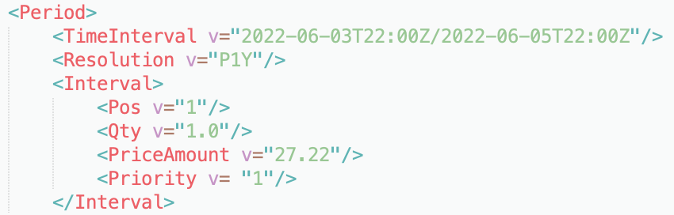
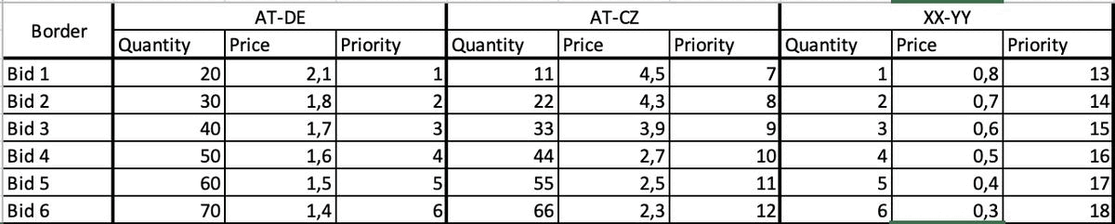
Priority as bid component
  Bid XSD is extended to include third component: priority
  Priority is mandatory and unique for each bid
  Priority is auto-allocated by bid order on the Web UI
  PROs:
    Always up to date
    Faster to update in Web UI with drag and drop
    More granular
  CONs:
    Development for WS clients required
    More effort for MPs for each bid
    Updated XSD for Bid document
Sample Bid document:
Drag and drop in Web UI:

Slide 5

Priority as parameter
  Priority is assigned to border per horizon in Web UI as a standing parameter
  Priority is not at bid level, but border level
  If not filled out, a default ranking needs to be applied – most likely alphabetic sorting
  PROs:
    Set once and forget
    No change in XSD
    Less input required
  CONs:
    Granularity is lost
    Risk of MPs not updating it: default ranking required (alphabetic)
    Purely Web UI based: no fallback possible
File | Auction | Bid | Capacity right | Secondary market | PAs | Settlement | Bulletin board | Priority | Options
Horizon: |  |  |  |  | Monthly
Auction: |  |  |  |  | CORE--M-BASE-------250301-01
Border |  |  |  |  | Priority
AT-CZ |  |  |  |  | 1
AT-DE |  |  |  |  | 5
DE-CZ |  |  |  |  | 2

Slide 6
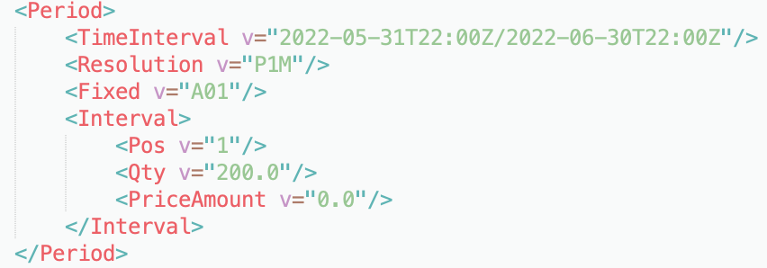
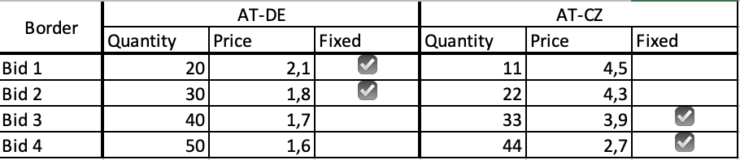
Priority as bid flag
  Bids are marked as fixed and optional
  Fixed bids are checked against the credit limit at bid submission and consume collateral
  Optional bids do not consume collateral and are rejected after bid submission is closed
  PROs:
    Less input required
    Credit limit is more stable as optional bids do not count
  CONs:
    Change in XSD and WS clients required
    Optional bids are still rejected on existing parameters (lowest bid price or bid value first)
Sample Bid document:
Selection interface in Web UI:

