Slide 1


Our client's satisfaction is critical for us.
Introduction
Open Call
19.03.2026

Slide 2

Introduction

Slide 3

Agenda
1. Cybersecurity
2. Project update
3. Orion
4. JAO Support Hub
5. Incident review
6. Q & A

Slide 4
Cybersecurity

Slide 5

Cybersecurity
The Security Trust Centre is a centralized, secure hub designed to enhance transparency and trust between JAO and its stakeholders.
Dedicated resource for sharing critical information security and compliance-related artefacts
The primary goal of the Security Trust Centre is to provide a single point of access to essential security documentation

Slide 6
Cybersecurity
DKIM - DomainKeys Identified Mail
Cryptographically signs outgoing messages so recipients can verify they’re genuine
DMARC - Domain‑based Message Authentication, Reporting & Conformance
Improve protection against spoofing and phishing while providing policy and reporting controls.
SPF - Sender Policy Framework
Specifies which servers are authorized to send mail on behalf of JAO

Slide 7
Project overview

Slide 8

Changes
2026
Q1
Q2
Q3
Q4
JAO Support Hub
JAO Support Hub – Wave 2
15 min MTU on the Swiss borders
Greece - North Macedonia Explicit Auctions

Slide 9
Project​ | Description​ | Go-Live​
UA Monthly​ | Monthly explicit auctions on the Ukrainian - Slovakia and Hungary borders | LIVE
Adria | Onboarding MEPSO (North Macedonia and CGES (Montenegro) | LIVE
UA ID | Ukrainian ID auctions on the UA-HU and UA-SK borders | Q2-Q3/2026
LTFBA | Long-term flow-based allocation for CORE and the Nordics | 11/2026
Cross CCR | Congestion Income Distribution for Capacity Calculation Regions (CCRs) mutually affected by allocation mechanisms with cross-CCR impact (Core, Nordic, Hansa, Baltic CCRs) | LIVE
Core AHC | Core Advance Hybrid Coupling | 06/2026
North Sea | Long-term FTR auctions on the North Sea Link (GB<->NO2) | 09/2026
Celtic Interconnector | Congestion Income Distribution and Long-term FTR auctions on the SEM-FR bidding zone border | SDAC / SIDC: 12/2027 Monthly Auctions: 04/2028 Yearly Auctions: 11-12/2028
on track and within tolerance
constrained timeline and/or notable risks,
but within MB's appetite
likely delay and/or risks outside of MB's appetite

Slide 10
Orion

Slide 11
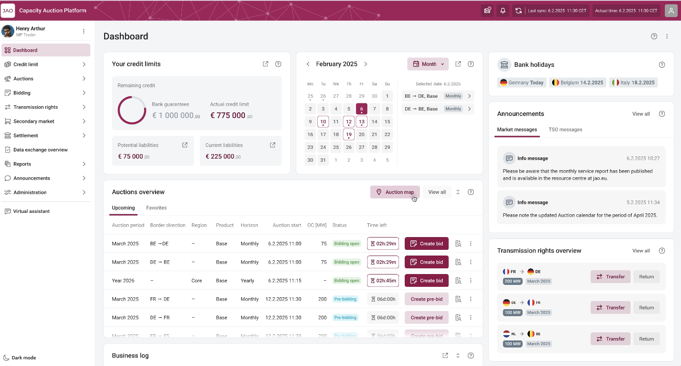
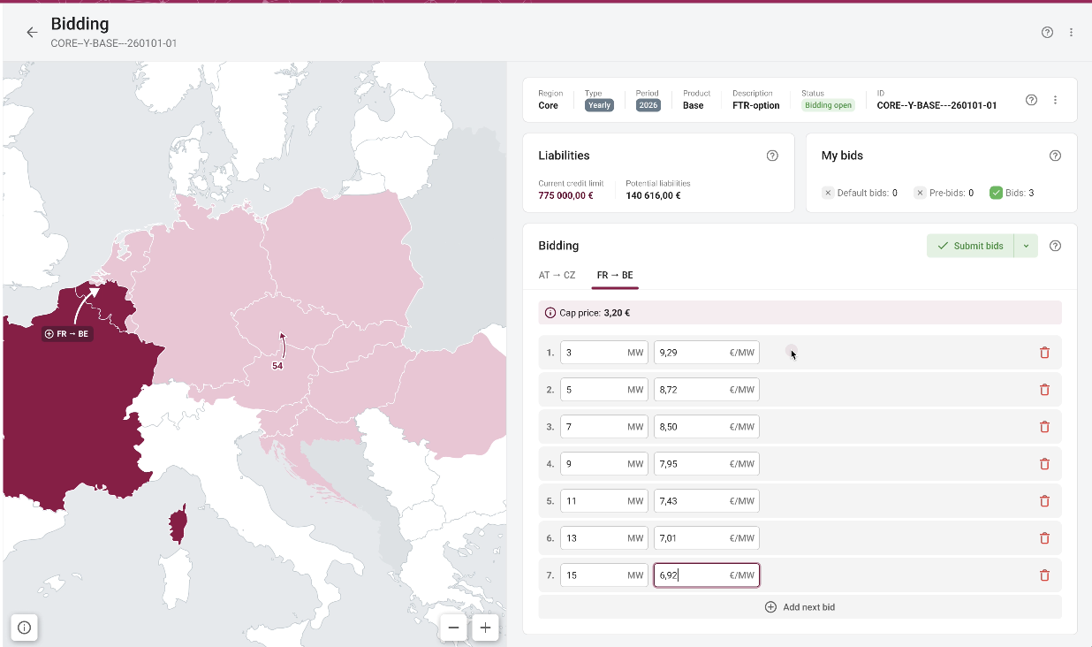
Objectives
* Preliminary mockup design not reflecting the final product
JAO engaged as part of their Corporate Strategic Objectives to improve explicit auction experiences.
A new Auction Platform with the following in mind:
User Experience: it must be fast, intuitive, appealing and streamlined
Stability and performance: it must be reliable and support market constraints whatever the volume
Integrability and automation: API first architecture design as part of its fundamentals for ease and standardization of integration.
Autonomy: integration of ease of life feature for clients
Unicorn has been selected as the provider

Slide 12
Roadmap
2025
2026
2027
April 2025: project kickoff
Dec 2026:
Technical readiness and deployment
Sept 2027:
Go-Live
Q4 2027:
hyper care
Q2-2025-Q2 2026: Agile Design phase (Detailed specification, UX, UI, flows, integrations…)
Q3 2025 -> Q4 2026:
Agile Implementation and validation phase
01/2027 -> Q2/3 2027:
Testing phases (Int. TSOs, MPs…), training (Int. MPs, TSOs…), Operations readiness
Q3 2026 -> Q4 2026:
Infrastructure setup and availability/recoverability
Q3 2027:
Data migration and Go-live sign-off
Post-Q4 2027: Optimization and Ongoing Enhancements
Continue leveraging platform flexibility for continuous improvement.
Q3 2025 -> Q2 2027:
Parallel project integration process

Slide 13
Orion – The new allocation tool
HARMONIZED AUCTION CALENDAR
INVOICES
DASHBOARD
NOTIFICATIONS
Use cases
DISPLAY AUCTIONS
SETTLEMENTS
API
User
Account management

Slide 14

Main Changes
User Interface
FTP and/or ECP as main communication channels
JSON-based payloads via REST API
Machine users hold certificate

Slide 15

User Group Discussion
Auction- and Resale gate counter
Credit Limit breakdown
Peak hours bidding
Bidding by multi-line paste input

Slide 16
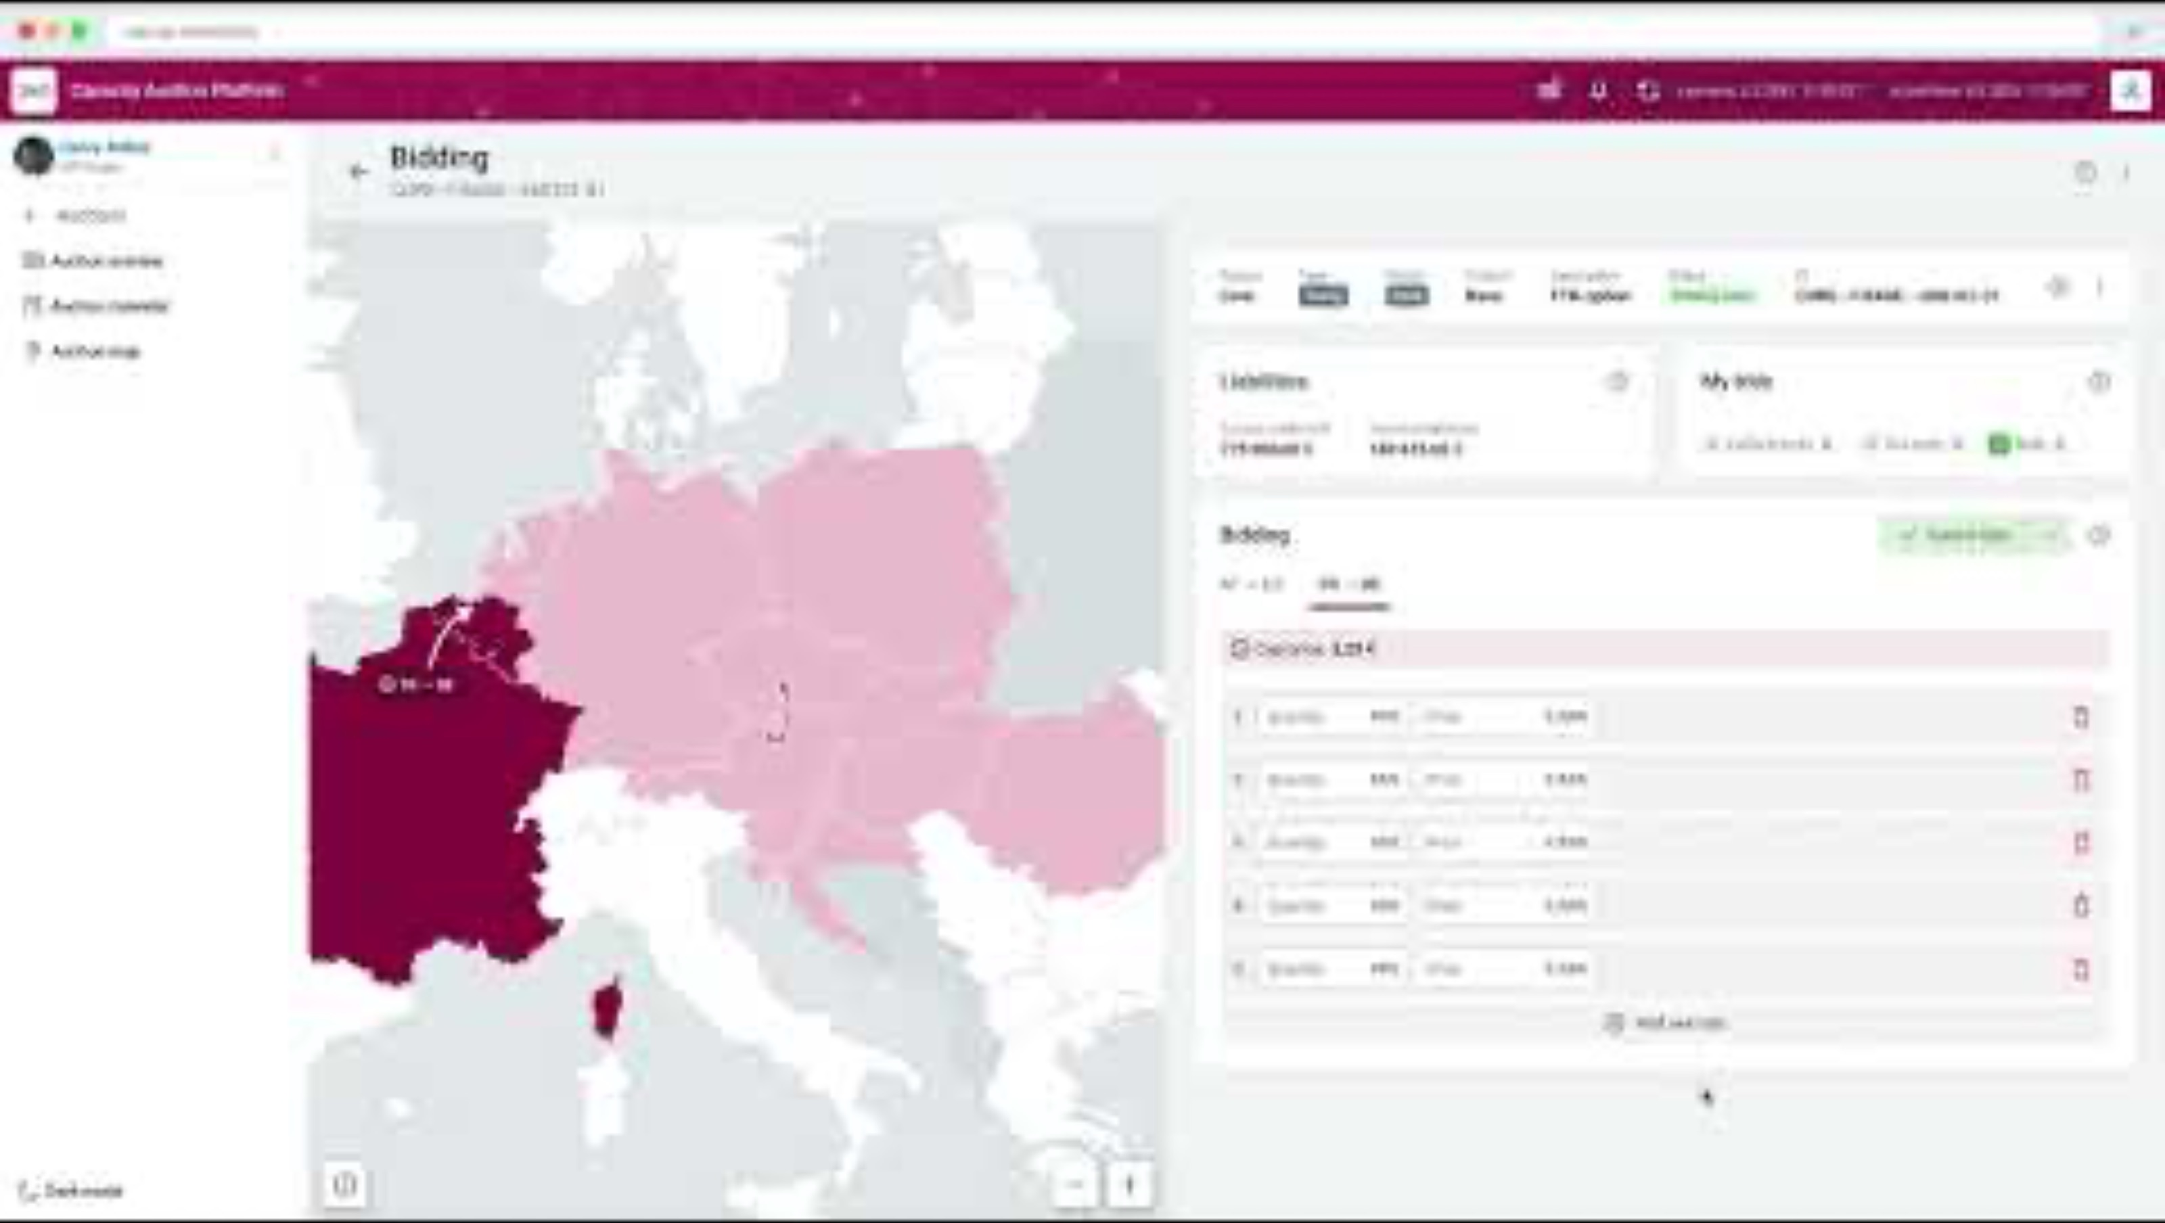

Slide 17
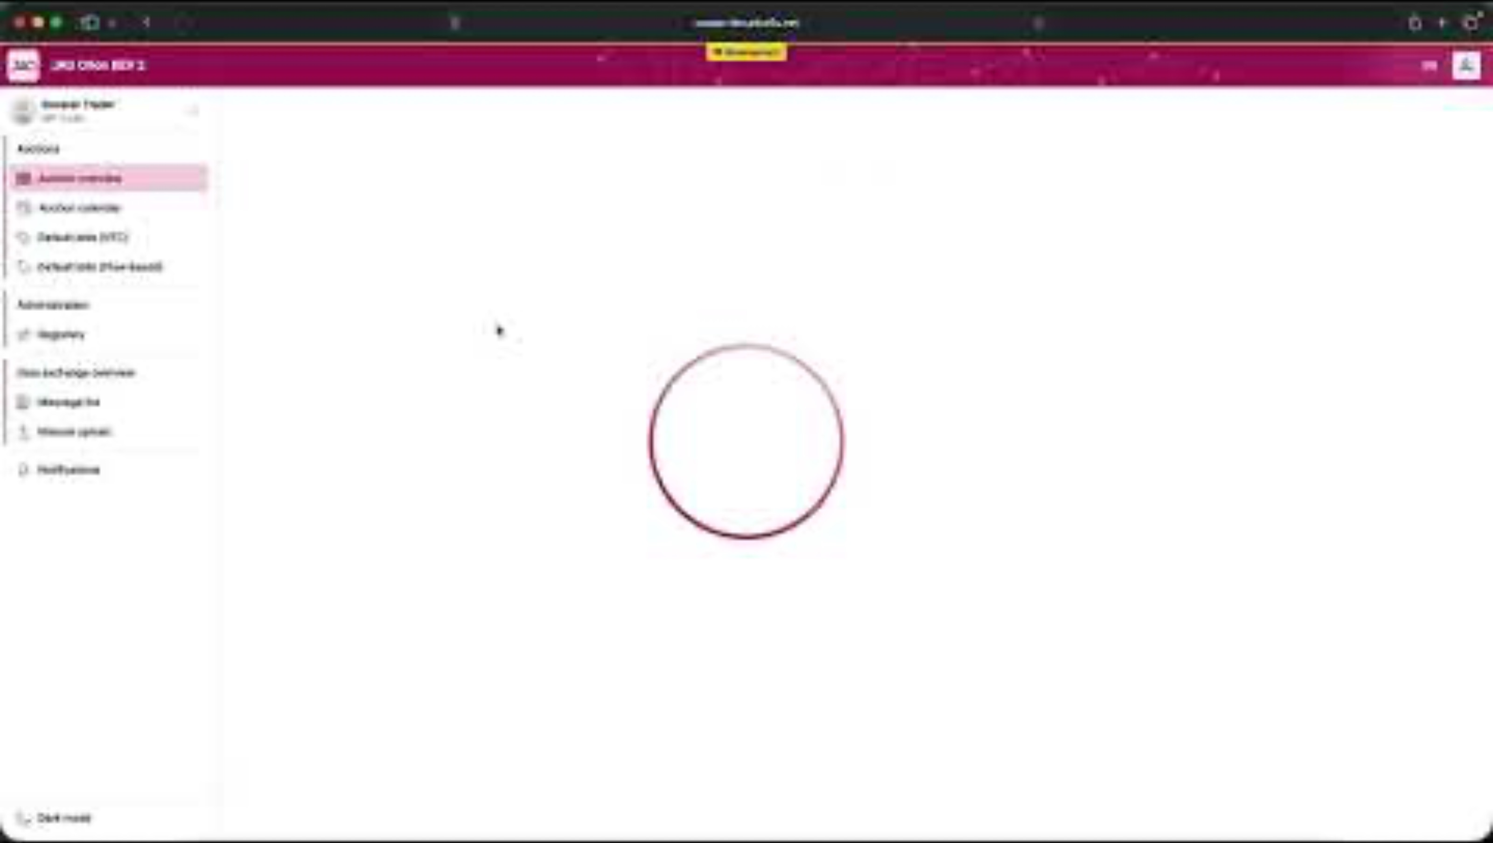

Slide 18
JAO Support Hub

Slide 19





JAO Support Hub
New Microsoft Dynamics based ticketing platform
Easy access for the customers via email
Multi-level ticket handling
Detailed customer feedbacks
AI Business assistant

Slide 20
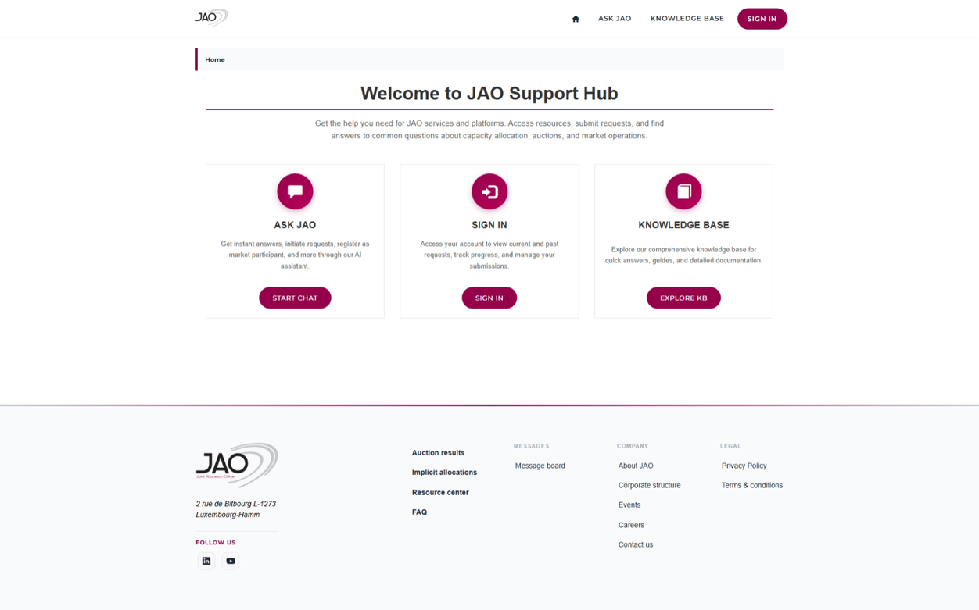


JAO Support Hub
Send your requests to support@jao.eu
Automatic case number generation Track progress via email responses
Access https://support.jao.eu
with secure login
View all your cases in one place Knowledge base and self-service options
Get instant answers 24/7
Ask questions about JAO services
Quick help for common requests Guided workflows to create new requests
JAO S.A - Public - Uncontrolled copy

Slide 21
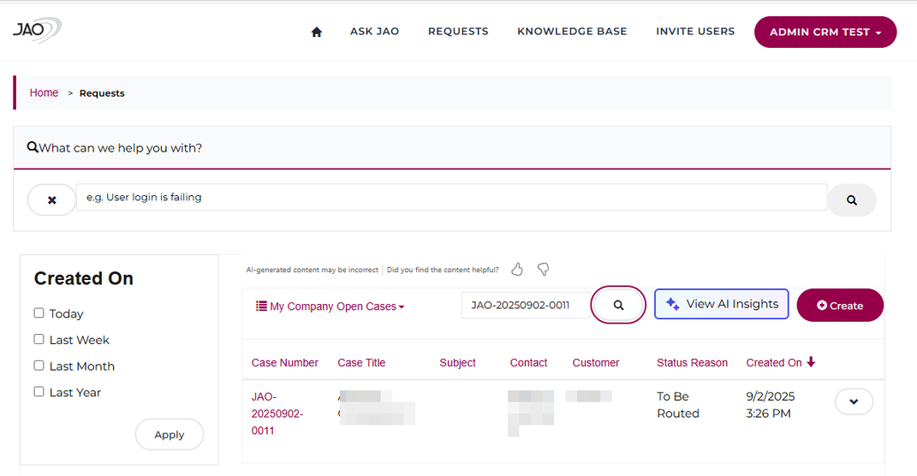
JAO Support Hub
User Interface
JAO S.A - Public - Uncontrolled copy

Slide 22
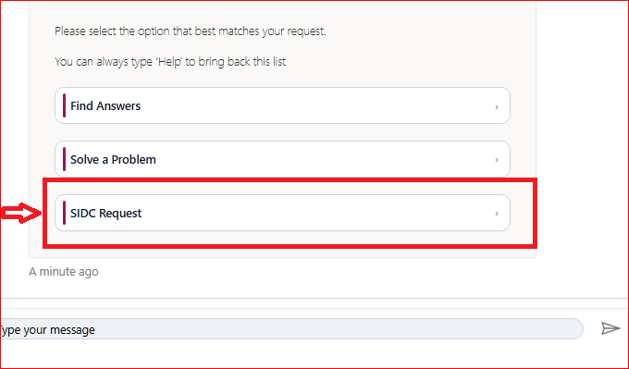
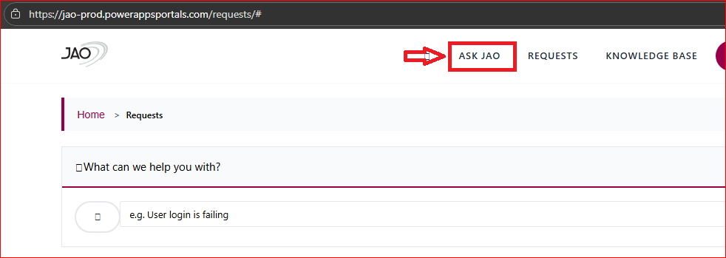
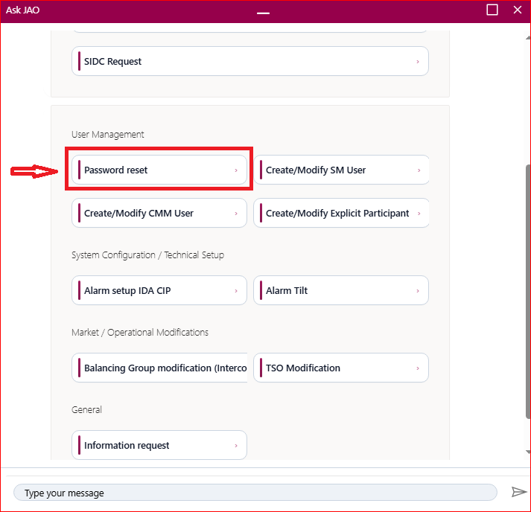
SIDC Cases

Slide 24
Incident review

Slide 25
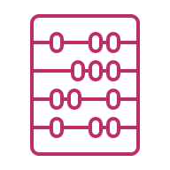



Incident review
Context
  JAO domain unreachable externally
  Email @jao.eu, website, IIP, eCAT, Publication Tool and webservices affected; external comms via phone/backup Gmail
Impact
  MPs could not access eCAT; intraday auctions (EL1, IF1, IF2) cancelled
  Credit-limit update delayed because the bank report was not received automatically
  Root Cause & Response
  Contact data mismatch led to EURid validation; during correction the extension was removed and the domain was suspended
  P1 opened; emergency support engaged; jao-sa.com activated for key systems; jao.eu restored and services switched back
Next Steps
  Keep jao-sa.com as an operational fallback for critical external apps, allowing immediate availability without interruption or manual intervention
Jao.eu - Domain Issue
Q1 2026

Slide 26
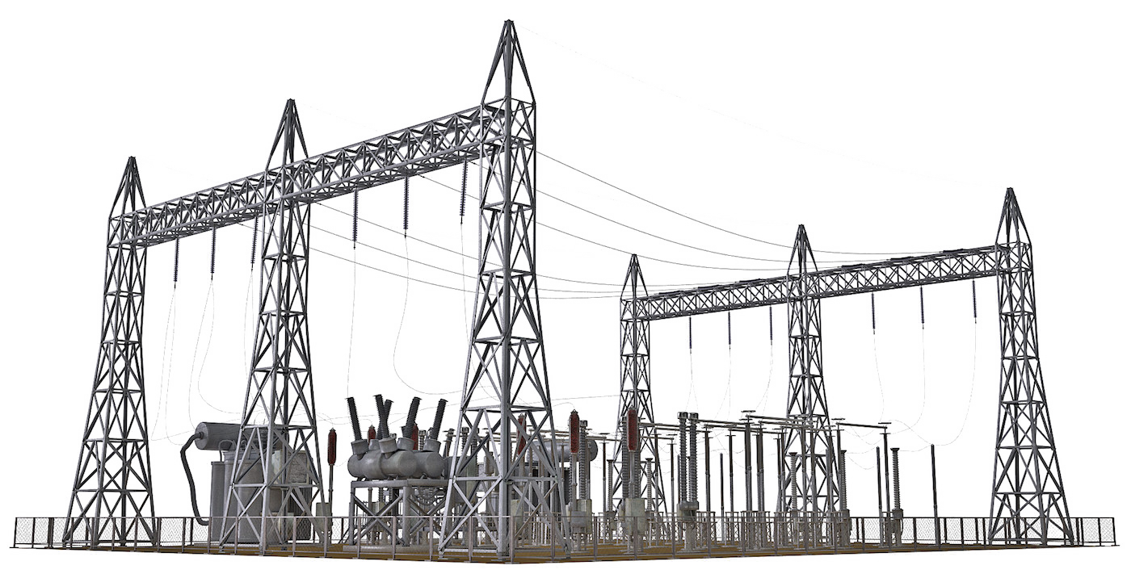
Q & A

Slide 27

Thank you!

