Slide 1
Core IDCC(e) External // run
Monitoring report
Q2 2026: 10/04/2026 – 18/08/2026

Slide 2
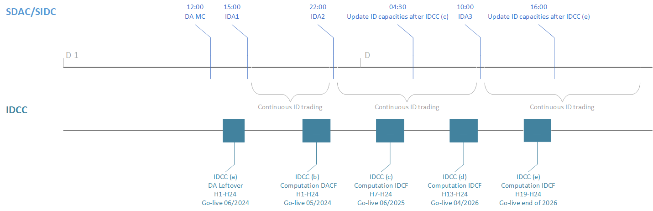
Core Intraday Capacity Calculation
IDCC(e) go-live preparations
Introduction
  Core TSOs have implemented IDCC(a-d) and are working towards go-live of IDCC(e) in 2026.
  The capacities are provided simultaneously to the JAO publication tool and to XBID. Once the capacities are accepted by XBID they are available for trading.
    For example, the intraday capacity calculation methodology requires the capacities for IDCC(c) to be published and submitted by 4:30. The target timing that TSOs have implemented to deliver and publish the capacities is 4:13, whereas 4:30 is taken as strict deadline.
  Find below an overview of the respective IDCC processes in relation to market coupling:
  The IDCC(e) EXT // run commenced on 08/04/2026 and IDCC PT is monitoring the KPIs and process stability.
  IDCC(e) aims to provide updated capacities before 16:00, which will be released directly to intraday continuous trading.

Slide 3
External // run monitoring report
Introduction, reporting period and limitations
Background
  According to Article 26(4) of the Core FB ID CCM, “Core TSOs shall continuously monitor the effects and the performance of the application of this methodology. For this purpose, they shall develop, in coordination with the Core regulatory authorities, ACER and stakeholders, the monitoring and performance criteria and report on the outcome of this monitoring on a quarterly basis in a quarterly report.”.
  IDCC(e) external // run started on 8th of April 2026 and will be finished on the 14th of October 2026(~6 months) with go-live on production.
Reporting period
  This report covers roughly 4 months (10/04/2026 – 18/08/2026) of IDCC(e) EXT //run results in the Core region.
  In the reporting period, fallback applied/process failed for 9 BDs.
Next steps
  14th October 2026: IDCC(e) go-live
BD | Applied Fallback / Process failure
13/04/2026 | IDCC(d) Fallback domain applied due to misconfiguration in the system.
15/04/2026 | Tool down due to server outage.
22/05/2026 | IDCC(d) Fallback domain used due to missing CGMs.
30/05/2026 | Failed business day due to connectivity issues with XBID (missing AACs).
01/07/2026 | IDCC(d) Fallback domain used due to missing CGMs.
BD | Applied Fallback / Process failure
29/07/2026 | Process failure due to environment downtime.
01/08/2026 | IDCC(d) Fallback domain used due to missing CGMs.
02/08/2026 | IDCC(d) Fallback domain used due to missing CGMs.
04/08/2026 | IDCC(d) Fallback domain used due to missing CGMs.

Slide 4
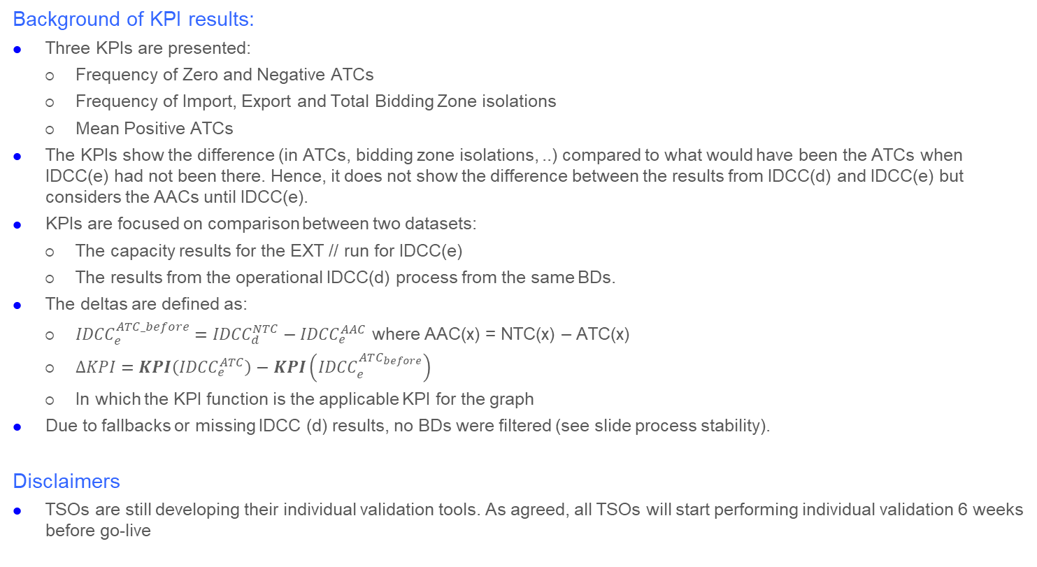
Intraday Capacity Calculation
IDCC(e) EXT // run - KPI results BD20260410 – BD20260818
Background of KPI results:
  Three KPIs are presented:
    Frequency of Zero and Negative ATCs
    Frequency of Import, Export and Total Bidding Zone isolations
    Mean Positive ATCs
  The KPIs show the difference (in ATCs, bidding zone isolations, ..) compared to what would have been the ATCs when IDCC(e) had not been there. Hence, it does not show the difference between the results from IDCC(d) and IDCC(e) but considers the AACs until IDCC(e).
  KPIs are focused on comparison between two datasets:
    The capacity results for the EXT // run for IDCC(e)
    The results from the operational IDCC(d) process from the same BDs.
  The deltas are defined as:
    ${IDCC}_{e}^{ATC_before}={IDCC}_{d}^{NTC}−{IDCC}_{e}^{AAC}$ where AAC(x) = NTC(x) – ATC(x)
    $∆KPI=KPI\left({IDCC}_{e}^{ATC}\right)−KPI\left({IDCC}_{e}^{ATC_{before}}\right)$
    In which the KPI function is the applicable KPI for the graph
  Due to fallbacks or missing IDCC (d) results, no BDs were filtered (see slide process stability).
Disclaimers
  TSOs are still developing their individual validation tools. As agreed, all TSOs will start performing individual validation 6 weeks before go-live

Slide 5
Intraday Capacity Calculation
Overview of individual validation
Note: “none” for fallback means no reduction in capacities applied in case the individual validation fails.
Core TSOs | Happy flow validation | IVA | Start date | ATC | Start date | Fallback procedures currently applied | Fallback procedure after go-live
50Hertz | IVA | Yes | 15/07 | Yes, as fallback | GL | None | ATC fallback
Amprion | IVA | Yes | 15/07 | Yes, as fallback | GL | None | ATC fallback
APG | Both IVA/ATC | Yes | 15/07 | Yes | 21/05 | No fallback for IVA (ATC no fallback) | ATC fallback
ČEPS | IVA | Yes | 26/08 | No | N/A | None | None
ELES | IVA | Yes | 16/09 | No | N/A | None | None
ELIA | N/A | No | N/A | No | N/A | N/A | N/A
HOPS | IVA | Yes | 16/09 | No | N/A | None | None
MAVIR | IVA | Yes | 14/09 | No | N/A | Calculated IVA in the vicinity of the realized MCP for the presolved elements either via CB file or GUI | Calculated IVA in the vicinity of the realized MCP for the presolved elements either via CB file or GUI
PSE | Both IVA/ATC | Yes | 19/05 | Yes | Before GL | None | None
RTE | IVA | Yes | GL | No | N/A | None | None
SEPS | IVA | Yes | 15/05 | No | N/A | None | None
TTN | IVA | Yes | 15/07 | Yes, as fallback | GL | None | ATC fallback
TTG | IVA | Yes | 15/07 | Yes, as fallback | GL | None | ATC fallback
Transelectrica | IVA | Yes | 11/08 | No | No | None | None
TBW | IVA | Yes | 15/07 | Yes, as fallback | GL | None | ATC fallback

Slide 6
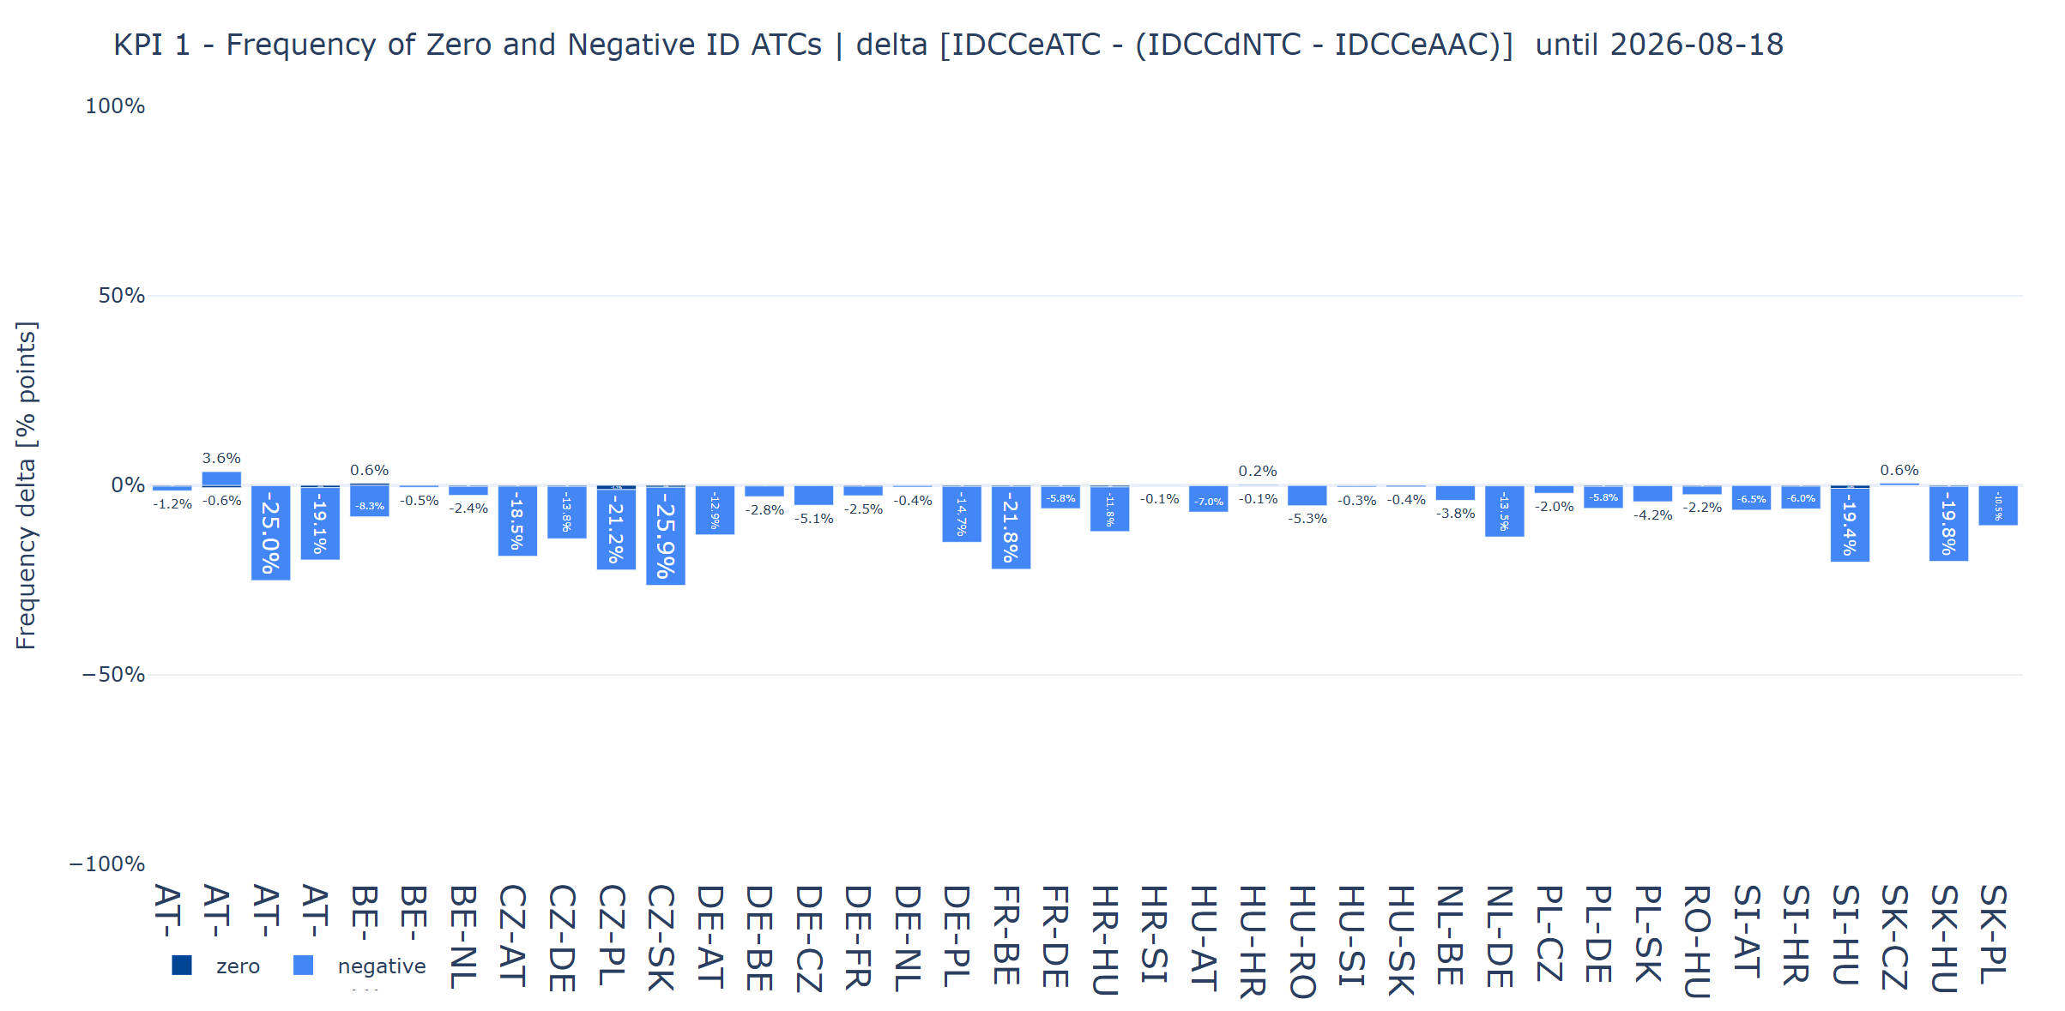
Intraday Capacity Calculation
IDCC(e) EXT // run - KPI results BD20260410 – BD20260818
KPI1: Frequency of Zero and Negative ID ATCs (delta), negative value is improvement here
  This graph shows how many Zero and Negative ATCs there are in IDCC(e) compared the results from IDCC(d).
  Overall, less Negative ATCs occur after the IDCC(e) calculation.

Slide 7
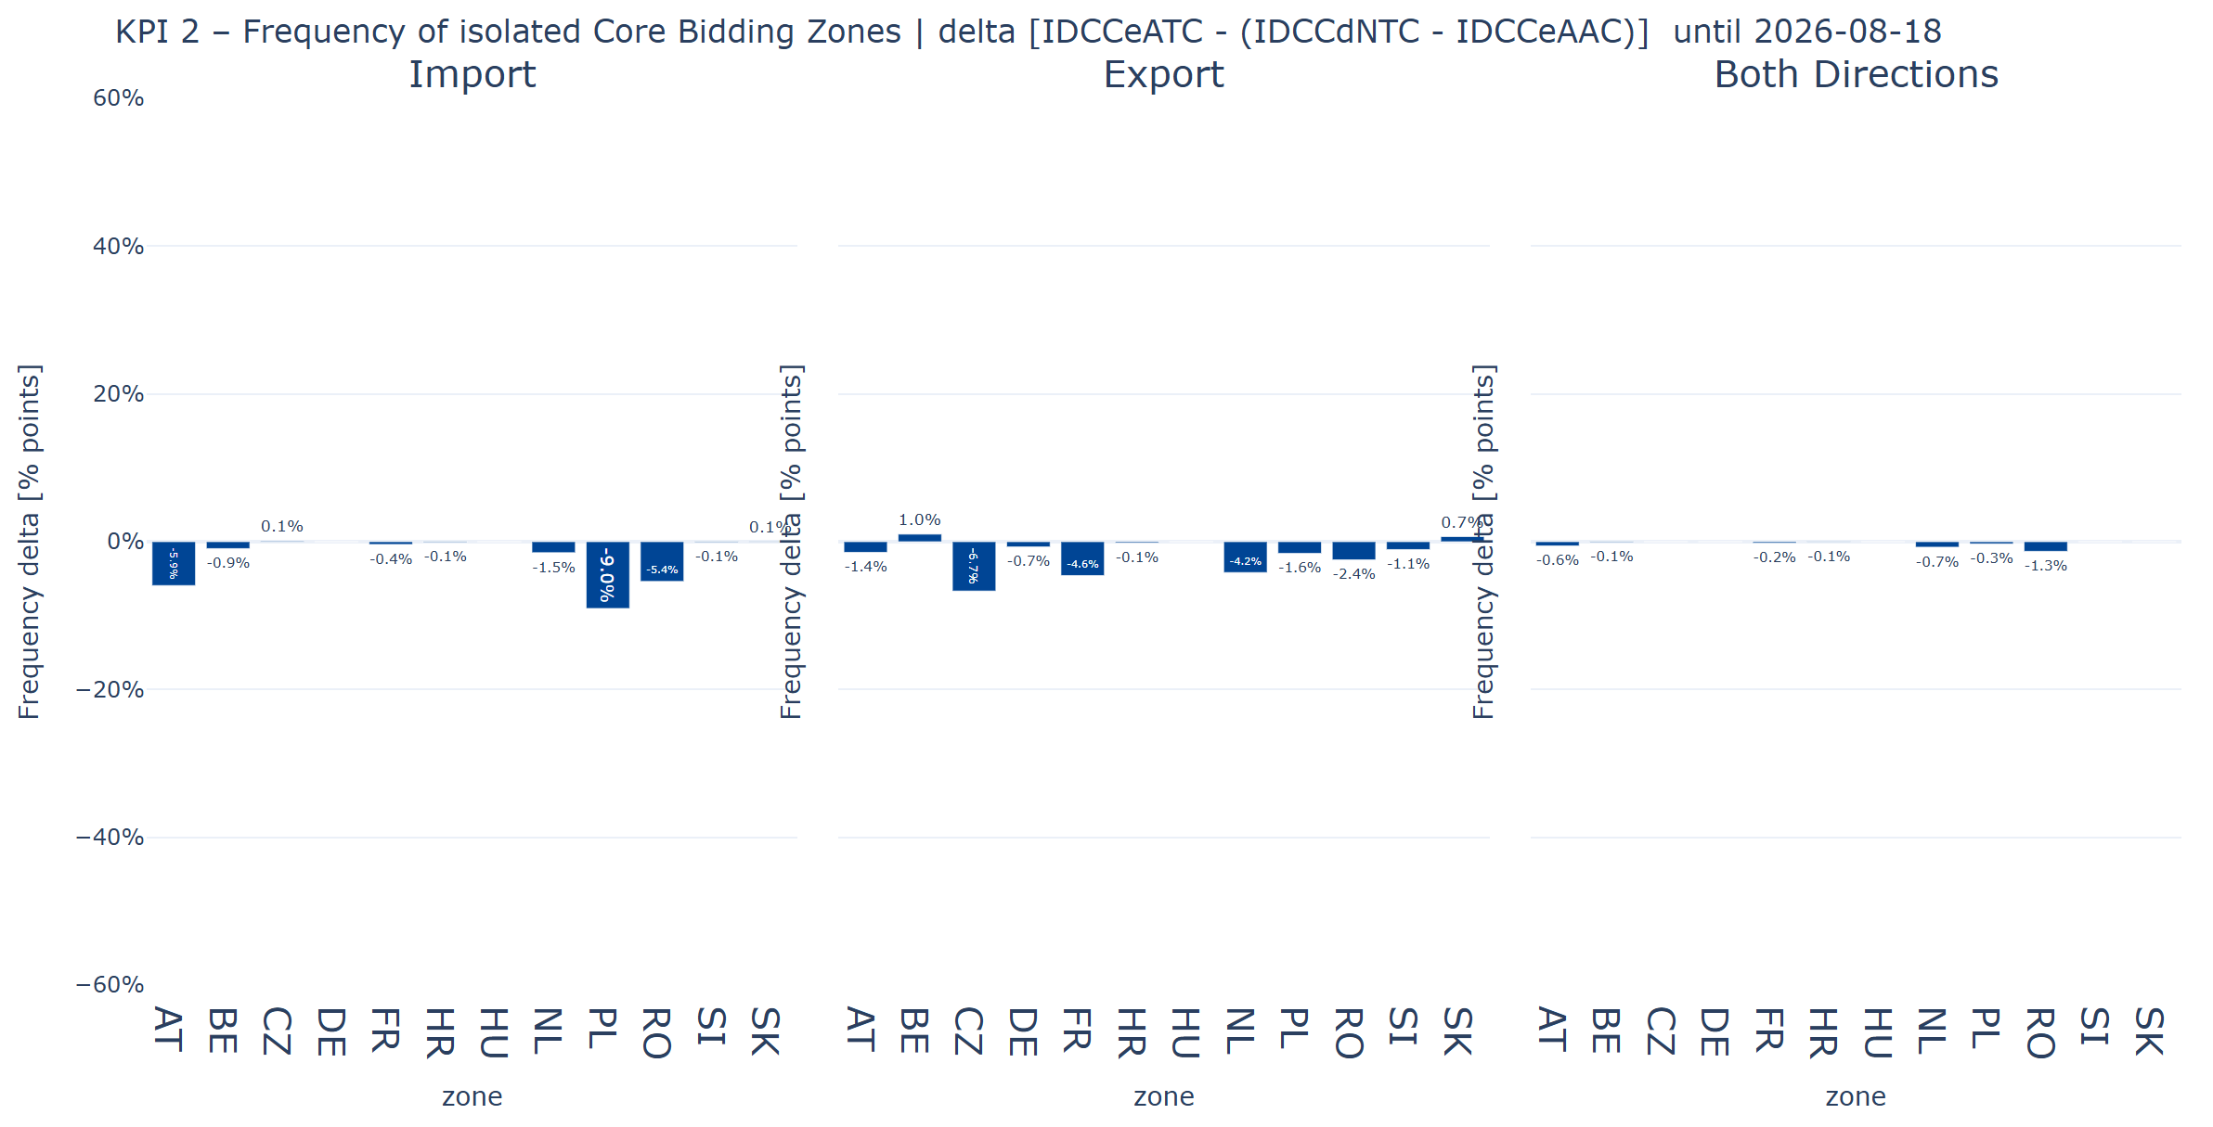
Intraday Capacity Calculation
IDCC(e) EXT // run - KPI results BD20260410 – BD20260818
KPI2: Frequency of isolated Core Bidding Zones(delta), negative value is improvement here
  Bidding Zone isolation means that there is no more cross border capacity (ATC <= 0) left for that certain Bidding Zone
  The graph shows the difference in BZ isolation for Import, Export and Both directions. Overall, less BZ isolations occur after IDCC(e) calculation.

Slide 8
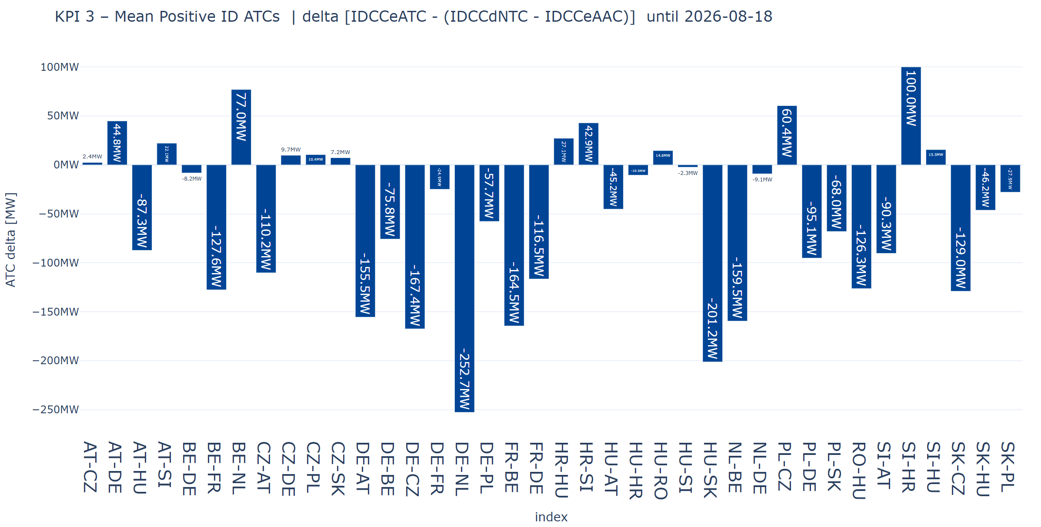
Intraday Capacity Calculation
IDCC(e) EXT // run - KPI results BD20260410 – BD20260818
KPI3: Mean Positive ID ATCs (delta), positive value is improvement here
  This graph shows the difference in mean positive ATCs per bidding zone border.
  Overall, the results show a heterogeneous effect on mean positive ATCs per BZB.

Slide 9
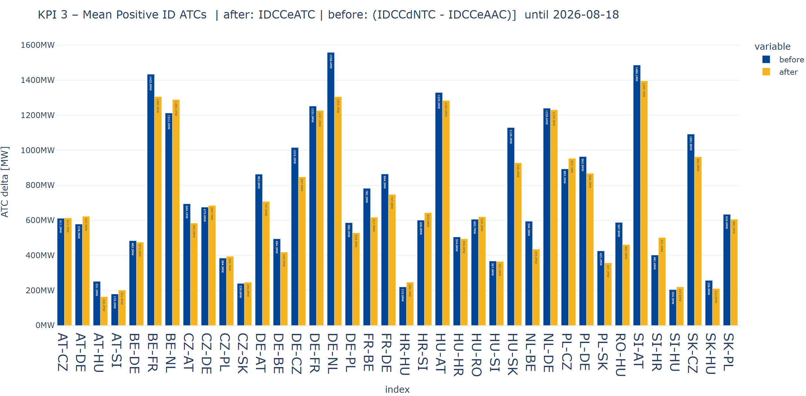
Intraday Capacity Calculation
IDCC(e) EXT // run - KPI results BD20260410 – BD20260818
KPI4: Mean Positive ID ATCs (delta), multiple bar version
  This graph shows the mean positive ATCs per bidding zone border for IDCC(e) and IDCC(d).
  Before: IDCC(d), After: IDCC(e)

Slide 10
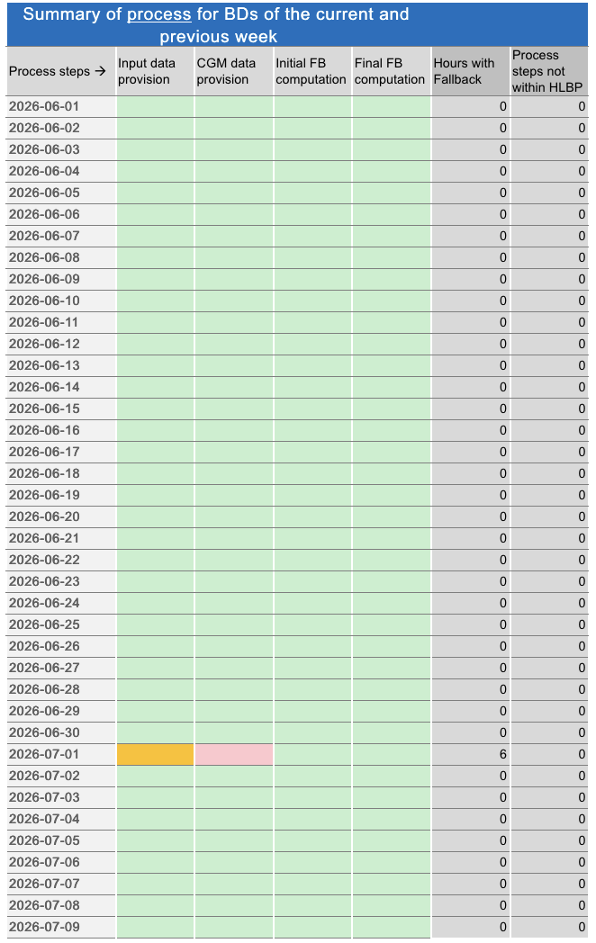
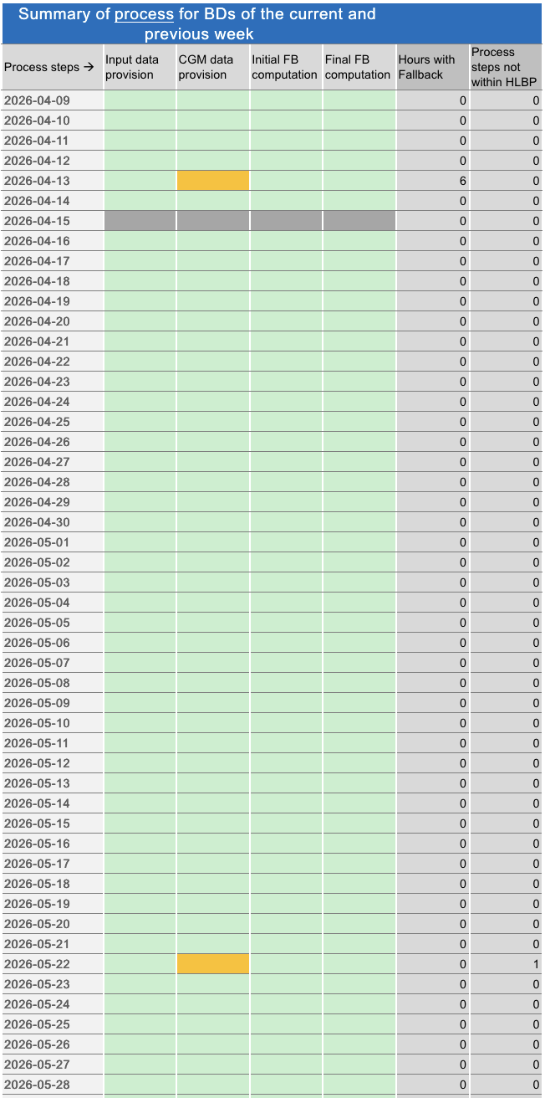
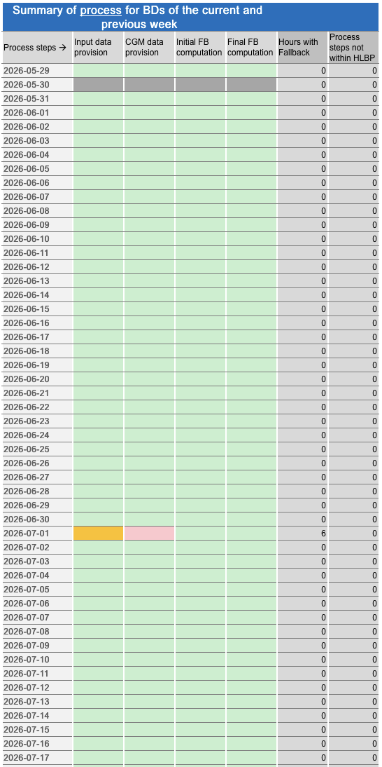
Intraday Capacity Calculation
Process stability of IDCC(e) EXT // run
Process IDCC(e) // run
BD 13.04.: IDCC(d) Fallback Domain applied due to misconfiguration in the //run test system.
BD 15.04.: Tool down due to Amprion-wide server outage
BD 22.05.: IDCC(d) Fallback Domain used due to missing CGMs from CorrelationID issue related to multiple environments
BD 30.05.: Failed buisness day due to connectivity issues with XBID (Missing AACs).
BD 01.07.: IDCC(d) Fallback Domain used due to missing CGMs because the merging tool was unavailable due to an internal server restart

Slide 11
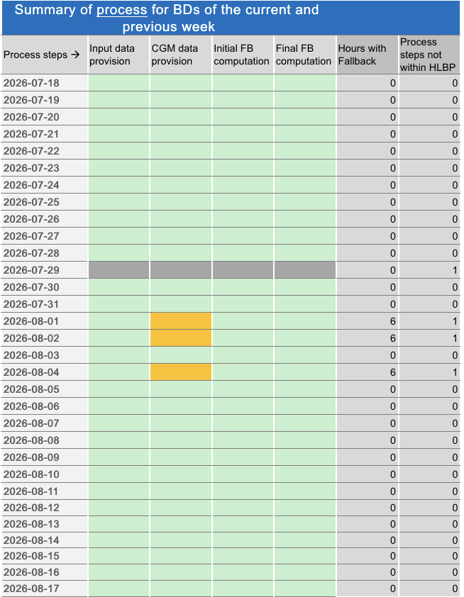
Intraday Capacity Calculation
Process stability of IDCC(e) EXT // run
Process IDCC(e) // run
BD 29.07.: Process failed due to env. downtime (firewall upgrade)
BDs 01.08.: IDCC(d) Fallback Domain used due to missing CGMs from incorrect configuration set for IDCC environment split testing.
BDs 02.08.: IDCC(d) Fallback Domain used due to missing CGMs from incorrect configuration set for IDCC environment split testing.
BDs 04.08.: IDCC(d) Fallback Domain used due to missing CGMs from CorrelationID issue related to multiple environments
Note: The observed misconfigurations and missing CGM issues are specific to the test environment, where several ECP environments and parallel testing activities coexist. As the production setup consists of a single ECP environment, these issues are not expected in the live process.

